Slide 1
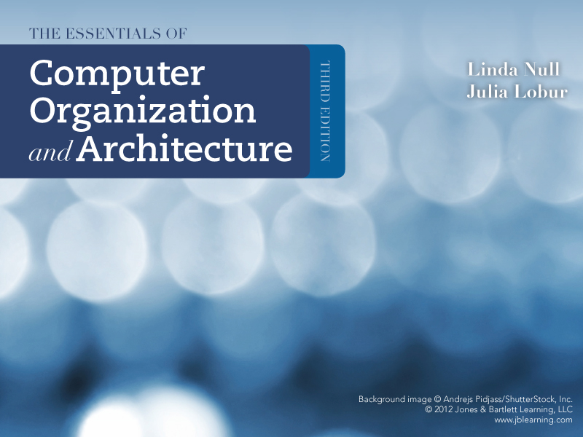
Chapter 1
Introduction

Slide 2
Table of Contents
Main Components of a Computer System
Historical Developments
The von Neumann and non-von Neumann Models

Slide 3
main components of a computer system
Sections 1.1 - 1.2

Slide 4
Objectives
After studying Sections 1.1 through 1.3, you should be able to:
Differentiate between computer organization and computer architecture
Recognize units of measure common to computer systems

Slide 5
Computers
Multipurpose electronic devices that
Accept input
Process data at speeds millions (even billions) of times faster than human beings can
Store data
Produce output
all according to a series of stored instructions

Slide 6
Computer Taxonomy
Personal Computers
Workstations
Mainframes
Supercomputers

Slide 7
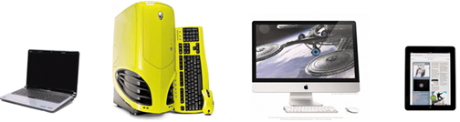
Personal Computers
Devices designed to meet the computing needs of individuals
Relatively small used by one person at a time
No sharing of computer resources

Slide 8
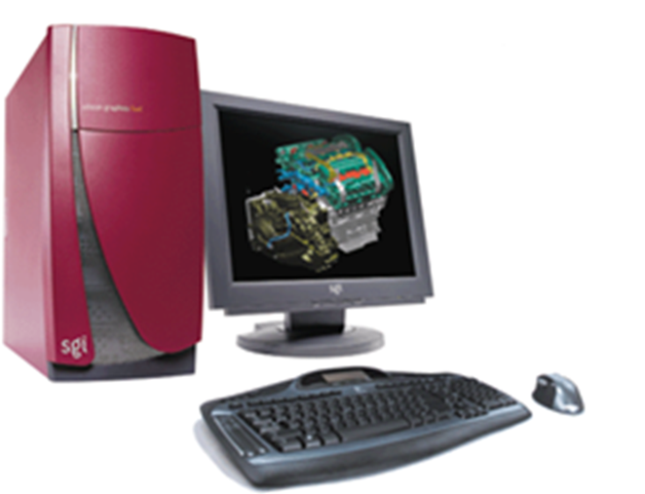
Workstations
Powerful desktop computers used for high-performance tasks
Larger and more powerful than personal computers
Provide a multiuser, time-sharing environment

Slide 9
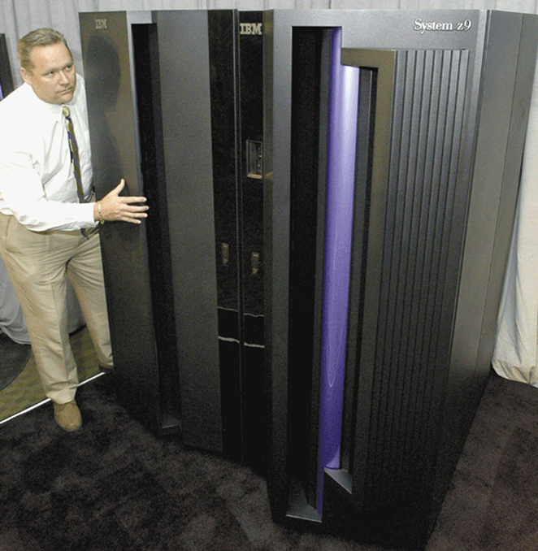
Mainframes
Large, expensive, but very powerful computers that can serve hundreds or thousands of connected users simultaneously
Provide a multiuser, time-sharing environment
Require support staff
Used by big corporations

Slide 10
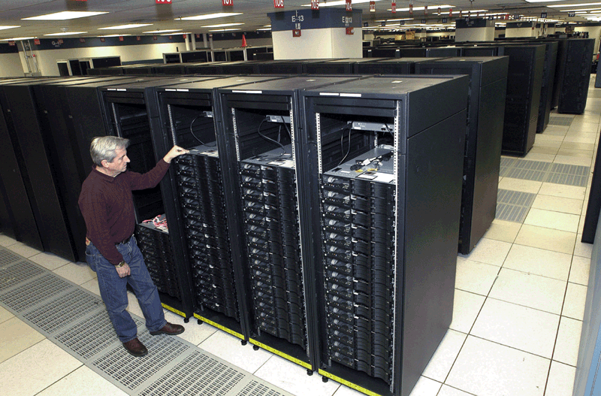
Supercomputers
The fastest, most powerful, but most expensive computers
Require support staff
Used for gigantic computing purposes!

Slide 11
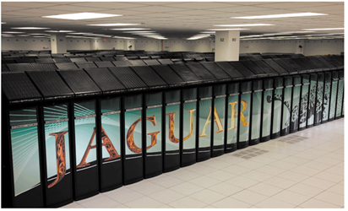
Supercomputers Example: CRAY XT5HE
The Jaguar
Fastest in 2010
Over 18,000 processors
Peak performance speed of 2.3 peta flops per second

Slide 12
Computer Systems
Hardware
The physical components of the computer
Software
The collection of programs that run on the computer

Slide 13
Computer Programs (Recall)
Computer programs guide the computer through orderly sets of actions specified by people called computer programmers
Computer programs are written in some programming language
A programming language is a set of words, special symbols, and syntax rules

Slide 14
Classification of Programming Languages
Low-Level
Machine Languages
Assembly Languages
High-Level
Procedural Languages
Object-Oriented Languages

Slide 15
Machine Languages
First generation
Only language a computer directly recognizes
Instructions are written as sequences of 0’s and 1’s
Advantages: very fast!
Disadvantages: machine dependent and very hard!
0001000100000100
0011000100000101
0010000100000110
0111000000000000

Slide 16
Assembly Languages
Second generation
Programmer writes instructions using symbolic instruction codes
A source program contains the code to be converted to machine language using an assembler
Easier to program with but still machine dependent!
Load X
Add Y
Store Z
Halt

Slide 17
High-Level Languages
Programmers write instructions that look almost like everyday English and contain commonly used mathematical notations
Designed to be easy to read and write
Machine independent

Slide 18
Procedural Languages
Third generation
In a procedural language, the programmer writes instructions that tell the computer what to accomplish and how to do it
Instructions need to be translated into machine language using a compiler

Slide 19
Object-Oriented Languages
Fourth generation
An object-oriented language program uses objects to accomplish a task
An object is anything that can be seen, touched, or used
Instructions need to be translated into machine language using an interpreter

Slide 20
Compiler vs. Interpreter
A compiler translates all instructions producing a program written in low-level machine language
Compilers produce better optimized code that generally run faster
Compiled code is self sufficient and can be run on their intended platforms without the compiler present
Interpreter converts and executes one instruction at a time
Interpreters are easier to use and produce more immediate results
The source code of an interpreted language cannot run without the interpreter

Slide 21
Computer Software Main Categories
Hardware
Application Software
Programming software, games, etc.
System Software
Operating systems, utility programs, etc.

Slide 22
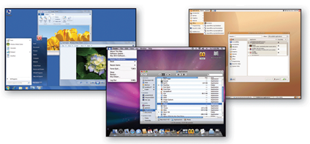
System Software: Operating System
Acts as the master controller for all activities that take place within a computer system

Slide 23
Operating System Tasks

Slide 24
Computer Hardware Main Components
Input Unit
Output Unit
Central Processing Unit (CPU)
Memory Unit
Secondary Storage Unit
Allows the user to enter data and instructions into the computer
Conveys to the user information that the computer processed
Coordinates and supervises the other components’ operations
Stores data and instructions while they are being executed
Stores programs and data not actively being used by other units
Arithmetic and Logic Unit (ALU)
Responsible for performing calculations (arithmetic and logic)

Slide 25
Section 1.2 – End
Notes:
25

