Slide 1
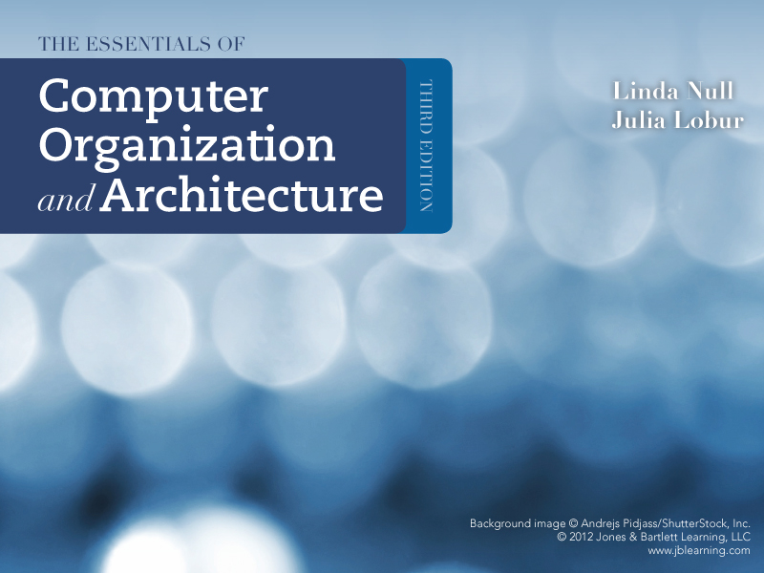
Chapter 1
Introduction

Slide 2
Table of Contents
Main Components of a Computer System
Historical Developments
The von Neumann and non-von Neumann Models

Slide 3
Historical developments
Sections 1.3 - 1.6

Slide 4
Objectives
After studying Sections 1.3 through 1.6, you should be able to:
Recognize units of measure common to computer systems
Differentiate between computer organization and computer architecture

Slide 5
Computer Hardware Main Components
Input Unit
Output Unit
Central Processing Unit (CPU)
Memory Unit
Secondary Storage Unit
Allows the user to enter data and instructions into the computer
Conveys to the user information that the computer processed
Coordinates and supervises the other components’ operations
Stores data and instructions while they are being executed
Stores programs and data not actively being used by other units
Arithmetic and Logic Unit (ALU)
Responsible for performing calculations (arithmetic and logic)

Slide 6
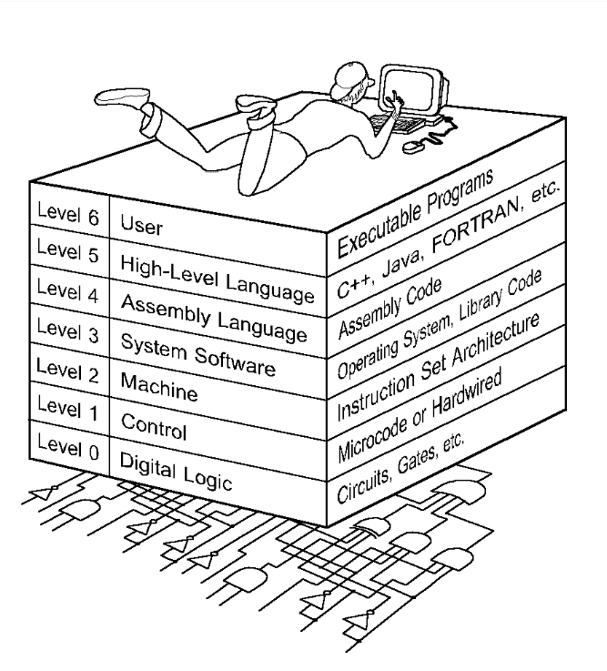
Computer Level Hierarchy
Computers consist of many things besides chips
Before a computer can do anything worthwhile, it must also use software
Writing complex programs requires a “divide and conquer” approach, where each program module solves a smaller problem
Complex computer systems employ a similar technique through a series of virtual machine layers

Slide 7
Computer Level Hierarchy
Each virtual machine layer is an abstraction of the level below it
The machines at each level execute their own particular instructions, calling upon machines at lower levels to perform tasks as required
Computer circuits ultimately carry out the work

Slide 8
Computer Level Hierarchy: Level 6
The User Level
Program execution and user interface level.
The level with which we are most familiar

Slide 9
Computer Level Hierarchy: Level 5
The High-Level Language Level is the level with which we interact when we write programs in languages such as C, Pascal, Lisp, and Java
Z = X + Y;

Slide 10
Computer Level Hierarchy: Level 4
The Assembly Language Level acts upon assembly language produced from Level 5, as well as instructions programmed directly at this level
Load 100
Add 101
Store 102

Slide 11
Computer Level Hierarchy: Level 3
The System Software Level
Controls executing processes on the system.
Protects system resources.
Assembly language instructions often pass through Level 3 without modification
Load 100
Add 101
Store 102

Slide 12
Computer Level Hierarchy: Level 2
The Machine Level
Also known as the Instruction Set Architecture (ISA) Level
Consists of instructions that are particular to the architecture of the machine
Programs written in machine language need no compilers, interpreters, or assemblers
0001000100000100
0011000100000101
0010000100000110

Slide 13
Computer Level Hierarchy: Level 1
The Control Level
A control unit decodes and executes instructions and moves data through the system
0001000100000100
0011000100000101
0010000100000110

Slide 14
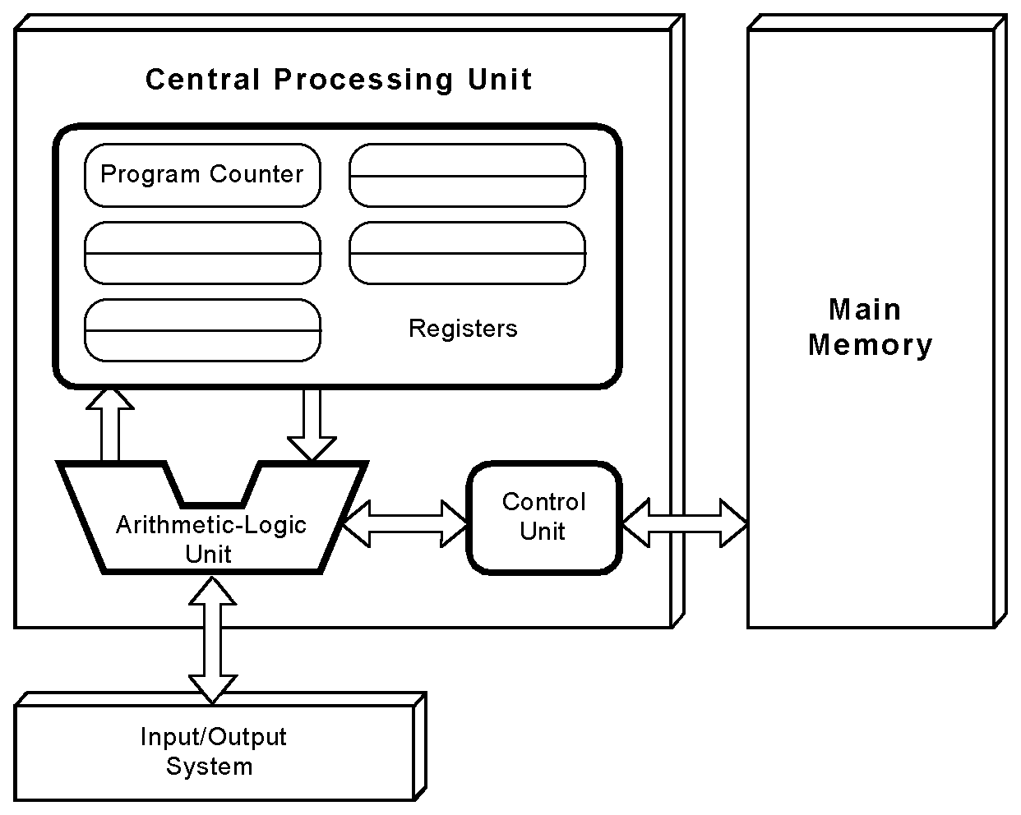
Computer Main Components

Slide 15
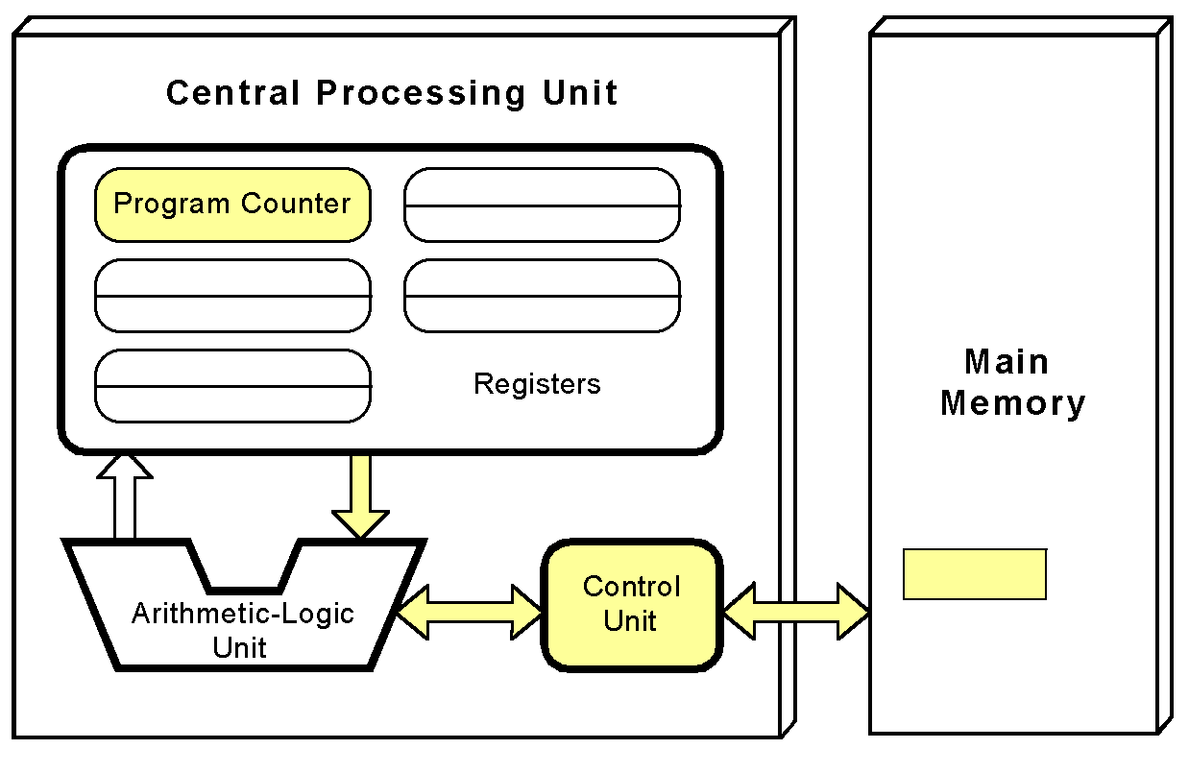
Fetching an Instruction

Slide 16
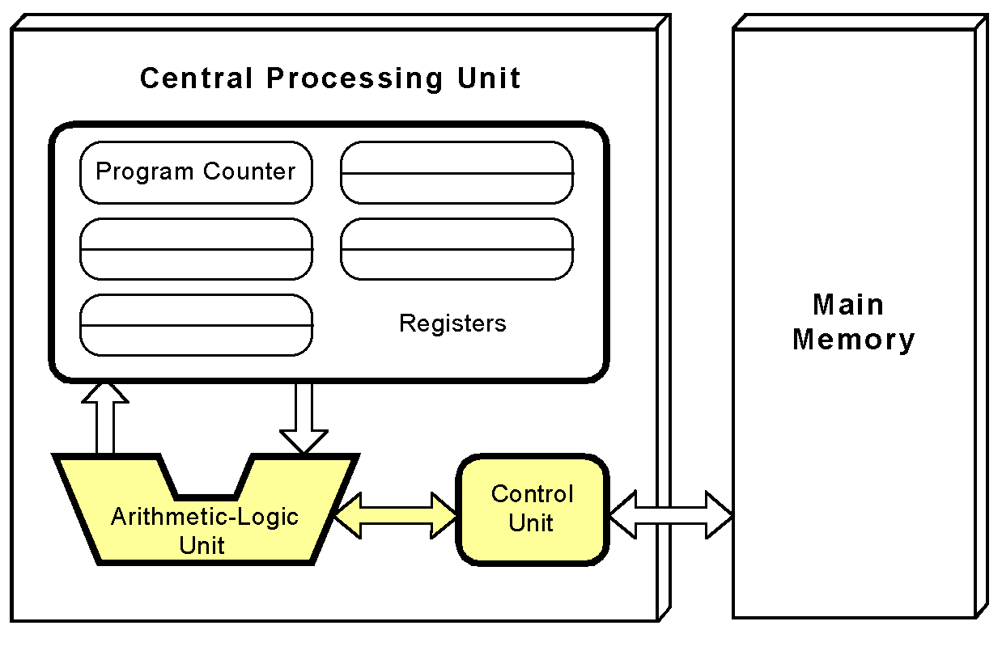
Decoding an Instruction

Slide 17
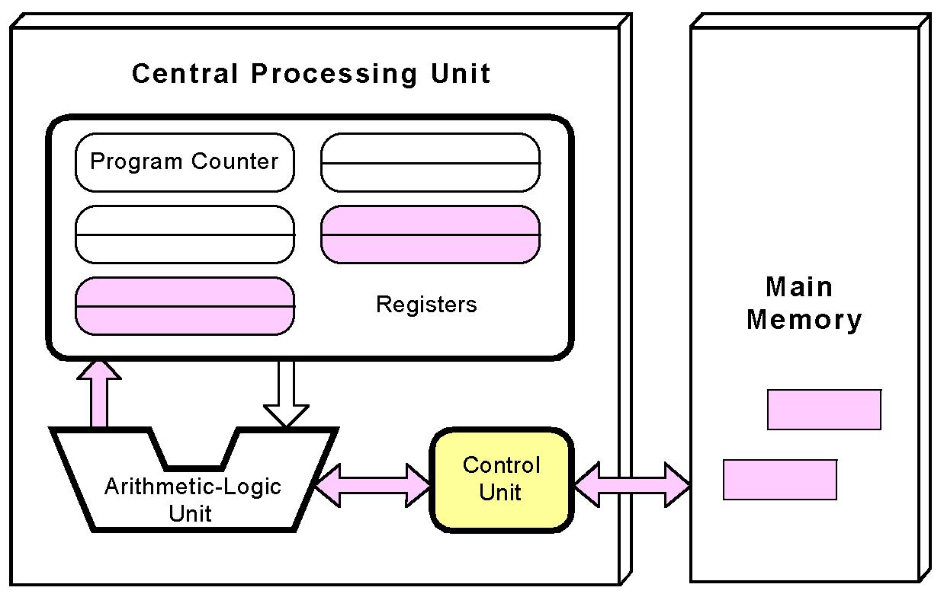
Executing an Instruction (1/2)

Slide 18
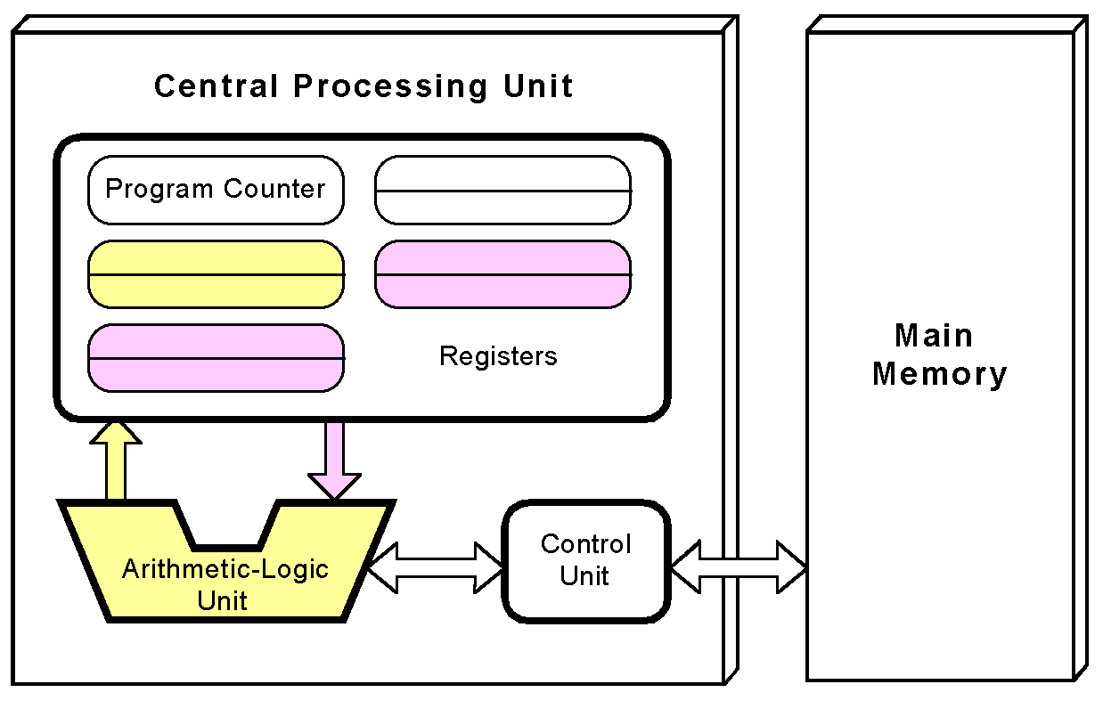
Executing an Instruction (2/2)

Slide 19
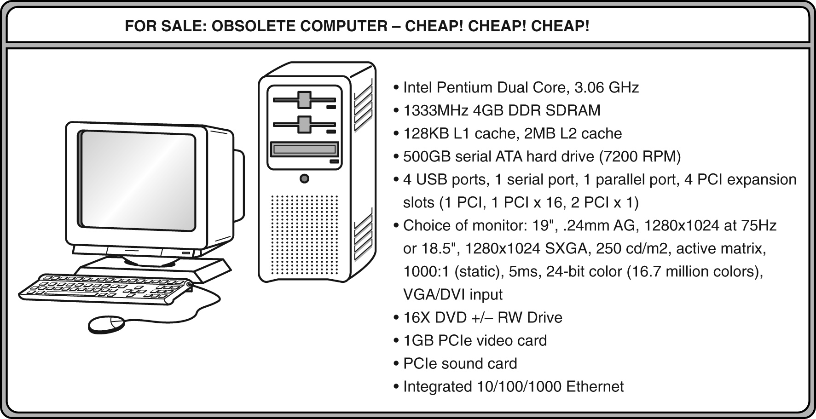
What Does It All Mean???

Slide 20
Common Prefixes Used in Measuring Speed
Kilo- (K) = 1 thousand = 10³
Mega- (M) = 1 million = 10⁶
Giga- (G) = 1 billion = 10⁹
Tera- (T) = 1 trillion = 10¹²
Peta- (P) = 1 quadrillion = 10¹⁵
Exa- (E) = 1 quintillion = 10¹⁸
Zetta- (Z) = 1 sextillion = 10²¹
Yotta- (Y) = 1 septillion = 10²⁴

Slide 21
Example
Hertz (Hz) = clock cycles per second
In computing, CPUs are labeled in terms of their clock rate expressed in megahertz (10⁶ =1,000,000 Hz) or gigahertz (10⁹ =1,000,000,000 Hz)
This number refers to the frequency of the CPU’s master clock signal
This signal is simply an electrical voltage which changes from low to high and back again at regular intervals

Slide 22
Common Prefixes Used in Measuring Capacity
Kilo- (K) = 1 thousand = 2¹⁰
Mega- (M) = 1 million = 2²⁰
Giga- (G) = 1 billion = 2³⁰
Tera- (T) = 1 trillion = 2⁴⁰
Peta- (P) = 1 quadrillion = 2⁵⁰
Exa- (E) = 1 quintillion = 2⁶⁰
Zetta- (Z) = 1 sextillion = 2⁷⁰
Yotta- (Y) = 1 septillion = 2⁸⁰

Slide 23
Example
Byte = a unit of storage
1KB = 2¹⁰ = 1,024 Bytes
1MB = 2²⁰ = 1,048,576 Bytes
Main memory (RAM) is measured in MB for small systems, GB for large systems
Disk storage is measured in GB for small systems, TB for large systems

Slide 24
Questions
To what power of 10 does the prefix giga- refer? What is the approximate equivalent power of 2?
How many bytes are there in 20 megabytes (MB)?
How many kilobytes (KB) are there in 2 gigabytes (GB)?

Slide 25
Measuring Time and Space
Milli- (m) = 1 thousandth = 10 ⁻³
Micro- (μ) = 1 millionth = 10 ⁻⁶
Nano- (n) = 1 billionth = 10 ⁻⁹
Pico- (p) = 1 trillionth = 10 ⁻¹²
Femto- (f) = 1 quadrillionth = 10 ⁻¹⁵
Atto- (a) = 1 quintillionth = 10 ⁻¹⁸
Zepto- (z) = 1 sextillionth = 10 ⁻²¹
Yocto- (y) = 1 septillionth = 10 ⁻²⁴

Slide 26
Example
Millisecond = 1 thousandth of a second
Hard disk drive access times are often 10 to 20 milliseconds (ms)
Nanosecond = 1 billionth of a second
Main memory access times are often 50 to 70 nanoseconds (ns)
Micron (micrometer) = 1 millionth of a meter
Circuits on computer chips are measured in microns

Slide 27
Questions
To what power of 10 does the prefix micro- refer?
What is the cycle time for a bus operating at 133 MHz?
Recall that Hertz = clock cycles per second (frequency) and that 1 MHz = 1,000,000 Hz
Thus, we note that cycle time is the reciprocal of clock frequency.
Therefore, a bus operating at 133MHz has a cycle time of 1 / 133,000,000 seconds
Since there are 1,000,000,000 nanoseconds in 1 second, we get a cycle time of 7.52 nanoseconds: 133,000,000 cycles/second = 7.52ns/cycl

Slide 28
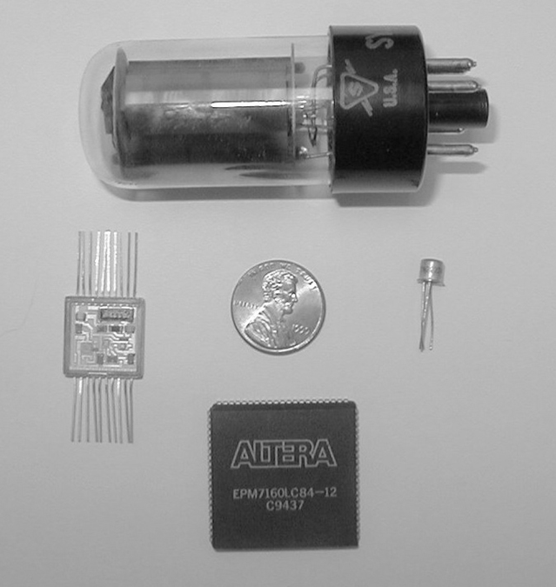
Historical Developments of Computers
Each generation of computer is characterized by a major technological development that fundamentally changed the way computers operate
Increasingly smaller, cheaper, more powerful, more efficient, and reliable devices

Slide 29
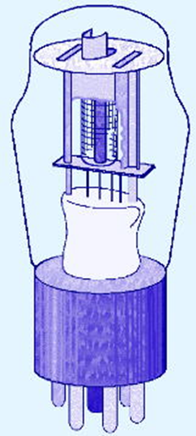
First Generation (1940-1956) Vacuum Tubes
Enormous in size
Very expensive to operate, used lots of electricity, and produced lots of heat causing frequent malfunction
Relied on machine language
Could solve only one problem at a time
Example computer: ENIAC

Slide 30
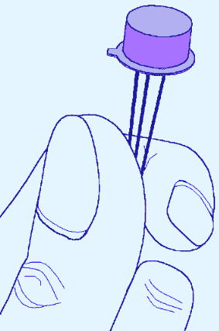
Second Generation (1956-1963) Transistors
Smaller, faster, cheaper, more energy-efficient and more reliable
Relied on assembly language
High-level languages were being developed during this era
Still limited to one application at a time
Example computers: UNIVAC, IBM-7094, and IBM-1401

Slide 31
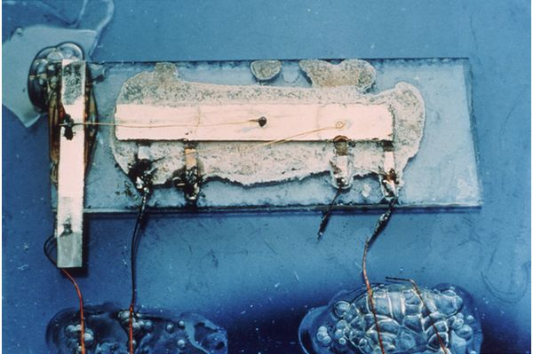
Third Generation (1954-1971) Integrated Circuits
Hundreds of transistors were placed on silicon chips, called semiconductors
Drastically increased the speed and efficiency of computers
Smaller and cheaper
Keyboards and monitors
Could run multiple applications at the same time
Sophisticated operating systems were developed during this era
Jack Kilby’s original IC

Slide 32
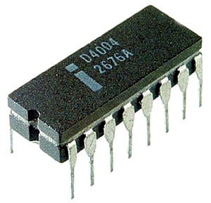
Fourth Generation (1971-Present) Microprocessors
Thousands of integrated circuits are built onto a single silicon chip
All components (CPU, memory, IO controls) are located on a single chip
Drastically increased the speed and efficiency of computers
Even smaller and cheaper
GUI, mouse, and hand held devices have been developed during this era
Intel 4004 Chip, first general-purpose commercial microprocessor

Slide 33
Moore’s Law (1965)
Gordon Moore, Intel founder
“The density of transistors in an integrated circuit will double every year.”
Contemporary version:
“The density of silicon chips doubles every 18 months.”
Can this “law” hold forever?

Slide 34
Rock’s Law (1968)
Arthur Rock, Intel financier
“The cost of capital equipment to build semiconductors will double every four years.”
In 1968, a new chip plant cost about $12,000
In 2005, a chip plants under construction cost over $2.5 billion
This “law” cannot hold forever either …

Slide 35
Section 1.2 – End
Notes:
35

