Slide 1
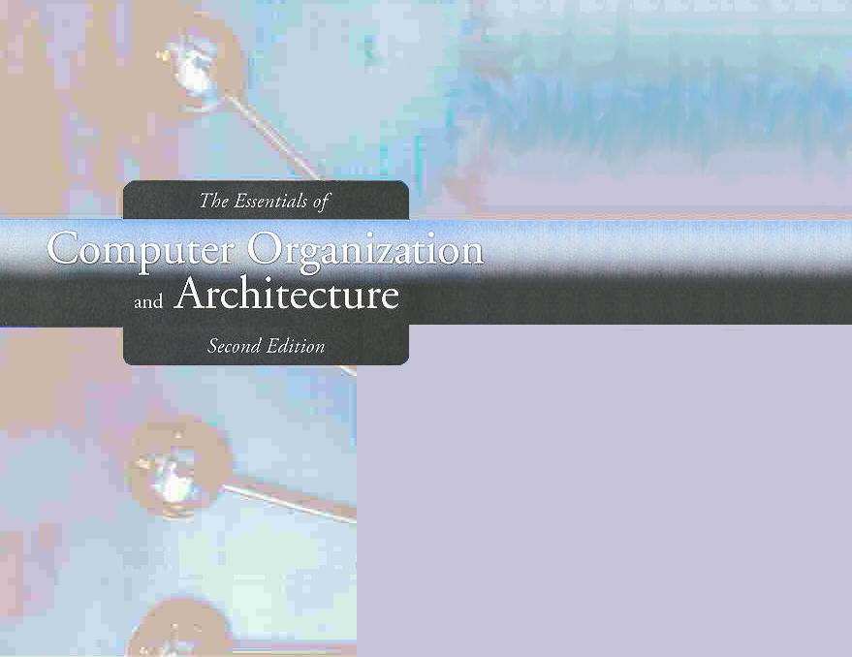
Chapter 1
Introduction

Slide 2
Chapter 1
1.1 Overview
1.2 The Main Components of a Computer System
1.3 An Example System
1.4 Standards Organizations
1.5 Historical Development
1.6 The Computer Level Hierarchy
1.7 The von Neumann Model
1.8 Non-von Neumann Models
2
Notes:
2

Slide 3
The von Neumann Model
On the ENIAC, all programming was done at the digital logic level.
Programming the computer involved moving plugs and wires.
A different hardware configuration was needed to solve every unique problem type.
Configuring the ENIAC to solve a “simple” problem required many days labor by skilled technicians.

Slide 4
The von Neumann Model
Inventors of the ENIAC, John Mauchley and J. Presper Eckert, conceived of a computer that could store instructions in memory.
The invention of this idea has since been ascribed to a mathematician, John von Neumann, who was a contemporary of Mauchley and Eckert.
Stored-program computers have become known as von Neumann Architecture systems.

Slide 5
The von Neumann Model
Today’s stored-program computers have the following characteristics:
Three hardware systems:
A central processing unit (CPU)
A main memory system
An I/O system
The capacity to carry out sequential instruction processing.
A single data path between the CPU and main memory.
This single path is known as the von Neumann bottleneck.

Slide 6
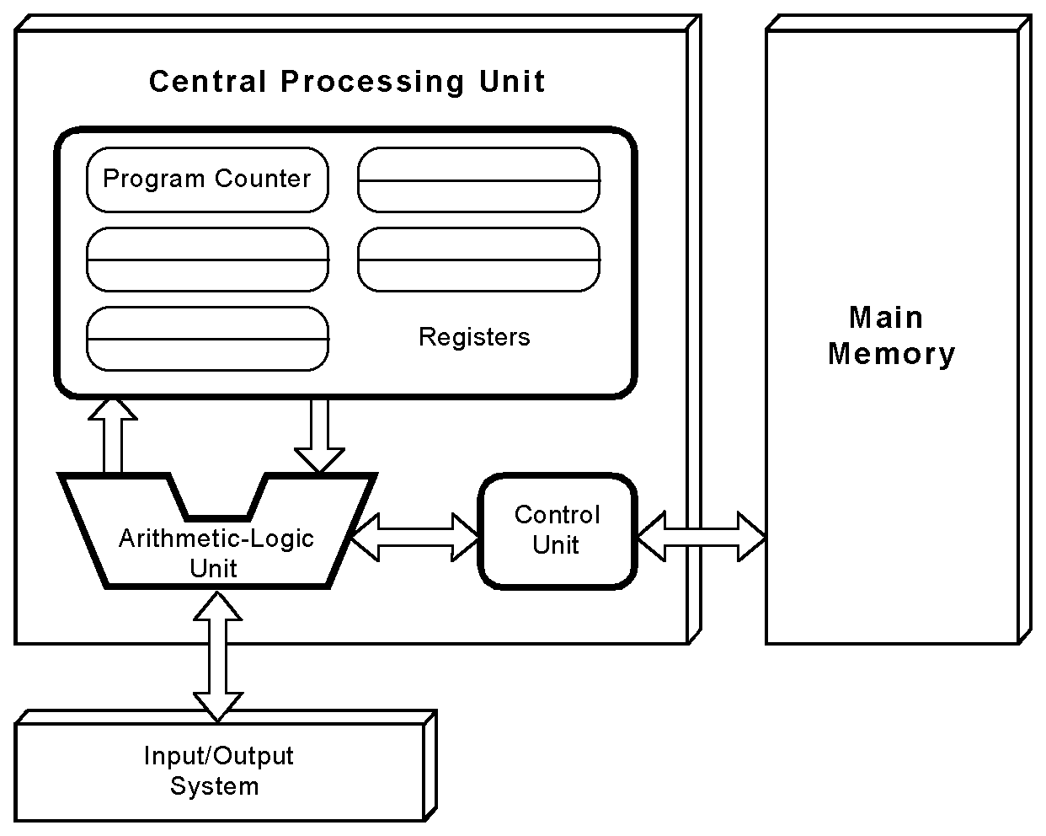
The von Neumann Model
This is a general depiction of a von Neumann system:
These computers employ a fetch-decode-execute cycle to run programs as follows . . .

Slide 7
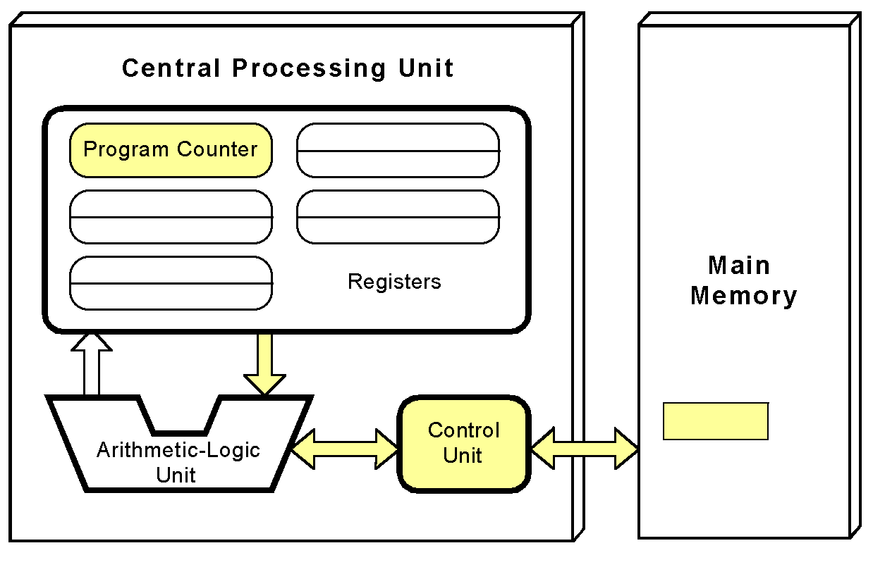
The Fetch-Decode-Execute Cycle
The control unit fetches the next instruction from memory using the program counter to determine where the instruction is located.

Slide 8
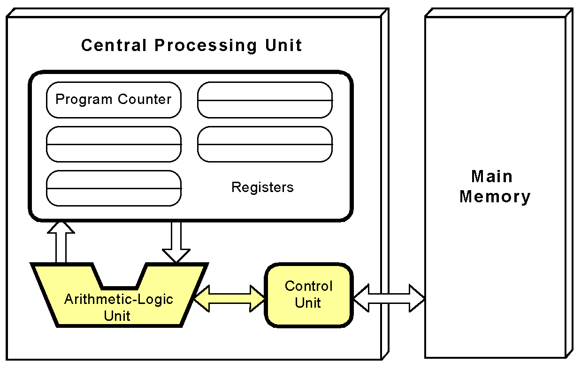
The Fetch-Decode-Execute Cycle
The instruction is decoded into a language that the ALU can understand.

Slide 9
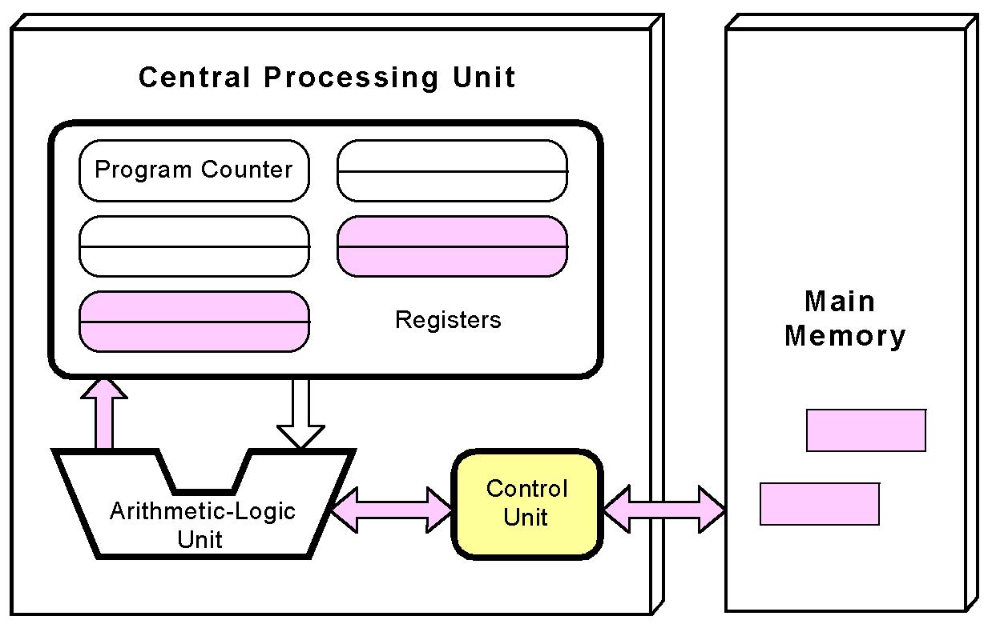
The Fetch-Decode-Execute Cycle
Any data operands required to execute the instruction are fetched from memory and placed into registers within the CPU.

Slide 10
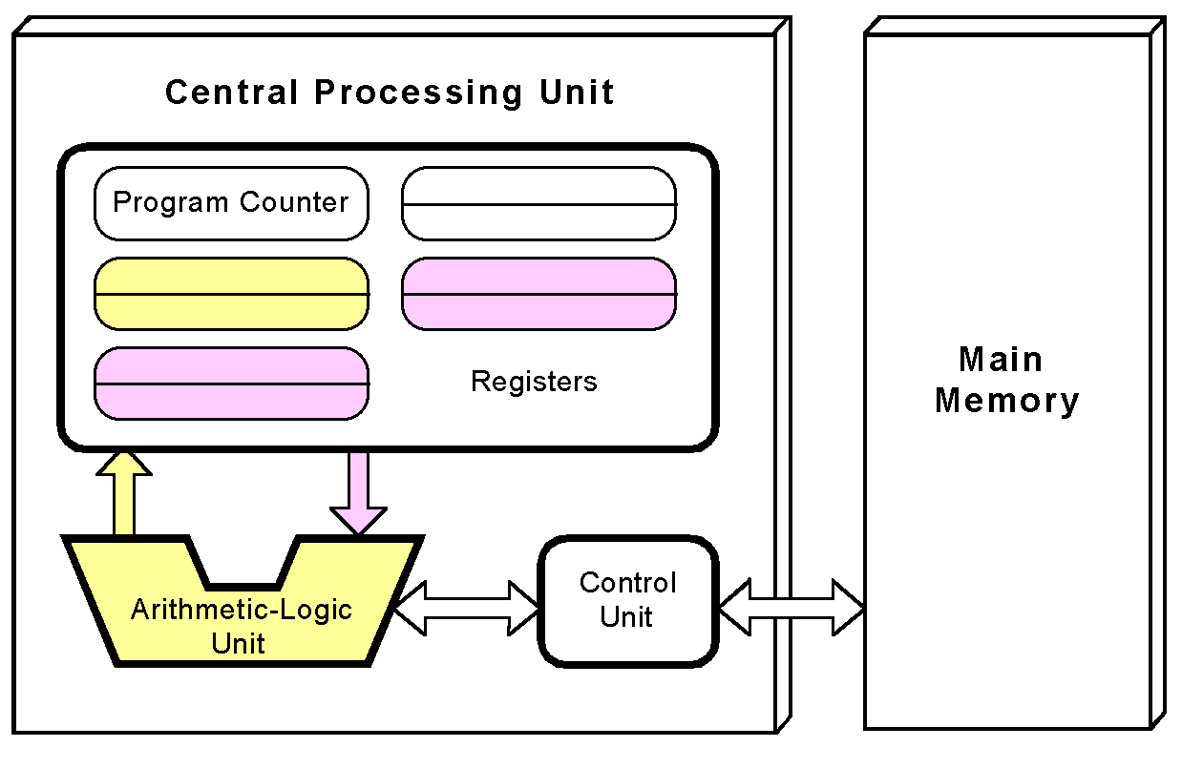
The Fetch-Decode-Execute Cycle
The ALU executes the instruction and places results in registers or memory.

Slide 11
Section 1.7 – End
11
Notes:
11

Slide 12
Chapter 1
1.1 Overview
1.2 The Main Components of a Computer System
1.3 An Example System
1.4 Standards Organizations
1.5 Historical Development
1.6 The Computer Level Hierarchy
1.7 The von Neumann Model
1.8 Non-von Neumann Models
12
Notes:
12

Slide 13
Non-von Neumann Models
Conventional stored-program computers have undergone many incremental improvements over the years.
These improvements include adding specialized buses, floating-point units, and cache memories, to name only a few.
But enormous improvements in computational power require departure from the classic von Neumann architecture.
Adding processors is one approach.

Slide 14
Non-von Neumann Models
In the late 1960s, high-performance computer systems were equipped with dual processors to increase computational throughput.
In the 1970s supercomputer systems were introduced with 32 processors.
Supercomputers with 1,000 processors were built in the 1980s.
In 1999, IBM announced its Blue Gene system containing over 1 million processors.

Slide 15
Non-von Neumann Models
Parallel processing is only one method of providing increased computational power.
More radical systems have reinvented the fundamental concepts of computation.
These advanced systems include genetic computers, quantum computers, and dataflow systems.
At this point, it is unclear whether any of these systems will provide the basis for the next generation of computers.

Slide 16
Conclusion
This chapter has given you an overview of the subject of computer architecture.
You should now be sufficiently familiar with general system structure to guide your studies throughout the remainder of this course.
Subsequent chapters will explore many of these topics in great detail.

Slide 17
Section 1.8 & Chapter 1 – End
17
Notes:
17

