Slide 1
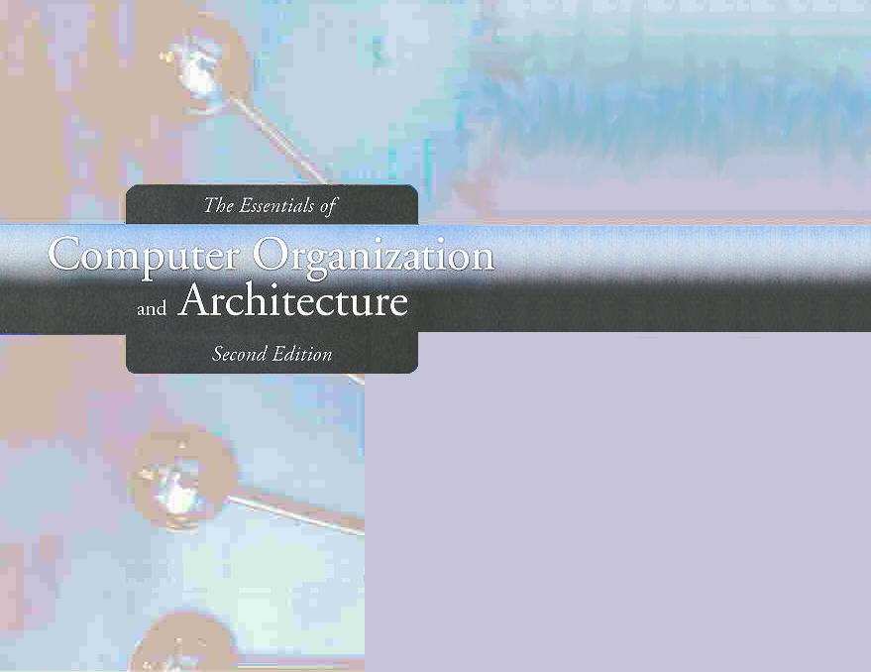
Chapter 2
Data Representation in Computer Systems

Slide 2
Chapter 2
2.1 Introduction
2.2 Positional Number Systems
2.3 Decimal to Binary Conversions
2.4 Signed Integer Representation
2.5 Floating-Point Representation
2.6 Character Codes
2
Notes:
2

Slide 3
Introduction
A bit is the most basic unit of information in a computer.
It is a state of “on” or “off” in a digital circuit.
Sometimes these states are “high” or “low” voltage instead of “on” or “off..”
A byte is a group of eight bits.
A byte is the smallest possible addressable unit of computer storage.
The term, “addressable,” means that a particular byte can be retrieved according to its location in memory.

Slide 4
Introduction
A word is a contiguous group of bytes.
Words can be any number of bits or bytes.
Word sizes of 16, 32, or 64 bits are most common.
In a word-addressable system, a word is the smallest addressable unit of storage.
A group of four bits is called a nibble (or nybble).
Bytes, therefore, consist of two nibbles: a “high-order nibble,” and a “low-order” nibble.

Slide 5
Section 2.1 – End
5
Notes:
5

Slide 6
Chapter 2
2.1 Introduction
2.2 Positional Number Systems
2.3 Decimal to Binary Conversions
2.4 Signed Integer Representation
2.5 Floating-Point Representation
2.6 Character Codes
6
Notes:
6

Slide 7
Positional Numbering Systems
Bytes store numbers using the position of each bit to represent a power of 2.
The binary system is also called the base-2 system.
Our decimal system is the base-10 system. It uses powers of 10 for each position in a number.
Any integer quantity can be represented exactly using any base (or radix).

Slide 8
Positional Numbering Systems
The decimal number 947 in powers of 10 is:
The decimal number 5836.47 in powers of 10 is:
9 × 10 2 + 4 × 10 1 + 7 × 10 0
5 × 10 3 + 8 × 10 2 + 3 × 10 1 + 6 × 10 0 + 4 × 10 -1 + 7 × 10 -2

Slide 9
Positional Numbering Systems
The binary number 11001 in powers of 2 is:
When the radix of a number is something other than 10, the base is denoted by a subscript.
Sometimes, the subscript 10 is added for emphasis:
11001₂ = 25₁₀
1 × 2 4 + 1 × 2 3 + 0 × 2 2 + 0 × 2 1 + 1 × 2 0
= 16 + 8 + 0 + 0 + 1 = 25

Slide 10
Exercise
Represent the following numbers as powers of a radix:
11101₂
21121₃
27361₈
29471₁₀
3FD41₁₆

Slide 11
Section 2.2 – End
11
Notes:
11

