Slide 1
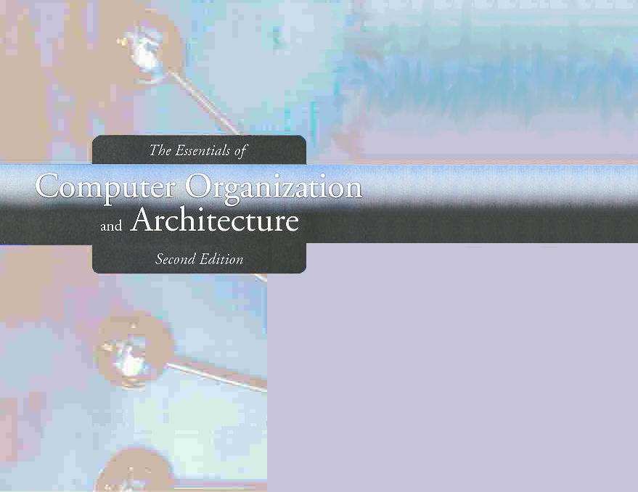
Chapter 2
Data Representation in Computer Systems

Slide 2
Chapter 2
2.1 Introduction
2.2 Positional Number Systems
2.3 Decimal to Binary Conversions
2.4 Signed Integer Representation
2.5 Floating-Point Representation
2.6 Character Codes
2
Notes:
2

Slide 3
Decimal to Binary Conversions
Because binary numbers are the basis for all data representation in digital computer systems, it is important that you become proficient with this radix system.
Your knowledge of the binary numbering system will enable you to understand the operation of all computer components as well as the design of instruction set architectures.

Slide 4
Decimal to Binary Conversions
In the previous section, we said that every integer value can be represented exactly using any radix system.
You can use either of two methods for radix conversion: the subtraction method and the division remainder method.
The subtraction method is more intuitive, but cumbersome. It does, however reinforce the ideas behind radix mathematics.

Slide 5
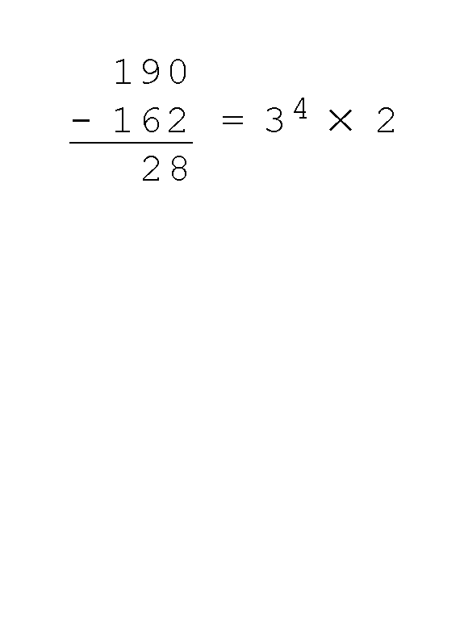
The Subtraction Method: Example
Suppose we want to convert the decimal number 190 to base 3.
We know that 3 ⁵ = 243 so our result will be less than six digits wide. The largest power of 3 that we need is therefore 3 ⁴ = 81, and 81 × 2 = 162.
Write down the 2 and subtract 162 from 190, giving 28.

Slide 6
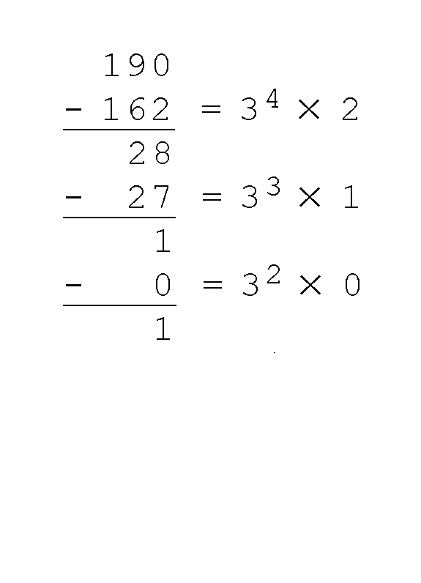
The Subtraction Method: Example
Converting 190 to base 3...
The next power of 3 is 3 ³ = 27. We’ll need one of these, so we subtract 27 and write down the numeral 1 in our result.
The next power of 3, 3 ² = 9, is too large, but we have to assign a placeholder of zero and carry down the 1.

Slide 7
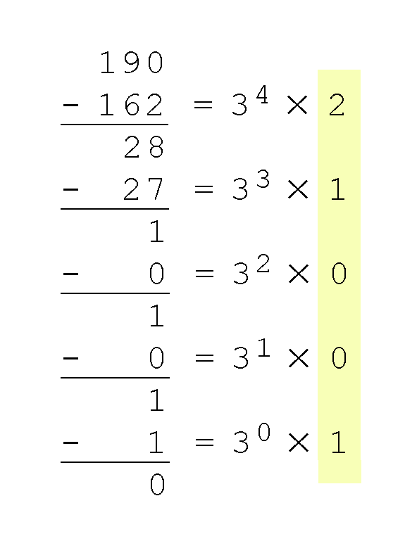
The Subtraction Method: Example
Converting 190 to base 3...
3 ¹ = 3 is again too large, so we assign a zero placeholder.
The last power of 3, 3 ⁰ = 1, is our last choice, and it gives us a difference of zero.
Our result, reading from top to bottom is:
190₁₀ = 21001₃

Slide 8
Exercise
Perform the following base conversions using the subtraction method:
458₁₀ = X₂
458₁₀ = X₃
458₁₀ = X₈
458₁₀ = X₁₆
6771₁₀ = X₅
1518₁₀ = X₇
4401₁₀ = X₉

Slide 9
Exercise (Solutions)
Perform the following base conversions using the subtraction method:
458₁₀ = 111001010₂
458₁₀ = 121222₃
458₁₀ = 712₈
458₁₀ = 1CA₁₆
6771₁₀ = 10202₅
1518₁₀ = 4266₇
4401₁₀ = 6030₉

Slide 10
The Division Method
Another method of converting integers from decimal to some other radix uses division.
This method is mechanical and easy.
It employs the idea that successive division by a base is equivalent to successive subtraction by powers of the base.
Let’s use the division remainder method to again convert 190 in decimal to base 3.

Slide 11
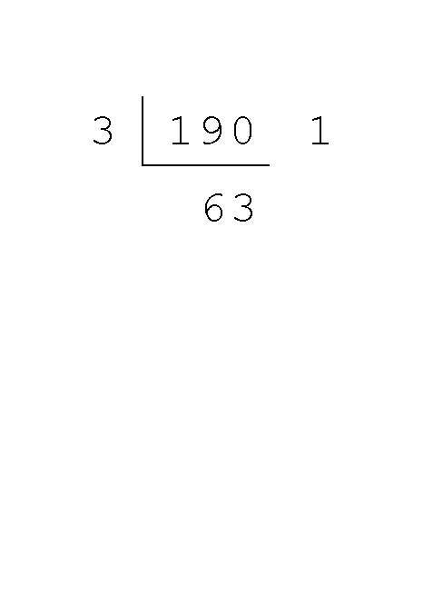
The Division Method: Example
Converting 190 to base 3...
First we take the number that we wish to convert and divide it by the radix in which we want to express our result.
In this case, 3 divides 190 63 times, with a remainder of 1.
Record the quotient and the remainder.

Slide 12
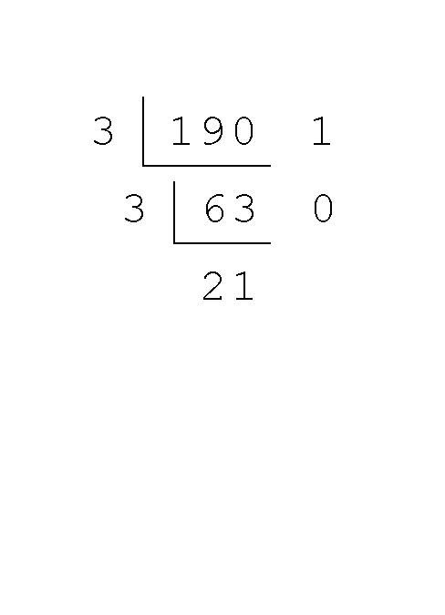
The Division Method: Example
Converting 190 to base 3...
63 is evenly divisible by 3.
Our remainder is zero, and the quotient is 21.

Slide 13
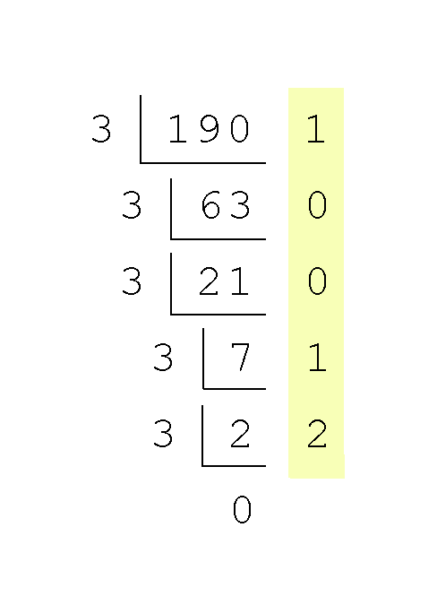
The Division Method: Example
Converting 190 to base 3...
Continue in this way until the quotient is zero.
In the final calculation, we note that 3 divides 2 zero times with a remainder of 2.
Our result, reading from bottom to top is:
190₁₀ = 21001₃

Slide 14
Exercise
Perform the following base conversions using the division method:
458₁₀ = X₂
458₁₀ = X₃
458₁₀ = X₈
458₁₀ = X₁₆
6771₁₀ = X₅
1518₁₀ = X₇
4401₁₀ = X₉

Slide 15
Exercise (Solutions)
Perform the following base conversions using the division method:
458₁₀ = 111001010₂
458₁₀ = 121222₃
458₁₀ = 712₈
458₁₀ = 1CA₁₆
6771₁₀ = 10202₅
1518₁₀ = 4266₇
4401₁₀ = 6030₉

Slide 16
What About Fractions?
Fractional values can be approximated in all base systems.
Unlike integer values, fractions do not necessarily have exact representations under all radices.
Fractions that contain repeating strings of digits to the right of the radix point in one base system may not necessarily have a repeating sequence of digits in another base
The quantity ⅓ is a repeating decimal fraction, but in the ternary (base 3) numbering system it terminates as 0.1₃. Why?
The quantity ½ is exactly representable in the binary and decimal systems, but is not in the ternary system. Why?

Slide 17
Fractions & Radix Point
Fractional decimal values have nonzero digits to the right of the decimal point.
Fractional values of other radix systems have nonzero digits to the right of the radix point.

Slide 18
Fractions & Radix Point
Numerals to the right of a radix point represent negative powers of the radix:
0.47₁₀ = 4 × 10 -1 + 7 × 10 -2
0.11₂ = 1 × 2 -1 + 1 × 2 -2
= ½ + ¼
= 0.5 + 0.25 = 0.75

Slide 19
Fraction Conversions
As with whole-number conversions, you can use either of two methods: a subtraction method and an easy multiplication method.
The subtraction method for fractions is identical to the subtraction method for whole numbers. Instead of subtracting positive powers of the target radix, we subtract negative powers of the radix.
We always start with the largest value first, n ⁻¹, where n is our radix, and work our way along using larger negative exponents.

Slide 20
Some Useful Negative Powers of 2
2⁻¹ = 0.5
2⁻² = 0.25
2⁻³ = 0.125
2⁻⁴ = 0.0625
2⁻⁵ = 0.03125
2⁻⁶ = 0.015625

Slide 21
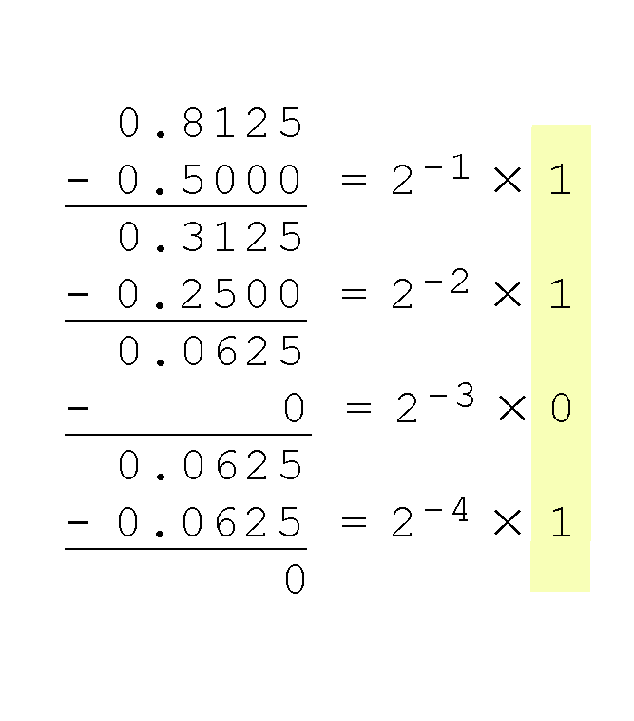
The Subtraction Method: Example
The calculation to the right is an example of using the subtraction method to convert the decimal 0.8125 to binary.
Our result, reading from top to bottom is:
0.8125₁₀ = 0.1101₂
Of course, this method works with any base, not just binary.

Slide 22
Exercise
Use the subtraction method to convert the following decimal fractions to binary with a maximum of six places to the right of the binary point:
26.78125
194.03125
298.796875
16.1240234375

Slide 23
Exercise (Solutions)
Use the subtraction method to convert the following decimal fractions to binary with a maximum of six places to the right of the binary point:
26.78125 = 11010.11001
194.03125 = 11000010.00001
298.796875 = 100101010.110011
16.1240234375 = 10000.000111

Slide 24
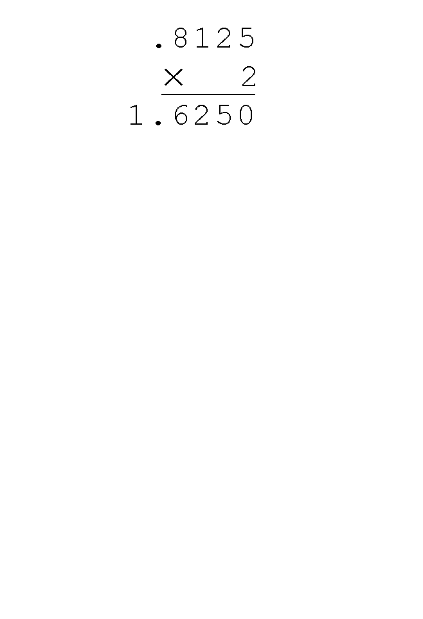
The Multiplication Method: Example
Using the multiplication method to convert the decimal 0.8125 to binary, we multiply by the radix 2.
The first product carries into the units place.

Slide 25
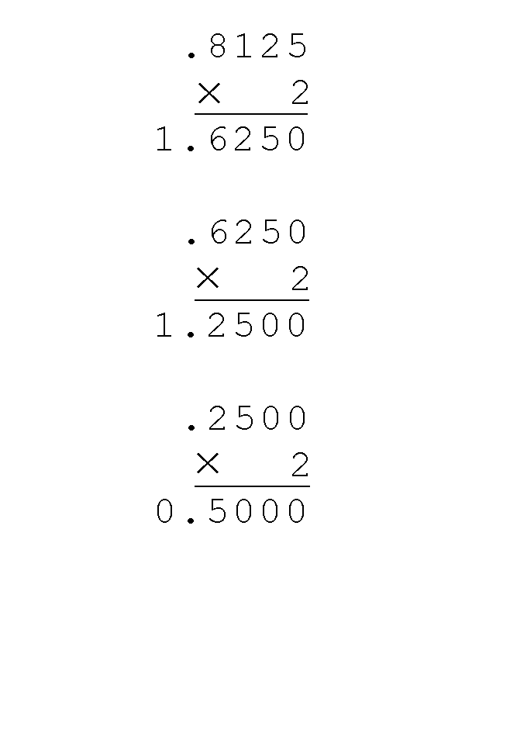
The Multiplication Method: Example
Converting 0.8125 to binary . . .
Ignoring the value in the units place at each step, continue multiplying each fractional part by the radix.

Slide 26
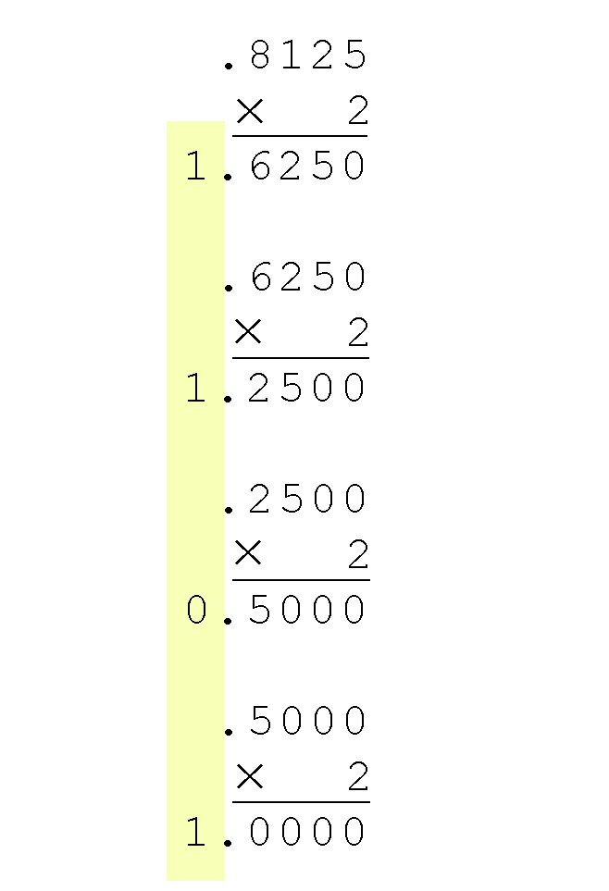
The Multiplication Method: Example
Converting 0.8125 to binary . . .
You are finished when the product is zero, or until you have reached the desired number of binary places.
Our result, reading from top to bottom is:
0.8125₁₀ = 0.1101₂
This method also works with any base. Just use the target radix as the multiplier.

Slide 27
Exercise
Use the multiplication method to convert the following decimal fractions to binary with a maximum of six places to the right of the binary point:
26.78125
194.03125
298.796875
16.1240234375

Slide 28
Exercise (Solutions)
Use the multiplication method to convert the following decimal fractions to binary with a maximum of six places to the right of the binary point:
26.78125 = 11010.11001
194.03125 = 11000010.00001
298.796875 = 100101010.110011
16.1240234375 = 10000.000111

Slide 29
Converting Between Power of 2 Radices
The binary numbering system is the most important radix system for digital computers.
However, it is difficult to read long strings of binary numbers-- and even a modestly-sized decimal number becomes a very long binary number.
For example: 11010100011011₂ = 13595₁₀
For compactness and ease of reading, binary values are usually expressed using the hexadecimal, or base-16, and octal, or base-8, numbering systems.

Slide 30
The Hexadecimal Number System
There are 16 digits in the hexadecimal numbering system:
0 1 2 3 4 5 6 7
8 9 A B C D E F
Thus, the base of the hexadecimal numbering system is 16
Examples:
The decimal number 12 is C₁₆
The decimal number 26 is 1A₁₆

Slide 31
Binary to Hex Conversions
It is easy to convert between base 16 and base 2, because 16 = 2⁴.
Thus, to convert from binary to hexadecimal, all we need to do is group the binary digits into groups of four.

Slide 32
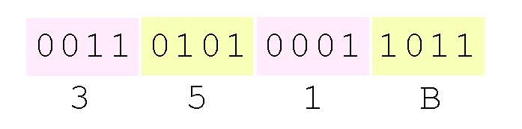
Binary to Hex Conversions: Example
The binary number
11010100011011₂
(which is 13595₁₀)
in hexadecimal is:

Slide 33
The Octal Number System
There are 8 digits in the octal number system:
0 1 2 3 4 5 6 7
Thus, the base of the hexadecimal numbering system is 8
Examples:
The decimal number 12 is 14₈
The decimal number 26 is 32₈
Octal was very useful when computers used six-bit words

Slide 34
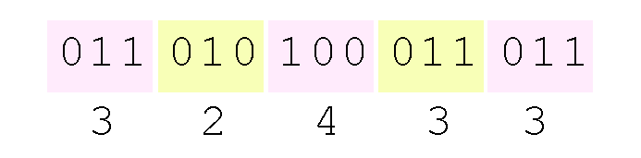
Binary to Octal Conversions
Octal (base 8) values are derived from binary by using groups of three bits (8 = 2³):

Slide 35
Section 2.3 – End
35
Notes:
35

