Slide 1
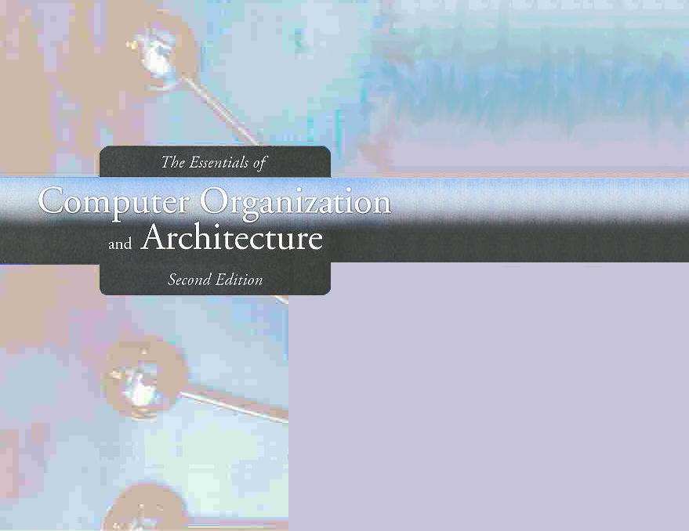
Chapter 2
Data Representation in Computer Systems

Slide 2
Chapter 2
2.1 Introduction
2.2 Positional Number Systems
2.3 Decimal to Binary Conversions
2.4 Signed Integer Representation
2.5 Floating-Point Representation
2.6 Character Codes
2
Notes:
2

Slide 3

Unsigned Integers: Remark
The conversions we have so far presented have involved only positive numbers.
If the integer is unsigned, all bits are used to represent the magnitude of the integer
The range of unsigned integers that can be represented using N bits is:

Slide 4
Signed Integer Representation
To represent negative values, computer systems allocate the high-order bit to indicate the sign of a value.
The high-order bit is the leftmost bit in a byte. It is also called the most significant bit.
The remaining bits contain the value of the number.

Slide 5
Signed Integer Representation
There are three ways in which signed binary numbers may be expressed:
Signed magnitude
One’s complement
Two’s complement

Slide 6
Signed Magnitude Representation
In an N-bit word, signed magnitude representation places the absolute value of the number in the N-1 bits to the right of the sign bit.
Sign bit | Magnitude (N-1) bits

Slide 7
Signed Magnitude Representation
In an 8-bit word, signed magnitude representation places the absolute value of the number in the 7 bits to the right of the sign bit.
Example, in 8-bit signed magnitude:
+3 is: 00000011
-3 is: 10000011

Slide 8

Signed Magnitude Representation
The range of signed integers that can be represented using N bits is signed magnitude representation is:

Slide 9
Signed Magnitude Representation
Decimal | Binary | SM | 1’s C | 2’sC
0 | 0000 | +0
1 | 0001 | +1
2 | 0010 | +2
3 | 0011 | +3
4 | 0100 | +4
5 | 0101 | +5
6 | 0110 | +6
7 | 0111 | +7
8 | 1000 | -0
9 | 1001 | -1
10 | 1010 | -2
11 | 1011 | -3
12 | 1100 | -4
13 | 1101 | -5
14 | 1110 | -6
15 | 1111 | -7

Slide 10
Signed Magnitude Representation: Exercise
Express 23, -23, and -9 in 8-bit Signed Magnitude representation
Convert the following signed magnitude integers to decimal
00010111
10010000
11110001
11101001

Slide 11
Signed Magnitude Arithmetic
Computers perform arithmetic operations on signed magnitude numbers in much the same way as humans carry out pencil and paper arithmetic.
Humans often ignore the signs of the operands while performing a calculation, applying the appropriate sign after the calculation is complete.

Slide 12
Signed Magnitude Arithmetic
Binary addition is as easy as it gets. You need to know only four rules:
0 + 0 = 0 0 + 1 = 1
1 + 0 = 1 1 + 1 = 10
The simplicity of this system makes it possible for digital circuits to carry out arithmetic operations.

Slide 13
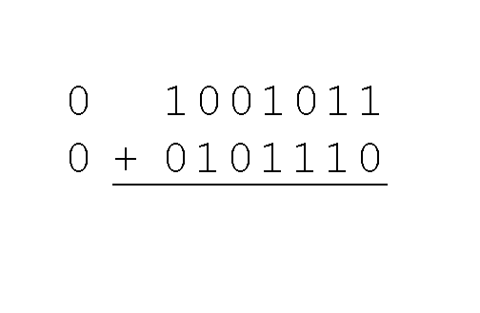
Signed Magnitude Arithmetic: Example 1
Using signed magnitude binary arithmetic, find the sum of 75 and 46.
First, convert 75 and 46 to binary, and arrange as a sum, but separate the (positive) sign bits from the magnitude bits.

Slide 14
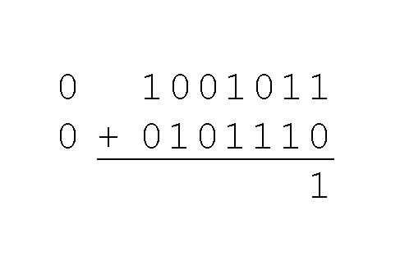
Signed Magnitude Arithmetic: Example 1
Using signed magnitude binary arithmetic, find the sum of 75 and 46.
Just as in decimal arithmetic, we find the sum starting with the rightmost bit and work left.

Slide 15
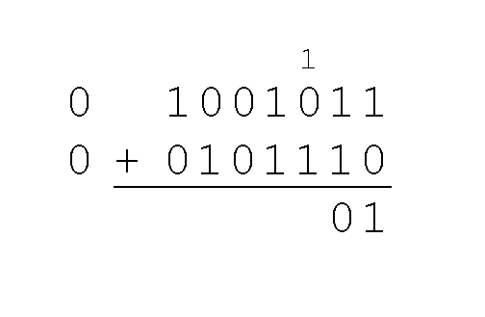
Signed Magnitude Arithmetic: Example 1
Using signed magnitude binary arithmetic, find the sum of 75 and 46.
In the second bit, we have a carry, so we note it above the third bit.

Slide 16
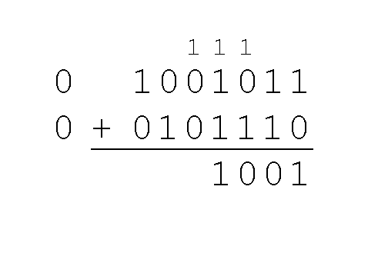
Signed Magnitude Arithmetic: Example 1
Using signed magnitude binary arithmetic, find the sum of 75 and 46.
The third and fourth bits also give us carries.

Slide 17
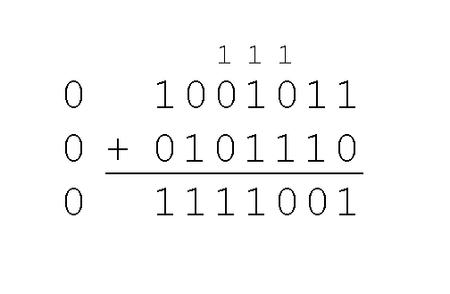
Signed Magnitude Arithmetic: Example 1
Using signed magnitude binary arithmetic, find the sum of 75 and 46.
Once we have worked our way through all eight bits, we are done.
In this example, we were careful to pick two values whose sum would fit into seven bits. If that is not the case, we have a problem.

Slide 18
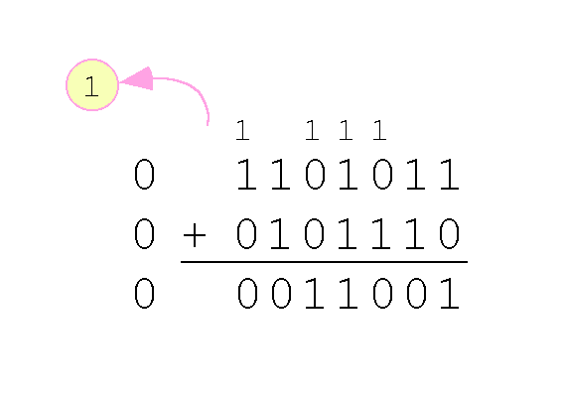
Signed Magnitude Arithmetic: Example 2
Using signed magnitude binary arithmetic, find the sum of 107 and 46.
We see that the carry from the 7th bit overflows and is discarded, giving us the erroneous result:
107 + 46 = 25.

Slide 19
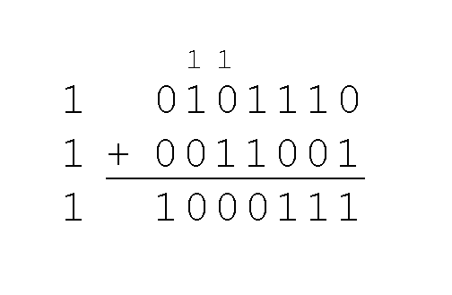
Signed Magnitude Arithmetic: Example 3
The signs in signed magnitude representation work just like the signs in pencil and paper arithmetic.
Example: Using signed magnitude binary arithmetic, find the sum of - 46 and - 25.
Because the signs are the same, all we do is add the numbers and supply the negative sign when we are done.

Slide 20
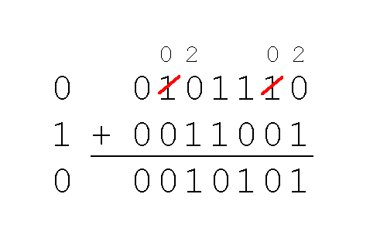
Signed Magnitude Arithmetic: Example 4
Mixed sign addition (or subtraction) is done the same way.
Example: Using signed magnitude binary arithmetic, find the sum of 46 and - 25.
The sign of the result gets the sign of the number that is larger.
Note the “borrows” from the second and sixth bits.

Slide 21
Signed Magnitude Arithmetic: Exercise
Perform the following operations using signed magnitude arithmetic:
01001111 + 00100011
01001111 + 01100011
10010011 + 00001101
01100011 – 01001111
10101011 – 10011000

Slide 22
Signed Magnitude Arithmetic: Summary
Signed magnitude representation is easy for people to understand, but it requires complicated computer hardware.
Another disadvantage of signed magnitude is that it allows two different representations for zero: positive zero and negative zero.
For these reasons (among others) computers systems employ complement systems for numeric value representation.

Slide 23
Complement Systems
In complement systems, negative values are represented by some difference between a number and its base.
In diminished radix complement systems, a negative value is given by the difference between the absolute value of a number and one less than its base.
In the binary system, this gives us one’s complement. It amounts to little more than flipping the bits of a binary number.

Slide 24

Diminished Radix Complement
Given an integer N in base (radix) r having d digits, the diminished radix complement of the integer N is given by

Slide 25
One’s Complement Representation
Decimal | Binary | SM | 1’s C | 2’sC
0 | 0000 | +0 | +0
1 | 0001 | +1 | +1
2 | 0010 | +2 | +2
3 | 0011 | +3 | +3
4 | 0100 | +4 | +4
5 | 0101 | +5 | +5
6 | 0110 | +6 | +6
7 | 0111 | +7 | +7
8 | 1000 | -0 | -7
9 | 1001 | -1 | -6
10 | 1010 | -2 | -5
11 | 1011 | -3 | -4
12 | 1100 | -4 | -3
13 | 1101 | -5 | -2
14 | 1110 | -6 | -1
15 | 1111 | -7 | -0

Slide 26
One’s Complement Representation
In 8-bit one’s complement,
positive 3 is: 00000011
Negative 3 is: 11111100
In one’s complement, as with signed magnitude, negative values are indicated by a 1 in the high order bit.

Slide 27
One’s Complement Representation: Exercise
Express 23, -23, and -9 in 8-bit one’s complement representation
Convert the following one’s complement integers to decimal
00010111
10010000
11110001
11101001

Slide 28
One’s Complement Arithmetic
Complement systems are useful because they eliminate the need for subtraction:
The difference of two values is found by adding the minuend to the complement of the subtrahend.

Slide 29
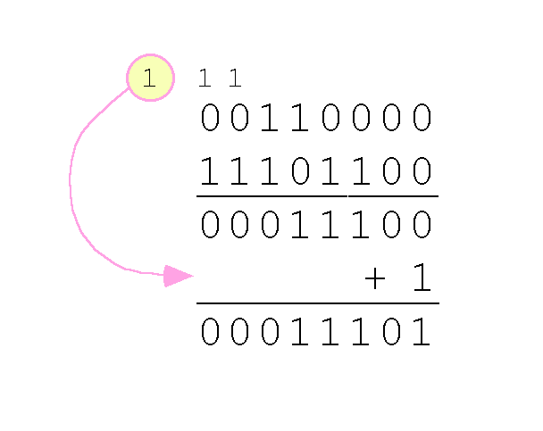
One’s Complement Arithmetic: Example
With one’s complement addition, the carry bit is “carried around” and added to the sum.
Example: Using one’s complement binary arithmetic, find the sum of 48 and - 19
We note that 19 in one’s complement is 00010011, so -19 in one’s complement is: 11101100.

Slide 30
One’s Complement Arithmetic: Exercise
Perform the following operations using one’s complement arithmetic:
01001111 + 00100011
01001111 + 01100011
10010011 + 00001101
00010111 + 11110110
00001001 + 11101000

Slide 31
Radix Complement Representation
Although the “end carry around” adds some complexity, one’s complement is simpler to implement than signed magnitude.
But it still has the disadvantage of having two different representations for zero: positive zero (00000000) and negative zero (11111111).
Two’s complement solves this problem.
Two’s complement is the radix complement of the binary numbering system.

Slide 32
Two’s Complement Representation
To express a value in two’s complement:
If the number is positive, just convert it to binary and you’re done.
If the number is negative, find the one’s complement of the number and then add 1.
Example:
In 8-bit one’s complement, positive 3 is: 00000011
Negative 3 in one’s complement is: 11111100
Adding 1 gives us -3 in two’s complement form: 11111101.

Slide 33
Signed Integers Representation
Decimal | Binary | SM | 1’s C | 2’sC
0 | 0000 | +0 | +0 | +0
1 | 0001 | +1 | +1 | +1
2 | 0010 | +2 | +2 | +2
3 | 0011 | +3 | +3 | +3
4 | 0100 | +4 | +4 | +4
5 | 0101 | +5 | +5 | +5
6 | 0110 | +6 | +6 | +6
7 | 0111 | +7 | +7 | +7
8 | 1000 | -0 | -7 | -8
9 | 1001 | -1 | -6 | -7
10 | 1010 | -2 | -5 | -6
11 | 1011 | -3 | -4 | -5
12 | 1100 | -4 | -3 | -4
13 | 1101 | -5 | -2 | -3
14 | 1110 | -6 | -1 | -2
15 | 1111 | -7 | -0 | -1

Slide 34
Two’s Complement Representation: Exercise
Express 23, -23, and -9 in 8-bit two’s complement representation
Convert the following two’s complement integers to decimal
00010111
10010000
11110001
11101001
11110111

Slide 35
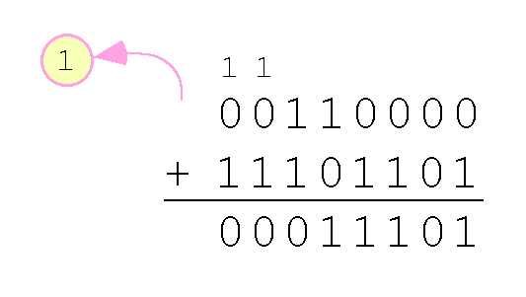
Two’s Complement Arithmetic: Example
With two’s complement arithmetic, all we do is add our two binary numbers. Just discard any carries emitting from the high order bit.
Example: Using one’s complement binary arithmetic, find the sum of 48 and - 19.
We note that 19 in one’s complement is: 00010011, so -19 in one’s complement is: 11101100,
and -19 in two’s complement is: 11101101.

Slide 36
Two’s Complement Arithmetic: Exercise
Perform the following operations using two’s complement arithmetic:
01001111 + 00100011
01001111 + 01100011
10010011 + 00001101
00010111 + 11110111
00001001 + 11101001
01111110 + 00001000

Slide 37
Two’s Complement and Overflow
When we use any finite number of bits to represent a number, we always run the risk of the result of our calculations becoming too large to be stored in the computer.
While we can’t always prevent overflow, we can always detect overflow.
In complement arithmetic, an overflow condition is easy to detect.

Slide 38
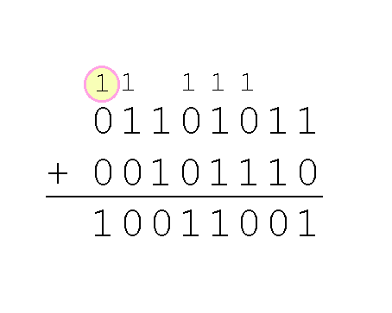
Two’s Complement and Overflow
Example:
Using two’s complement binary arithmetic, find the sum of 107 and 46.
We see that the nonzero carry from the seventh bit overflows into the sign bit, giving us the erroneous result: 107 + 46 = -103.
Rule for detecting signed two’s complement overflow: When the “carry in” and the “carry out” of the sign bit differ, overflow has occurred.

Slide 39
Signed Integers Representation
Signed and unsigned numbers are both useful.
For example, memory addresses are always unsigned.
Using the same number of bits, unsigned integers can express twice as many values as signed numbers.
Trouble arises if an unsigned value “wraps around.”
In four bits: 1111 + 1 = 0000.
Good programmers stay alert for this kind of problem.

Slide 40
Signed Integer Arithmetic
Research into finding better arithmetic algorithms has continued apace for over 50 years.
One of the many interesting products of this work is Booth’s algorithm.
In most cases, Booth’s algorithm carries out multiplication faster and more accurately than naïve pencil-and-paper methods.
The general idea is to replace arithmetic operations with bit shifting to the extent possible.

Slide 41
Signed Integer Arithmetic: Example
Perform the following operations assuming unsigned integers:
0011 × 0110
1001 × 0011
11111101 × 00000101
101101 / 101

Slide 42
Signed Integer Arithmetic: Example
Perform the following operations assuming signed integers:
0011 × 0110
1001 × 0011
11111101 × 00000101

Slide 43
Booth’s Algorithm
If the current multiplicand bit is 1 and the preceding bit was 0, we are at the beginning of a string of ones, so subtract the multiplicand from the product (or add the opposite)
If the current multiplicand bit is 0 and the preceding bit was 1, we are at the end of a string of ones, so we add the multiplicand to the product
If it is a 00, or a 11 pair, do no arithmetic operation (we are in the middle of a string of zeros or a string of ones). Simply shift

Slide 44
Booth’s Algorithm: Example
In Booth’s algorithm, the first 1 in a string of 1s in the multiplier is replaced with a subtraction of the multiplicand.
Shift the partial sums until the last 1 of the string is detected.
Then add the multiplicand.
0011
x 0110
+ 0000
- 0011
+ 0000
+ 0011____
00010010

Slide 45
Booth’s Algorithm: Example 2
00110101
x 01111110
+ 0000000000000000
+ 111111111001011
+ 00000000000000
+ 0000000000000
+ 000000000000
+ 00000000000
+ 0000000000
+ 000110101_______
10001101000010110
Here is a larger example.
Ignore all bits over 2n.

Slide 46
Booth’s Algorithm: Exercise
Perform the following binary multiplications using Booth’s algorithm, assuming signed two’s complement integers:
1011 × 0101
0011 × 1011

Slide 47
Signed Integer Representation
Overflow and carry are tricky ideas.
Signed number overflow means nothing in the context of unsigned numbers, which set a carry flag instead of an overflow flag.
If a carry out of the leftmost bit occurs with an unsigned number, overflow has occurred.
Carry and overflow occur independently of each other.
The table on the next slide summarizes these ideas.

Slide 48
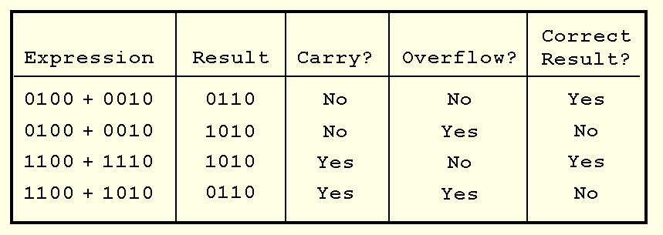
Signed Integer Representation

Slide 49
Section 2.4 – End
49
Notes:
49

