Slide 1

Chapter 2
Data Representation in Computer Systems

Slide 2
Chapter 2
2.1 Introduction
2.2 Positional Number Systems
2.3 Decimal to Binary Conversions
2.4 Signed Integer Representation
2.5 Floating-Point Representation
2.6 Character Codes
2
Notes:
2

Slide 3
Floating-Point Representation
The signed magnitude, one’s complement, and two’s complement representation presented in the previous section deal with integer values only.
Without modification, these formats are not useful in scientific or business applications that deal with real number values.

Slide 4
Floating-Point Representation
Floating-point representation solves this problem.
Most of today’s computers are equipped with specialized hardware that performs floating-point arithmetic with no special programming required.

Slide 5
Floating-Point Representation
Floating-point numbers allow an arbitrary number of decimal places to the right of the decimal point.
Examples:
0.5
0.25
3.14159
0.5 × 0.25 = 0.125

Slide 6
Floating-Point Representation: Scientific Notation
Floating-point numbers are often expressed in scientific notation.
Examples:
34.1 = 3.41 × 10¹
5,000,000 = 5.0 × 10⁶
367000000000000000.0 = 3.67 × 10¹⁷
0.125 = 1.25 × 10^{─1}
0.00000589 = 5.89 × 10^{─6}

Slide 7
Scientific Notation
Numbers are expressed in two parts:
A fractional part and
An exponential part that indicates the power of 10 to which the fractional part should be raised to obtain the value we need:
17 = 17 × 10⁰
= 1.7 × 10¹

Slide 8
Binary Scientific Notation
Scientific notation can be extended to binary numbers (17 = 10001):
10001 = 10001 × 2⁰
= 1000.1 × 2¹
= 100.01 × 2²
= 10.001 × 2³
= 1.0001 × 2⁴
= 0.10001 × 2⁵

Slide 9
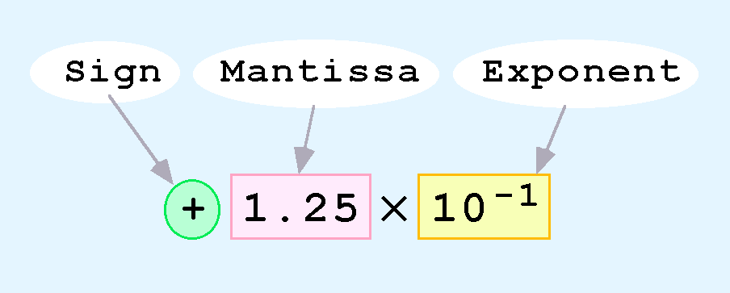
Floating-Point Representation
Computers use a form of scientific notation for floating-point representation
Numbers written in scientific notation have three components:

Slide 10
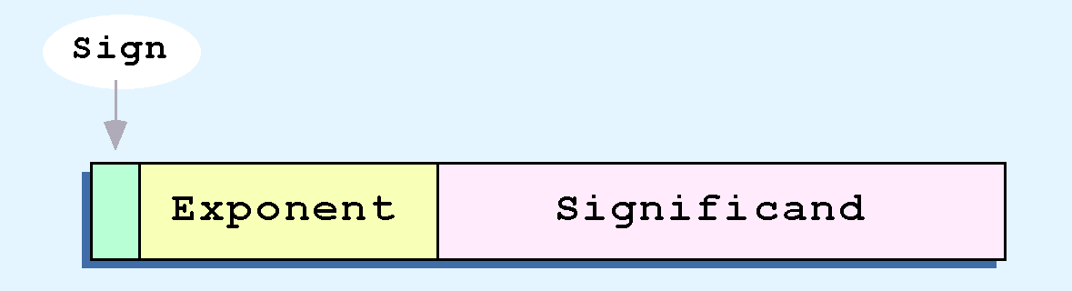
Floating-Point Representation
Computer representation of a floating-point number consists of three fixed-size fields.
Below is the standard arrangement of these fields:

Slide 11
Floating-Point Representation
The one-bit Sign field is the sign of the stored value.
The Exponent field indicates the power of 2 to which the significand is raised.
The exponent base (2) is implicit and need not be stored

Slide 12
Floating-Point Representation
The Significand field always contains a fractional binary value.
The significand of a floating-point number is always preceded by an implied binary point.
There is no need to represent the implied binary point

Slide 13
Floating-Point Representation
The size of the exponent field, determines the range of values that can be represented.
The size of the significand determines the precision of the representation.

Slide 14
A Simplified Model: Textbook Model
Total of 14 bits:
Sign Field: 1 bit
Exponent Field: 5 bits
Significand Field: 8 bits

Slide 15
IEEE-754 Single-Precision Standard Model
Total of 32 bits:
Sign Field: 1 bit
Exponent Field: 8 bits
Significand Field: 23 bits

Slide 16
IEEE-754 Double-Precision Standard Model
Total of 64 bits:
Sign Field: 1 bit
Exponent Field: 11 bits
Significand Field: 52 bits

Slide 17



To Summarize:
If where d is a decimal digit
Then N is represented as follows:
In Textbook Model:
In IEEE-754 Single-Precision Model:
IEEE-754 Single-Precision Model:

Slide 18
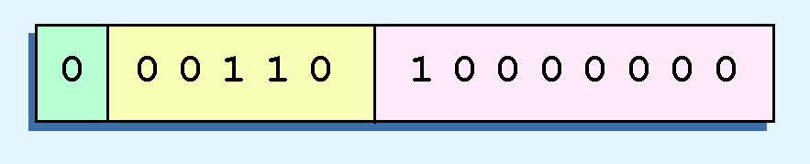
Textbook Floating-Point Model: Example
Express 32₁₀ in the simplified 14-bit floating-point model.
We know that 32 is 2⁵. So in (binary) scientific notation 32 = 1.0 x 2⁵ = 0.1 x 2⁶.
Using this information, we put 110 (= 6₁₀) in the exponent field and 1 in the significand as shown.

Slide 19
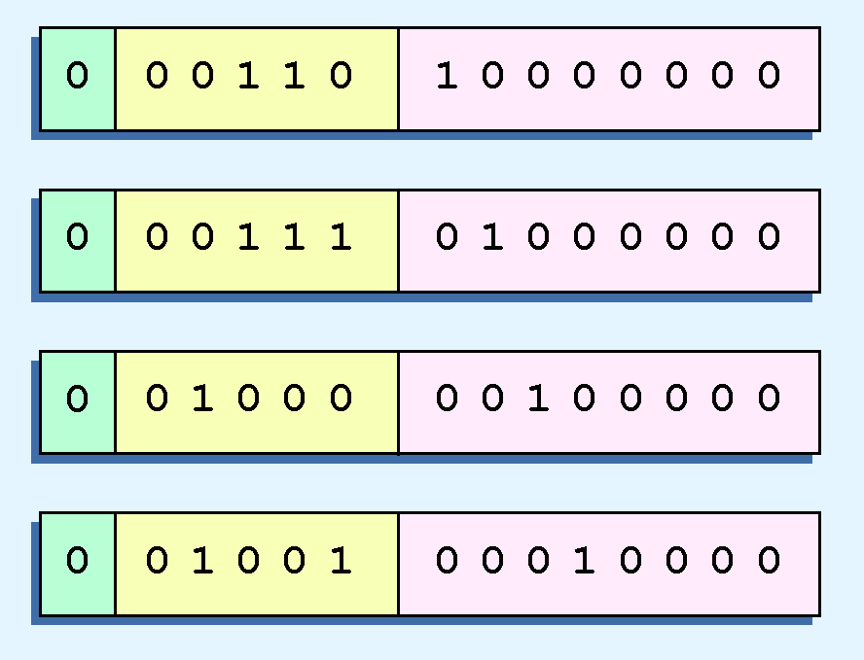
Textbook Floating-Point Model: Problem (1/2)
Synonymous representations for 32.
Disadvantages:
Waste of space
Can cause confusion

Slide 20

Textbook Floating-Point Model: Problem (1/2) Solution
To resolve the problem of synonymous forms, we will establish a rule that the first digit of the significand must be 1.
This is called normalization.
Example:
The integer 32 (normalized) is expressed as

Slide 21
Textbook Floating-Point Model: Problem (2/2)
Another problem with our system is that we have made no allowances for negative exponents.
For example, we have no way to express 0.5 (=2 ⁻¹)
Notice that there is no sign in the exponent field
To provide for negative exponents, we will use a biased exponent.

Slide 22
Problem (2/2) Solution: Biased Exponent
A bias is a number that is approximately midway in the range of values expressible by the exponent.
In our case, we have a 5-bit exponent. So, the range of expressible values is 0 to 31 and midway of this range is approximately 16.
We will use 16 for our bias.
This is called excess-16 representation.

Slide 23
Textbook Floating-Point Model: Biased Exponent
In our model:
Exponents of all zeros or all ones are allowed
Exponent values less than 16 (00000 – 01111) are negative.
Exponent values greater than 16 (10000 – 11111) are positive.

Slide 24
Revised Textbook Floating-Point Model: Summary
Normalized Form
Normalization works well for every number except zero
All models treat zero as a special case
Excess-16 Representation
The range of number s that can be represented:
Smallest: – 0.11111111₂ x 2¹⁵
Largest: + 0.11111111₂ x 2¹⁵

Slide 25
To Express a Floating-Point Number In the Revised Textbook
Find the binary representation of the absolute value of the number
Write in binary scientific notation
Normalize
Decide on:
Sign Field: Set to 0 if the floating-point number is positive; or set it to 1 if it is negative
Exponent Field: Add 16 to the power of 2 in the normalized form and set Exponent to the binary representation of the result
Significand Field: Set to binary bits to the of the binary point in the normalized form (trimming extra 0’s or appending necessary 0’s)

Slide 26
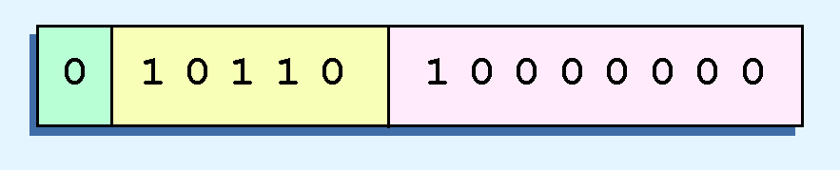
Textbook Floating-Point Model: Example 1
Express 32₁₀ in the revised textbook model.
We know that 32 is 2⁵
In binary scientific notation: 32 = 1.0 x 2⁵
Normalizing: 32 = 0.1 x 2⁶.
Decide the three fields:
Sign Field: Set to 0.
Exponent Field: add 16 to 6, giving 22₁₀ (=10110₂).
Significand Field: Set to 1 and append necessary 0’s to the right.

Slide 27

Textbook Floating-Point Model: Example 2
Express 0.0625₁₀ in the textbook model.
We know that 0.0625 is 2⁻⁴.
In binary scientific notation: 0.0625 = 1.0 x 2⁻⁴
Normalizing: 0.0625 = 0.1 x 2 ⁻³.
Decide the three fields:
Sign Field: Set to 0.
Exponent Field: add 16 to -3, giving 13₁₀ (=01101₂).
Significand Field: Set to 1 and append necessary 0’s to. the right.

Slide 28

Textbook Floating-Point Model: Example 3
Express -26.625₁₀ in the textbook model.
We find 26.625₁₀ = 11010.101₂.
In binary scientific notation: 26.625₁₀ = 11010.101 x 2⁰
Normalizing: 26.625₁₀ = 0.11010101 x 2 ⁵.
Decide the three fields:
Sign Field: Set to 1 (since the number is negative).
Exponent Field: add 16 to 5, giving 21₁₀ (=10101₂).
Significand Field: Set to 11010101 (append no 0’s).

Slide 29
Floating-Point Representation: Exercise
Express the following numbers in the textbook model.
0.03125
0.8125
18.5
1/16
-9.25
-6 5/8

Slide 30
Floating-Point Representation: Exercise
Each of the following is the binary representation of a decimal number in the textbook model. Find these decimal numbers.
0 01100 10000000
0 10000 11010000
0 10101 10010100
0 01101 10000000
1 10100 10010100
1 10011 11010100

Slide 31
IEEE-754 Single Precision Floating-Point Standard
Sign: 1 bit
Exponent: 8 bits
Significand: 23 bits
Bias: 127

Slide 32


IEEE-754 Single Precision Floating-Point Standard
Given the IEEE-754 single precision representation of a decimal number N, we compute the decimal value of N using:
where

Slide 33
IEEE-754 Single Precision Standard: Special Values
An exponent of 255 (11111111) indicates a special value:
If the significand is zero, the value is ± infinity.
If the significand is nonzero, the value is NaN, “not a number,” often used to flag an error condition.
If the exponent is 0 (00000000), then the value of the decimal number N is computed as follows:
N = (-1)^{Sign} × 0.Significand × 2⁻¹²⁶
33
Notes:
33

Slide 34
IEEE-754 Single Precision Standard: Example
Express the following numbers using the IEEE-754 Single Precision Standard.
0.03125: 0 100000010 00000000000000000000000
0.8125: 0 100000000 10100000000000000000000
-6 5/8: 1 100000010 10101000000000000000000

Slide 35
IEEE-754 Single Precision Standard: Exercise
Express the following numbers using the IEEE-754 Single Precision Standard.
0.0625
-26.625
35
Notes:
35

Slide 36
IEEE-754 Single Precision Standard: Example
Each of the following is the binary representation of a decimal number in the IEEE-754 Single Precision Standard. Find these decimal numbers.
0 01111011 00000000000000000000000 (.0625)
0 10000011 00101000000000000000000 (18.5)
0 01111011 00000000000000000000000 (1/16)
1 10000001 00010100000000000000000 (-9.25)

Slide 37
IEEE-754 Single Precision Standard: Exercise
Each of the following is the binary representation of a decimal number in the IEEE-754 Single Precision Standard. Find these decimal numbers.
0 00000000 00001000000000000000000 (2⁻¹³¹)
0 11111110 11111111111111111111111 (2¹²⁸)
1 00000000 00000000000000000000001 (-2⁻¹⁴⁹)

Slide 38
IEEE-754 Double Precision Floating-Point Standard
The IEEE-754 double precision floating point standard uses 64 bits:
Sign: 1 bit
Exponent: 11 bits
Significand: 52 bits
It uses bias of 1023 over its 11-bit exponent

Slide 39

IEEE-754 Double Precision Floating-Point Standard
Given the IEEE-754 double precision representation of a decimal number N using, we compute the decimal value of N using:
where

Slide 40
IEEE-754 Double Precision Floating-Point Standard
An exponent of 2047 (11111111111) indicates a special value.
If the significand is zero, the value is ± infinity.
If the significand is nonzero, the value is NaN, “not a number,” often used to flag an error condition.
If the exponent is 0 (00000000000) then
N = (-1)^{Sign} × 0.Significand × 2⁻¹⁰²²
40
Notes:
40

Slide 41
Floating-Point Representation
Both the 14-bit model that we have presented and the IEEE-754 floating point standard allow two representations for zero.
Zero is indicated by all zeros in the exponent and the significand, but the sign bit can be either 0 or 1.
This is why programmers should avoid testing a floating-point value for equality to zero.
Negative zero does not equal positive zero.

Slide 42
Floating-Point Arithmetic
Floating-point addition and subtraction are done using methods analogous to how we perform calculations using pencil and paper.
The first thing that we do is express both operands in the same exponential power, then add the numbers, preserving the exponent in the sum.
If the exponent requires adjustment, we do so at the end of the calculation.

Slide 43
Floating-Point Arithmetic
To add
1.5 x 10 ² + 3.5 x 10 ³
Change one of the numbers so that both of them are expressed in the same power of the base
Then add the numbers, preserving the exponent in the sum.
43
Notes:
43

Slide 44
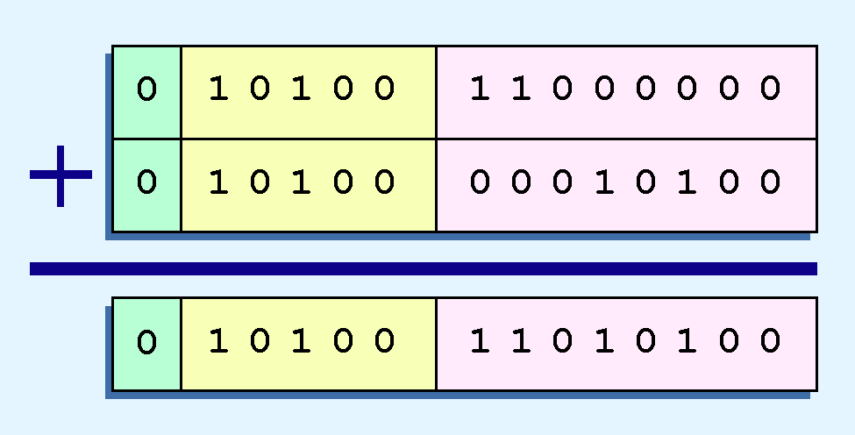
Floating-Point Arithmetic: Example
Find the sum of 12₁₀ and 1.25₁₀ using the 14-bit floating-point model.
We find
12₁₀ = 0.1100 x 2 ⁴.
1.25₁₀ = 0.101 x 2 ¹ = 0.000101 x 2 ⁴.
Thus, our sum is: 0.110101 x 2 ⁴.

Slide 45
Floating-Point Arithmetic: Exercise
Add the following binary numbers as represented in a normalized 14-bit format, using the revised simple model with a bias of 16:
0 10010 11001000 + 0 10000 10011010
(0 10010 11101110)
45
Notes:
45

Slide 46
Floating-Point Arithmetic
Floating-point multiplication is also carried out in a manner akin to how we perform multiplication using pencil and paper.
We multiply the two operands and add their exponents.
If the exponent requires adjustment, we do so at the end of the calculation.

Slide 47
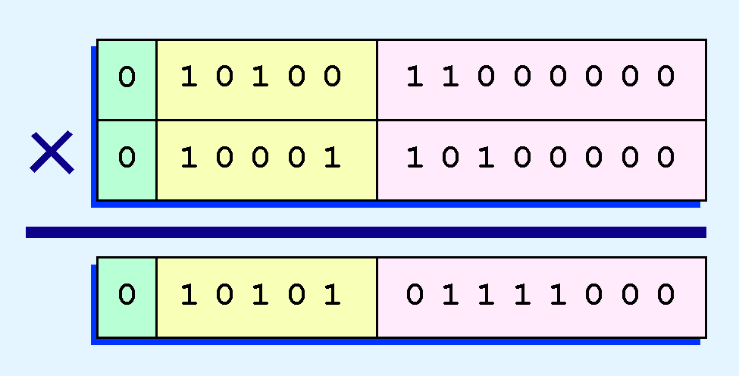
Floating-Point Representation
Example:
Find the product of 12₁₀ and 1.25₁₀ using the 14-bit floating-point model.
We find 12₁₀ = 0.1100 x 2 ⁴. And 1.25₁₀ = 0.101 x 2 ¹.
Thus, our product is 0.0111100 x 2 5 = 0.1111 x 2 4.
The normalized product requires an exponent of 22₁₀ = 10110₂.

Slide 48
Floating-Point Arithmetic: Exercise
Multiply the following binary numbers as represented in a normalized 14-bit format, using the revised simple model with a bias of 16:
0 10010 11001000 × 0 10000 10011010
(0 10001 11110000)
48
Notes:
48

Slide 49
Section 2.5 – End
49
Notes:
49

Slide 50
Chapter 2
2.1 Introduction
2.2 Positional Number Systems
2.3 Decimal to Binary Conversions
2.4 Signed Integer Representation
2.5 Floating-Point Representation
2.6 Character Codes
50
Notes:
50

Slide 51
Character Codes
ASCII (American Standard Code for Information Interchange)
ASCII is a 128 character set
ASCII is a 7-bit representation
51
Notes:
51

Slide 52
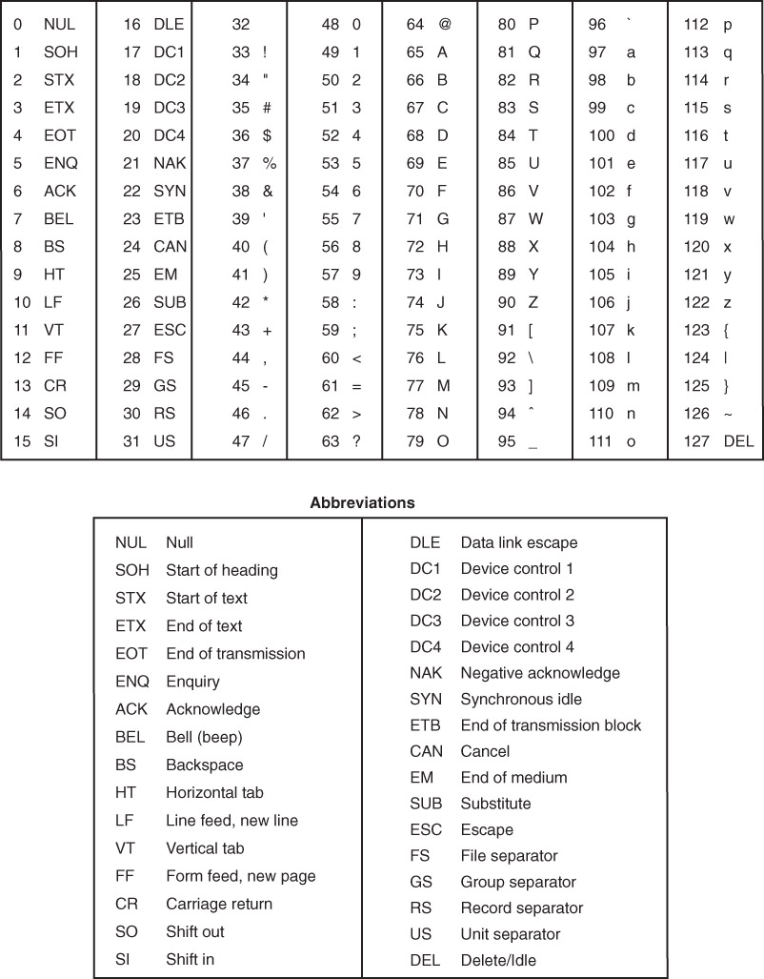
ASCII

Slide 53
Character Codes
Many of today’s systems embrace Unicode, a 16-bit system that can encode the characters of every language in the world.
The Java programming language, and some operating systems now use Unicode as their default character code.
The Unicode codespace is divided into six parts. The first part is for Western alphabet codes, including English, Greek, and Russian.
53
Notes:
53

Slide 54
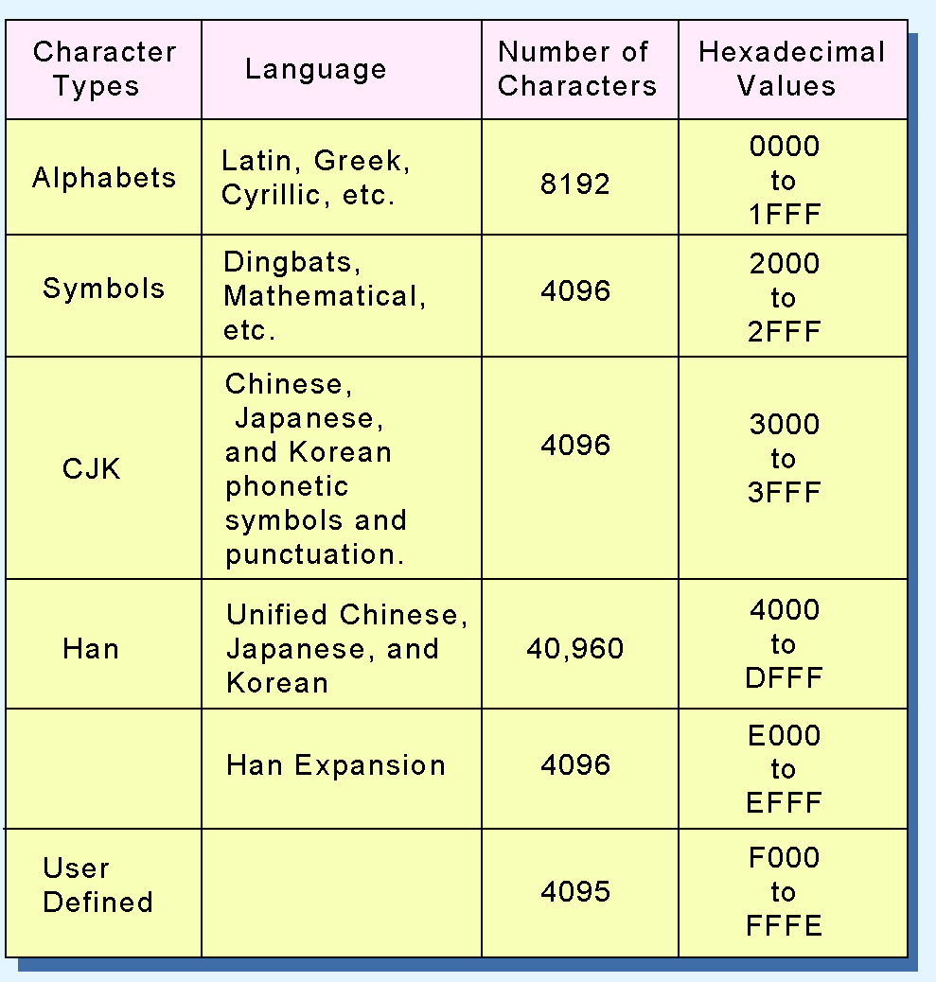
Character Codes
The Unicode codes- pace allocation is shown at the right.
The lowest-numbered Unicode characters comprise the ASCII code.
The highest provide for user-defined codes.
54
Notes:
54

Slide 55
Section 2.6 & Chapter 2 – End
55
Notes:
55

