Slide 1

Chapter 3
Boolean Algebra and Digital Logic

Slide 2
Chapter 3
3.1 Introduction
3.2 Boolean Algebra
3.3 Logic Gates
3.4 Digital Components
3.5 Combinational Circuits
3.6 Sequential Circuits
2
Notes:
2

Slide 3
Section 3.1
Introduction

Slide 4
Introduction
In the latter part of the nineteenth century, George Boole incensed philosophers and mathematicians alike when he suggested that logical thought could be represented through mathematical equations.
How dare anyone suggest that human thought could be encapsulated and manipulated like an algebraic formula?
Computers, as we know them today, are implementations of Boole’s Laws of Thought.
John Atanasoff and Claude Shannon were among the first to see this connection.
4
Notes:
4

Slide 5
Introduction
In the middle of the twentieth century, computers were commonly known as “thinking machines” and “electronic brains.”
Many people were fearful of them.
Nowadays, we rarely ponder the relationship between electronic digital computers and human logic. Computers are accepted as part of our lives.
Many people, however, are still fearful of them.
In this chapter, you will learn the simplicity that constitutes the essence of the machine.
5
Notes:
5

Slide 6
Section 3.1 – End
6
Notes:
6

Slide 7
Chapter 3
3.1 Introduction
3.2 Boolean Algebra
3.3 Logic Gates
3.4 Digital Components
3.5 Combinational Circuits
3.6 Sequential Circuits
7
Notes:
7

Slide 8
Section 3.2
Boolean Algebra

Slide 9
Boolean Algebra
Boolean algebra is a mathematical system for the manipulation of variables that can have one of two values.
In formal logic, these values are “true” and “false.”
In digital systems, these values are “on” and “off,” 1 and 0, or “high” and “low.”
9
Notes:
9

Slide 10
Boolean Expressions
Boolean expressions are created by performing operations on Boolean variables.
Common Boolean operators include AND, OR, and NOT.
A Boolean operator can be completely described using a truth table.
10
Notes:
10

Slide 11
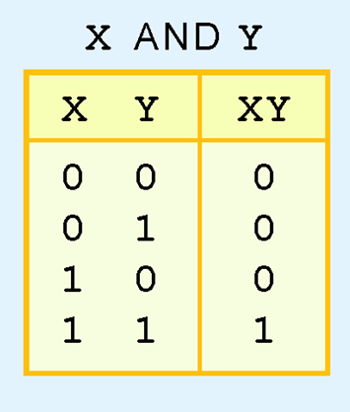
Boolean Operators: AND
The truth table for the Boolean operator AND is shown at the right.
The AND operator is also known as a Boolean product
We write X·Y or XY for X AND Y
11
Notes:
11

Slide 12
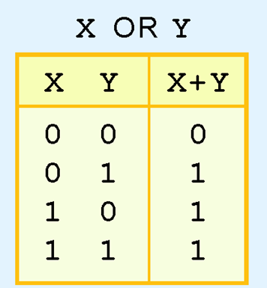
Boolean Operators: OR
The truth table for the Boolean operator OR is shown at the right.
The OR operator is the Boolean sum.
We write X + Y for X OR Y
12
Notes:
12

Slide 13
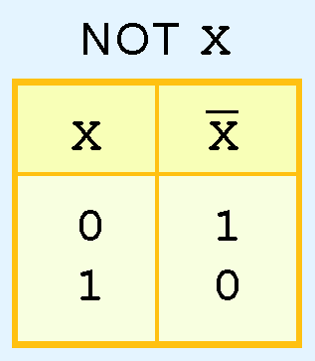
Boolean Operators: NOT
The truth table for the Boolean NOT operator is shown at the right.
The NOT operation is most often designated by an over bar. It is sometimes indicated by a prime mark ( ‘ ) or an “elbow” (¬).
13
Notes:
13

Slide 14
Boolean Functions
A Boolean function has:
At least one Boolean variable,
At least one Boolean operator, and
At least one input from the set {0,1}.
It produces an output that is also a member of the set {0,1}.
A Boolean function is also represented using a truth table

Slide 15
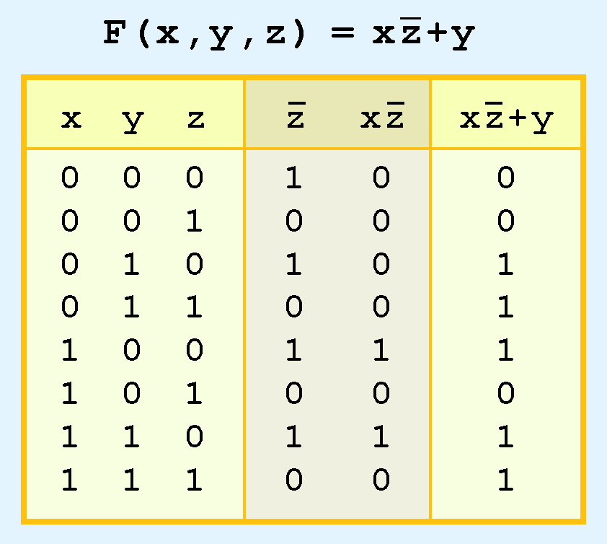
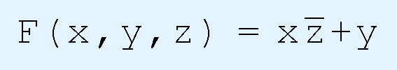
Boolean Functions: Example
The truth table for the Boolean function:
is shown at the right.
To make evaluation of the Boolean function easier, the truth table contains extra (shaded) columns to hold evaluations of subparts of the function.

Slide 16
Boolean Operators: Precedence
As with common arithmetic, Boolean operations have rules of precedence.
The NOT operator has highest priority, followed by AND and then OR.
This is how we chose the (shaded) function subparts in our table.

Slide 17

Boolean Expressions: Example
Construct a truth table for the following:
17
Notes:
17

Slide 18


Boolean Expressions: Exercises
Construct a truth table for each of the following expressions:
18
Notes:
18

Slide 19
Boolean Identities
Digital computers contain circuits that implement Boolean functions.
The simpler that we can make a Boolean function, the smaller the circuit that will result.
Simpler circuits are cheaper to build, consume less power, and run faster than complex circuits.
With this in mind, we always want to reduce our Boolean functions to their simplest form.
There are a number of Boolean identities that help us to do this.

Slide 20
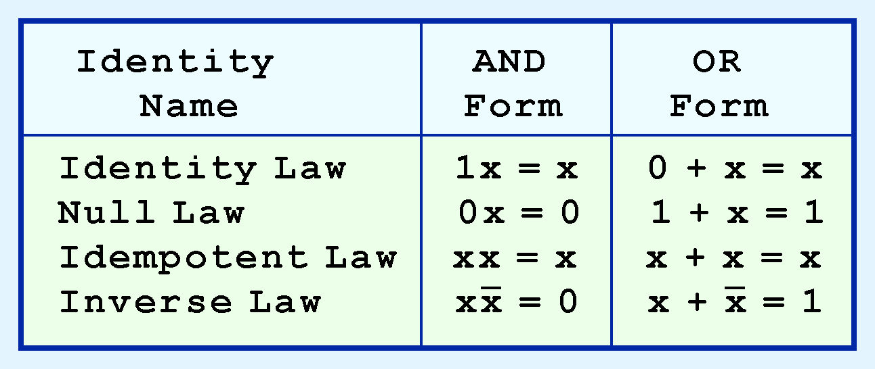
Boolean Identities
Most Boolean identities have an AND (product) form as well as an OR (sum) form. We give our identities using both forms. Our first group is rather intuitive:

Slide 21
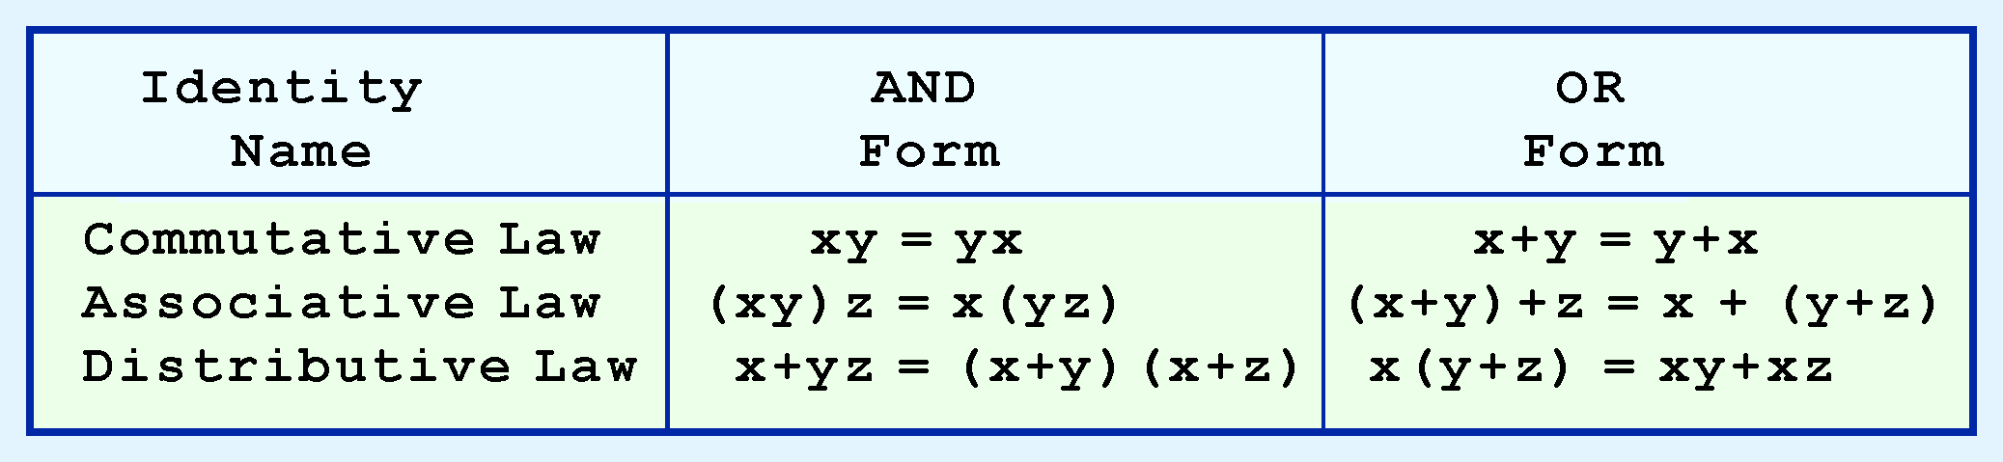
Boolean Identities
Our second group of Boolean identities should be familiar to you from your study of algebra:

Slide 22
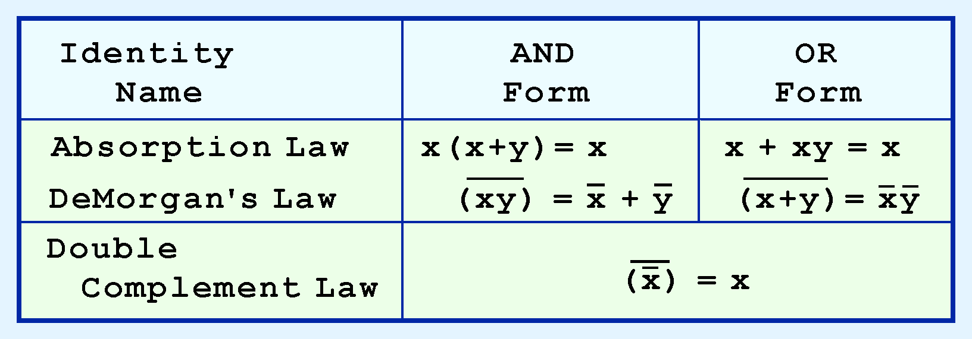
Boolean Identities
Our last group of Boolean identities are perhaps the most useful.

Slide 23

Simplification of Boolean Expressions: Example 1
Simplify the following Boolean function:
Easy!
xy + yx = xy + xy (Commutative Law)
= xy (Idempotent Law)
23
Notes:
23

Slide 24

Simplification of Boolean Expressions: Example 2
Simplify the following Boolean function:
Not As Easy!
Distributive Law
Inverse Law
Identity Law
24
Notes:
24

Slide 25

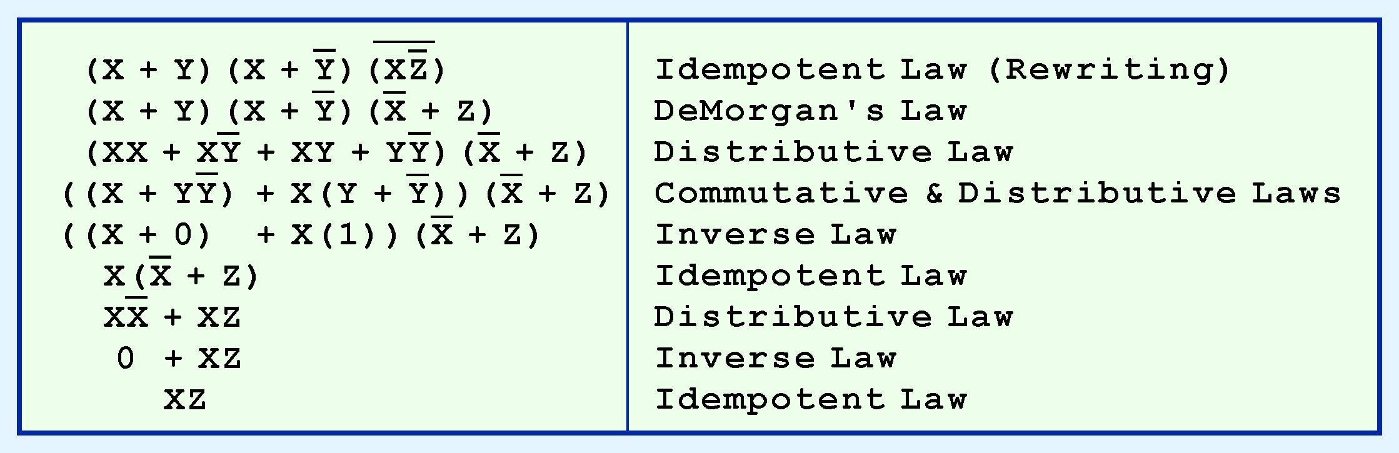
Simplification of Boolean Expressions: Example 3
Simplify:
Not Bad!
25
Notes:
25

Slide 26

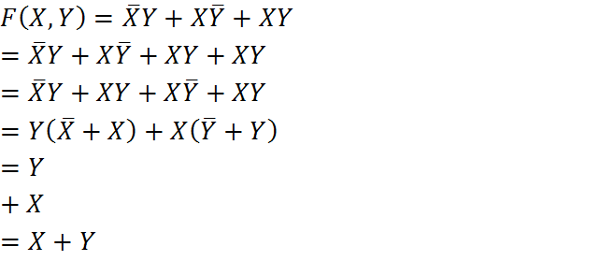
Simplification of Boolean Expressions: Example 4
Simplify the following Boolean function:
Tricky!
26
Notes:
26

Slide 27

Simplification of Boolean Expressions: Example 5
Simplify the following Boolean function:
Not easy at all!
Where/How do we start?
27
Notes:
27

Slide 28

Simplification of Boolean Expressions: Example 5
Identity Law :
Inverse Law:
Distributive Law
Commutative Law
Associative Law
Commutative Law
Distributive Law
Null Law, and finally, the Identity Law
28
Notes:
28

Slide 29
K-Maps
Simplification of Boolean functions leads to simpler (and usually faster) digital circuits.
Simplifying Boolean functions using identities is time-consuming and error-prone.
This special section presents an easy, systematic method for reducing Boolean expressions.

Slide 30
K-Maps
In 1953, Maurice Karnaugh was a telecommunications engineer at Bell Labs.
While exploring the new field of digital logic and its application to the design of telephone circuits, he invented a graphical way of visualizing and then simplifying Boolean expressions.
This graphical representation, now known as a Karnaugh map, or Kmap, is named in his honor.

Slide 31
K-Maps: Minterms
A Kmap is a matrix consisting of rows and columns that represent the output values of a Boolean function.
The output values placed in each cell are derived from the minterms of a Boolean function.
A minterm is a product term that contains all of the function’s variables exactly once, either complemented or not complemented.

Slide 32


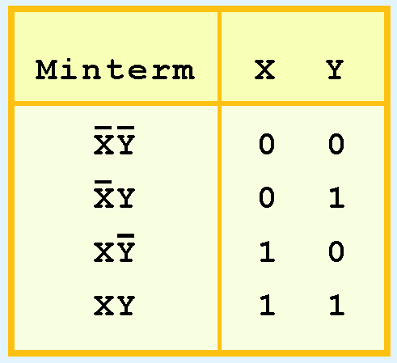
K-Maps: Minterms
For example, the minterms for a function having the inputs x and y are:
Consider the Boolean function,
Its minterms are:

Slide 33
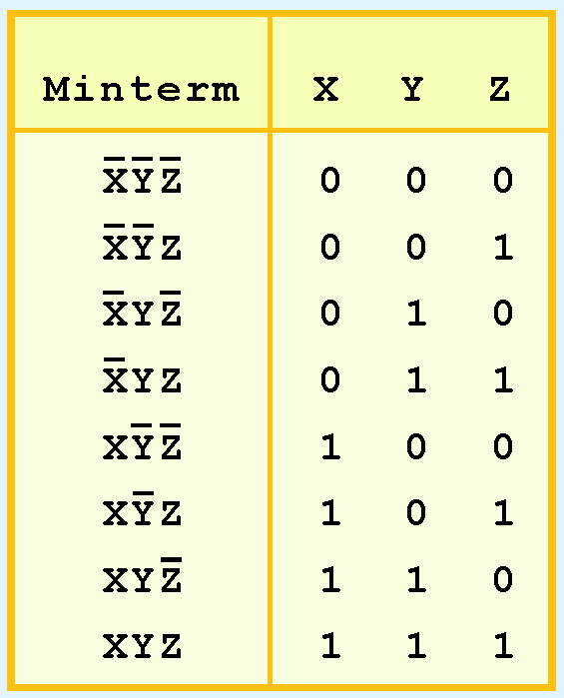
K-Maps: Description and Terminology
Similarly, a function having three inputs, has the minterms that are shown in this diagram.

Slide 34
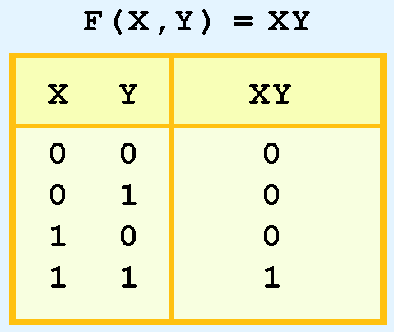
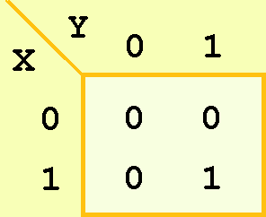
K-Maps: Description and Terminology
A Kmap has a cell for each minterm.
This means that it has a cell for each line for the truth table of a function.
The truth table for the function F(x,y) = xy is shown at the right along with its corresponding Kmap.

Slide 35
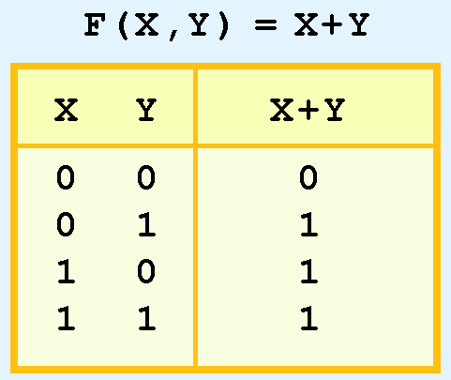
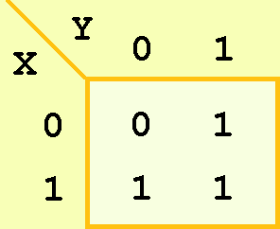

K-Maps: Description and Terminology
As another example, we give the truth table and KMap for the function, F(x,y) = x + y at the right.
This function is equivalent to the OR of all of the minterms that have a value of 1. Thus:

Slide 36
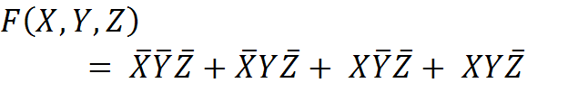
K-Maps: Example
Give the truth table and Kmap for each of the following Boolean functions:
36
Notes:
36

Slide 37

K-Maps: Exercise
Give the truth table and Kmap for the following Boolean function:
37
Notes:
37

Slide 38
K-Maps: Simplification for Two Variables
Of course, the minterm function that we derived from our Kmap was not in simplest terms!
Simplify the above!
That’s what we started with in this example.

Slide 39
K-Maps: Simplification for Two Variables
We can, however, reduce our complicated expression to its simplest terms by finding adjacent 1s in the Kmap that can be collected into groups that are powers of two.
In our example, we have two such groups.
Can you find them?

Slide 40
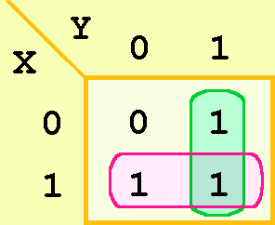
K-Maps: Simplification for Two Variables
The best way of selecting two groups of 1s form our simple Kmap is shown below.
We see that both groups are powers of two and that the groups overlap.

Slide 41
K-Maps: Simplification Rules
Groupings can contain only 1s; no 0s.
Groups can be formed only at right angles; diagonal groups are not allowed.
The number of 1s in a group must be a power of 2 (even if it contains a single 1).
The groups must be made as large as possible.
Groups can overlap and wrap around the sides of the Kmap.

Slide 42
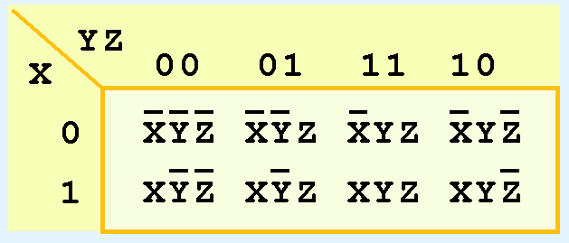
K-Maps: Simplification for Three Variables
A Kmap for three variables is constructed as shown in the diagram below.

Slide 43
K-Maps: Simplification for Three Variables
Notice that each minterm is placed in the cell that will hold its value.
Also, notice that the values for the yz combination at the top of the matrix form a pattern that is not a normal binary sequence.

Slide 44
K-Maps: Simplification for Three Variables
Thus, the first row of the Kmap contains all minterms where x has a value of zero.
The first column contains all minterms where y and z both have a value of zero.

Slide 45
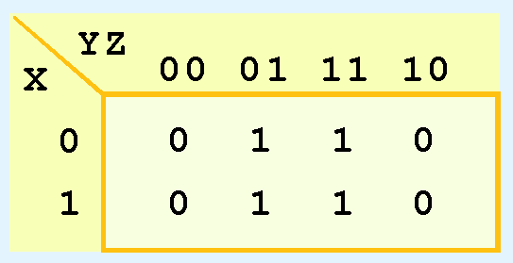
K-Maps: Simplification for Three Variables
Consider the function:
Its Kmap is:
What is the largest group of 1s that is a power of 2?

Slide 46
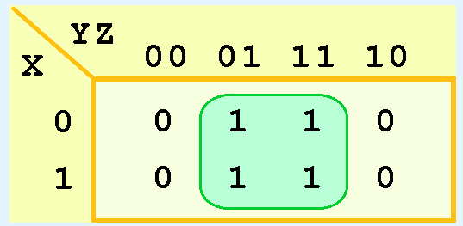
K-Maps: Simplification for Three Variables
Here it is!
What does this group tell us?
Now what? How do we reduce?

Slide 47
K-Maps: Simplification for Three Variables
This means that the function,
reduces to F(x) = z.
You could verify this reduction with identities or a truth table.

Slide 48
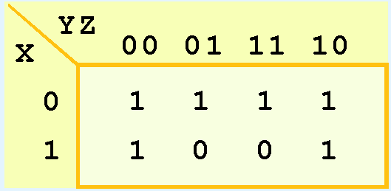
K-Maps: Simplification for Three Variables
Now for a more complicated Kmap. Consider the function:
Its Kmap is shown below. There are (only) two groupings of 1s. Can you find them?

Slide 49
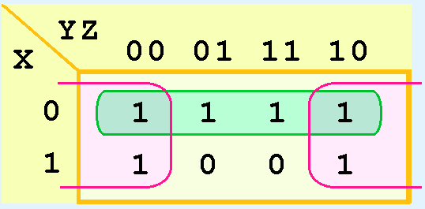
K-Maps: Simplification for Three Variables
In this Kmap, we see an example of a group that wraps around the sides of a Kmap.
What does each group tell us?

Slide 50
K-Maps: Simplification for Three Variables
The pink group tells us that only the value of Z is significant in that group
We see that Z is complemented in those columns
The green group in the top row tells us that only the value of X is significant in that group.
We see that it is complemented in that row

Slide 51

K-Maps: Simplification for Three Variables
Each group produces one term in the reduced function.
Our reduced function is:
Recall that we had six minterms in our original function!

Slide 52
K-Maps: Simplification Example
Simplify each of the following Boolean functions using Kmaps:
52
Notes:
52

Slide 53
K-Maps: Simplification Exercise
Simplify the following Boolean function using Kmaps:
53
Notes:
53

Slide 54
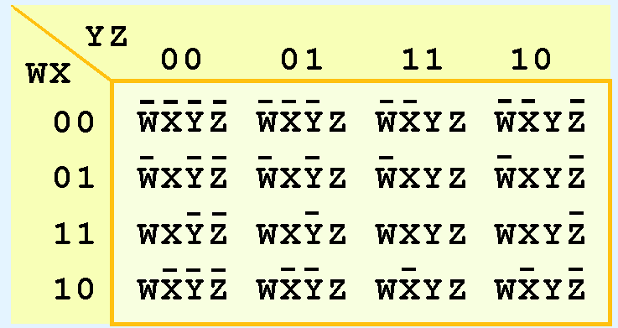
K-Maps: Simplification for Four Variables
Our model can be extended to accommodate the 16 minterms that are produced by a four-input function.
This is the format for a 16-minterm Kmap.

Slide 55
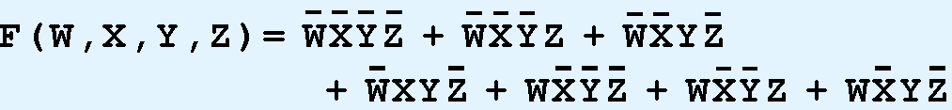
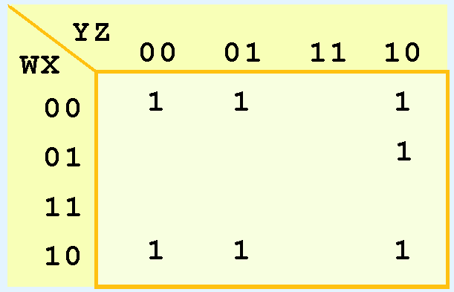
K-Maps: Simplification for Four Variables
We have populated the Kmap shown below with the nonzero minterms from the function:
Can you identify (only) three groups in this Kmap?
Recall that groups can overlap.

Slide 56
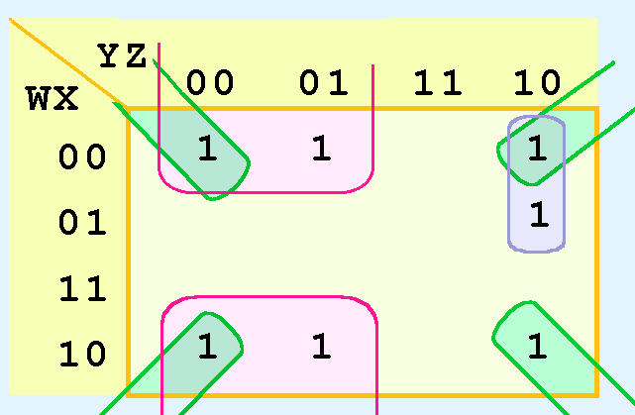
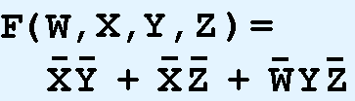
K-Maps: Simplification for Four Variables
Our three groups consist of:
A purple group entirely within the Kmap at the right.
A pink group that wraps the top and bottom.
A green group that spans the corners.
Thus we have three terms in our final function:

Slide 57
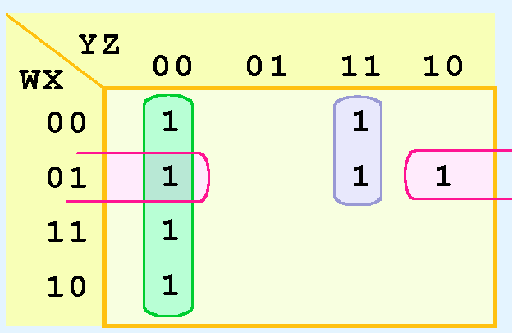
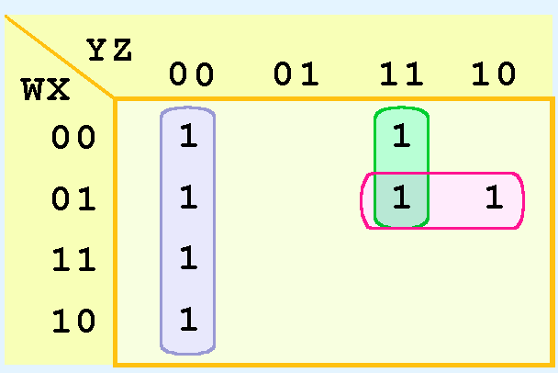
K-Maps: Simplification for Four Variables
It is possible to have a choice as to how to pick groups within a Kmap, while keeping the groups as large as possible.
The (different) functions that result from the groupings below are logically equivalent.

Slide 58
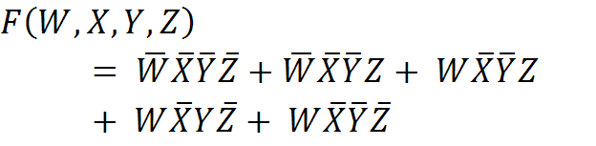
K-Maps: Simplification Example
Simplify the following Boolean function using Kmaps:
58
Notes:
58

Slide 59
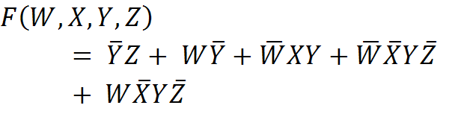
K-Maps: Simplification Exercise
Simplify the following Boolean function using Kmaps:
59
Notes:
59

Slide 60
K-Maps: Don’t Care Conditions
Real circuits don’t always need to have an output defined for every possible input.
For example, some calculator displays consist of 7-segment LEDs. These LEDs can display 2 ⁷ -1 patterns, but only ten of them are useful.
If a circuit is designed so that a particular set of inputs can never happen, we call this set of inputs a don’t care condition.
They are very helpful to us in Kmap circuit simplification.

Slide 61
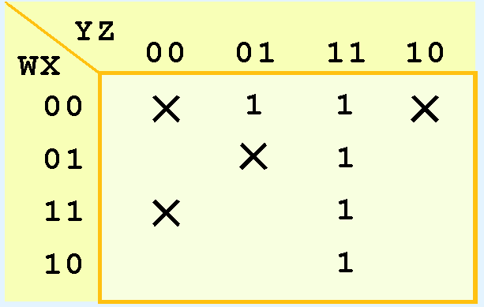
K-Maps: Don’t Care Conditions
In a Kmap, a don’t care condition is identified by an X in the cell of the minterm(s) for the don’t care inputs, as shown below.
In performing the simplification, we are free to include or ignore the X’s when creating our groups.

Slide 62

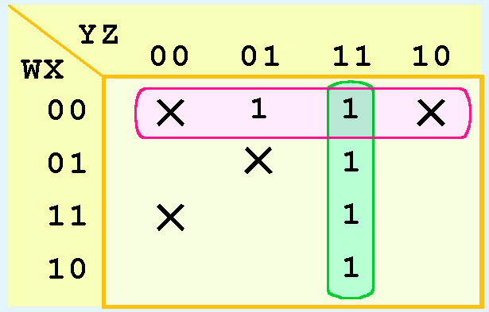
K-Maps: Don’t Care Conditions
In one grouping in the Kmap below, we have the function:

Slide 63

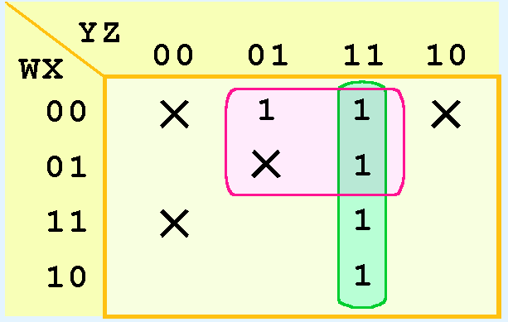
K-Maps: Don’t Care Conditions
A different grouping gives us the function:

Slide 64
K-Maps: Don’t Care Conditions
The truth table of:
is different from the truth table of:
However, the values for which they differ, are the inputs for which we have don’t care conditions.

Slide 65
K-Maps: Conclusion
Recapping the rules of Kmap simplification:
Groupings can contain only 1s; no 0s.
Groups can be formed only at right angles; diagonal groups are not allowed.
The number of 1s in a group must be a power of 2 – even if it contains a single 1.
The groups must be made as large as possible.
Groups can overlap and wrap around the sides of the Kmap.
Use don’t care conditions when you can.

Slide 66
Complements
Sometimes it is more economical to build a circuit using the complement of a function (and complementing its result) than it is to implement the function directly.
DeMorgan’s law provides an easy way of finding the complement of a Boolean function.

Slide 67
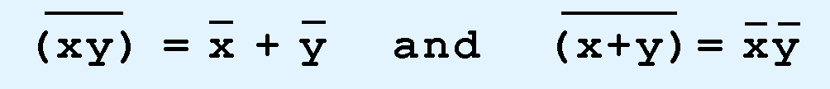
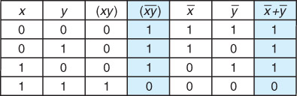
Complements: DeMorgan’s Laws
Recall DeMorgan’s laws state:
The truth table for the AND Form of DeMorgan’s Law

Slide 68
Complements: DeMorgan’s Laws
DeMorgan’s law can be extended to any number of variables.
Replace each variable by its complement and change all ANDs to ORs and all ORs to ANDs.
68
Notes:
68

Slide 69


Complements: Example 1
The complement of the following Boolean function:
is:
69
Notes:
69

Slide 70
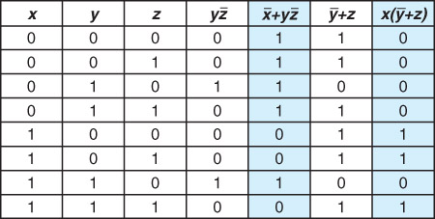
Complements: Example 1 Continued
The truth table for the function F on the previous slide and its complement:
70
Notes:
70

Slide 71
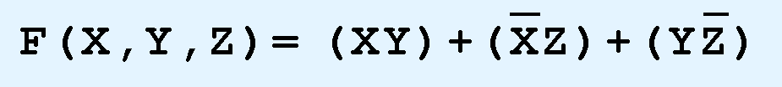
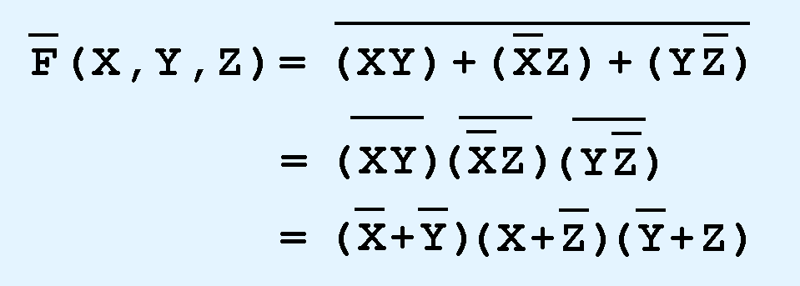
Complements: Example 2
Find the complement of the following Boolean function:
Complement is:
71
Notes:
71

Slide 72
Representing Boolean Functions
Through our exercises in simplifying Boolean expressions, we see that there are numerous ways of stating the same Boolean expression.
These “synonymous” forms are logically equivalent.
Logically equivalent expressions have identical truth tables.
In order to eliminate as much confusion as possible, designers express Boolean functions in standardized or canonical form.

Slide 73
Representing Boolean Functions
There are two canonical forms for Boolean expressions:
sum-of-product
product-of-sums
Recall
Boolean product is the AND operation
Boolean sum is the OR operation.

Slide 74
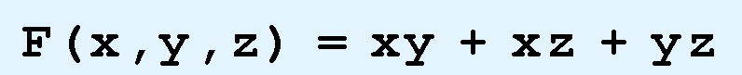
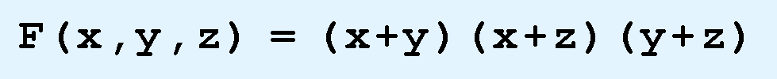
Representing Boolean Functions: Example
In the sum-of-products form, ANDed variables are ORed together:
In the product-of-sums form, ORed variables are ANDed together:
74
Notes:
74

Slide 75
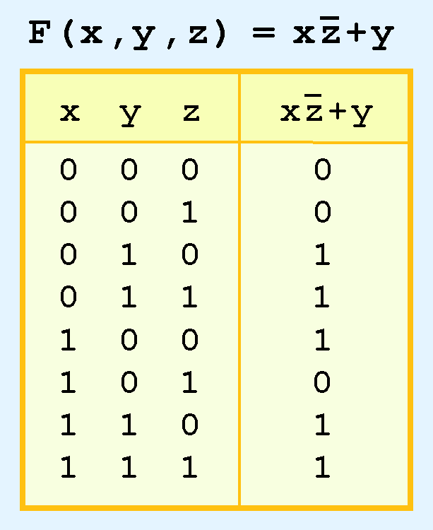
Representing Boolean Functions
It is easy to convert a function to sum-of-products form using its truth table.
We are interested in the values of the variables that make the function true (=1).
Using the truth table, we list the values of the variables that result in a true function value.
Each group of variables is then ORed together.

Slide 76
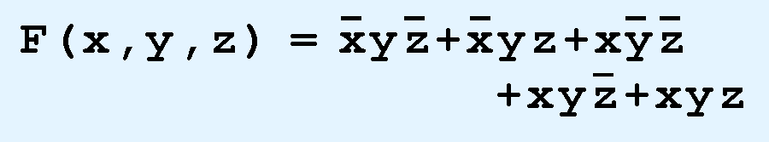
Representing Boolean Functions
The sum-of-products form for our function is:
We note that this function is not in simplest terms. Our aim is only to rewrite our function in canonical sum-of-products form.

Slide 77
Section 3.2 – End
77
Notes:
77

