Slide 1
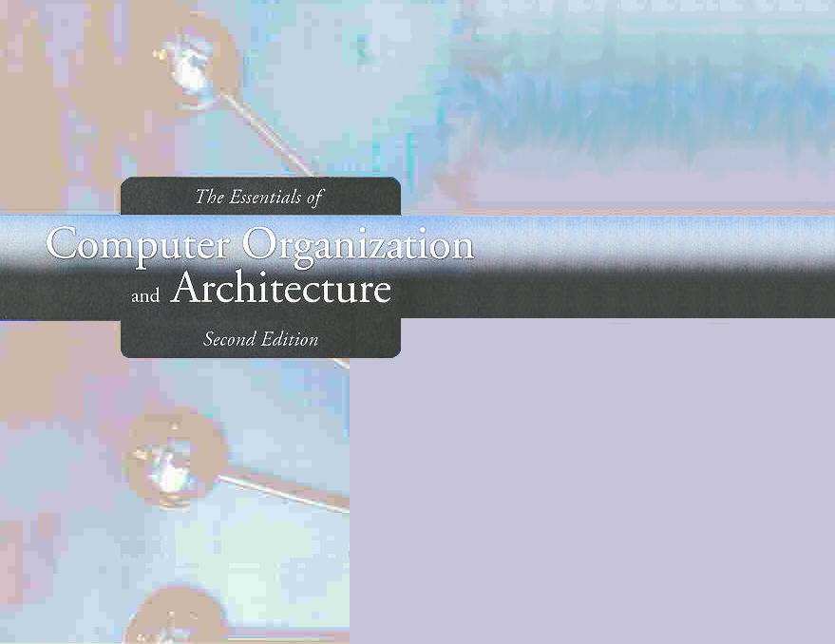
Chapter 3
Boolean Algebra and Digital Logic

Slide 2
Chapter 3
3.1 Introduction
3.2 Boolean Algebra
3.3 Logic Gates
3.4 Digital Components
3.5 Combinational Circuits
3.6 Sequential Circuits
2
Notes:
2

Slide 3
Section 3.3
Logic Gates

Slide 4
Logic Gates
We have looked at Boolean functions in abstract terms.
In this section, we see that Boolean functions are implemented in digital computer circuits called gates.
Gates implement each of the basic logic functions discussed earlier
Gates are building blocks for digital design

Slide 5
Logic Gates
A gate is an electronic device that produces a result based on two or more input values.
In reality, gates consist of one to six transistors, but digital designers think of them as a single unit.
Integrated circuits contain collections of gates suited to a particular purpose.

Slide 6
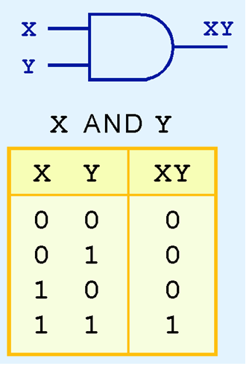
Symbols for Logic Gates: The AND Gate
The symbol and truth table of the AND gate are shown to the right
The AND gate corresponds directly to its respective Boolean operation, as you can see by its truth tables

Slide 7
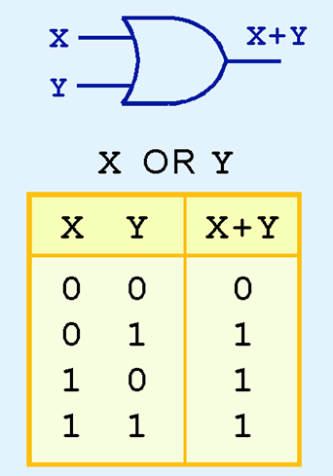
Symbols for Logic Gates: The OR Gate
The symbol and truth table of the OR gate are shown to the right
The OR gate corresponds directly to its respective Boolean operation, as you can see by its truth tables

Slide 8
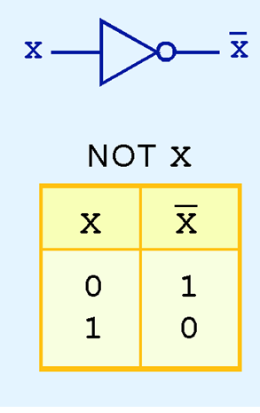
Symbols for Logic Gates: The NOT Gate
The symbol and truth table of the NOT gate are shown to the right
The NOT gate corresponds directly to its respective Boolean operation, as you can see by its truth tables

Slide 9
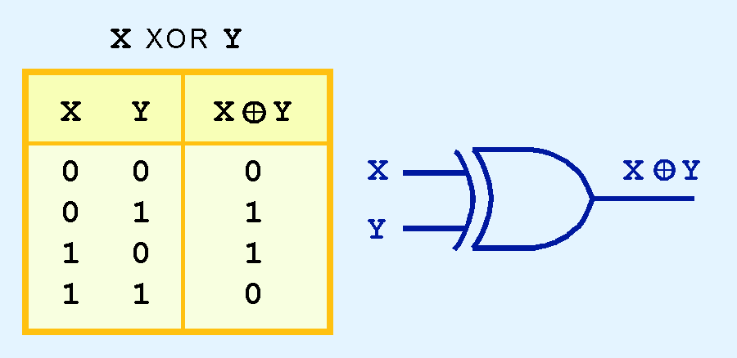
Symbols for Logic Gates: The XOR Gate
Another very useful gate is the exclusive OR (XOR) gate.
The output of the XOR operation is true only when the values of the inputs differ.
Note the special symbol ⊕ for the XOR operation.

Slide 10
Universal Gates
Two very important gates are called the NAND and NOR gates
They produce complementary output to AND and OR, respectively
They are inexpensive to manufacture
Any Boolean function can be constructed using only NAND or only NOR gates. Thus, they are known as universal gates

Slide 11
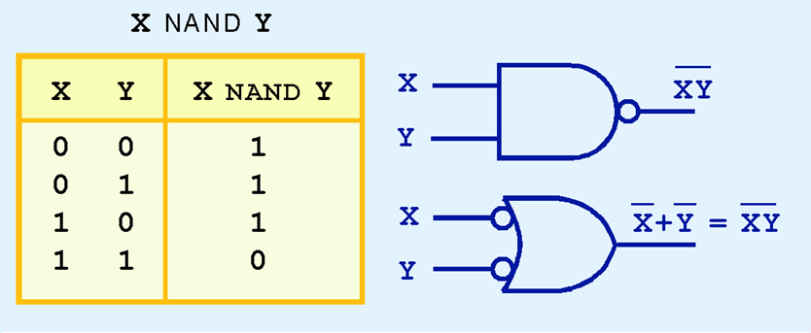
Universal Gates: NAND
The symbols and truth table of the NAND gate are shown below

Slide 12
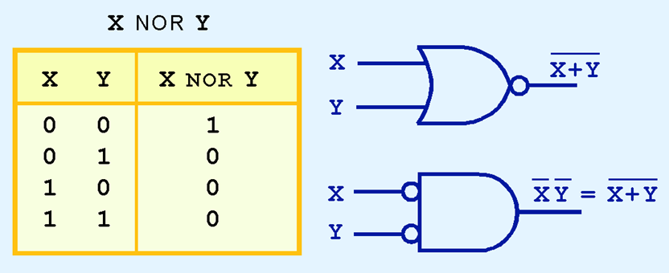
Universal Gates: NOR
The symbols and truth table of the NOR gate are shown below

Slide 13
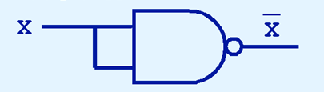
Universal Gates
Using only NAND gates to construct the NOT gate

Slide 14
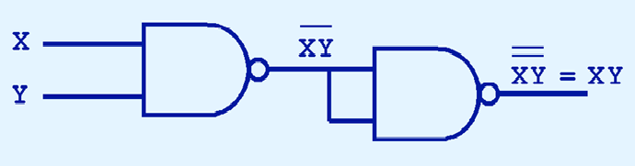
Universal Gates
Using only NAND gates to construct the AND gate

Slide 15
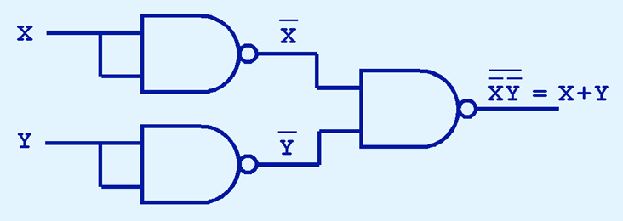
Universal Gates
Using only NAND gates to construct the OR gate

Slide 16
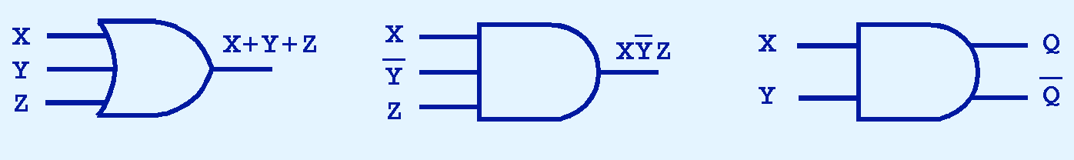
Logic Gates
Gates can have multiple inputs and more than one output.
A second output can be provided for the complement of the operation.
We’ll see more of this later.

Slide 17
Section 3.3 – End
17
Notes:
17

Slide 18
Chapter 3
3.1 Introduction
3.2 Boolean Algebra
3.3 Logic Gates
3.4 Digital Components
3.5 Combinational Circuits
3.6 Sequential Circuits
18
Notes:
18

Slide 19
Section 3.4
Digital Components

Slide 20
Digital Components
Computers are built using collections of gates
Gates are connected by way of wires
Wires act as signal pathways
The collection of gates is standard resulting in a set of building blocks that can be used to build the entire system
20
Notes:
20

Slide 21
Digital Circuits and Boolean Algebra
Boolean operations such as AND and OR can be represented by a simple logic gate
Representation of more complex Boolean expressions results in logic diagrams
21
Notes:
21

Slide 22
Logic Diagrams
Logic Diagrams represent the physical implementation of the given expressions
Logic Diagrams (which in turn leads to digital circuits) can be built for any Boolean expression
Every operation carried out by a computer is an implementation of a Boolean expression
22
Notes:
22

Slide 23

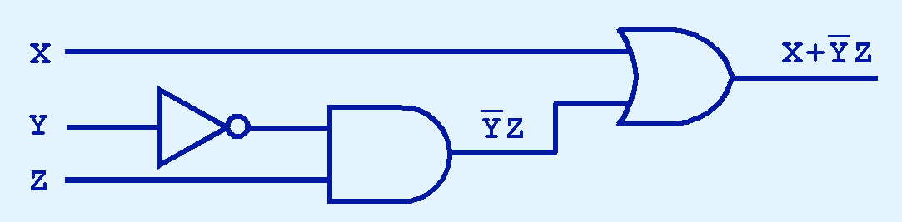
Logic Diagrams
The main thing to remember is that combinations of gates implement Boolean functions.
The circuit below implements the Boolean function:
We simplify our Boolean expressions so that we can create simpler circuits.

Slide 24
Integrated Circuits
Gates are not sold individually; they are sold in units called integrated circuits (ICs) or chips
A chip is an electronic device consisting of the necessary components (transistors, resistors, and capacitors) to implement various gates
24
Notes:
24

Slide 25
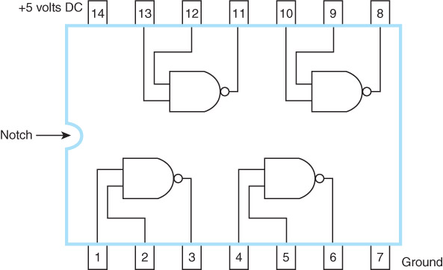
Integrated Circuits
25
Notes:
25

Slide 26
Section 3.4 – End
26
Notes:
26

