Slide 1

Chapter 3
Boolean Algebra and Digital Logic

Slide 2
Chapter 3
3.1 Introduction
3.2 Boolean Algebra
3.3 Logic Gates
3.4 Digital Components
3.5 Combinational Circuits
3.6 Sequential Circuits
2
Notes:
2

Slide 3
Section 3.5
Combinational Circuits
Notes:
3

Slide 4

Combinational Circuits
We have designed a circuit that implements the Boolean function:
This circuit is an example of a combinational logic circuit.
Combinational logic circuits produce a specified output (almost) at the instant when input values are applied.
In a later section, we will explore circuits where this is not the case.

Slide 5
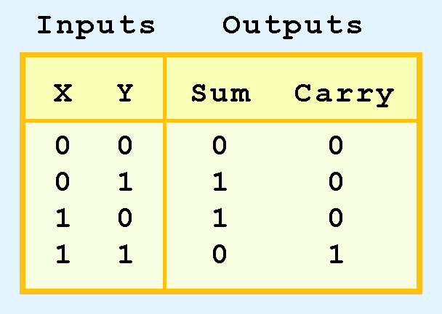
Typical Combinational Circuits: Half Adder
Combinational logic circuits give us many useful devices.
One of the simplest is the half adder, which finds the sum of two bits.
We can gain some insight as to the construction of a half adder by looking at its truth table, shown at the right.

Slide 6
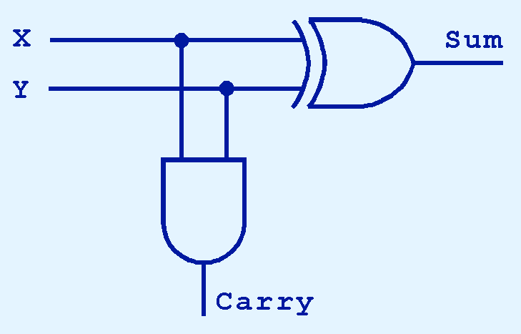
Typical Combinational Circuits: Half Adder
As we see, the sum can be found using the XOR operation and the carry using the AND operation.

Slide 7
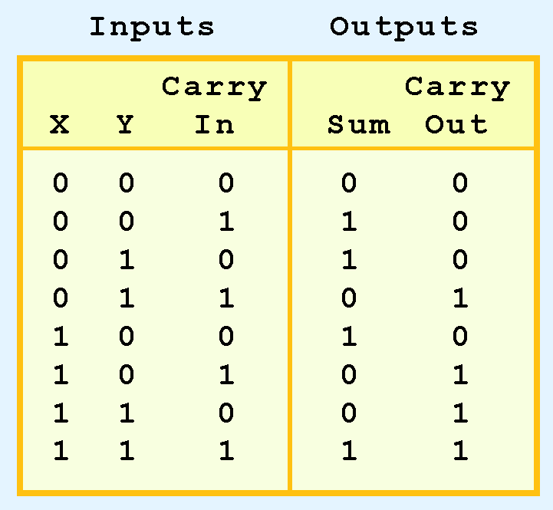
Typical Combinational Circuits: Full Adder
We can change our half adder into to a full adder by including gates for processing the carry bit.
The truth table for a full adder is shown at the right.

Slide 8
Typical Combinational Circuits: Full Adder
How can we change the half adder shown below to make it a full adder?

Slide 9
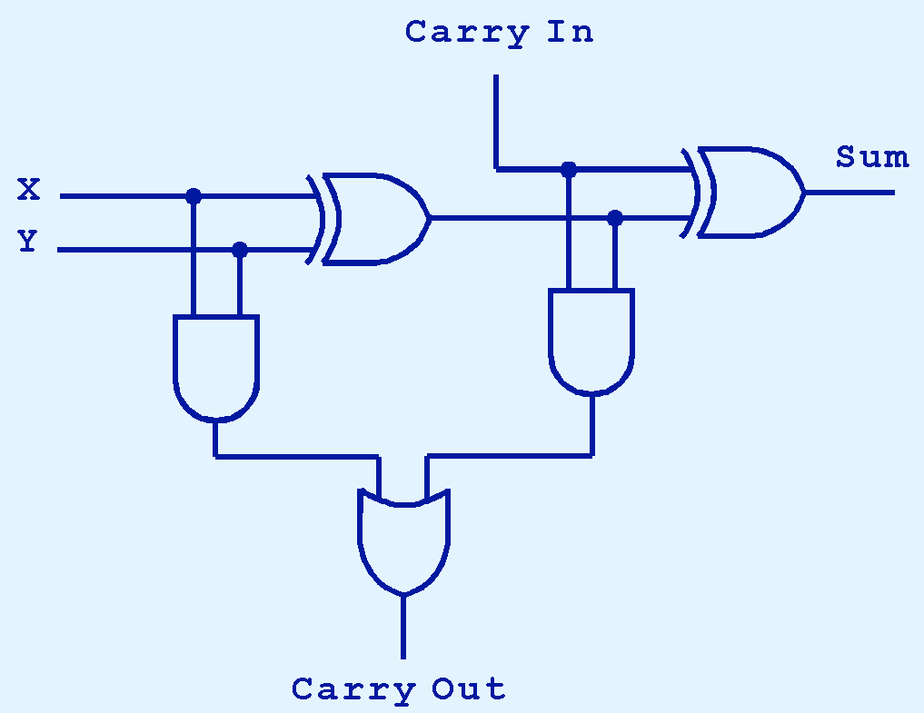
Typical Combinational Circuits: Full Adder
Here’s our completed full adder.

Slide 10

Typical Combinational Circuits: Full Adder
Just as we combined half adders to make a full adder, full adders can be connected in series.
The carry bit “ripples” from one adder to the next; hence, this configuration is called a ripple-carry adder.
Today’s systems employ more efficient adders.

Slide 11
Typical Combinational Circuits: Decoder
Adders are very important circuits
How useful a computer would be if it cannot add numbers?
An equally important operation that all computers use frequently is decoding binary information from a set of n inputs to a maximum of 2^{n} outputs
11
Notes:
11

Slide 12
Typical Combinational Circuits: Decoder
A decoder uses the inputs and their respective values to select one specific output line.
This means that one unique line is asserted (set to 1) while the other lines are set to 0

Slide 13
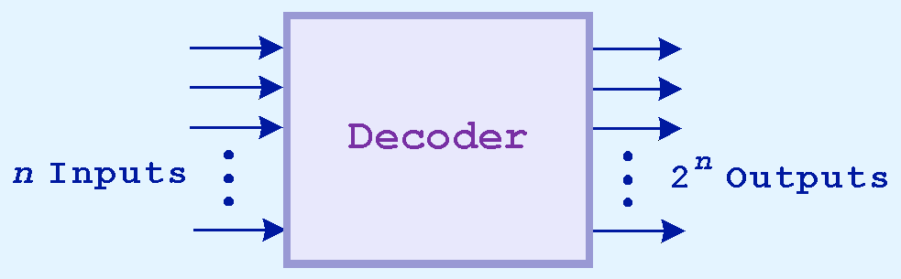
Typical Combinational Circuits: Decoder
Decoders are normally defined by the number of inputs and number of outputs (n-to-2^{n}):
2-to-4 3-to-8 4-to-16 decoders.

Slide 14
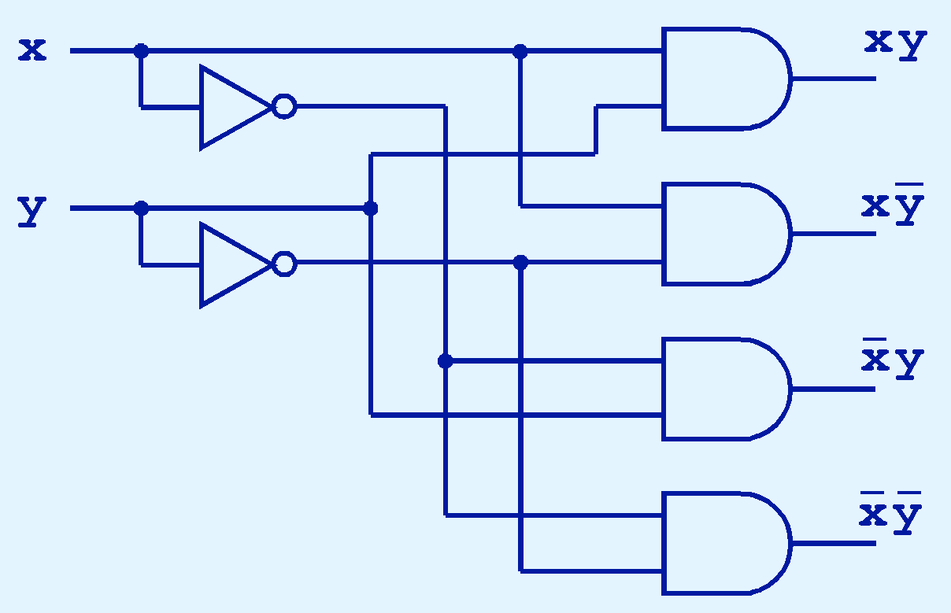
Typical Combinational Circuits: Decoder
This is what a 2-to-4 decoder looks like on the inside.
If x = 0 and y = 1, which output line is enabled?

Slide 15
Typical Combinational Circuits: Decoder (Application Example)
Among other things, decoders are useful in selecting a memory location according to a binary value placed on the address lines of a memory bus.
When given an address, a decoder is used to determine the chip to use
15
Notes:
15

Slide 16
Typical Combinational Circuits: Decoder (Application Example)
A memory consist of 8 chips. Each chip contains 8K bytes.
What is the size of this memory?
8 × 8K = 64K
16
Notes:
16

Slide 17
Typical Combinational Circuits: Decoder (Application Example)
How many bits are needed to represent each address?
64K = 2⁶ × 2¹⁰ = 2¹⁶
So, 16 bits are needed to represent each address
17
Notes:
17

Slide 18
Typical Combinational Circuits: Decoder (Application Example)
How many bits are needed to represent an address on a chip?
8K = 2³ × 2¹⁰ = 2¹³
So, 13 bits are needed to represent an address on a chip
18
Notes:
18

Slide 19
Typical Combinational Circuits: Decoder (Application Example)
What are the addresses on each chip?
Chip 0: 0 – 8191 0 – (2¹³-1)
Chip 1: 8192 – 16383
…
Chip 8: …
19
Notes:
19

Slide 20
Typical Combinational Circuits: Decoder (Application Example)
The addresses in binary are:
0000000000000000 … 0001111111111111
0010000000000000 … 0011111111111111
0100000000000000 … 0101111111111111
0110000000000000 … 0111111111111111
1000000000000000 … 1001111111111111
1010000000000000 … 1011111111111111
1100000000000000 … 1101111111111111
1110000000000000 … 1111111111111111
20
Notes:
20

Slide 21
Typical Combinational Circuits: Multiplexer
Another important combinational circuit is a multiplexer
A multiplexer selects binary information from one of many input lines and directs it to a single output line
Thus, a multiplexer does just the opposite of a decoder.

Slide 22
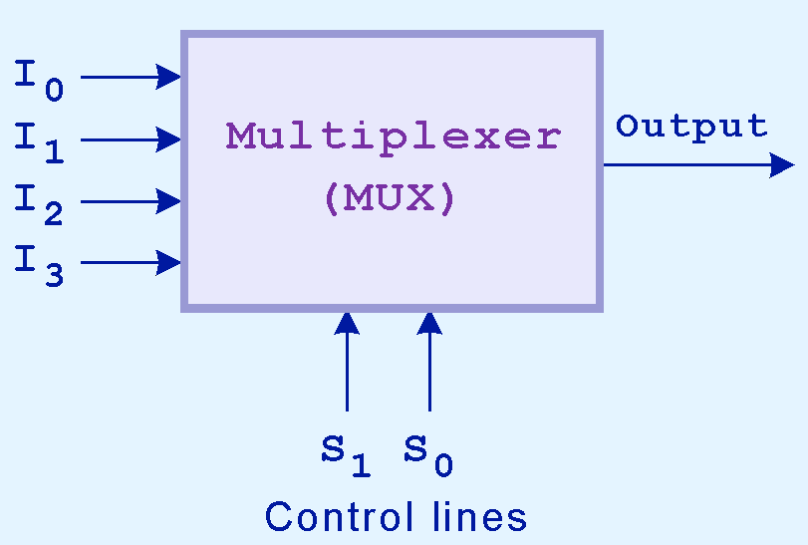
Typical Combinational Circuits: Multiplexer
The particular input chosen for output is determined by the value of the multiplexer’s control lines.
To be able to select among n inputs, log₂n control lines are needed.
This is a block diagram for a multiplexer.

Slide 23
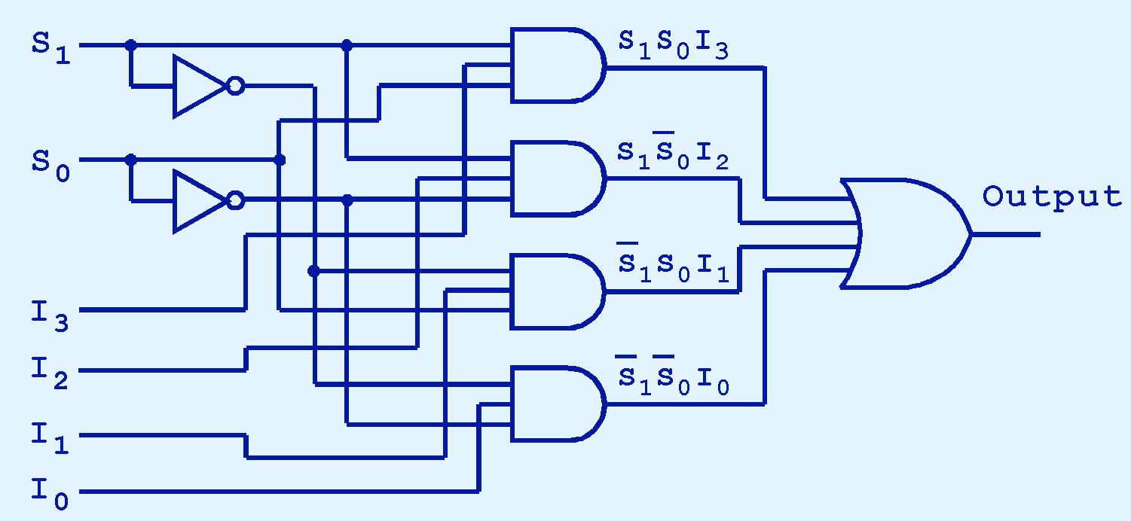
Typical Combinational Circuits: Multiplexer
This is what a 4-to-1 multiplexer looks like on the inside.
If S₀ = 1 and S₁ = 0, which input is transferred to the output?

Slide 24
Typical Combinational Circuits: Shifter
Bit shifting is moving the bits of a word one position to the left or one position to the right
Bit shifting is a very useful operation:
Given an unsigned integer n. What is the effect of shifting the bits of n to the left? To the right?

Slide 25
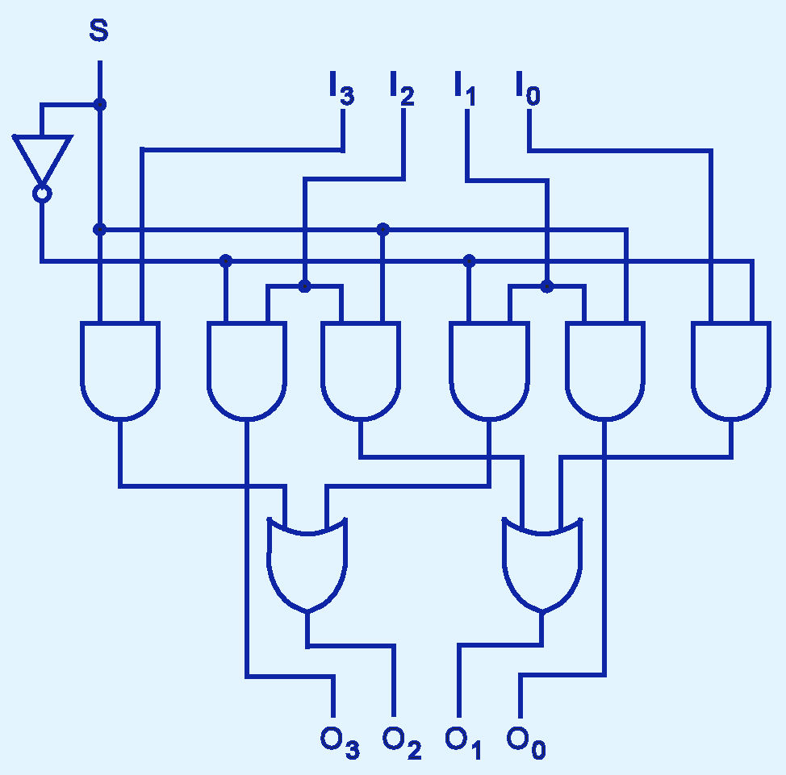
Typical Combinational Circuits: Shifter
This shifter moves the bits of a nibble one position to the left or right.
If S = 0, in which direction do the input bits shift?

Slide 26
Typical Combinational Circuits: 2-bit ALU
The next slide illustrates a very simple ALU with 4 basic operations carried out on two machine words of 2 bits each.
The 4 basic operations are:
ADD
NOT
OR
AND

Slide 27
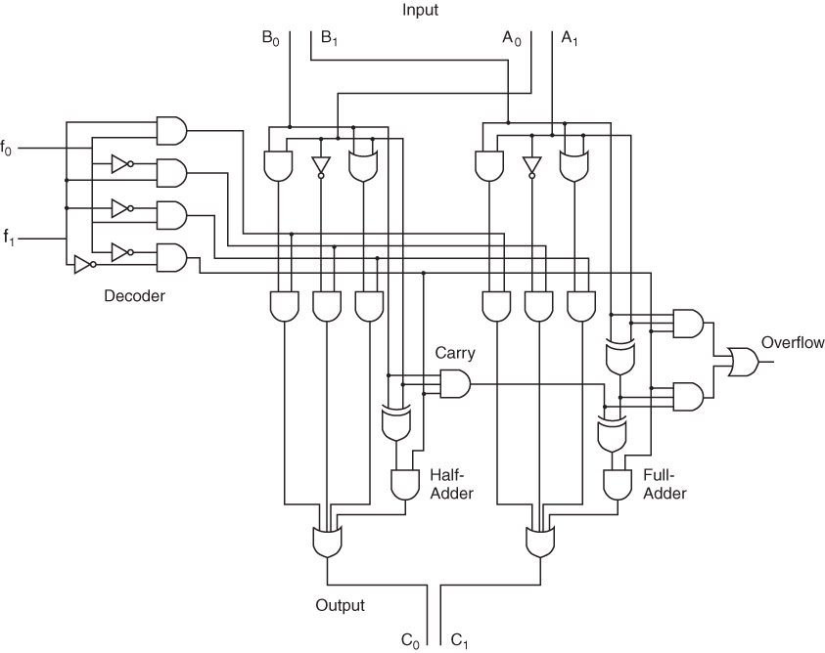
Typical Combinational Circuits: 2-bit ALU

Slide 28
Section 3.5 – End
28
Notes:
28

