Slide 1

Chapter 3
Boolean Algebra and Digital Logic

Slide 2
Chapter 3
3.1 Introduction
3.2 Boolean Algebra
3.3 Logic Gates
3.4 Digital Components
3.5 Combinational Circuits
3.6 Sequential Circuits
2
Notes:
2

Slide 3
Section 3.6
Sequential Circuits
Notes:
3

Slide 4
Sequential Circuits
Combinational logic circuits are perfect for situations when we require the immediate application of a Boolean function to a set of inputs.
There are other times, however, when we need a circuit to change its value with consideration to its current state as well as its inputs.
These circuits have to “remember” their current state.
Sequential logic circuits provide this functionality for us.

Slide 5
Sequential Circuits
As the name implies, sequential logic circuits require a means by which events can be sequenced.
State changes are controlled by clocks.

Slide 6

Clock
A “clock” is a special circuit that sends electrical pulses through a circuit.
Clocks produce electrical waveforms such as the one shown below.

Slide 7
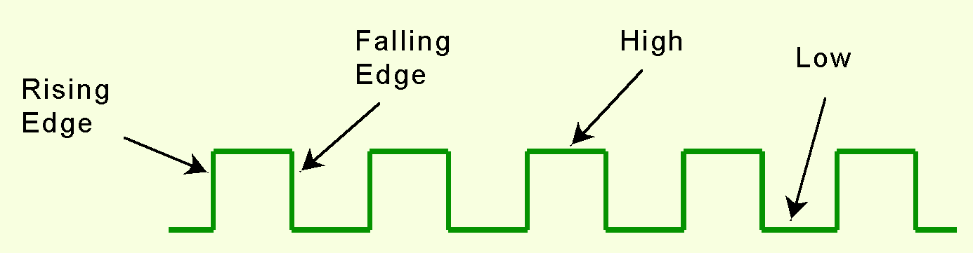
Sequential Circuits and Clocks
State changes occur in sequential circuits only when the clock ticks.
Circuits can change state on the rising edge, falling edge, or when the clock pulse reaches its highest voltage.

Slide 8
Sequential Circuits and Clocks
Circuits that change state on the rising edge, or falling edge of the clock pulse are called edge-triggered.
Level-triggered circuits change state when the clock voltage reaches its highest or lowest level.

Slide 9
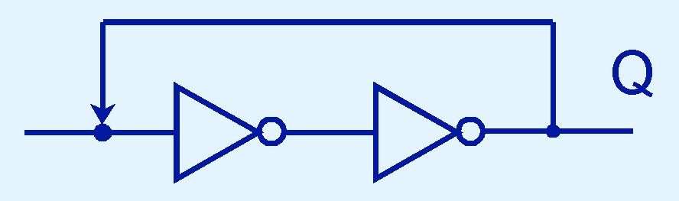
Sequential Circuits: Feedback
To retain their state values, sequential circuits rely on feedback.
Feedback in digital circuits occurs when an output is looped back to the input.
A simple example of this concept is shown below.
If Q is 0 it will always be 0, if it is 1, it will always be 1. Why?

Slide 10
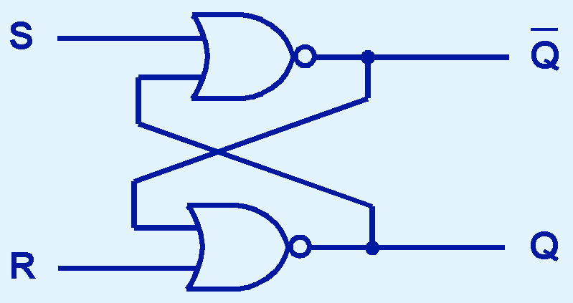
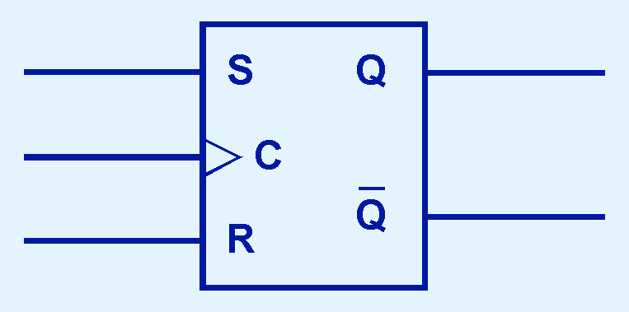
Flip-Flops: SR
You can see how feedback works by examining the most basic sequential logic components, the SR flip-flop.
The “SR” stands for set/reset.
The internals of an SR flip-flop are shown below, along with its block diagram.

Slide 11
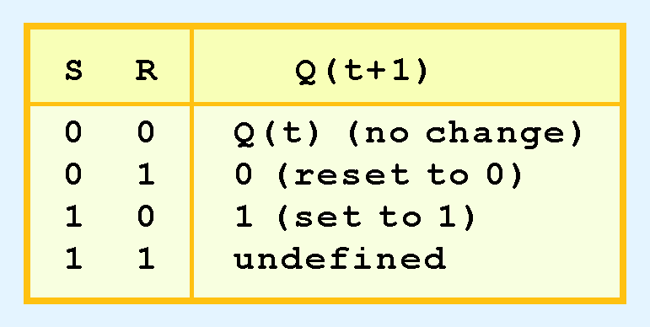
Flip-Flops: SR
The behavior of an SR flip-flop is described by a characteristic table.
Q(t) means the value of the output at time t. Q(t+1) is the value of Q after the next clock pulse.

Slide 12
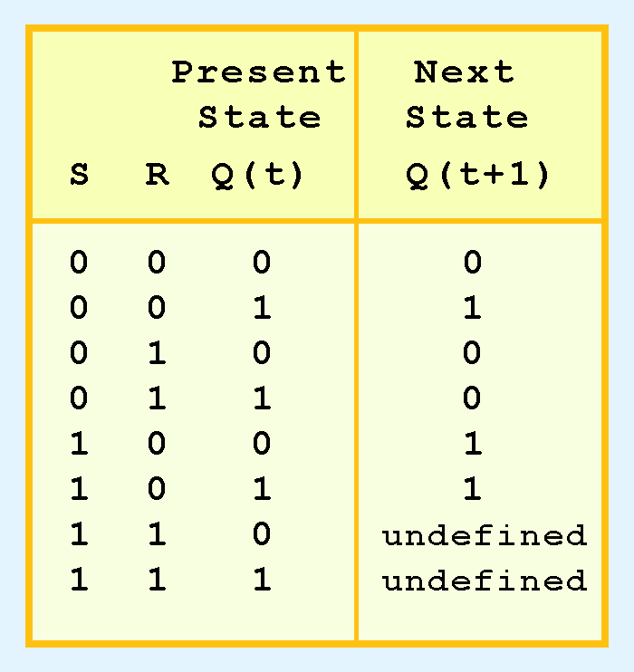
Flip-Flops: SR
The SR flip-flop actually has three inputs: S, R, and its current output, Q.
Thus, we can construct a truth table for this circuit, as shown at the right.
Notice the two undefined values. When both S and R are 1, the SR flip-flop is unstable.

Slide 13
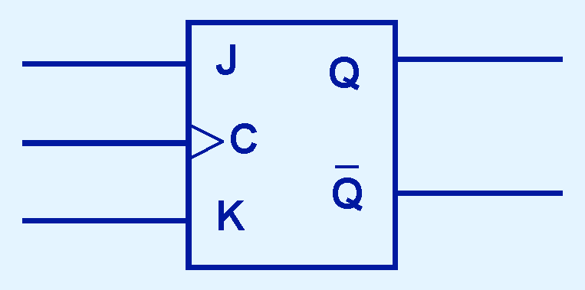
Flip-Flops: JK
If we can be sure that the inputs to an SR flip-flop will never both be 1, we will never have an unstable circuit. This may not always be the case.
The SR flip-flop can be modified to provide a stable state when both inputs are 1.
This modified flip-flop is called a JK flip-flop, shown at the right.
The “JK” is in honor of Jack Kilby.

Slide 14
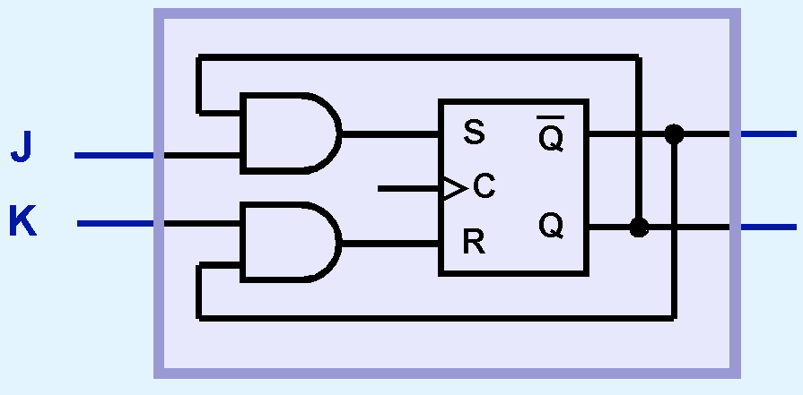
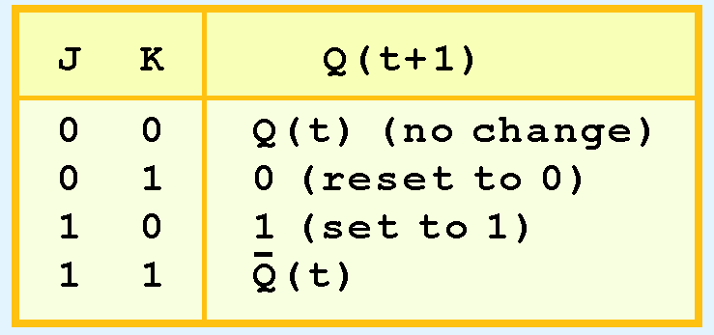
Flip-Flops: JK
At the right, we see how an SR flip-flop can be modified to create a JK flip-flop.
The characteristic table indicates that the flip-flop is stable for all inputs.

Slide 15
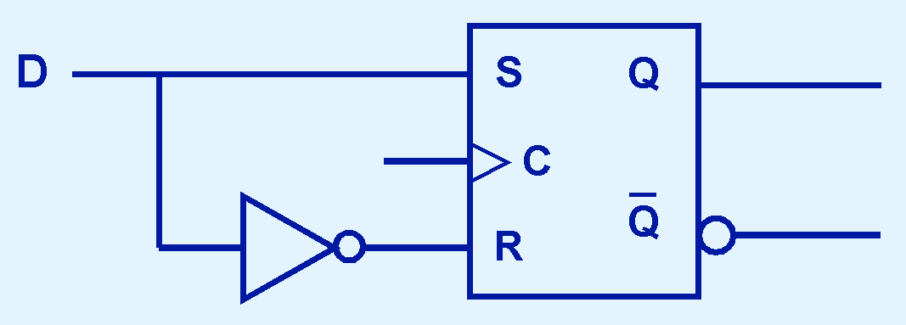
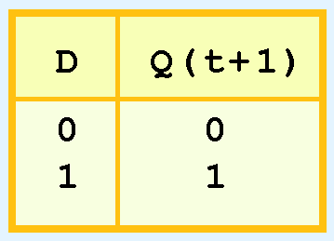
Flip-Flops: D
Another modification of the SR flip-flop is the D flip-flop, shown below with its characteristic table.
You will notice that the output of the flip-flop remains the same during subsequent clock pulses. The output changes only when the value of D changes.

Slide 16
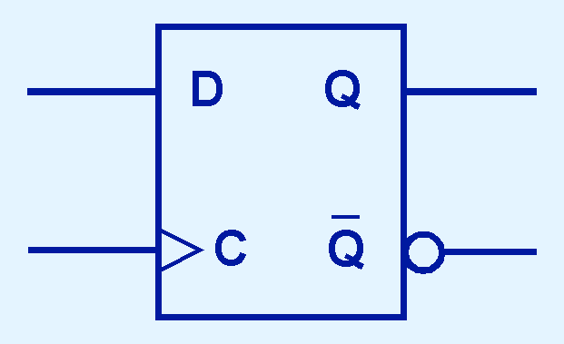
Flip-Flops: D
The D flip-flop is the fundamental circuit of computer memory.
D flip-flops are usually illustrated using the block diagram shown below.
The characteristic table for the D flip-flop is shown at the right.

Slide 17
Sequential Circuits
Sequential circuits are used anytime that we have a “stateful” application.
A stateful application is one where the next state of the machine depends on the current state of the machine and the input.
A stateful application requires both combinational and sequential logic.
The following slides provide several examples of circuits that fall into this category.
Can you think of others?

Slide 18
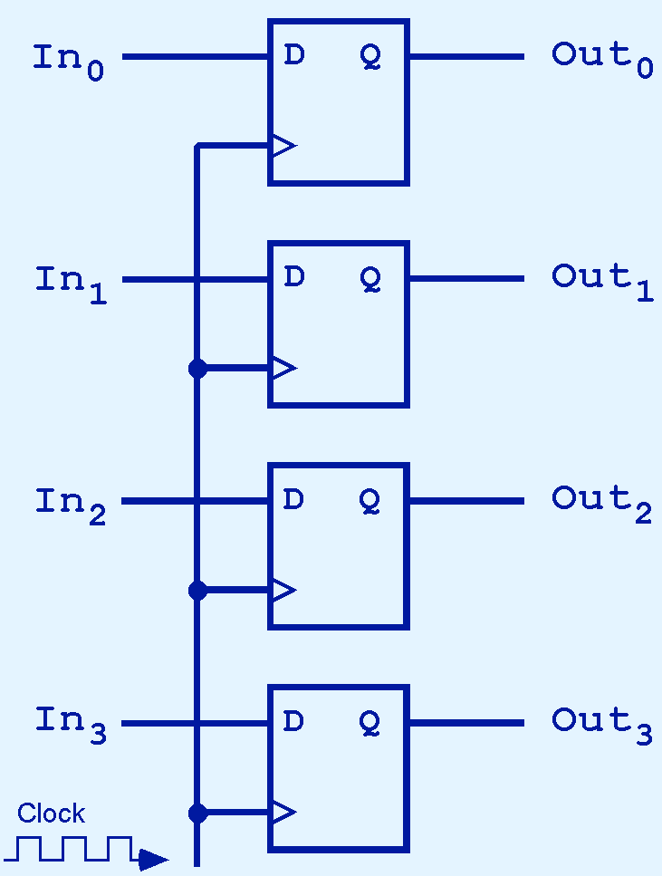
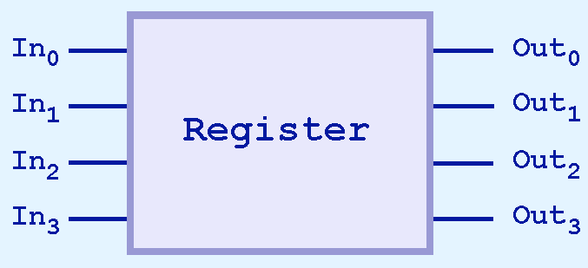
Typical Sequential Circuits: Registers
This illustration shows a 4-bit register consisting of D flip-flops. You will usually see its block diagram (below) instead.
A larger memory configuration is shown on the next slide.

Slide 19
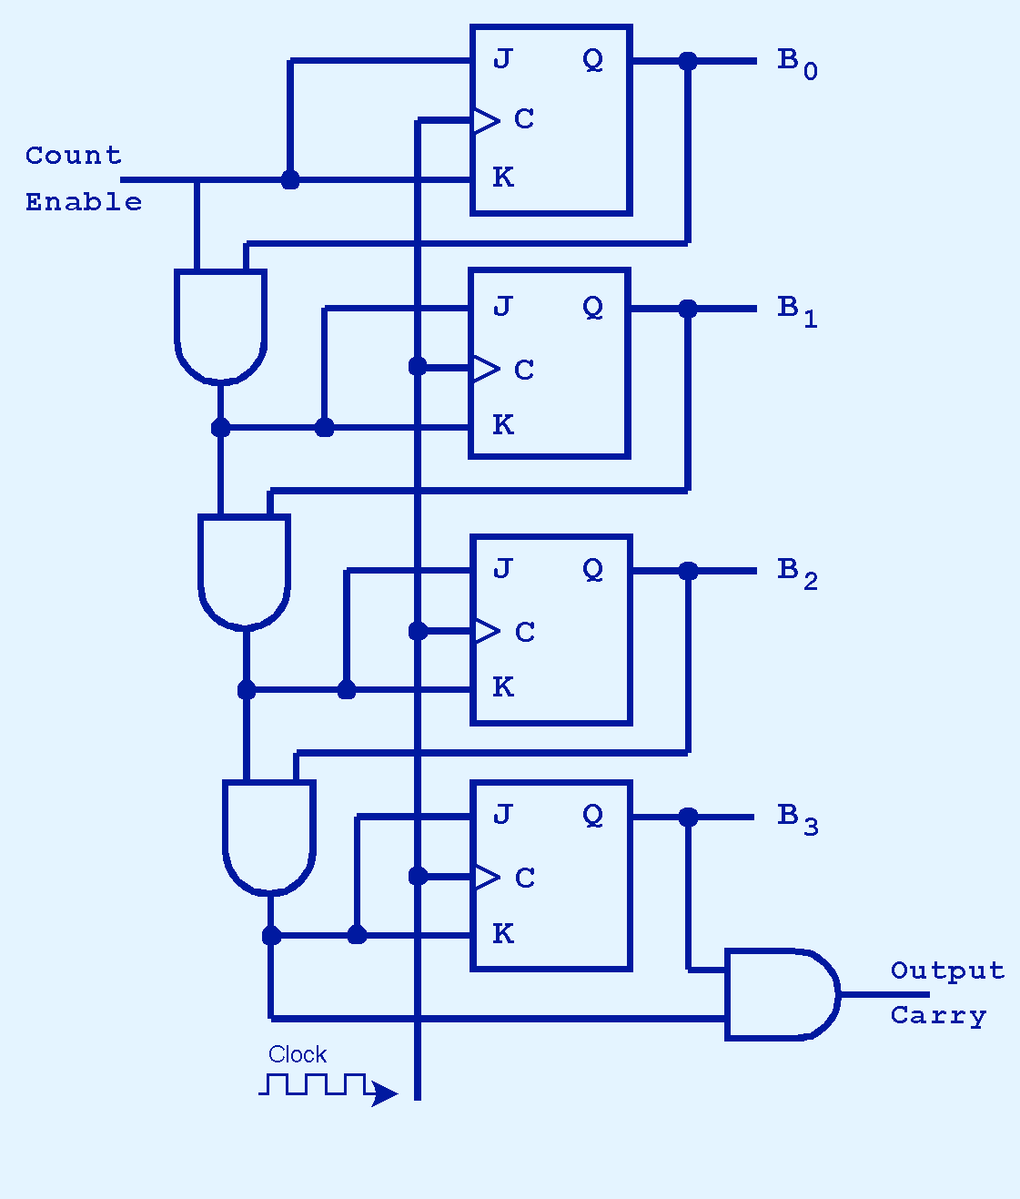
Typical Sequential Circuits: Binary Counters
A binary counter is another example of a sequential circuit.
The low-order bit is complemented at each clock pulse.
Whenever it changes from 0 to 1, the next bit is complemented, and so on through the other flip-flops.

Slide 20
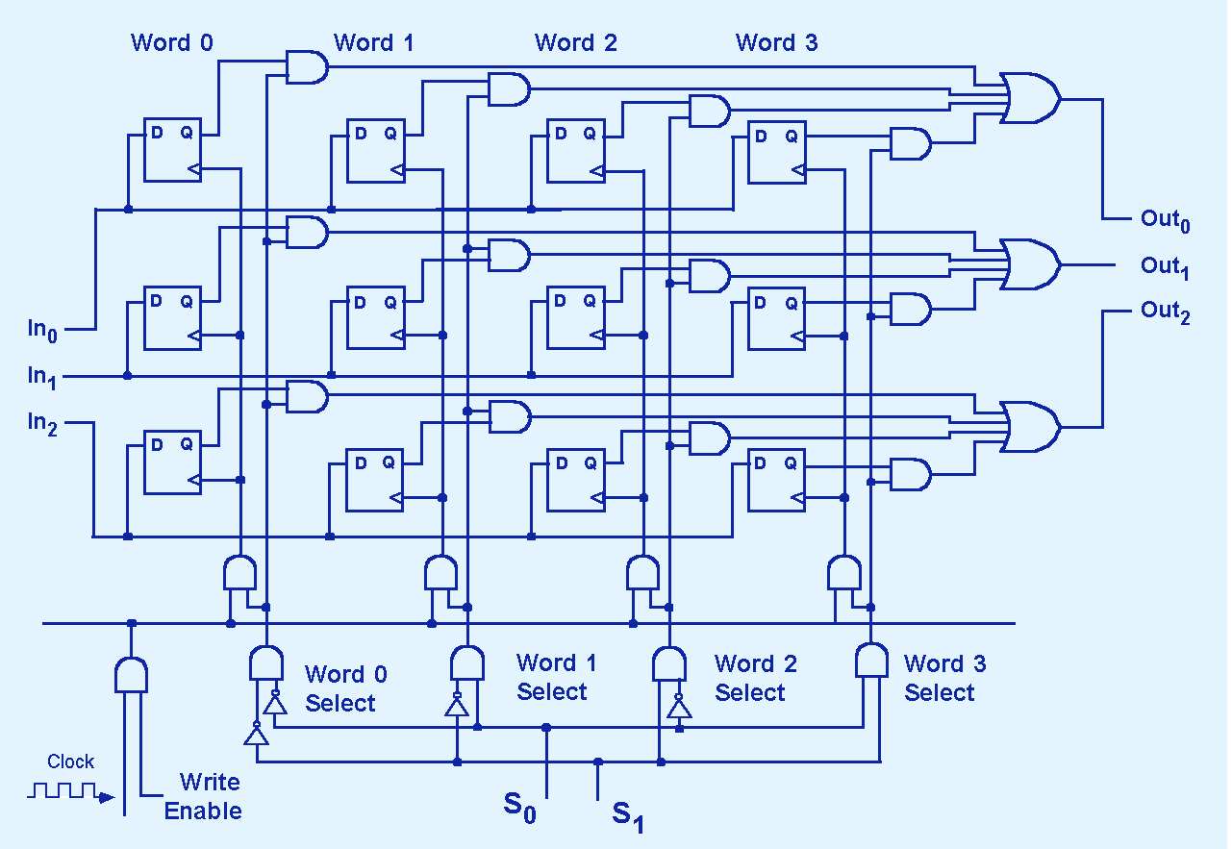
Typical Sequential Circuits: 4×3 Memory
20
Notes:
20

Slide 21
Typical Sequential Circuits: 4×3 Memory (Write)
An address is asserted on S0 and S1
WE is set to high
The decoder using S0 and S1 enables one AND gate, selecting a given word in memory
21
Notes:
21

Slide 22
Typical Sequential Circuits: 4×3 Memory (Write)
The line selected in Step 3 combined with the clock and WE select only one word
The write gate enabled in Step 4 drives the clock for the selected word
When the clock pulses, the word on the input lines is loaded into the D flip-flops
Can you think of the steps necessary to read a word from this memory?
22
Notes:
22

Slide 23
End Section 3.6 & Chapter 3
23
Notes:
23

