Slide 1
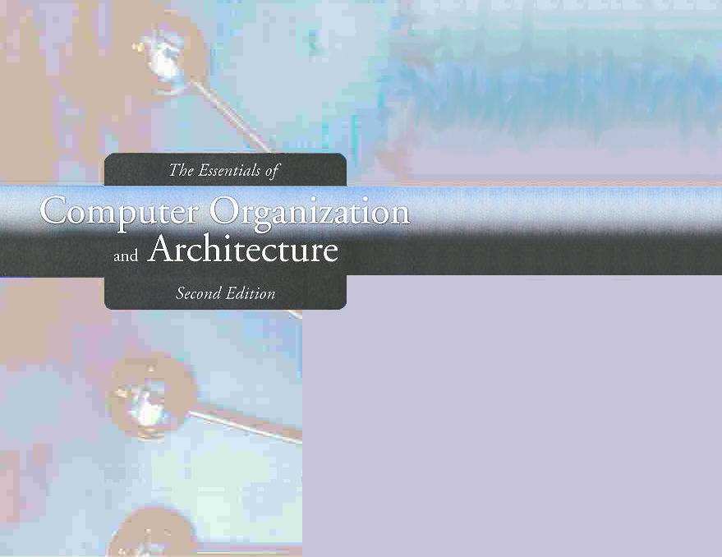
Chapter 4
MARIE: An Introduction to a Simple Computer

Slide 2
Chapter 4
4.1 Introduction
4.2 CPU Basics and Organization
4.3 The Bus
4.4 Clocks
4.5 The Input/Output Subsystem
4.6 Memory Organization and Addressing
4.7 Interrupts
4.8 MARIE
4.9 Instruction Processing
4.10 A Simple Program
4.11 A Discussion on Assemblers
4.12 Extending Our Instruction Set
4.13 A Discussion on Decoding
4.14 Real-World Examples of Computer Architecture

Slide 3
Section 4.1
Introduction
Notes:
3

Slide 4
Introduction
Chapter 1 presented a general overview of computer systems.
In Chapter 2, we discussed how data is stored and manipulated by various computer system components.
Chapter 3 described the fundamental components of digital circuits.
Having this background, we can now understand how computer components work, and how they fit together to create useful computer systems.

Slide 5
MARIE
The main goal of this chapter is to give you an understanding of how a computer functions.
Machine Architecture that is Really Intuitive and Easy

Slide 6
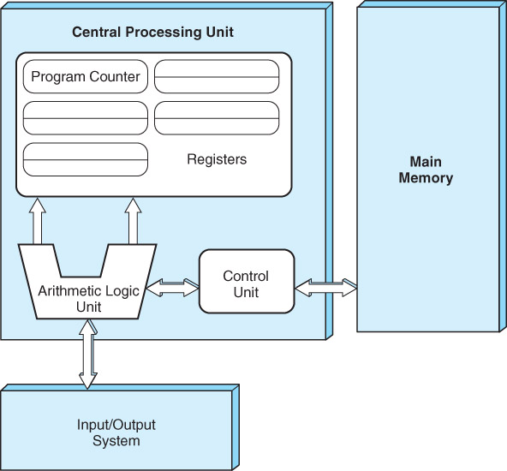
Recall..
6

Slide 7
Section 4.1 – End
7
Notes:
7

Slide 8
Section 4.2
CPU Basics and Organization
Notes:
8

Slide 9
The CPU
Computers manipulate binary-coded data
Memory is used to store both data and program instructions (also in binary)
Somehow, the program must be executed and the data must be processed correctly
The Central Processing Unit is responsible for doing exactly that!

Slide 10
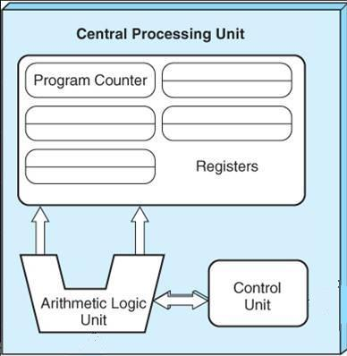
What Does the CPU Do?
Fetch-Decode-Execute!
10
Notes:
10

Slide 11
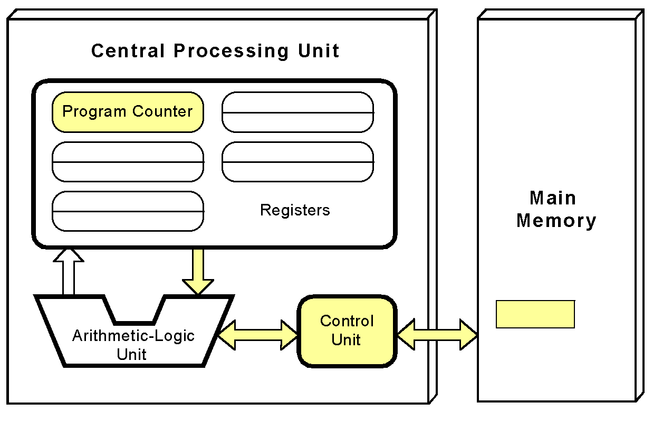
The Fetch-Decode-Execute Cycle
The control unit fetches the next instruction from memory using the program counter to determine where the instruction is located.

Slide 12
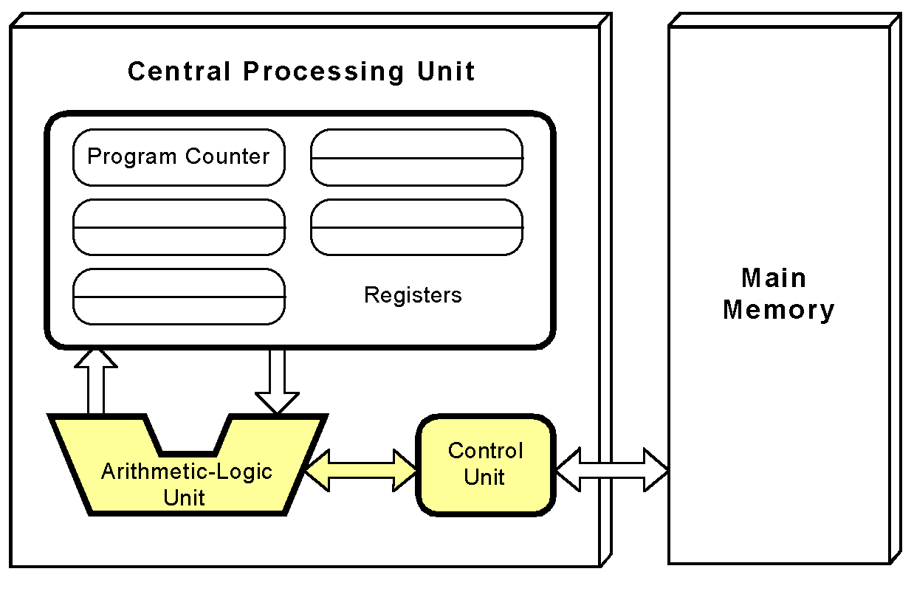
The Fetch-Decode-Execute Cycle
The instruction is decoded into a language that the ALU can understand.

Slide 13
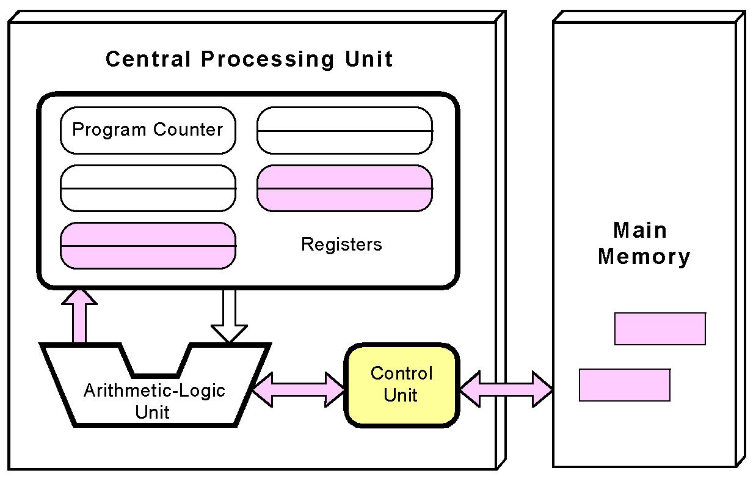
The Fetch-Decode-Execute Cycle
Any data operands required to execute the instruction are fetched from memory and placed into registers within the CPU.

Slide 14
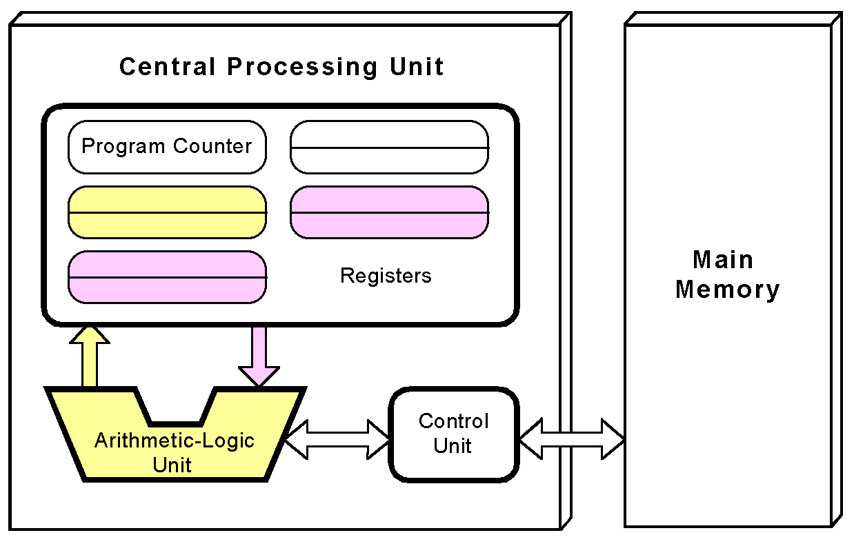
The Fetch-Decode-Execute Cycle
The ALU executes the instruction and places results in registers or memory.

Slide 15
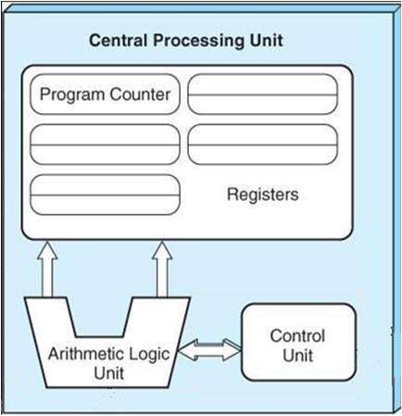
CPU Components
Datapath
Control Unit
15
Notes:
15

Slide 16
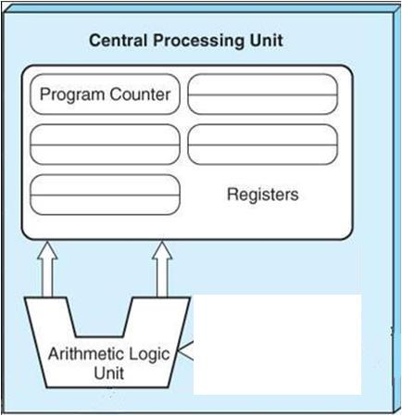
CPU Components: Datapath
Registers
Storage Units
ALU
Arithmetic-Logic Units
16
Notes:
16

Slide 17
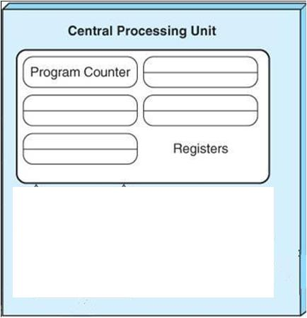
CPU Components: Datapath (Registers)
Registers are temporary memory units that store words:
They hold data that can be readily accessed by the CPU.
17
Notes:
17

Slide 18
CPU Components: Datapath (Registers)
Registers are temporary memory units that store words:
They hold data that can be readily accessed by the CPU.
18
Notes:
18

Slide 19
CPU Components: Datapath (Registers)
Data processing is done on fixed-size binary words stored in registers.
Registers have a common size:
16-bit registers
32-bit registers
64-bit registers
19
Notes:
19

Slide 20
CPU Components: Datapath (Registers)
How many registers does a system have?
Number of registers in a system is typically a power of 2
16 and 32 registers are being most common
64 is becoming common too!
20
Notes:
20

Slide 21
CPU Components: Datapath (Registers)
Categories of Registers:
General Purpose Registers
Special Purpose Registers
21
Notes:
21

Slide 22
CPU Components: Datapath (Registers)
General Purpose Registers may hold:
Data
Addresses
Control Information
at various times
22
Notes:
22

Slide 23
CPU Components: Datapath (Registers)
Special Purpose Registers may hold:
Only Data
Only Addresses
Only Control Information
23
Notes:
23

Slide 24
CPU Components: Datapath (Registers)
Information may be:
Written to a register
Read from a register
Transferred from register to register
24
Notes:
24

Slide 25
CPU Components: Datapath (Registers)
Registers are manipulated by the control unit
Registers have addresses
However, registers are not addressed in the same way memory is addressed
25
Notes:
25

Slide 26
CPU Components: Datapath (Registers)
Specialty Registers:
Store information
Shift values
Compare values
Count
26
Notes:
26

Slide 27
CPU Components: Datapath (Registers)
Scratchpad Registers
Store temporary values
Index registers to control program looping
Stack pointer registers to manage stacks of information for processing
Status (flag) registers to hold status or mode of operation (overflow, carry, or zero condition)
Registers that are available for the programmer
27
Notes:
27

Slide 28
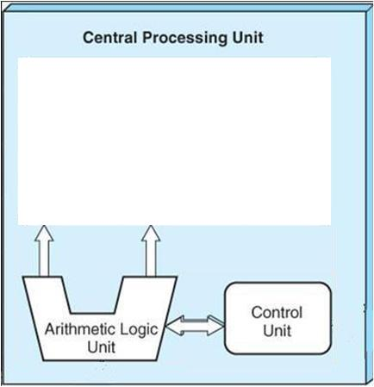
CPU Components: Datapath (ALU)
Carries out:
logical operations (e.g., comparisons)
arithmetic operations (e.g., addition)
As directed by the control unit.
28
Notes:
28

Slide 29
CPU Components: Datapath (ALU)
Generally, an ALU has two data inputs and one data output
Operations performed by the ALU often affect bits in the status registers
29
Notes:
29

Slide 30
CPU Components: Datapath (ALU)
Generally, an ALU has two data inputs and one data output
Operations performed by the ALU often affect bits in the status registers
30
Notes:
30

Slide 31
CPU Components: Control Unit
Various CPU components perform sequenced operations according to signals provided by its control unit.
31
Notes:
31

Slide 32
CPU Components: Control Unit
The control unit determines which actions to carry out according to the values in a program counter register and a status register.
32
Notes:
32

Slide 33
CPU Components: Control Unit
Fetches an instruction from memory
Decodes the instruction
Makes sure data is in the right place at the right time
Tells the ALU which registers to use
Turns on the correct circuitry in the ALU for the execution of the desired operation
33
Notes:
33

Slide 34
Section 4.2 – End
34
Notes:
34

Slide 35
Section 4.3
The Bus
Notes:
35

Slide 36
The Bus
The CPU shares data with other system components by way of a data bus.
A bus is a set of wires that simultaneously convey a single bit along each line.

Slide 37
The Bus
The speed of the bus is affected by
Its length and
The number of devices sharing it
Only one device is allowed to use the bus at any one time.
37
Notes:
37

Slide 38
The Bus: Types
Two types of buses are commonly found in computer systems:
Point-to-Point Bus
Multipoint Bus
38
Notes:
38

Slide 39
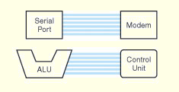
Point-to-Point Bus Configuration
A Point-to-Point Bus connects two specific components
39
Notes:
39

Slide 40
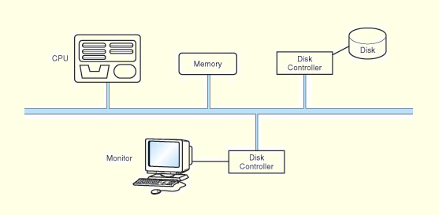
MultiPoint Bus Configuration
A MultiPoint Bus is a common pathway that connects a number of devices
40
Notes:
40

Slide 41
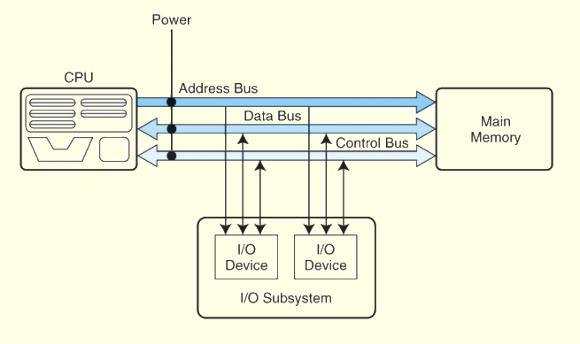
Model Bus Configuration

Slide 42
Bus Components
Data Lines
Control Lines
Address Lines

Slide 43
Bus Components: Data Lines
Convey bits from one device to another

Slide 44
Bus Components: Control Lines
Determine the direction of data flow and when each device can access the bus

Slide 45
Bus Components: Address Lines
Determine the location of the source or destination of the data

Slide 46
Section 4.3 – End
46
Notes:
46

Slide 47
Section 4.4
Clocks
Notes:
47

Slide 48
Clocks
Every computer contains at least one clock that synchronizes the activities of its components.
A fixed number of clock cycles are required to carry out each data movement or computational operation.

Slide 49
Clocks
The clock frequency, measured in megahertz or gigahertz, determines the speed with which all operations are carried out.
Clock cycle time is the reciprocal of clock frequency.
An 800 MHz clock has a cycle time of 1.25 ns.
49
Notes:
49

Slide 50
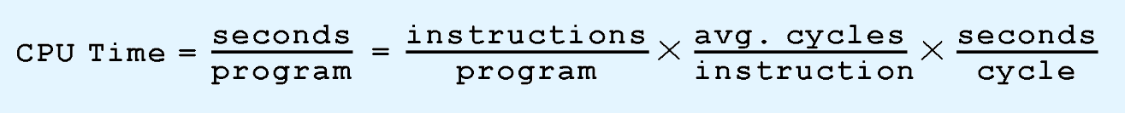
Clocks
Clock speed should not be confused with CPU performance.
The CPU time required to run a program is given by the general performance equation:

Slide 51
Clocks
We see that we can improve CPU throughput when we reduce the number of instructions in a program, reduce the number of cycles per instruction, or reduce the number of nanoseconds per clock cycle.
We will return to this important equation in later chapters.

Slide 52
Section 4.4 – End
52
Notes:
52

Slide 53
Section 4.5
The Input/Output Subsystem
Notes:
53

Slide 54
The Input / Output Subsystem
A computer communicates with the outside world through its input/output (I/O) subsystem.
I/O devices connect to the CPU through various interfaces.
I/O can be memory-mapped-- where the I/O device behaves like main memory from the CPU’s point of view.
Or I/O can be instruction-based, where the CPU has a specialized I/O instruction set.
We study I/O in detail in chapter 7.

Slide 55
Section 4.5 – End
55
Notes:
55

