Slide 1
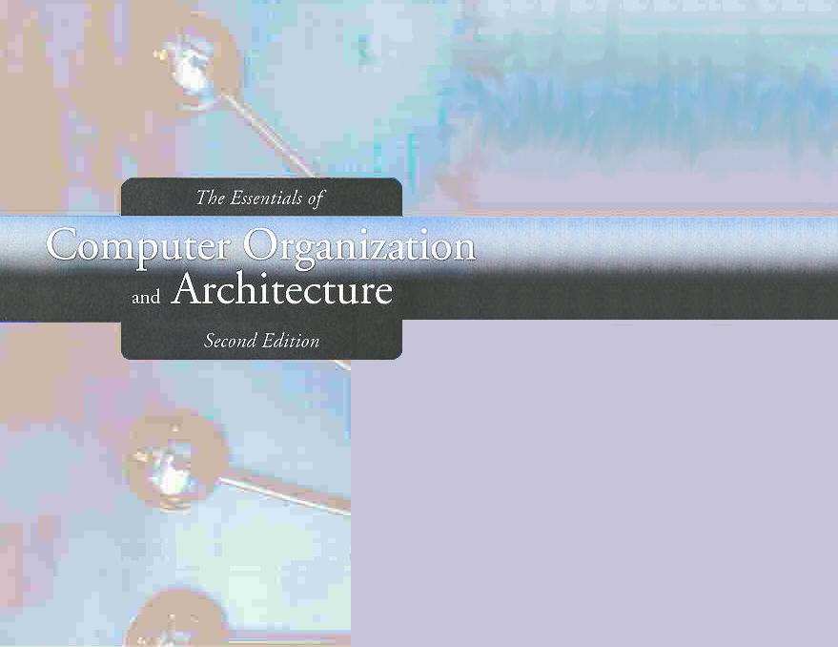
Chapter 4
MARIE: An Introduction to a Simple Computer

Slide 2
Chapter 4
4.1 Introduction
4.2 CPU Basics and Organization
4.3 The Bus
4.4 Clocks
4.5 The Input/Output Subsystem
4.6 Memory Organization and Addressing
4.7 Interrupts
4.8 MARIE
4.9 Instruction Processing
4.10 A Simple Program
4.11 A Discussion on Assemblers
4.12 Extending Our Instruction Set
4.13 A Discussion on Decoding
4.14 Real-World Examples of Computer Architecture

Slide 3
Section 4.11
A Discussion on Assemblers
Notes:
3

Slide 4
A Discussion on Assemblers
Mnemonic instructions, such as LOAD 104, are easy for humans to write and understand.
They are impossible for computers to understand.

Slide 5
Assemblers
Assemblers translate instructions that are comprehensible to humans into the machine language that is comprehensible to computers
Assemblers create an object program file from mnemonic source code in two passes.

Slide 6
Assembly Passes
During the first pass, the assembler assembles as much of the program as it can, while it builds a symbol table that contains memory references for all symbols in the program.
During the second pass, the instructions are completed using the values from the symbol table.

Slide 7
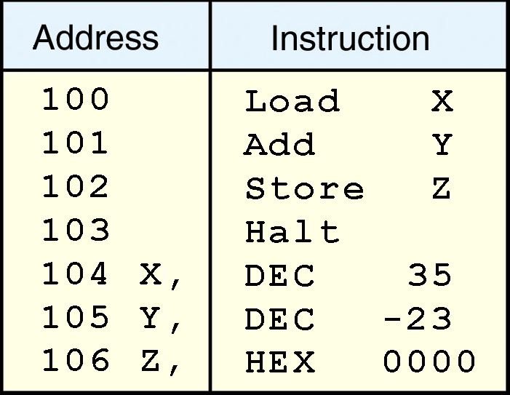
A Discussion on Assemblers: Example
Note that two directives HEX and DEC that specify the radix of the constants have been included.

Slide 8
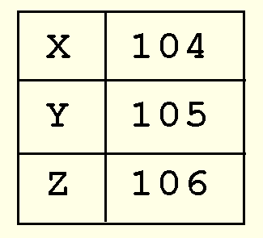
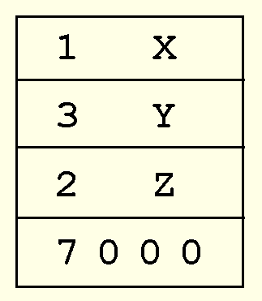
A Discussion on Assemblers: Example (Pass 1)
During the first pass, we have a symbol table (top) and the partial instructions (bottom).

Slide 9
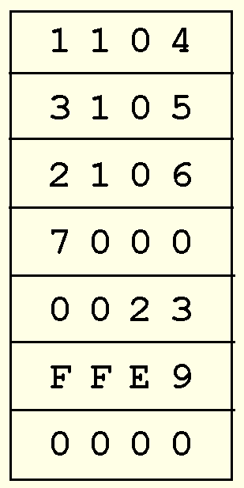
A Discussion on Assemblers: Example (Pass 2)

Slide 10
A Discussion on Assemblers: Exercise (Hand Assemble!)
100 If, LOAD X
101 SUBT Y
102 SKIPCOND 400
103 JUMP Else
104 Then, LOAD X
105 ADD X
106 STORE X
107 JUMP Endif
108 Else, LOAD Y
109 SUBT X
10A STORE Y
10B Endif, Halt
10C X, DEC 12
10D Y, DEC 20

Slide 11
Section 4.11 – End
11
Notes:
11

Slide 12
Section 4.12
Extending Our Instruction Set
Notes:
12

Slide 13
Extending Our Instruction Set
So far, all of the MARIE instructions that we have discussed use a direct addressing mode.
This means that the address of the operand is explicitly stated in the instruction.

Slide 14
Extending Our Instruction Set
It is often useful to employ a indirect addressing, where the address of the address of the operand is given in the instruction.
If you have ever used pointers in a program, you are already familiar with indirect addressing.

Slide 15
Extending Our Instruction Set
To help you see what happens at the machine level, we have included indirect addressing mode instructions to the MARIE instruction set:
AddI X
JumpI X

Slide 16
Extending Our Instruction Set: RTL for ADDI
The ADDI instruction specifies the address of the address of the operand.
MAR ← X
MBR ← M[MAR]
MAR ← MBR
MBR ← M[MAR]
AC ← AC + MBR

Slide 17
Extending Our Instruction Set: RTL for JUMPI
The JUMPI instruction specifies the address of the address to jump to
MAR ← X
MBR ← M[MAR]
PC ← MBR

Slide 18
Extending Our Instruction Set: Subroutine Functionality (JNS)
Another helpful programming tool is the use of subroutines.
The jump-and-store instruction, JNS, gives us limited subroutine functionality.

Slide 19
Extending Our Instruction Set: RTL for JNS
JNS X
MBR ← PC
MAR ← X
M[MAR] ← MBR
MBR ← X
AC ← 1
AC ← AC + MBR
PC ← AC

Slide 20
Extending Our Instruction Set: Example (Loops)
100 LOAD Addr
101 STORE Next
102 LOAD Num
103 SUBT One
104 STORE Ctr
105 Loop, LOAD Sum
106 ADDI Next
107 STORE Sum
108 LOAD Next
109 ADD One
10A STORE Next
10B LOAD Ctr
10C SUBT One
10D STORE Ctr
10E SKIPCOND 000
10F JUMP Loop
110 HALT
111 Addr, HEX 117
112 Next, HEX 0
113 Num, DEC 5
114 Sum, DEC 0
115 Ctr, HEX 0
116 One, DEC 1
117 DEC 10
118 DEC 15
119 DEC 2
11A DEC 25
11B DEC 30

Slide 21
Extending Our Instruction Set: Example (Subroutine)
100 LOAD X
101 STORE Temp
102 JnS Subr
103 STORE X
104 LOAD Y
105 STORE Temp
106 JnS Subr
107 STORE Y
108 HALT
109 X, DEC 20
10A Y, DEC 48
10B Temp, DEC 0
10C Subr, HEX 0
10D LOAD Temp
10E ADD Temp
10F JUMPI Subr

Slide 22
Section 4.12 – End
22
Notes:
22

