Slide 1
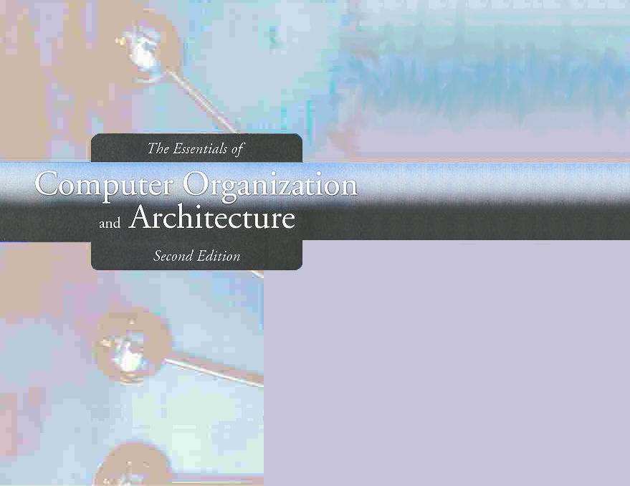
Chapter 4
MARIE: An Introduction to a Simple Computer

Slide 2
Chapter 4
4.1 Introduction
4.2 CPU Basics and Organization
4.3 The Bus
4.4 Clocks
4.5 The Input/Output Subsystem
4.6 Memory Organization and Addressing
4.7 Interrupts
4.8 MARIE
4.9 Instruction Processing
4.10 A Simple Program
4.11 A Discussion on Assemblers
4.12 Extending Our Instruction Set
4.13 A Discussion on Decoding
4.14 Real-World Examples of Computer Architecture

Slide 3
Section 4.6
Memory Organization
Notes:
3

Slide 4
Memory Organization: Concepts
Memory is a collection of cells capable of storing binary information
Envision computer memory as a matrix of bits
01101101 10101101 00000000 00000011
00000000 00000000 11111111 11111111
00000000 00000000 10011010 10100010
11111111 11111111 00000000 00000000

Slide 5
Memory Organization
In addition to the storage cells, memory contains electronic circuits for storing and retrieving the information
Computer memory consists of a linear array of addressable storage cells that are similar to registers.
5
Notes:
5

Slide 6
Memory Types
Read Only Memory (ROM)
Random Access Memory (RAM)
Volatile
Accepts new information for storage to be available later for use
Read/Write Operations
RAM sizes may range from millions to trillions of bits
6
Notes:
6

Slide 7
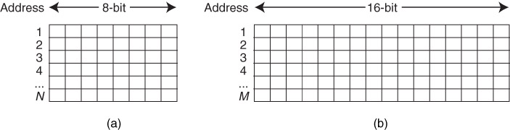
Memory Organization: RAM
Binary information is stored in memory in groups of bits, each of which is called a word
A word is an entity of bits that moves in and out of memory as a unit
A word may represent data, instructions, …

Slide 8
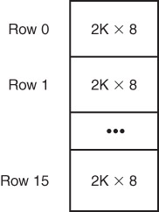
Memory Organization
Memory is constructed of RAM chips, often referred to in terms of
Length × Width
Length refers to the total number of words in the memory
Width is the total number of bits in a word (word size)

Slide 9
Memory Organization: 4M×32 Memory
2M×16 RAM Chips:
2M×8 RAM Chips:
9
Notes:
9

Slide 10
Memory Organization: 4M×32 Memory
1M×16 RAM Chips:
1M×8 RAM Chips:
10
Notes:
10

Slide 11
Memory Organization: Banks
Physical memory usually consists of more than one RAM chip.
Access is more efficient when memory is organized into banks
A memory bank is a row RAM chips

Slide 12
Memory Organization: Banks (Example)
We construct a 4M×32 using 1M×8 RAM Chips as shown below, how many banks are there?
Bank 0
Bank 1
Bank 2
Bank 3
12
Notes:
12

Slide 13
Memory Organization: Addressing
Memory can be
byte-addressable, or
word-addressable,
where a word typically consists of two or more bytes.
13
Notes:
13

Slide 14
Memory Organization: Addressing (Byte Addressable)
Every byte has a unique address.
14
Notes:
14

Slide 15
Memory Organization: Addressing (Word Addressable)
Every word has a unique address.
A word address is the address of the first byte in that word
15
Notes:
15

Slide 16
Memory Organization: Addressing (Example)
How does the computer access a memory location corresponds to a particular address?
We observe that 4M can be expressed as
2² × 2²⁰ = 2²² words.
The memory locations for this memory are numbered 0 through 2²² -1.

Slide 17
Memory Organization: Addressing (Example)
0 0000000000000000000000
….
2²⁰ – 1 0011111111111111111111
2²⁰ 0100000000000000000000
….
2²¹ – 1 0111111111111111111111
2²¹ 1000000000000000000000
.…
2²¹ + 2²⁰ – 1 1011111111111111111111
2²¹ + 2²⁰ 1100000000000000000000
….
2²² – 1 1111111111111111111111
17
Notes:
17

Slide 18
Memory Organization: Addressing (Example)
Thus, the memory bus of this system requires at least 22 address lines.
The address lines “count” from 0 to 2²² - 1 in binary.
Each line is either “on” or “off” indicating the location of the desired memory element.

Slide 19
Memory Organization: Address Interleaving
Physical memory usually consists of more than one RAM chip.
Access is more efficient when memory is organized into banks of chips with the addresses interleaved across the chips
There are two types of interleaving

Slide 20
Memory Organization: Interleaving Types
With low-order interleaving, the low order bits of the address specify which memory bank contains the address of interest.
Accordingly, in high-order interleaving, the high order address bits specify the memory bank.
The next slides illustrate these two ideas.

Slide 21
Memory Organization: High-Order Interleaving
0 00000000000000000000 0 0
….
2²⁰ – 1 0011111111111111111111 0 1048575
2²⁰ 0100000000000000000000 1 0
….
2²¹ – 1 0111111111111111111111 1 1048575
2²¹ 1000000000000000000000 2 0
.…
2²¹ + 2²⁰ – 1 1011111111111111111111 2 1048575
2²¹ + 2²⁰ 1100000000000000000000 3 0
….
2²² – 1 1111111111111111111111 3 1048575
21
Notes:
21

Slide 22
Memory Organization: Low-Order Interleaving
0 00000000000000000000 0 0
1 00000000000000000001 1 1
2 00000000000000000010 2 2
3 00000000000000000011 3 3
….
2²⁰ – 1 0011111111111111111111 3 1048575
2²⁰ 0100000000000000000000 0 0
….
2²¹ – 1 0111111111111111111111 3 1048575
2²¹ 1000000000000000000000 0 0
.…
2²¹ + 2²⁰ – 1 1011111111111111111111 3 1048575
2²¹ + 2²⁰ 1100000000000000000000 0 0
….
2²² – 1 1111111111111111111111 3 1048575
22
Notes:
22

Slide 23
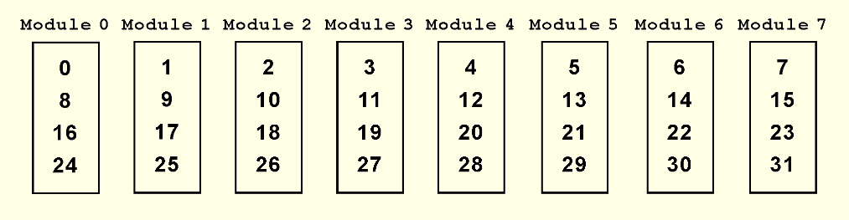
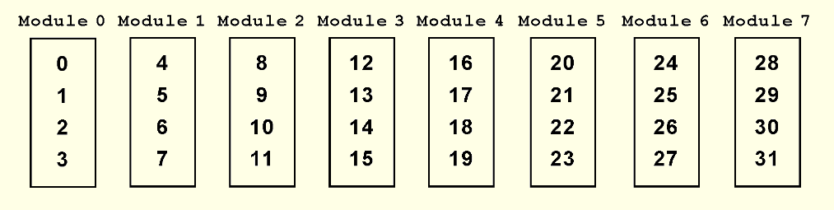
Memory Organization: Address Interleaving
Low-Order Interleaving
High-Order Interleaving
23
Notes:
23

Slide 24
Low-Order Interleaving: Advantages
Good if the CPU can request multiple adjacent memory locations
Since adjacent memory locations lie in different banks, an “advanced” memory system can perform the access in parallel
Examples:
Elements in an array
Instructions in a program
Higher Performance!
24
Notes:
24

Slide 25
High-Order Interleaving: Advantages
Good if banks can be accessed independently by different units (CPU, a 2nd CPU, etc.) and the units partition their data into different banks
Parallel operation implies higher performance
25
Notes:
25

Slide 26
Section 4.6 – End
26
Notes:
26

Slide 27
Section 4.7
Interrupts
Notes:
27

Slide 28
Interrupts
The normal execution of a program is altered when an event of higher-priority occurs. The CPU is alerted to such an event through an interrupt.
Interrupts can be triggered by I/O requests, arithmetic errors (such as division by zero), or when an invalid instruction is encountered.
Each interrupt is associated with a procedure that directs the actions of the CPU when an interrupt occurs.

Slide 29
Section 4.7 – End
29
Notes:
29

