Slide 1
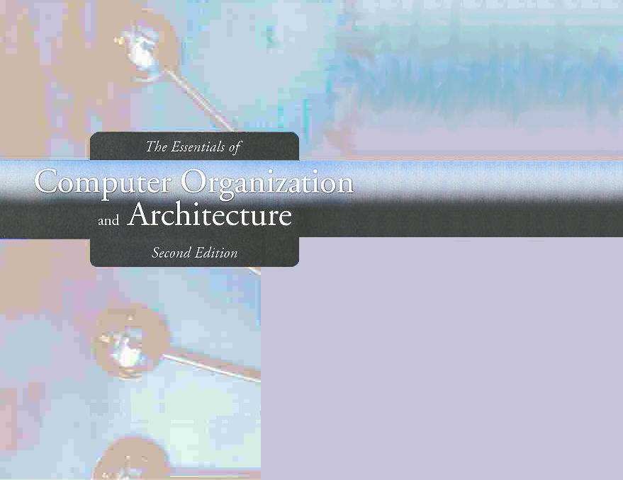
Chapter 4
MARIE: An Introduction to a Simple Computer

Slide 2
Chapter 4
4.1 Introduction
4.2 CPU Basics and Organization
4.3 The Bus
4.4 Clocks
4.5 The Input/Output Subsystem
4.6 Memory Organization and Addressing
4.7 Interrupts
4.8 MARIE
4.9 Instruction Processing
4.10 A Simple Program
4.11 A Discussion on Assemblers
4.12 Extending Our Instruction Set
4.13 A Discussion on Decoding
4.14 Real-World Examples of Computer Architecture

Slide 3
Section 4.8
MARIE
Notes:
3

Slide 4
MARIE
We can now bring together many of the ideas that we have discussed to this point using a very simple model computer.
Our model computer, the Machine Architecture that is Really Intuitive and Easy, MARIE, was designed for the singular purpose of illustrating basic computer system concepts.

Slide 5
MARIE
While this system is too simple to do anything useful in the real world, a deep understanding of its functions will enable you to comprehend system architectures that are much more complex.

Slide 6
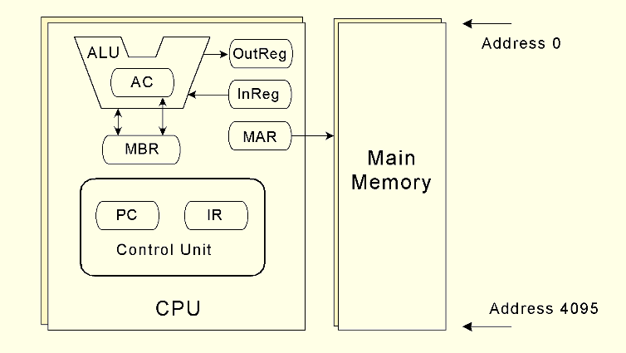
MARIE: Architecture (Graphically)

Slide 7
MARIE: Architecture Characteristics
Binary, two's complement data representation.
Stored program, fixed word length data and instructions.
4K×16 word-addressable main memory.
How may bits are needed to address each word in this memory?

Slide 8
MARIE: Architecture Characteristics
16-bit data words.
16-bit instructions, 4 for the opCode and 12 for the address.
A 16-bit arithmetic logic unit (ALU).
Seven registers for control and data movement.

Slide 9
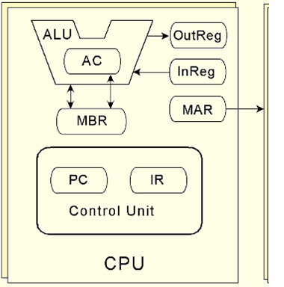
MARIE: Registers
Accumulator, AC, a 16-bit register that holds one operand of a two-operand instruction or a conditional operator (e.g., "less than").

Slide 10
MARIE: Registers
Memory Address Register, MAR, a 12-bit register that holds the memory address of an instruction or the operand of an instruction.

Slide 11
MARIE: Registers
Memory Buffer Register, MBR, a 16-bit register that holds the data after its retrieval from, or before its placement in, memory.

Slide 12
MARIE: Registers
Program Counter, PC, a 12-bit register that holds the address of the next program instruction to be executed.

Slide 13
MARIE: Registers
Instruction Register, IR, a 16-bit register that holds an instruction immediately preceding its decoding and execution.

Slide 14
MARIE: Registers
Input Register, InREG, an 8-bit register that holds data read from an input device.

Slide 15
MARIE: Registers
Output Register, OutREG, an 8-bit register, that holds data that is ready for the output device.

Slide 16
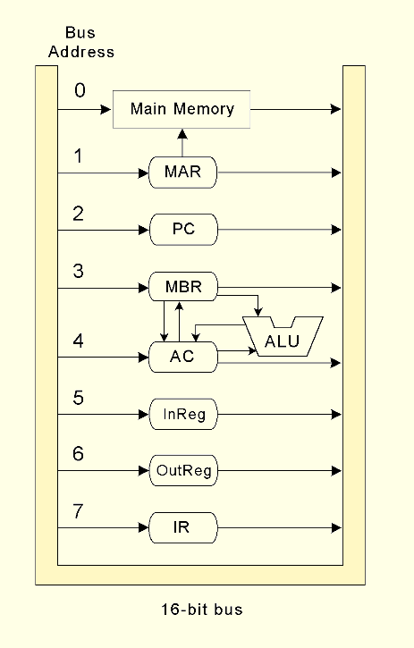
MARIE: Bus
The registers are interconnected, and connected with main memory through a common data bus.

Slide 17
The Bus
The CPU shares data with other system components by way of a data bus.
A bus is a set of wires that simultaneously convey a single bit along each line.

Slide 18
The Bus
The speed of the bus is affected by
Its length and
The number of devices sharing it
Only one device is allowed to use the bus at any one time.
18
Notes:
18

Slide 19
The Bus: Types
Two types of buses are commonly found in computer systems:
Point-to-Point Bus
Multipoint Bus
19
Notes:
19

Slide 20
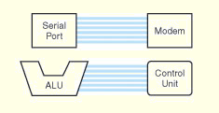
Point-to-Point Bus Configuration
A Point-to-Point Bus connects two specific components
20
Notes:
20

Slide 21
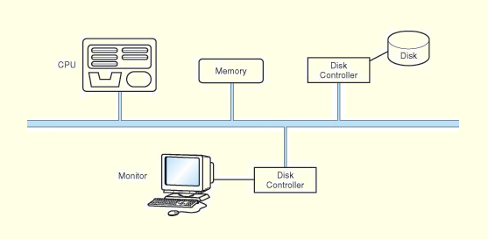
MultiPoint Bus Configuration
A MultiPoint Bus is a common pathway that connects a number of devices
21
Notes:
21

Slide 22
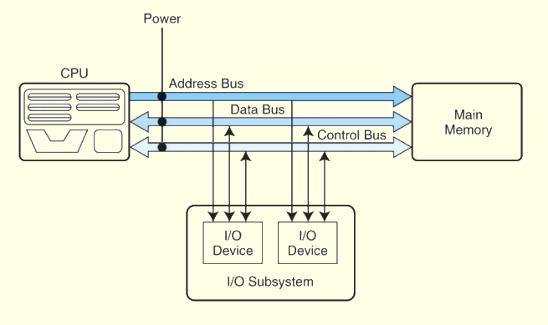
Model Bus Configuration

Slide 23
Bus Components
Data Lines
Control Lines
Address Lines

Slide 24
Bus Components: Data Lines
Convey bits from one device to another

Slide 25
Bus Components: Control Lines
Determine the direction of data flow and when each device can access the bus

Slide 26
Bus Components: Address Lines
Determine the location of the source or destination of the data

Slide 27
MARIE: Bus
Each device on the bus is identified by a unique number
This number is set on the control lines of the bus whenever that device is required to carry out an operation.

Slide 28
MARIE: Bus
To speedup data movement, separate connections are also provided between:
the accumulator and the memory buffer register, and
the ALU and the accumulator and memory buffer register.

Slide 29
Instruction Set Architectures
A computer’s instruction set architecture (ISA) specifies the format of its instructions and the primitive operations that the machine can perform.
The ISA is an interface between a computer’s hardware and its software.

Slide 30
MARIE: ISA
Some ISAs include hundreds of different instructions for processing data and controlling program execution.
The MARIE ISA consists of only thirteen instructions.

Slide 31
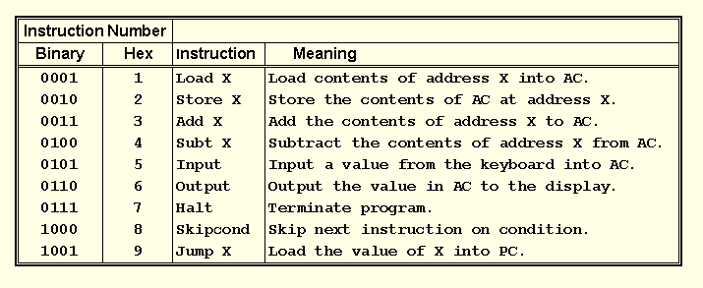
MARIE: Fundamental Instructions

Slide 32
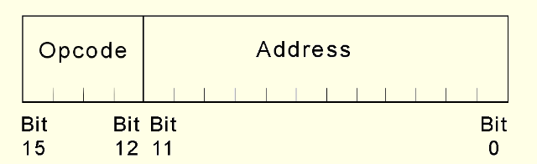
MARIE: Instruction Format

Slide 33
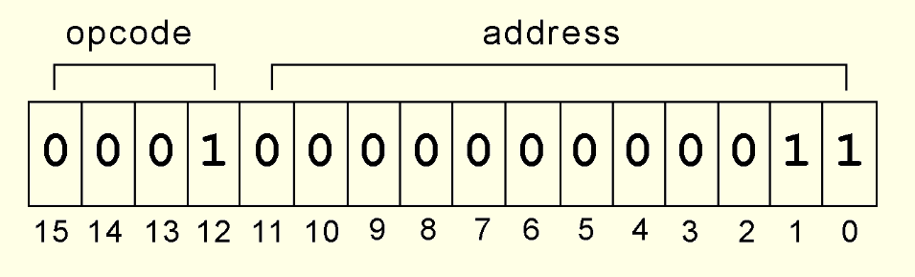
MARIE: Instruction Example
This is a bit pattern for a LOAD instruction as it would appear in the IR:
What is the hexadecimal representation of this instruction?

Slide 34
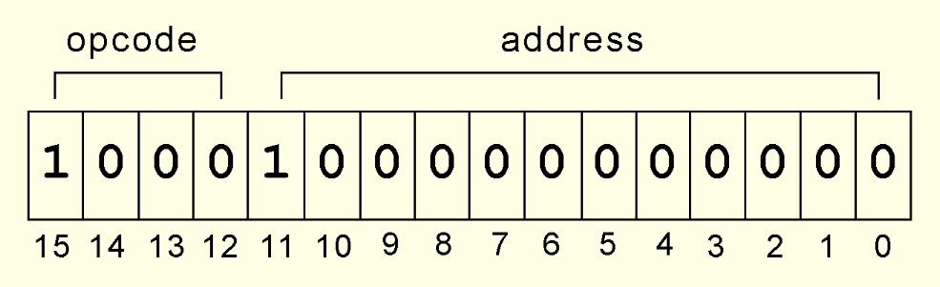
MARIE: Instruction Example
This is a bit pattern for a SKIPCOND instruction as it would appear in the IR:
What is the hexadecimal representation of this instruction?

Slide 35
MARIE: Register Transfer Language
Each of our instructions actually consists of a sequence of smaller instructions called micro-operations.
The exact sequence of micro-operations that are carried out by an instruction can be specified using register transfer language (RTL).

Slide 36
MARIE: Register Transfer Language
In MARIE RTL, we use the notation:
M[X] to indicate the actual data value stored in memory location X,
← to indicate the transfer of bytes to a register or memory location.

Slide 37
MARIE: RTL for LOAD
Load X:
How many clock cycles are
needed?
MAR ← X
MBR ← M[MAR]
AC ← MBR
MAR ← X
MBR ← M[MAR], AC ← MBR

Slide 38
MARIE: RTL for STORE
Store X:
Requires 2 bus cycles:
MAR ← X
MBR ← AC
M[MAR] ← MBR
MAR ← X, MBR ← AC
M[MAR] ← MBR

Slide 39
MARIE: RTL for ADD and SUBT
Add X:
Subt X:
MAR ← X
MBR ← M[MAR]
AC ← AC + MBR
MAR ← X
MBR ← M[MAR]
AC ← AC - MBR

Slide 40
MARIE: RTL for INPUT & OUTPUT
Input:
Output:
AC ← InREG
OutREG ← AC

Slide 41
MARIE: RTL for JUMP
Jump X:
or
PC ← X
PC ← IR[11-0]

Slide 42
MARIE: RTL for SKIPCOND
Recall that SKIPCOND skips the next instruction according to the value of the AC.
If IR[11 - 10] = 00 then
If AC < 0 then PC ← PC + 1
else If IR[11 - 10] = 01 then
If AC = 0 then PC ← PC + 1
else If IR[11 - 10] = 10 then
If AC > 0 then PC ← PC + 1

Slide 43
MARIE: RTL for CLEAR
Our last helpful instruction is the CLEAR instruction.
All it does is set the contents of the accumulator to all zeroes.
This is the RTL for CLEAR:
AC ← 0

Slide 44
Section 4.8 – End
44
Notes:
44

Slide 45
Section 4.9
Instruction Processing
Notes:
45

Slide 46
Instruction Processing
The fetch-decode-execute cycle is the series of steps that a computer carries out when it runs a program.
We first have to fetch an instruction from memory, and place it into the IR.
Once in the IR, it is decoded to determine what needs to be done next.

Slide 47
Instruction Processing
If a memory value (operand) is involved in the operation, it is retrieved and placed into the MBR.
With everything in place, the instruction is executed.
The next slide shows a flowchart of this process.

Slide 48
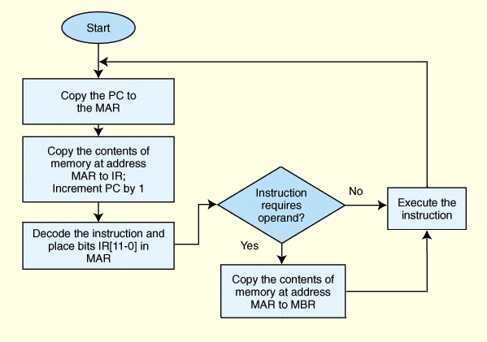
Instruction Processing

Slide 49
Section 4.9 – End
49
Notes:
49

Slide 50
Section 4.10
A Sample Program
Notes:
50

Slide 51
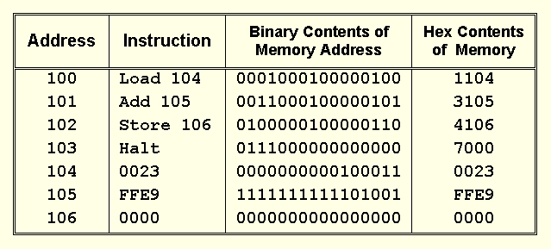
A Simple Program

Slide 52
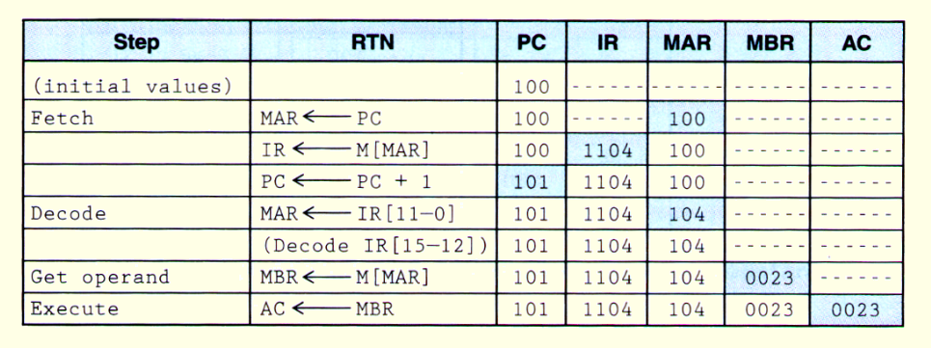
A Simple Program: Load 104

Slide 53
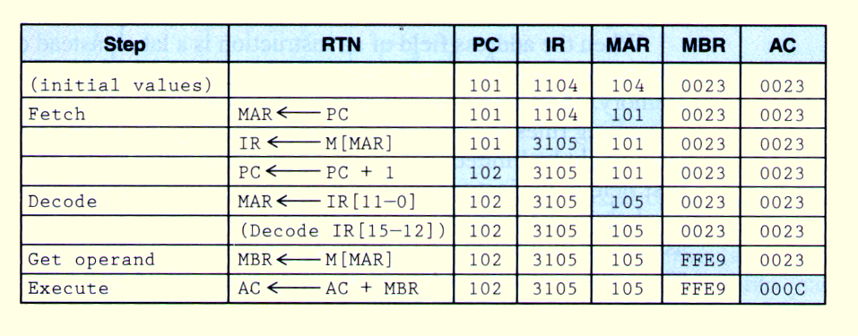
A Simple Program: Add 105

Slide 54
A Simple Program: Store 106
Try it!

Slide 55
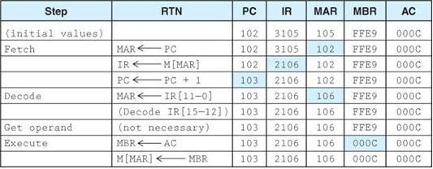
A Simple Program: Store 106

Slide 56
A MARIE Example: if – Statement
Write the following code segment in MARIE’s assembly language:
if X > 1 then
Y = X + X;
X = 0;
endif;
Y = Y + 1;

Slide 57
A MARIE Example: if – Statement
If, Load X
Subt One
Skipcond 800
Jump Endif
Then, Load X
Add X
Store Y
Clear
Store X
Endif, Load Y
Add One
Store Y
Halt
X, Dec ?
Y, Dec ?
One, Dec 1

Slide 58
A MARIE Example: (if – else)
The code segment on the next slide is written in MARIE’s assembly language. Re-write the code in C++:

Slide 59
A MARIE Example: (if – else)
100 If, LOAD X
101 SUBT Y
102 SKIPCOND 400
103 JUMP Else
104 Then, LOAD X
105 ADD X
106 STORE X
107 JUMP Endif
108 Else, LOAD Y
109 SUBT X
10A STORE Y
10B Endif, Halt
10C X, DEC 12
10D Y, DEC 20

Slide 60
A MARIE Example: While - Loop
Write the following code segment in MARIE’s assembly language:
X = 1;
while x < 10 do
x = x + 1;
endwhile;

Slide 61
A MARIE Example: While - Loop
Load One
Store X
Loop, Load X
Subt Ten
SkipCond 000
Jump Endloop
Load X
Add One
Store X
Jump Loop
Endloop, Halt
X, Dec 0
One, DEC 1
Ten, Dec 10

Slide 62
A MARIE Example: For - Loop
Write the following code segment in MARIE’s assembly language:
Sum = 0;
For x = 1 to 10 do
Sum = Sum + x;

Slide 63
A MARIE Example: For - Loop
Load One
Store X
Loop, Load X
Subt Ten
SkipCond 000
Jump Endloop
Load Sum
Add X
Store Sum
Load X
Add One
Store X
Jump Loop
Endloop, Load Sum
Output
Halt
Sum, Dec 0
X, Dec 0
One, Dec 1
Ten, Dec 10
END

Slide 64
A MARIE Example: Multiplication
Write a MARIE program using a loop that multiplies two positive numbers by using repeated addition.
For example, to multiple 3 × 6, the program would add 3 six times, or 3+3+3+3+3+3.

Slide 65
A MARIE Example: Multiplication
Load Y
Store Ctr
Loop, Load Sum
Add X
Store Sum
Load Ctr
Subt One
Store Ctr
SkipCond 400
Jump Loop
Endloop, Load Sum
Output
Halt
Ctr, Dec 0
X, Dec ?
Y, Dec ?
Sum, Dec 0
One, Dec 1
END

Slide 66
Section 4.10 – End
66
Notes:
66

