Slide 1
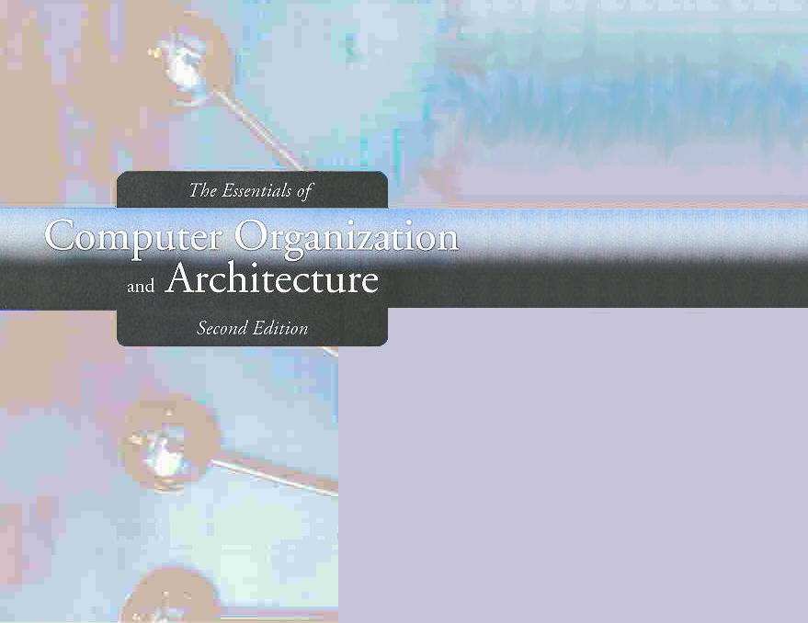
Chapter 5
A Closer Look at Instruction Set Architectures

Slide 2
Chapter 5
5.1 Introduction
5.2 Instruction Formats
5.3 Instruction types
5.4 Addressing
5.5 Instruction-Level Pipelining
5.6 Real-World Examples of ISAs
2
Notes:
2

Slide 3
Introduction
Machine instructions consist of opCode and operands
The opCodes specify the operations to be executed
The operands specify registers or memory locations of data
Why, when we have languages such as C++ and Java available, should we be concerned with machine instructions?
3
Notes:
3

Slide 4
Introduction
High-level languages hide the details of the architecture from the programmer.
Programmers have little awareness of the topics discussed in Chapter 4
Understanding computer architecture results in better programmers
They write more efficient and more effective programs!
4
Notes:
4

Slide 5
Introduction
This chapter builds upon the ideas in Chapter 4.
We present a detailed look at different instruction formats, operand types, and memory access methods.
We will see the interrelation between machine organization and instruction formats.
This leads to a deeper understanding of computer architecture in general.

Slide 6
End Section 5.1
6
Notes:
6

Slide 7
Instruction Formats
Recall: a machine instruction has an opCode and zero or more operands
For example, MARIE instructions:
Length: 16 bits
Number of operands: 0 or 1
Encoding an instruction can be done in a variety of ways
7
Notes:
7

Slide 8
Instruction Set Architectures
Instruction set architectures are measured according to:
Main memory space occupied by a program.
Instruction complexity.
Instruction length (in bits).
Total number of instructions in the instruction set.

Slide 9
Instruction Sets: Design Decisions
Instruction Length:
Number of bits per instruction
Short vs. long
16, 32, and 64 are most common
Fixed length vs. variable length

Slide 10
Instruction Sets: Design Decisions
Number of explicit operands per instruction:
0, 1, 2, or 3
Example: write instructions to execute the following assignment statement allowing 3 operands, 2 operands, 1 operand, and 0 operands per instruction
E = (A × B) + (C × D)

Slide 11
Instruction Sets: Design Decisions
Internal storage of operands in CPU
Stack or registers
Combination of operands allowed per instruction
register-to-register
register-to-memory
memory-to-memory
Example: refer to the previous example on evaluating E = (A × B) + (C × D)

Slide 12
Instruction Sets: Design Decisions
Types of Instructions and data
Type of operations
which instructions can access memory and which cannot
Type and size of operands
Number of addressable registers
Addressing Mode
Choose any or all: direct, indirect, indexed

Slide 13
Instruction Sets: Design Decisions
Memory Organization
Word vs. byte addressable
Byte ordering (Endianness):
If we have a two-byte integer, the integer may be stored so that the least significant byte is followed by the most significant byte or vice versa.
In little endian machines, the least significant byte is followed by the most significant byte.
Big endian machines store the most significant byte first (at the lower address).

Slide 14
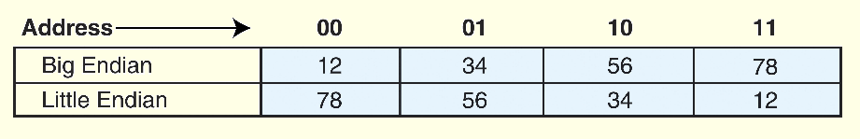
Instruction Sets: Little vs. Big Endian
As an example, suppose we have a four-byte binary number represented here as the hexadecimal number 12345678.

Slide 15
Instruction Sets: Little vs. Big Endian
Big Endian:
Is more natural.
The sign of the number can be determined by looking at the byte at address offset 0.
Strings and integers are stored in the same order.
UNIX, Motorola, most newer RISC architectures
Little Endian:
Makes it easier to place values on non-word boundaries.
Conversion from a 16-bit integer address to a 32-bit integer address does not require any arithmetic.
Most PCs, Intel

Slide 16
Instruction Formats: Internal Storage in the CPU
The next consideration for architecture design concerns how the CPU will store data.
We have three choices:
1. A stack architecture
2. An accumulator architecture
3. A general purpose register architecture.
In choosing one over the other, the tradeoffs are simplicity (and cost) of hardware design with execution speed and ease of use.

Slide 17
Instruction Formats: Internal Storage in the CPU
In a stack architecture, instructions and operands are implicitly taken from the stack.
A stack cannot be accessed randomly.
In an accumulator architecture, one operand of a binary operation is implicitly in the accumulator.
One operand is in memory, creating lots of bus traffic.
In a general purpose register (GPR) architecture, registers can be used instead of memory.
Faster than accumulator architecture.
Efficient implementation for compilers.
Results in longer instructions.

Slide 18
Instruction Formats: Internal Storage in the CPU
Most systems today are GPR systems.
There are three types:
Memory-memory where two or three operands may be in memory.
Register-memory where at least one operand must be in a register.
Load-store where no operands may be in memory.
The number of operands and the number of available registers has a direct affect on instruction length.

Slide 19
Instruction Formats: Internal Storage in the CPU
Stack machines use one - and zero-operand instructions.
LOAD and STORE instructions require a single memory address operand.
Other instructions use operands from the stack implicitly.
PUSH and POP operations involve only the stack’s top element.
Binary instructions (e.g., ADD, MULT) use the top two items on the stack.

Slide 20
Instruction Formats: Internal Storage in the CPU
Stack architectures require us to think about arithmetic expressions a little differently.
We are accustomed to writing expressions using infix notation, such as: Z = X + Y.
Stack arithmetic requires that we use postfix notation: Z = XY+.
This is also called reverse Polish notation, (somewhat) in honor of its Polish inventor, Jan Lukasiewicz (1878 - 1956).

Slide 21
Instruction Formats: Internal Storage in the CPU
The principal advantage of postfix notation is that parentheses are not used.
For example, the infix expression,
Z = (X × Y) + (W × U),
becomes:
Z = X Y × W U × +
in postfix notation.

Slide 22
Instruction Formats: Internal Storage in the CPU
In a stack ISA, the postfix expression,
Z = X Y × W U × +
might look like this:
PUSH X
PUSH Y
MULT
PUSH W
PUSH U
MULT
ADD
PUSH Z
Note: The result of a binary operation is implicitly stored on the top of the stack!

Slide 23
Instruction Formats: Internal Storage in the CPU
In a one-address ISA, like MARIE, the infix expression,
Z = X × Y + W × U
looks like this:
LOAD X
MULT Y
STORE TEMP
LOAD W
MULT U
ADD TEMP
STORE Z

Slide 24
Instruction Formats: Internal Storage in the CPU
In a two-address ISA, (e.g.,Intel, Motorola), the infix expression,
Z = X × Y + W × U
might look like this:
LOAD R1,X
MULT R1,Y
LOAD R2,W
MULT R2,U
ADD R1,R2
STORE Z,R1
Note: One-address ISAs usually require one operand to be a register.

Slide 25
Instruction Formats: Internal Storage in the CPU
With a three-address ISA, (e.g.,mainframes), the infix expression,
Z = X × Y + W × U
might look like this:
MULT R1,X,Y
MULT R2,W,U
ADD Z,R1,R2
Would this program execute faster than the corresponding (longer) program that we saw in the stack-based ISA?

Slide 26
Instruction Formats: Expanding OpCodes
We have seen how instruction length is affected by the number of operands supported by the ISA.
In any instruction set, not all instructions require the same number of operands.
Operations that require no operands, such as HALT, necessarily waste some space when fixed-length instructions are used.
One way to recover some of this space is to use expanding opCodes.

Slide 27
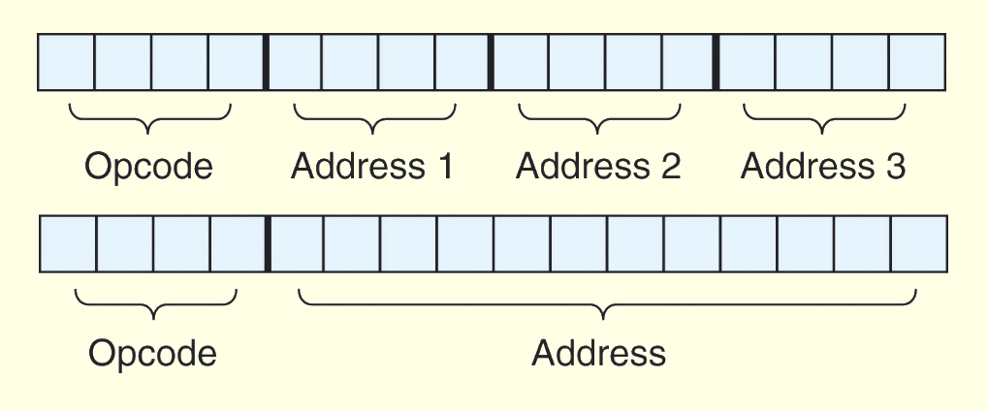
Instruction Formats: Expanding OpCodes
A system has 16 registers and 4K of memory.
We need 4 bits to access one of the registers. We also need 12 bits for a memory address.
If the system is to have 16-bit instructions, we have two choices for our instructions:

Slide 28
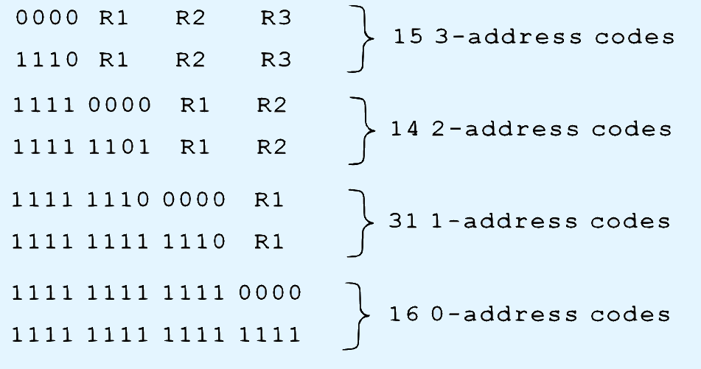
Instruction Formats: Expanding OpCodes
If we allow the length of the opCode to vary, we could create a very rich instruction set:

Slide 29
End Section 5.2
29
Notes:
29

