Slide 1
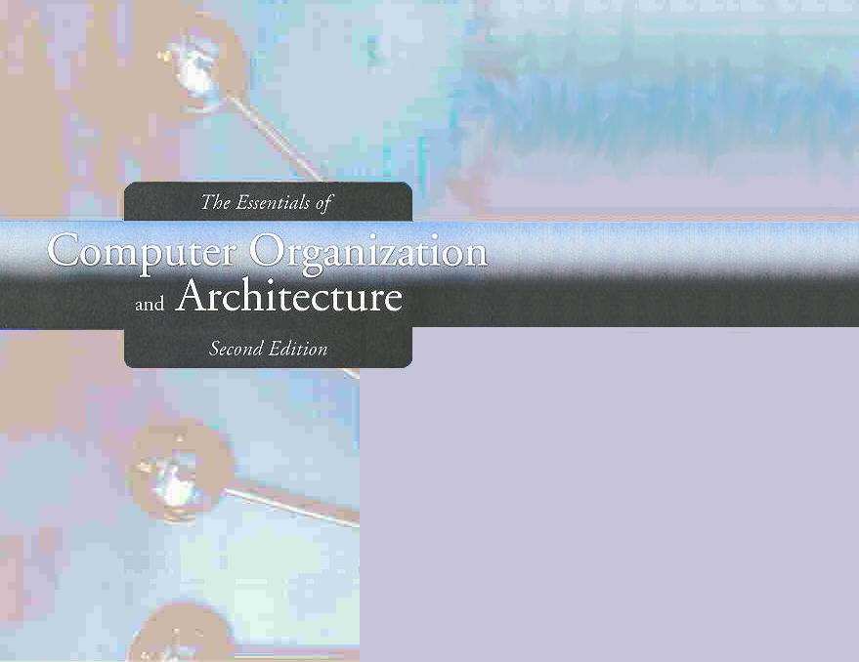
Chapter 5
A Closer Look at Instruction Set Architectures

Slide 2
Chapter 5
5.1 Introduction
5.2 Instruction Formats
5.3 Instruction types
5.4 Addressing
5.5 Instruction-Level Pipelining
2
Notes:
2

Slide 3
Instruction types
Instructions fall into several broad categories that you should be familiar with:
Data movement.
Arithmetic.
Boolean.
Bit manipulation.
I/O.
Control transfer.
Special purpose.
Can you think of some examples of each of these?

Slide 4
End Section 5.3
4
Notes:
4

Slide 5
Addressing
Addressing modes specify where an operand is located.
They can specify a constant, a register, or a memory location.
The actual location of an operand is its effective address.
Certain addressing modes allow us to determine the address of an operand dynamically.

Slide 6
Addressing Modes
Immediate addressing
Direct addressing
Indirect addressing

Slide 7
Address Modes: Immediate Addressing
The data is part of the instruction.
The value to be operated on immediately follows the operation code.
That is to say, the instruction itself dictates what value will be operated on.
Advantage: very fast since the value to be loaded is included in the instruction.
Disadvantage: since the value to be loaded is fixed at compile-time, immediate addressing is not very flexible.

Slide 8
Address Modes: Direct Addressing
The address of the data is given in the instruction.
The value to be operated on is obtained by directly retrieving it from another memory location.
Advantages:
Generally fast since, although the value to be loaded is not included in the instruction, it is quickly accessible since it is stored in the memory.
It is also much more flexible than Immediate Addressing since the value to be loaded is whatever is found at the given address--which may be variable.

Slide 9
Address Modes: Indirect Addressing
The address of the address of the address of the data is given in the instruction.
Advantages:
Very powerful
Provides an exceptional level of flexibility

Slide 10
Address Modes: Register Addressing
Register addressing: the data is located in a register.
Register indirect addressing: uses a register to store the address of the address of the data.

Slide 11
Address Modes: Indexed Addressing
Uses an index register as an offset.
The address in the operand is the base address.
The value in the index register is added to the address in the operand to determine the effective address of the data.

Slide 12
Address Modes: Based Addressing
Uses a base register to hold a base address.
The address in the operand is the displacement from the base.
The value in the base register is added to the address in the operand to determine the effective address of the data.

Slide 13
Address Modes: Based & Indexed Addressing
The difference between Indexed addressing and Based addressing is that
an index register holds an offset relative to the address given in the instruction
a base register holds a base address where the address field represents a displacement from this base.

Slide 14
Address Modes: Stack Addressing
The operand is assumed to be on top of the stack.
Data Movement Operations:
Push: stores data on top of the stack
Pop: removes data from top of the stack
Arithmetic Operations assume the two operands are the top two elements
Both operands are removed
Operated On
Result is put back on top of the stack

Slide 15
Address Modes: Other Addressing
There are many variations to these addressing modes including:
Indirect indexed.
Base/offset.
Self-relative
Auto increment - decrement.
Let’s look at an example of the principal addressing modes.

Slide 16
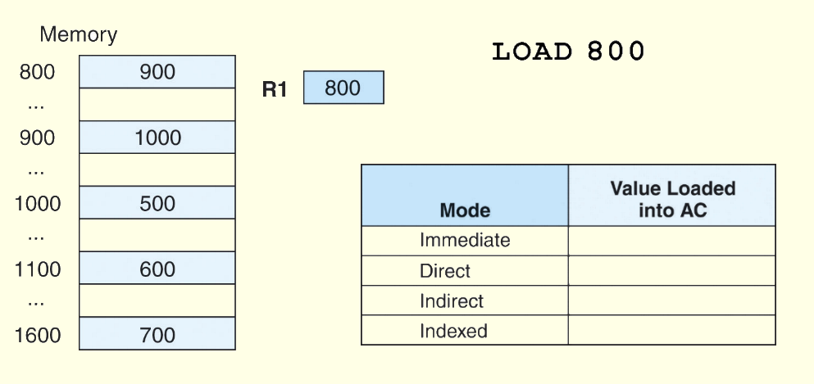
Address Modes: Example
For the instruction shown, what value is loaded into the accumulator for each addressing mode?

Slide 17
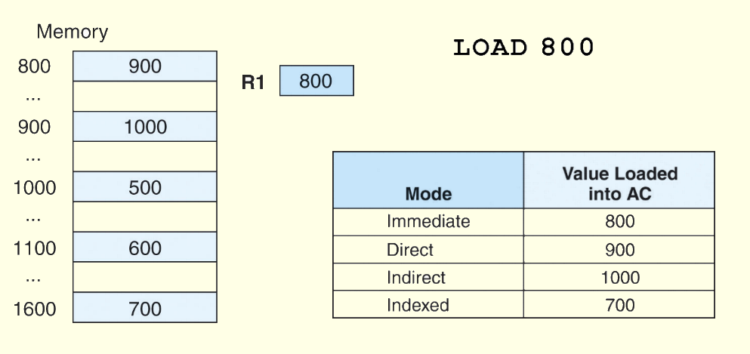
Address Modes: Example
These are the values loaded into the accumulator for each addressing mode.

Slide 18
End Section 5.4
18
Notes:
18

