Slide 1

Chapter 5
A Closer Look at Instruction Set Architectures

Slide 2
Chapter 5
5.1 Introduction
5.2 Instruction Formats
5.3 Instruction types
5.4 Addressing
5.5 Instruction-Level Pipelining
5.6 Real-World Examples of ISAs

Slide 3
Instruction-Level Pipelining
Some CPUs divide the fetch-decode-execute cycle into smaller steps.
These smaller steps can often be executed in parallel to increase throughput.
Such parallel execution is called instruction-level pipelining.
This term is sometimes abbreviated ILP in the literature.
The next slide shows an example of instruction-level pipelining.

Slide 4
Instruction-Level Pipelining
Suppose a fetch-decode-execute cycle were broken into the following smaller steps:
Suppose we have a six-stage pipeline. S1 fetches the instruction, S2 decodes it, S3 determines the address of the operands, S4 fetches them, S5 executes the instruction, and S6 stores the result.
1. Fetch instruction. 4. Fetch operands.
2. Decode opcode. 5. Execute instruction.
3. Calculate effective 6. Store result.
address of operands.

Slide 5
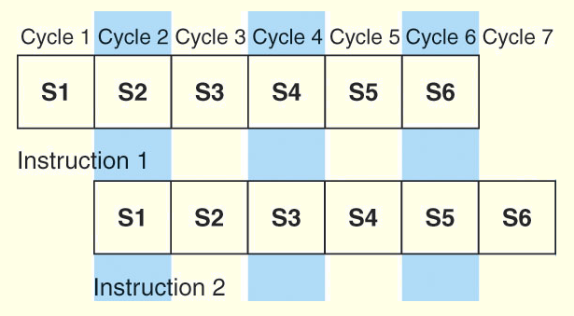
Instruction-Level Pipelining
For every clock cycle, one small step is carried out, and the stages are overlapped.
S1. Fetch instruction. S4. Fetch operands.
S2. Decode opcode. S5. Execute.
S3. Calculate effective S6. Store result.
address of operands.

Slide 6
Instruction-Level Pipelining
The theoretical speedup offered by a pipeline can be determined as follows:
  Let t_{p} be the time per stage. Each instruction represents a task, T, in the pipeline.
  The first task (instruction) requires k × t_{p} time to complete in a k-stage pipeline. The remaining (n - 1) tasks emerge from the pipeline one per cycle. So the total time to complete the remaining tasks is (n - 1)t_{p}.
  Thus, to complete n tasks using a k-stage pipeline requires:
  (k × t_{p}) + (n - 1)t_{p} = (k + n - 1)t_{p}.

Slide 7

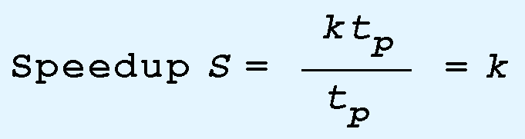
Instruction-Level Pipelining
If we take the time required to complete n tasks without a pipeline and divide it by the time it takes to complete n tasks using a pipeline, we find:
If we take the limit as n approaches infinity, (k + n - 1) approaches n, which results in a theoretical speedup of:

Slide 8
Instruction-Level Pipelining: Example
A nonpipelined system takes 200ns to process a task. The same task can be processed in a 5-segment pipeline with a clock cycle of 40ns. Determine the speedup ratio of the pipeline for 200 tasks. What is the maximum speedup could be achieved with the pipeline unit over the nonpipelined unit?

Slide 9




Instruction-Level Pipelining: Example
k = 5
n = 200

Slide 10
Instruction-Level Pipelining: Exercise
A nonpipelined system takes 100ns to process a task. The same task can be processed in a 5-segment pipeline with a clock cycle of 20ns. Determine the speedup ratio of the pipeline for 100 tasks. What is the maximum speedup could be achieved with the pipeline unit over the nonpipelined unit?

Slide 11
Instruction-Level Pipelining
Our neat equations take a number of things for granted.
First, we have to assume that the architecture supports fetching instructions and data in parallel.
Second, we assume that the pipeline can be kept filled at all times. This is not always the case. Pipeline hazards arise that cause pipeline conflicts and stalls.

Slide 12
Instruction-Level Pipelining
An instruction pipeline may stall, or be flushed for any of the following reasons:
  Resource conflicts.
  Data dependencies.
  Conditional branching.
Measures can be taken at the software level as well as at the hardware level to reduce the effects of these hazards, but they cannot be totally eliminated.

Slide 13

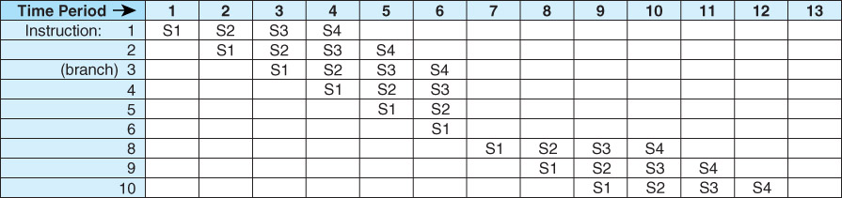
Instruction-Level Pipelining
S1. Fetch instruction.
S2. Decode and calculate effective address of operand.
S3. Fetch operand.
Execute instruction and store results.

Slide 14

End
Section 5.5

Slide 15
5.6 Real-World Examples of ISAs
We return briefly to the Intel and MIPS architectures from the last chapter, using some of the ideas introduced in this chapter.
Intel introduced pipelining to their processor line with its Pentium chip.
The first Pentium had two five-stage pipelines. Each subsequent Pentium processor had a longer pipeline than its predecessor with the Pentium IV having a 24-stage pipeline.
The Itanium (IA-64) has only a 10-stage pipeline.

Slide 16
5.6 Real-World Examples of ISAs
Intel processors support a wide array of addressing modes.
The original 8086 provided 17 ways to address memory, most of them variants on the methods presented in this chapter.
Owing to their need for backward compatibility, the Pentium chips also support these 17 addressing modes.
The Itanium, having a RISC core, supports only one: register indirect addressing with optional post increment.

Slide 17
5.6 Real-World Examples of ISAs
MIPS was an acronym for Microprocessor Without Interlocked Pipeline Stages.
The architecture is little endian and word-addressable with three-address, fixed-length instructions.
Like Intel, the pipeline size of the MIPS processors has grown: The R2000 and R3000 have five-stage pipelines.; the R4000 and R4400 have 8-stage pipelines.

Slide 18
5.6 Real-World Examples of ISAs
The R10000 has three pipelines: A five-stage pipeline for integer instructions, a seven-stage pipeline for floating-point instructions, and a six-state pipeline for LOAD/STORE instructions.
In all MIPS ISAs, only the LOAD and STORE instructions can access memory.
The ISA uses only base addressing mode.
The assembler accommodates programmers who need to use immediate, register, direct, indirect register, base, or indexed addressing modes.

Slide 19
5.6 Real-World Examples of ISAs
The Java programming language is an interpreted language that runs in a software machine called the Java Virtual Machine (JVM).
A JVM is written in a native language for a wide array of processors, including MIPS and Intel.
Like a real machine, the JVM has an ISA all of its own, called bytecode. This ISA was designed to be compatible with the architecture of any machine on which the JVM is running.
The next slide shows how the pieces fit together.

Slide 20
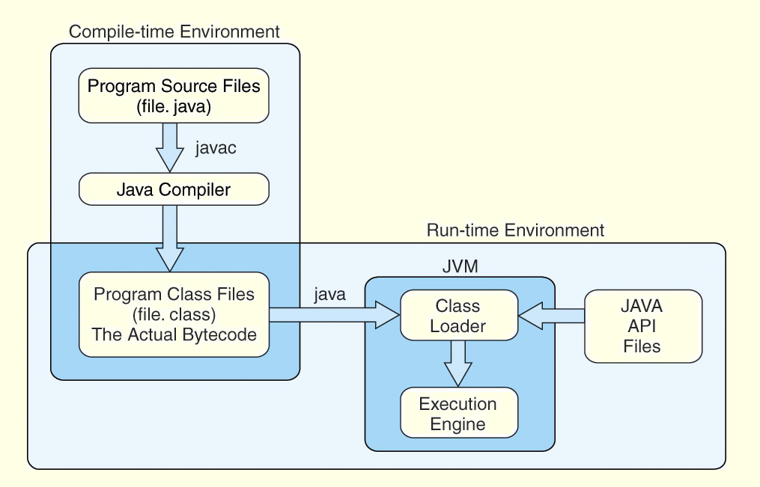
5.6 Real-World Examples of ISAs

Slide 21
5.6 Real-World Examples of ISAs
Java bytecode is a stack-based language.
Most instructions are zero address instructions.
The JVM has four registers that provide access to five regions of main memory.
All references to memory are offsets from these registers. Java uses no pointers or absolute memory references.
Java was designed for platform interoperability, not performance!

Slide 22
End
Section 5.6 & Chapter 5

Slide 23
Chapter 5 Conclusion
ISAs are distinguished according to their bits per instruction, number of operands per instruction, operand location and types and sizes of operands.
Endianness as another major architectural consideration.
CPU can store store data based on
  1. A stack architecture
  2. An accumulator architecture
  3. A general purpose register architecture.

Slide 24
Chapter 5 Conclusion
Instructions can be fixed length or variable length.
To enrich the instruction set for a fixed length instruction set, expanding opcodes can be used.
The addressing mode of an ISA is also another important factor. We looked at:
  Immediate – Direct
  Register – Register Indirect
  Indirect – Indexed
  Based – Stack

Slide 25
Chapter 5 Conclusion
A k-stage pipeline can theoretically produce execution speedup of k as compared to a non-pipelined machine.
Pipeline hazards such as resource conflicts and conditional branching prevents this speedup from being achieved in practice.
The Intel, MIPS, and JVM architectures provide good examples of the concepts presented in this chapter.

Slide 26
End of Chapter 5

