Slide 1
Functional Programming
Chapter 15
CS 304 – Ch. 15

Slide 2
Introduction
Functional Programming Languages
The design of the imperative languages is based directly on the von Neumann architecture
  Efficiency is the primary concern, rather than the suitability of the language for software development
The design of the functional languages is based on mathematical functions
  A solid theoretical basis that is also closer to the user, but relatively unconcerned with the architecture of the machines on which programs will run
CS 304 – Ch. 15

Slide 3
Introduction
Functional programming began in the late 1950s with LISP programming language
  The second oldest programming language (after FORTRAN)
  John McCarthy (MIT) - 1958
  There are many LISP dialects
    LISP 1.5 (1960)
    Scheme (1975)
    Common LISP (1985)
  LISP ⬄ LISt Processing
  LISP ⬄ Lots of Irritating Stupid Parenthesis ☺
Other important functional programming languages :
  ML, Miranda, Haskell.
The mathematical basis of many functional programming languages is λ-calculus
  Allows expressions that have functions as values
CS 304 – Ch. 15

Slide 4
Mathematical Functions
Def: A mathematical function is a mapping of members of one set, called the domain set, to another set, called the range set
A lambda expression specifies the parameter(s) and the mapping of a function in the following form
λ(x) x * x * x
for the function cube (x) = x * x * x
Lambda functions are nameless functions
CS 304 – Ch. 15

Slide 5
Simple Functions
Lambda expressions describe nameless functions
  Alonzo Church, 1941
Lambda expressions are applied to parameter(s) by placing the parameter(s) after the expression
  e.g. (λ(x) x * x * x)(3)
  which evaluates to 27
  Parameters of a function represent any member of the domain set
  However, during function application, each parameter is bound to exactly one specific member of the domain set
CS 304 – Ch. 15

Slide 6
Functional Forms
Def: A higher-order function, or functional form, is one that either takes functions as parameters or yields a function as its result, or both
1. Function Composition
A functional form that takes two functions as parameters and yields a function whose result is a function whose value is the first actual parameter function applied to the result of the application of the second
  Form: h = f ° g
  which means h (x) =  f ( g ( x))
CS 304 – Ch. 15

Slide 7
Functional Forms
2. Construction
A functional form that takes a list of functions as parameters and yields a list of the results of applying each of its parameter functions to a given parameter
  Form: [f, g]
  For f (x) = x * x * x and g (x) = x + 3,
  [f, g] (4) yields (64, 7)
  For f (x) = x * x, g (x) = 2 * x + 3, h (x) = 5 – x
  [f, g, h] (5) = (25, 13, 0)
CS 304 – Ch. 15

Slide 8
Functional Forms
3. Apply-to-all
A functional form that takes a single function as a parameter and yields a list of values obtained by applying the given function to each element of a list of parameters
  Form: α
  For h (x) =  x * x * x
  α ( h, (3, 2, 4)) yields (27, 8, 64)
  Scheme example of apply to all:
  (apply (lambda (x) (+ x 3)) ‘(3 5 2 6))
  result: (6, 8, 5, 9)
CS 304 – Ch. 15

Slide 9
Fundamentals of Functional Languages
The objective of the design of a Functional Programming Language (FPL) is to mimic mathematical functions to the greatest extent possible
The basic process of computation is fundamentally different in a FPL than in an imperative language
  In an imperative language, operations are done and the results are stored in variables for later use
  Management of variables is a constant concern and source of complexity for imperative programming
In an FPL, variables are not necessary, as is the case in mathematics
CS 304 – Ch. 15

Slide 10
Fundamentals of Functional Languages
In an FPL, the evaluation of a function always produces the same result given the same parameters
  This is called referential transparency
  Makes semantics of pure functional languages simpler that that of imperative languages
    No side effects !!!
A functional programming language provides:
  A set of primitive functions
  A set of functional forms for complex function construction
  A function application operation
  Data structure(s) for data representation
CS 304 – Ch. 15

Slide 11
LISP
LISP - the first functional programming language
  Originally, LISP was a typeless language
  Data object types: originally only atoms and lists
List form: parenthesized collections of sublists and/or atoms
  e.g., (A B (C D) E (F (G H)))
  4层- 第一A B E 第二 C D 第三F 第四 G H
LISP lists are stored internally as single-linked lists
  Lambda notation is used to specify functions and function definitions
  function applications, and data all have the same form
CS 304 – Ch. 15

Slide 12
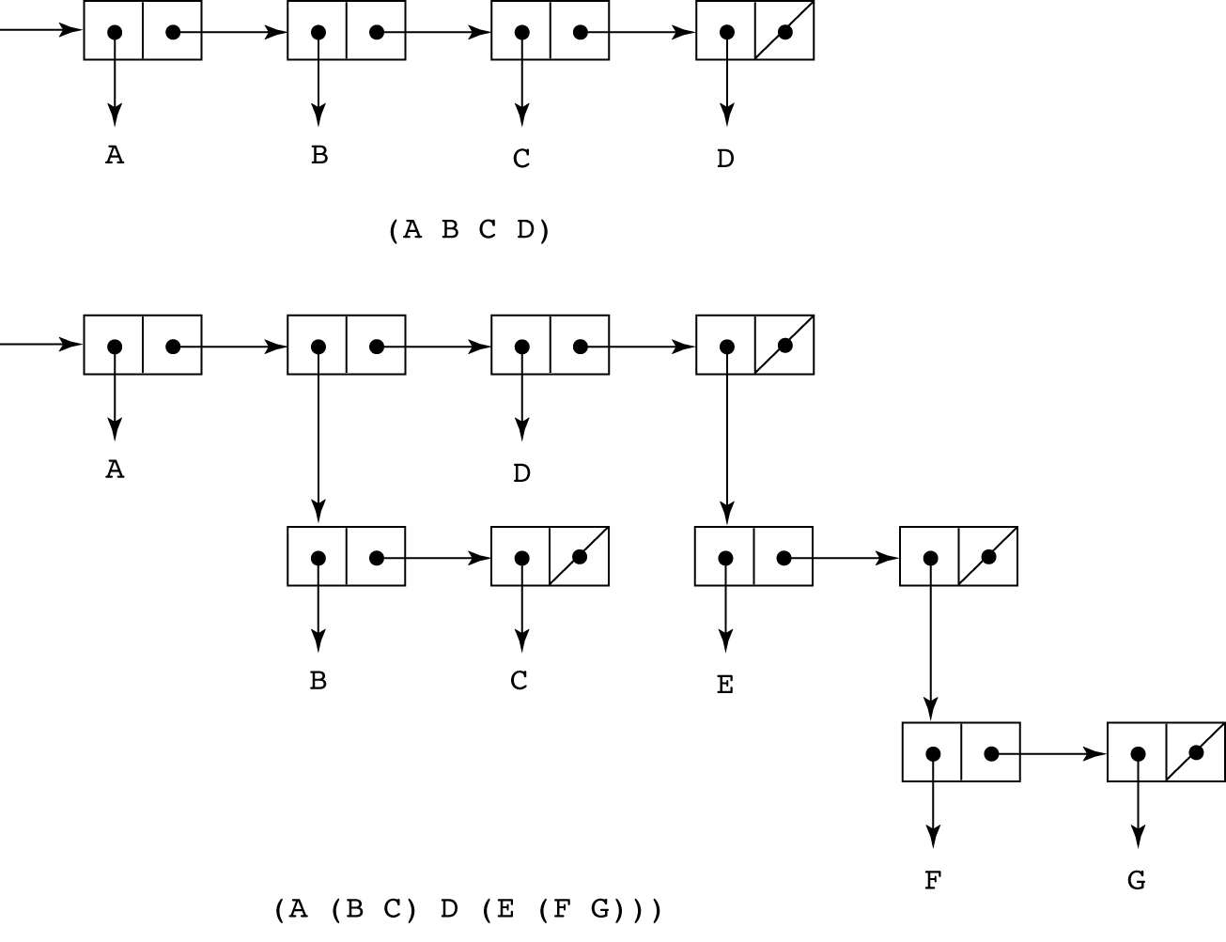
Figure 15.1
Internal representation of two LISP lists
CS 304 – Ch. 15

Slide 13
LISP
Lambda notation is used to specify functions and function definitions
Function applications and data all have the same form
e.g.,
  If the list (A B C) is interpreted as data it is a simple list of three atoms, A, B, and C
  If it is interpreted as a function application, it means that the function named A is applied to the two parameters, B and C
  The first LISP interpreter appeared only as a demonstration of the universality of the computational capabilities of the notation
  The original lisp used dynamic scoping
    Functions were evaluated in the caller’s environment
CS 304 – Ch. 15

Slide 14
LISP
John McCarthy
  Wrote a paper about symbolic derivation to promote functional programming
  But thought list processing can replace Turing machines
    More natural way of computation
  EVAL :
    universal LISP function that evaluates other functions
  Cambridge Polish notation (prefix):
    Expressing data and functions in the same way
    (function_name arg_1 … arg_n)
    (+ 5 7 9)
    Lambda notation for function specification
    (function_name (LABMDA (arg_1 … arg_n) expression)
  Lisp data and code are called S-expressions
CS 304 – Ch. 15

Slide 15
Scheme
A mid-1970s dialect of LISP, designed to be cleaner, more modern, and simpler version than the contemporary dialects of LISP
  Sussman and Steele, 1975
  Uses only static scoping
Functions are first-class entities
  They can be the values of expressions and elements of lists
  They can be assigned to variables and passed as parameters
Identifiers in Scheme:
  consist of letters, digits, and special characters except parentheses; cannot begin with a digit
CS 304 – Ch. 15

Slide 16
Scheme
Scheme interpreter
  Read – Evaluate – Write loop
Primitive Functions
1. Arithmetic: +, -, *, /, ABS, SQRT
  e.g., (+ 5 2) yields 7
  Can have more than two parameters
  (+ 1 2 3 4 5) yields 15
  (- 15 2 3 1) yields 9
  (- 24 (* 3 2)) yields 18
2. EVAL
  Basis of all evaluation in LISP
  Evaluate portion of the Read-Evaluate-Write loop
  EVAL evaluates all parameters of the given function first
CS 304 – Ch. 15

Slide 17
Scheme
  But sometimes data is not to be evaluated immediately
  A function receiving an atom and a list, deciding whether the atom is in the list
    The list and the atom should not be evaluated, but rather examined
  To avoid parameter evaluation, use function QUOTE
3. QUOTE
  takes one parameter; returns the parameter without evaluation
  QUOTE is required because the Scheme interpreter, named EVAL, always evaluates parameters to function applications before applying the function
  QUOTE is used to avoid parameter evaluation when it is not appropriate
  (QUOTE (A B C)) yields (A B C) : not evaluated as a function call!
  QUOTE can be abbreviated with the apostrophe prefix operator
    e.g., '(A B) is equivalent to (QUOTE (A B))
CS 304 – Ch. 15

Slide 18
Scheme
Primitive functions for list operations:
4. CAR (Contents of the Address Register)
  takes a list parameter; returns the first element of that list
  e.g., (CAR '(A B C)) yields A
  (CAR '((A B) C D)) yields (A B)
5. CDR (Contents of the Decrement Register)
  takes a list parameter; returns the list after removing its first element
  e.g., (CDR '(A B C)) yields (B C)
  (CDR '((A B) C D)) yields (C D)
6. CONS
  takes two parameters, the first of which can be either an atom or a list and the second of which is a list
  returns a new list that includes the first parameter as its first element and the second parameter as the remainder of its result
  e.g., (CONS 'A '(B C)) returns (A B C)
(CONS (CAR lis) (CDR lis)) = lis : identity function
CS 304 – Ch. 15

Slide 19
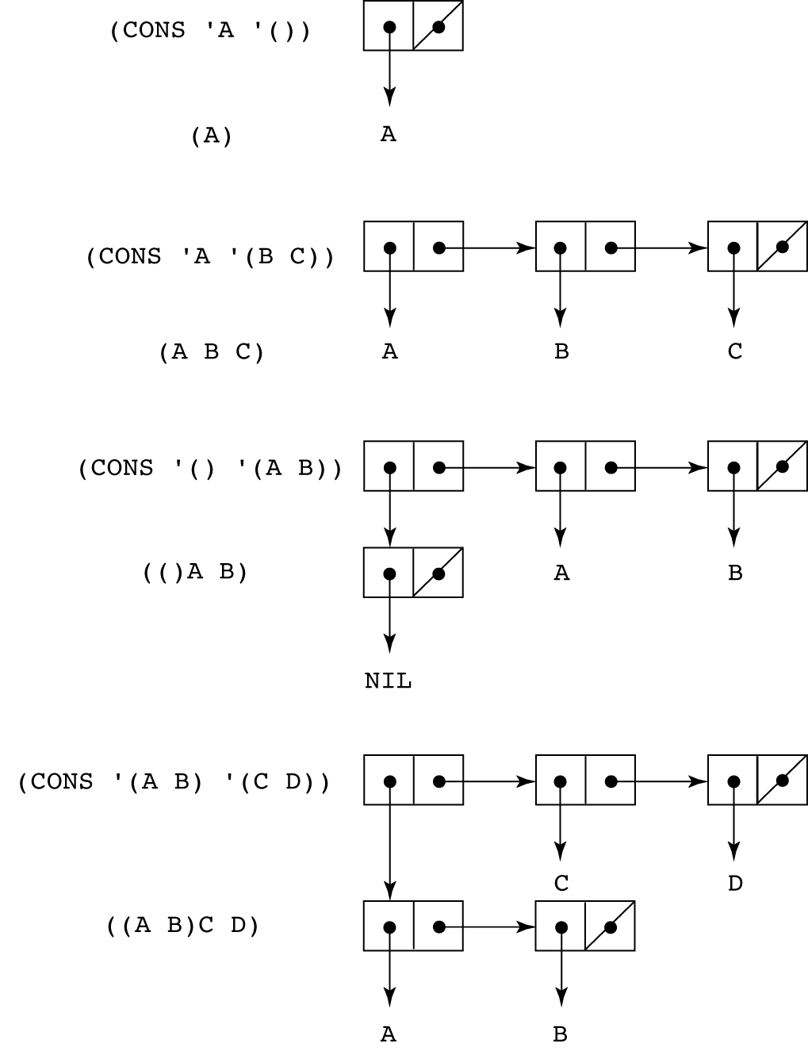
Figure 15.2
The result of
several CONS
operations
CS 304 – Ch. 15

Slide 20
Scheme
7. LIST
  takes any number of parameters; returns a list with the parameters as elements
  e.g., (list ‘A ‘B ‘C ‘D) yields (A B C D)
  (list ‘A ‘(B F) ‘(C D)) yields (A (B F) (C D))
Predicate Functions: (#T and () are true and false)
1. EQ?
  takes two symbolic parameters; it returns #T if both parameters are atoms and the two are the same
  e.g., (EQ? 'A 'A) yields #T
  (EQ? 'A '(A B)) yields ()
  Note that if EQ? is called with list parameters, the result is not reliable
    Depends on the internal list representation
  Also, EQ? does not work for numeric atoms
CS 304 – Ch. 15

Slide 21
Scheme
2. LIST?
  takes one parameter; it returns #T if the parameter is an list; otherwise ()
    (LIST? ‘(A B)) ➔ #T
    (LIST? ‘A) ➔ ()
3. NULL?
  takes one parameter; it returns #T if the parameter is the empty list; otherwise ()
  Note that NULL? returns #T if the parameter is ()
    (NULL? ‘A) ➔ ()
    (NULL? ‘(())) ➔ ()
4. Numeric Predicate Functions
  =, <>, >, <, >=, <=, EVEN?, ODD?, ZERO?
    (EVEN? 3) ➔ () (ODD? 3) ➔ #T
CS 304 – Ch. 15

Slide 22
Scheme
5. Output Utility Functions:
  (DISPLAY expression)
  (NEWLINE)
  e.g.,
    (DISPLAY “Please enter a number:”)
    (NEWLINE)
Lambda Expressions
  Form is based on λ notation
  e.g.,
    (LAMBDA (L) (CAR (CAR L)))
  L is called a bound variable
  Lambda expressions can be applied
  e.g.,
    ((LAMBDA (L) (CAR (CAR L))) '((A B) C D))
CS 304 – Ch. 15

Slide 23
Scheme
Functions for Constructing Functions
DEFINE - Two forms:
1. To bind a symbol to an expression
  e.g.,
    (DEFINE pi 3.141593)
    (DEFINE two_pi (* 2 pi))
2. To bind names to lambda expressions
  e.g.,
    (DEFINE (cube x) (* x x x))
Example use:
    (cube 4)
CS 304 – Ch. 15

Slide 24
Scheme
More examples:
  Function definition
    Bind name to a function
  (DEFINE (function_name parameters)
  body
  )
  (DEFINE square (LAMBDA (number) (* number number)))
  or
  (DEFINE (square number) (* number number))
    LAMBDA is implicit and therefore can be omitted
  Call:
  (square 10) ➔ 100
CS 304 – Ch. 15

Slide 25
Scheme
Evaluation process (for normal functions):
  1. Parameters are evaluated, in no particular order
  2. The values of the parameters are substituted into the function body
  3. The function body is evaluated
  4. The value of the last expression in the body is the value of the function
Special forms use a different evaluation process
  E.g., IF, COND, etc…
CS 304 – Ch. 15

Slide 26
Control Flow
Modeled after the mathematical functions
1. Selection - the special form IF
  (IF predicate then_exp else_exp)
  e.g.,
  (IF (<> count 0)
  (/ sum count)
  0
  )
  Example:
  (DEFINE (fact number)
  (IF (= number 0)
  1
  ( (* number
  (fact (- number 1))))
  )
CS 304 – Ch. 15

Slide 27
Control Flow
2. Multiple Selection - the special form COND
  General form:
(COND
(predicate_1 expr {expr})
(predicate_2 expr {expr})
...
(predicate_n expr {expr})
(ELSE expr {expr})
)
  Returns the value of the last expr in the first pair whose predicate evaluates to true
  (DEFINE (compare x y)
  (COND
  ((> x y) (DISPLAY “X > Y.”))
  ((< x y) (DISPLAY “X < Y.”))
  (#T (DISPLAY “X and Y are equal))
  )
  )
CS 304 – Ch. 15

Slide 28
Example Scheme Functions
1. member
  takes an atom and a list; returns #T if the atom is in the list; () otherwise
  (member ‘B ‘(A B C)) ➔ #T
  (member ‘D ‘(A B C)) ➔ ()
  (DEFINE (member atm lis)
  (COND
  ((NULL? lis) '())
  ((EQ? atm (CAR lis)) #T)
  ((ELSE (member atm (CDR lis)))
  ))
CS 304 – Ch. 15

Slide 29
Example Scheme Functions
2. equalsimp
  takes two simple lists as parameters; returns #T if the two simple lists are equal; () otherwise
  (DEFINE (equalsimp lis1 lis2)
  (COND
  ((NULL? lis1) (NULL? lis2))
  ((NULL? lis2) '())
  ((EQ? (CAR lis1) (CAR lis2))
  (equalsimp (CDR lis1) (CDR lis2)))
  (ELSE '())
  ))
CS 304 – Ch. 15

Slide 30
Example Scheme Functions
3. equal
  takes two lists as parameters; returns #T if the two general lists are equal; () otherwise
(DEFINE (equal lis1 lis2)
(COND
((NOT (LIST? lis1)) (EQ? lis1 lis2))
((NOT (LIST? lis2)) '())
((NULL? lis1) (NULL? lis2))
((NULL? lis2) '())
((equal (CAR lis1) (CAR lis2))
(equal (CDR lis1) (CDR lis2)))
(ELSE '())
))
CS 304 – Ch. 15

Slide 31
Example Scheme Functions
4. append
  takes two lists as parameters; returns the first parameter list with the elements of the second parameter list appended at the end
  (append ‘(B D E) ‘(A B C)) ➔ (B D E A B C)
  (append ‘((B) D E) ‘(A (B C))) ➔ ((B) D E A (B C))
  (DEFINE (append lis1 lis2)
  (COND
  ((NULL? lis1) lis2)
  (ELSE (CONS (CAR lis1)
  (append (CDR lis1) lis2)))
  ))
CS 304 – Ch. 15

Slide 32
Functional Forms in Scheme
1. Composition
  The previous examples have used it
  e.g., (CAR (CDR ‘(A B C)))
2. Apply to All
  one form in Scheme is mapcar
  Applies the given function to all elements of the given list; result is a list of the results
  (DEFINE mapcar fun lis)
  (COND
  ((NULL? lis) '())
  (ELSE (CONS (fun (CAR lis))
  (mapcar fun (CDR lis))))
  ))
CS 304 – Ch. 15

Slide 33
Functions that Build Code
It is possible in Scheme to define a function that builds Scheme code and requests its interpretation
  This is possible because the interpreter is a user-available function, EVAL
  e.g., suppose we have a list of numbers that must be added together
((DEFINE (adder lis)
(COND
((NULL? lis) 0)
(ELSE (+ (CAR lis) (adder (CDR lis))))
))
  ALTERNATIVELY, WE CAN USE EVAL …
((DEFINE (adder lis)
(COND
((NULL? lis) 0)
(ELSE (EVAL (CONS '+ lis)))
))
  The parameter is a list of numbers to be added; adder inserts a + operator and interprets the resulting list
CS 304 – Ch. 15

Slide 34
Trees in Scheme
List representation of trees
Format : (ROOT child_1 child_2 .... child_n)
  Where children may be other trees (lists)
  (define tree '(A (B (C D E)) F))
    A
    / \
    B F
    |
    C
    / \
    D E
CS 304 – Ch. 15

Slide 35
  - After the definition
  (define dozen 12)
  what will be the value of the Scheme expression (number? dozen)?
  - Give a Scheme definition that will determine the sum of 31, 29, 31, 30, 31, and 10 and bind the identifier day-of-year to this sum.
  - Define a recursive Scheme procedure first-symbol that finds and returns the first element of a given list that is a symbol (but returns #f if none of the elements of the list is a symbol).
  (define first-symbol
  (lambda (li)
  (cond ((null? li) #f)
  ((symbol? (car li)) (car li))
  (else (first-symbol (cdr li))))))
  10. Define a recursive Scheme procedure add-1-to-each that, given any list of numbers, returns a list of equal length in which each element is 1 greater than the corresponding element of the given list. For example, the value of (add-1-to-each '(3 8 6)) should be (4 9 7).
  (define add-1-to-each
  (lambda (li)
  (if (null? li)
  '()
  (cons (+ (car li) 1) (add-1-to-each (cdr li))))))
CS 304 – Ch. 15

Slide 36
  - Define a recursive Scheme procedure tally that counts and returns the number of occurrences of a given value in a given list. For example, the value of
  (tally 'a '(b a 7 c a a 3 a)) should be 4.
  (define tally
  (lambda (val li)
  (cond ((null? li) 0)
  ((equal? (car li) val) (+ 1 (tally val (cdr li))))
  (else (tally val (cdr li))))))
  - Define a Scheme procedure all-different? that determines whether all of the top-level elements of a given list are distinct (that is, not equal?).
  This solution uses the member? procedure (can you define it?)
  (define all-different?
  (lambda (li)
  (if (null? li)
  #t
  (and (not (member? (car li) (cdr li)))
  (all-different? (cdr li))))))
CS 304 – Ch. 15

Slide 37
  - Define a Scheme procedure attach-at-end that takes any value as its first argument and a list as its second argument and returns a list containing all of the same elements as the given list except that the given value has been added as the last element.
(define attach-at-end
(lambda (val li)
(if (null? li)
(list val)
(cons (car li) (attach-at-end val (cdr li))))))
- Define a Scheme procedure mean that takes a non-empty list of numbers and returns the arithmetic mean of its elements.
(define mean
(lambda (li)
(/ (sum li) (length li))))
(define sum
(lambda (li)
(if (null? li)
0
(+ (car li) (sum (cdr li))))))
CS 304 – Ch. 15

Slide 38
Imperative Features of Scheme
No needed in functional programming
  Included only to “spoil” imperative programmers ☺
  1. SET!
    binds or rebinds a value to a name
  2. SET-CAR!
    replaces the car of a list
  3. SET-CDR!
    replaces the cdr part of a list
  Functional programs that use imperative features are harder to debug
    Side Effects and Aliasing may cause trouble!
CS 304 – Ch. 15

Slide 39
Common LISP
A combination of many of the features of the popular dialects of LISP around in the early 1980s
  A large and complex language
  Can be said that it is the opposite of Scheme
LISP includes:
  - records
  - arrays
  - complex numbers
  - character strings
  - powerful i/o capabilities
  - packages with access control
  - imperative features like those of Scheme
  - iterative control statements
CS 304 – Ch. 15

Slide 40
Common LISP
Example (iterative set membership, member)
  (DEFUN iterative_member (atm lst)
  (PROG ()
  loop_1
  (COND
  ((NULL lst) (RETURN NIL))
  ((EQUAL atm (CAR lst)) (RETURN T))
  )
  (SETQ lst (CDR lst))
  (GO loop_1)
  ))
CS 304 – Ch. 15

Slide 41
ML (Machine Learning)
A static-scoped functional language with syntax that is closer to Pascal than to LISP
Uses type declarations, but also does type inferencing to determine the types of undeclared variables (See Chapter 4)
It is strongly typed (whereas Scheme is essentially typeless) and has no type coercions
Includes exception handling and a module facility for implementing abstract data types
Includes lists and list operations
CS 304 – Ch. 15

Slide 42
ML (Machine Learning)
The val statement binds a name to a value (similar to DEFINE in Scheme)
Function declaration form:
  fun function_name (formal_parameters) =
  function_body_expression;
  e.g., fun cube (x : int) = x * x * x;
  Functions that use arithmetic or relational operators cannot be polymorphic--those with only list operations can be polymorphic
  Powerful pattern-matching facilities
CS 304 – Ch. 15

Slide 43
Haskell
Similar to ML (syntax, static scoped, strongly typed, type inferencing)
Different from ML (and most other functional languages) in that it is PURELY functional
  e.g., no variables, no assignment statements, and no side effects of any kind!!!
Most Important Features
  Uses lazy evaluation (evaluate no subexpression until the value is needed)
  Has “list comprehensions,” which allow it to deal with infinite lists
Examples:
1. Fibonacci numbers (illustrates function definitions with different parameter forms)
fib 0 = 1
fib 1 = 1
fib (n + 2) = fib (n + 1) + fib n
CS 304 – Ch. 15

Slide 44
Haskell
  Examples:
  product [] = 1
  product (a:x) = a * product x
  fact n = product [1..n]
4. List comprehensions: set notation
  e.g., [n * n | n ← [1..20]]
  defines a list of the squares of the first 20 positive integers
  factors n = [i | i [1..n div 2],
  n mod i == 0]
    This function computes all of the factors of its given parameter
  Quicksort:
sort [] = []
sort (a:x) = sort [b | b ← x; b <= a]
++ [a] ++
sort [b | b ← x; b > a]
CS 304 – Ch. 15
Notes:
[4 7 3 5 2 8 6]
4:[7 3 5 2 8 6]
[3 2]++ 4 ++[7 5 8 6]

Slide 45
Haskell
5. Lazy evaluation
  Infinite lists
  e.g.,
  positives = [0..]
  squares = [n * n | n  [0..]]
  (only compute those that are necessary)
  e.g., member squares 16
  would return True
  The member function could be written as:
  member [] b = False
  member (a:x) b = (a == b) || member x b
  However, this would only work if the parameter to squares was a perfect square; if not, it will keep generating them forever. The following version will always work:
member2 (m:x) n
| m < n = member2 x n
| m == n = True
| otherwise = False
CS 304 – Ch. 15

Slide 46
Haskell
2. Factorial (illustrates guards)
fact n
| n == 0 = 1
| n > 0 = n * fact (n - 1)
  The special word otherwise can appear as a guard
3. List operations
  List notation: Put elements in brackets
    e.g., directions = [north, south, east, west]
  Length: #
    e.g., #directions is 4
  Arithmetic series with the .. operator
    e.g., [2, 4..10] is [2, 4, 6, 8, 10]
  Catenation is with +
    e.g., [1, 3] ++ [5, 7] results in [1, 3, 5, 7]
  CAR and CDR via the colon operator (as in Prolog)
    e.g., 1:[3, 5, 7] results in [1, 3, 5, 7]
CS 304 – Ch. 15

Slide 47
Applications of Functional Languages
APL is used for throw-away programs
LISP is used for artificial intelligence
  - Knowledge representation
  - Machine learning
  - Natural language processing
  - Modeling of speech and vision
Scheme is used to teach introductory programming at a significant number of universities
CS 304 – Ch. 15

Slide 48
Comparing Functional and Imperative Languages
Imperative Languages:
  Efficient execution
  Complex semantics
  Complex syntax
  Concurrency is programmer designed
Functional Languages:
  Simple semantics
  Simple syntax
  Inefficient execution
  Programs can automatically be made concurrent
CS 304 – Ch. 15

