Slide 1
Describing Syntax and Semantics
Chapter 3
CS 304 – Programming Languages – Ch. 3

Slide 2
Syntax and Semantics
Syntax - the form or structure of the expressions,
statements, and program units
- e.g., an integer variable may be followed with “++”
Semantics - the meaning of the expressions,
statements, and program units
- Depends on the context
- e.g., an integer variable followed by “++” is incremented after the assignment in the statement “x = i++;”
“The form and the meaning”
Very closely related
CS 304 – Programming Languages – Ch. 3

Slide 3
3.1 Introduction
Description of a PL :: Concise yet understandable
  Algol
Who must use language definitions?
  1. Other language designers
  2. Implementers
  3. Programmers (the users of the language)
Syntax
  while (<boolean_expr>) <statement> (Java)
Semantics
  while the value of <boolean_expr> is true, keep on executing <statement>
  Difficult to describe in a formal intuitive manner
CS 304 – Programming Languages – Ch. 3

Slide 4
3.2 The general problem of describing syntax
A sentence is a string of characters over some alphabet
A language is a set of sentences
OR
A language is a set of all valid strings over a finite alphabet
- e.g., words are valid strings of characters in English language
A lexeme is the lowest level syntactic unit of a language (e.g., *, sum, begin)
A token is a category of lexemes (e.g., identifier)
Examples:
Lexemes | Tokens
count | IDENTIFIER
= | EQUAL_OP
35 | INT_LITERAL
; | SEMICOLON
CS 304 – Programming Languages – Ch. 3

Slide 5
3.2 The general problem of describing syntax
Formal approaches to describing syntax:
1. Recognizers - used in compilers
2. Generators / Grammars – easier to understand
Languages can be specified by either a grammar or a recognizer
CS 304 – Programming Languages – Ch. 3

Slide 6

3.2.1 Language Recognizers
Compiler’s syntax analysis (parsing) part
  a recognizer for the language the compiler translates
  Need not enumerate all possible strings
    just check if inputs are valid strings
Given a language L and alphabet , construct a machine R that recognizes the language
Accept or reject a string
Infinite number of possibilities
Syntax analyzers / Parsers
CS 304 – Programming Languages – Ch. 3

Slide 7
3.2.2 Language Generators
Machine that generates sentences of a language
  Determine the correctness of a particular sentence of a language by comparing it to a generator’s structure
  Useful for programmers!
Language descriptor
Close connection between recognizers and generators
CS 304 – Programming Languages – Ch. 3

Slide 8
3.3 Formal Methods of Describing Syntax
Context-Free Grammars
  Developed by Noam Chomsky in the mid-1950s
  Language generators, meant to describe the syntax of natural languages
  Defined 4 class of languages / grammars :
    Regular
    Context-free
    Context-sensitive
    Unrestricted
  Tokens of a PLs can be described by a regular grammar
  PLs can be described by context-free grammars (almost!)
CS 304 – Programming Languages – Ch. 3

Slide 9
3.3 Formal Methods of Describing Syntax
Backus-Naur Normal Form (BNF)
  Invented by John Backus to describe Algol 58
  BNF is equivalent to context-free grammars
  A metalanguage is a language used to describe another language.
    BNF is a metalanguage for PLs
  In BNF, abstractions are used to represent classes of syntactic structures--they act like syntactic variables (also called nonterminal symbols)
  e.g.,
  <while_stmt> -> while <logic_expr> do <stmt>
    This is a rule; it describes the structure of a while statement
CS 304 – Programming Languages – Ch. 3

Slide 10
3.3 Formal Methods of Describing Syntax
<assign> → <var> = <expression>
  A rule (production) has a left-hand side (LHS) and a right-hand side (RHS), and consists of terminal and nonterminal symbols
  Abstractions :: nonterminal symbols
  Lexemes and tokens :: terminal symbols
  A grammar is a finite nonempty set of rules
  An abstraction (nonterminal symbol) can have more than one RHS
  <stmt> -> <single_stmt>
  | begin <stmt_list> end
  Simple, yet powerful
CS 304 – Programming Languages – Ch. 3

Slide 11
3.3 Formal Methods of Describing Syntax
  Variable-length lists : 1, 2, …
Syntactic lists are described in BNF using recursion
  <ident_list> -> ident
  | ident, <ident_list>
A rule is recursive if its LHS appears on its RHS
  Recursion is a cornerstone of functional programming
CS 304 – Programming Languages – Ch. 3

Slide 12
Grammars and Derivations
  Grammar : generative device for defining languages
A derivation is a repeated application of rules, starting with the start symbol and ending with a sentence (all terminal symbols)
  An example grammar:
  <program> -> <stmts>
  <stmts> -> <stmt> | <stmt> ; <stmts>
  <stmt> -> <var> = <expr>
  <var> -> a | b | c | d
  <expr> -> <term> + <term> | <term> - <term>
  <term> -> <var> | const
  An example derivation:
  <program> => <stmts> => <stmt>
  => <var> = <expr> => a = <expr>
  => a = <term> + <term>
  => a = <var> + <term>
  => a = b + <term>
  => a = b + const
CS 304 – Programming Languages – Ch. 3

Slide 13
Grammars and Derivations
Every string of symbols in the derivation is a sentential form
  e.g., <program>
A sentence is a sentential form that has only terminal symbols
  e.g., a = b + const
A leftmost derivation is one in which the leftmost nonterminal in each sentential form is the one that is expanded (similar for the rightmost derivation)
A derivation may be neither leftmost nor rightmost
CS 304 – Programming Languages – Ch. 3

Slide 14
Grammars and Derivations
A grammar for Simple Assignment Statements
    <assign> → <id> = <expr>
    <id> → A | B | C
    <expr> → <id> + <expr>
    | <id> * <expr>
    | (<expr>)
    | <id>
  Derivation of A = B * (A + C)
    <assign> ➔ <id> = <expr> ➔ A = <expr> ➔ A = <id> * <expr>
    ➔ A = B * <expr> ➔ A = B * (<expr>)
    ➔ A = B * (<id> + <expr>) ➔ A = B * (A + <expr>)
    ➔ A = B * (A + <id>) ➔ A = B * (A + C)
  Leftmost derivation
CS 304 – Programming Languages – Ch. 3

Slide 15
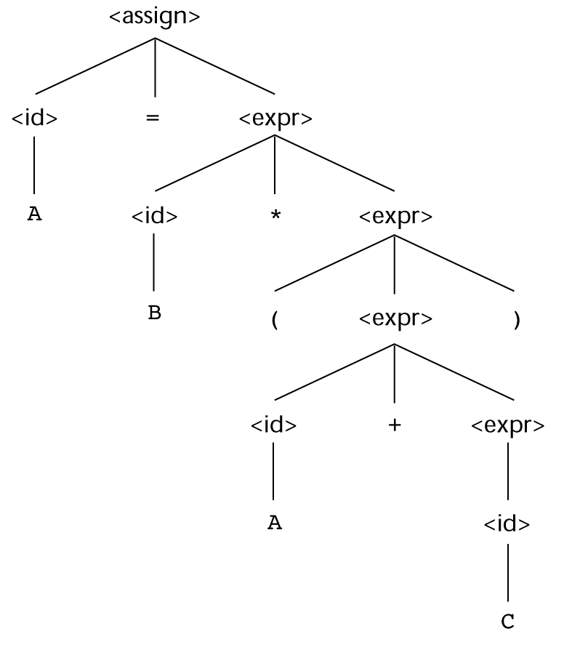
Parse Trees
A parse tree is a hierarchical representation of a derivation
  Parse tree for derivation :
  A = B * (A + C) :
    <assign> → <id> = <expr>
    <id> → A | B | C
    <expr> → <id> + <expr>
    | <id> * <expr>
    | (<expr>)
    | <id>
CS 304 – Programming Languages – Ch. 3

Slide 16
Ambiguity
Grammar is ambiguous if it generates two or more distinct parse trees for a single sentential form
  An ambiguous expression grammar:
  <expr> → <expr> <op> <expr> | const
  <op> → / | -
<expr> <expr>
<expr> <op> <expr> <expr> <op> <expr>
<expr><op><expr> <expr><op><expr>
const - const / const const - const / const
CS 304 – Programming Languages – Ch. 3

Slide 17
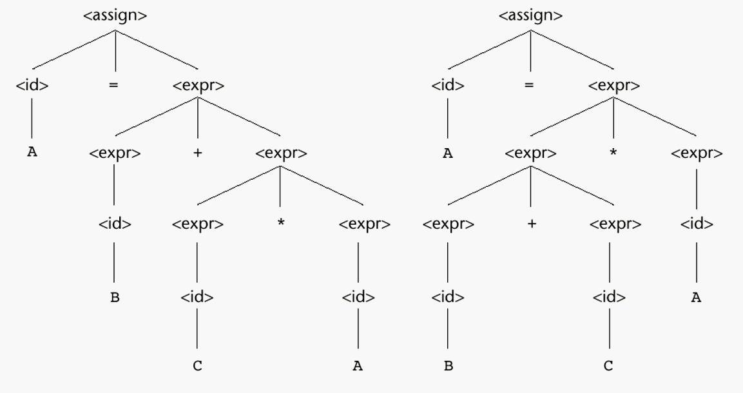
Ambiguity
    <assign> → <id> = <expr>
    <id> → A | B | C
    <expr> → <expr> + <expr>
    | <expr> * <expr>
    | (<expr>)
    | <id>
A = B + C * A
CS 304 – Programming Languages – Ch. 3

Slide 18
Operator Precedence
<expr> → <expr> - <term> | <term>
<term> → <term> / const | const
<expr>
<expr> - <term>
<term> <term> / const
const const
Unambiguous expression grammars
    <assign> → <id> = <expr>
    <id> → A | B | C
    <expr> → <expr> + <term>
    | <term>
    <term> → <term> * <factor>
    | <factor>
    <factor> → (<expr>)
    | <id>
    Derivation of const - const / const?
  Derivation of A = B + C * A?
CS 304 – Programming Languages – Ch. 3

Slide 19
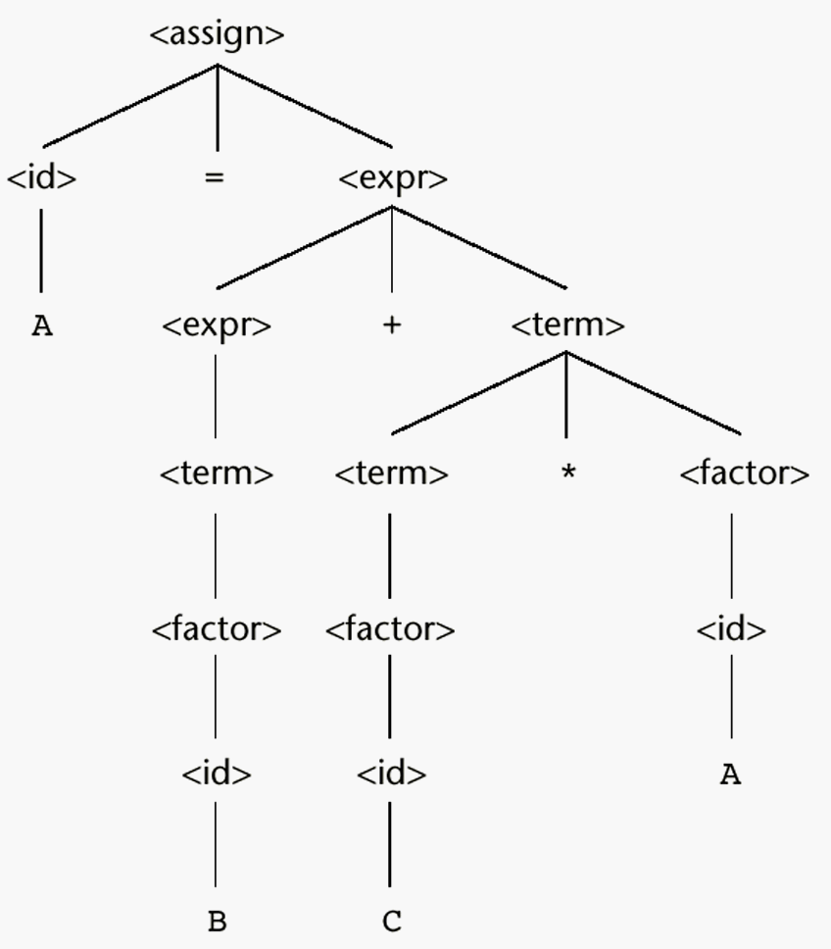
Operator Precedence
    Derivation of A = B + C * A :
    <assign> → <id> = <expr>
    <id> → A | B | C
    <expr> → <expr> + <term>
    | <term>
    <term> → <term> * <factor>
    | <factor>
    <factor> → (<expr>)
    | <id>
CS 304 – Programming Languages – Ch. 3

Slide 20
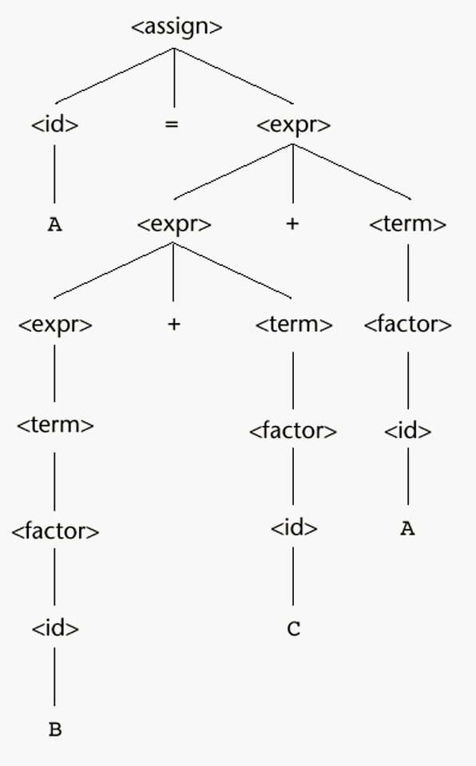
Associativity
A = B + C + A
  Does it matter?
  Answer : yes !
    Floating-point addition
  Left (right) recursive ⬄ left (right) associative
    Exponentiation rule :
    <factor> → <expr> ** <factor>
    | <expr>
    <expr> → (<expr>)
    | <id>
    <assign> → <id> = <expr>
    <id> → A | B | C
    <expr> → <expr> + <term>
    | <term>
    <term> → <term> * <factor>
    | <factor>
    <factor> → (<expr>)
    | <id>
CS 304 – Programming Languages – Ch. 3
Notes:
Max_int
<assign>=><id>=><expr>=><id>=<expr>+<term>=><id>=<expr>+<factor>=><id>=<expr>+<id>=><id>=<expr>+A=><id>=<expr>+<term>+A=><id>=<expr>+<factor>+A=><id>=<expr>+<id>+A=><id>=<expr>+C+A=><id>=<term>+C+A => <id> = <factor> + C + A => <id> =<id>+C+A =><id> = B+C+A=> A= B+C+A

Slide 21
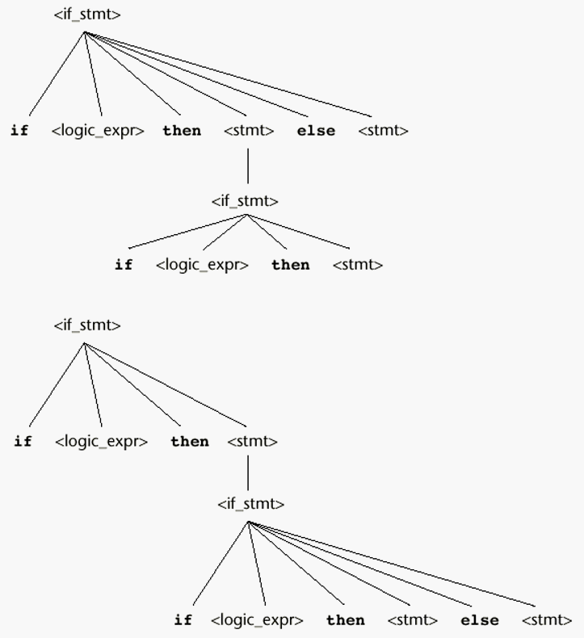
<if_stmt> →
if <logic_expr> then <stmt>
| if <logic_expr> then <stmt> else <stmt>
if <logic_expr> then if <logic_expr> then <stmt> else <stmt>
CS 304 – Programming Languages – Ch. 3

Slide 22
Unambiguous Grammar for if-then-else
<stmt> → matched | unmatched
<matched> → if <logic_expr> then <matched> else <matched>
| any non-if statement
<unmatched> → if <logic_expr> then <stmt>
| if <logic_expr> then <matched> else <unmatched>
Exercise: Construct a parse tree for
    if <logic_expr> then if <logic_expr> then <stmt> else <stmt>
CS 304 – Programming Languages – Ch. 3

Slide 23
Extended BNF
Extended BNF
1. Optional parts are placed in brackets ([])
  <proc_call> → ident [ ( <expr_list>)]
2. Put alternative parts of RHSs in parentheses and separate them with vertical bars
  <term> → <term> (+ | -) const
3. Put repetitions (0 or more) in braces ({})
  <ident> → letter {letter | digit}
CS 304 – Programming Languages – Ch. 3

Slide 24
BNF vs. EBNF
BNF:
  <expr> -> <expr> + <term>
  | <expr> - <term>
  | <term>
  <term> -> <term> * <factor>
  | <term> / <factor>
  | <factor>
EBNF:
  <expr> -> <term> {(+ | -) <term>}
  <term> -> <factor> {(* | /) <factor>}
CS 304 – Programming Languages – Ch. 3

Slide 25
EBNF
Some EBNF Versions allow a numeric subscript with the right brace
  Or you may use repetition symbols from regular grammars:
  “+” : one or more times
  “*” : zero or more times
  compound → begin <stmt> {<stmt>} end
  is equivalent to
  compound → begin {<stmt>}⁺ end
CS 304 – Programming Languages – Ch. 3

Slide 26
Attribute Grammars
Describes more of a structure of a programming language than it is possible to do with a context-free grammar
  Type checking
  Variable declarations before definitions
    Cannot be specified in BNF
  Static Semantics: Legal forms of the programs
    Compile time, syntax-related
    Not really the meaning, but about legal forms
  Additions to Context-Free Grammars (CFGs) to carry some semantic info along through parse trees
  Primary value of AGs:
  1. Static semantics specification
  2. Compiler design (static semantics checking)
CS 304 – Programming Languages – Ch. 3
Notes:
End 9/12

Slide 27
Attribute Grammars
An attribute grammar is a CFG G = (S, N, T, P) with the following additions:
1. For each grammar symbol x there is a set A(x) of attribute values
2. Each rule has a set of semantic functions that define certain attributes of the nonterminals in the rule
3. Each rule has a (possibly empty) set of predicates to check for attribute consistency
CS 304 – Programming Languages – Ch. 3

Slide 28
Attribute Grammars
Attributes A(X)
  Synthesized S(X)
  Inherited I(X)
    And of course, Intrinsic attributes
Attribute computation rules (Semantic functions)
  For a rule of form
X₀ -> X₁ X₂ … X_{n}
  S(X₀) = f( I(X₀), A(X₁), A(X₂), …, A(X_{n}) )
  I(X_{j}) = g_{j}(I(X₀), A(X₁), A(X₂), …, A(X_{j-1}))
for all j in 1..n
P( A(X₀), A(X₁), A(X₂), …, A(X_{n}) )
CS 304 – Programming Languages – Ch. 3

Slide 29
What to do?
Associate attributes with terminals and non-terminals
Associate attribute computation rules with rules (productions)
Associate predicates with rules to ensure the meaning you intend
Synthesized Attributes
  Pass information up the parse tree
Inherited Attributes
  Pass information down the parse tree or from left siblings to the right siblings
CS 304 – Programming Languages – Ch. 3

Slide 30


Information Flow
inherited
computed
available
synthesized
...
...
CS 304 – Programming Languages – Ch. 3

Slide 31
Synthesized Attributes
  Ν −> 0
  Ν −> 1
  Ν −> N 0
  Ν −> N 1
  Ν . val := 0
  Ν . val := 1
  Ν . val := 2∗ N. val
  Ν . val := 2∗ N. val + 1
Derivation Tree
N
N
0
N
1
110 ~> 6
1
CS 304 – Programming Languages – Ch. 3

Slide 32
Attribute Grammars
Attribute values assumed to be available from the context
Attribute values computed using the semantic rules provided
The constraints on the attribute evaluation rules permit top-down left-to-right (one-pass) traversal of the parse tree to compute the meaning
Initially, there are intrinsic attributes on the leaves
CS 304 – Programming Languages – Ch. 3

Slide 33
Static Semantics
  E -> n | m
  E -> x | y
  E -> E1 + E2
  E -> E1 * E2
  E.type := int
  E.type := real
  if E1.type = E2.type
  then E.type := E1.type
  else E.type := real
CS 304 – Programming Languages – Ch. 3

Slide 34
Static Semantics
  E -> n | m
  E -> p | q
  E -> if E0
  then E1
  else E2
  E.type := int
  E.type := bool
  if ( E0.type = bool ) ∧ ( E1.type = E2.type )
  then E.type := E1.type
  else type error
CS 304 – Programming Languages – Ch. 3

Slide 35
Attribute Grammars
Example: expressions of the form id + id
  id's can be either int_type or real_type
  types of the two id's must be the same
  type of the expression must match it's expected type
BNF:
<expr> -> <var> + <var>
<var> -> id
Attributes:
  actual_type - synthesized for <var> and <expr>
  expected_type - inherited for <expr>
CS 304 – Programming Languages – Ch. 3

Slide 36
Attribute Grammars
Attribute Grammar:
1. Syntax rule: <expr> -> <var>[1] + <var>[2]
  Semantic rules:
  <var>[1].env ← <expr>.env
  <var>[2].env ← <expr>.env
  <expr>.actual_type ← <var>[1].actual_type
  Predicate:
  <var>[1].actual_type = <var>[2].actual_type
  <expr>.expected_type = <expr>.actual_type
2. Syntax rule: <var> -> id
  Semantic rule:
  <var>.actual_type ← lookup (id, <var>.env)
CS 304 – Programming Languages – Ch. 3

Slide 37
Attribute Grammars
Another example with predicates ensuring consistency:
Syntax rule:
<proc_def> → procedure <proc_name>₁ <proc_body> end <proc_name>₂
Predicate:
<proc_name>₁.string == <proc_name>₂.string
CS 304 – Programming Languages – Ch. 3

Slide 38
Attribute Grammars
How are attribute values computed?
1. If all attributes were inherited, the tree could be decorated in top-down order.
2. If all attributes were synthesized, the tree could be decorated in bottom-up order.
3. In many cases, both kinds of attributes are used, and it is some combination of top-down and bottom-up that must be used.
CS 304 – Programming Languages – Ch. 3

Slide 39
Attribute Grammars
Consider the following CFG:
<assign> → <var> = <expr>
<expr> → <var>_{[2]} + <var>_{[3]}
<expr> → <var>
<var> → A | B | C
CS 304 – Programming Languages – Ch. 3

Slide 40
1. <assign> → <var> = <expr>
<expr>.expected_type ← <var>.actual_type
2. <expr> → <var>_{[2]} + <var>_{[3]}
<expr>.actual_type ← if (<var>_{[2]}.actual_type = int)
and (<var>_{[3]}.actual_type = int)
then int
else real
end if
Predicate: <expr>.actual_type = <expr>.expected_type
CS 304 – Programming Languages – Ch. 3

Slide 41
3. <expr> → <var>
<expr>.actual_type = <var>.actual_type
Predicate: <expr>.actual_type = <expr>.expected_type
4. <var> → A | B | C
<var>actual_type ← lookup (<var>.string)
CS 304 – Programming Languages – Ch. 3

Slide 42
Dynamic Semantics
The Meaning
No single widely acceptable notation or formalism for describing semantics
Semantics of Bit Pattern : 0101110
Number
  46 (if base 2)
  101110 (if base 10)
Fraction
  23/64
Unary encoding “15”
ASCII Character “.”
Switch positions
  ON-OFF-ON-…
Binary string “0101110”
CS 304 – Programming Languages – Ch. 3

Slide 43
Dynamic Semantics
I. Operational Semantics
  Describe the meaning of a program by executing its statements on a machine, either simulated or actual
  The change in the state of the machine (memory, registers, etc.) defines the meaning of the statement
  To use operational semantics for a high-level language, a virtual machine in needed
  1. Build a translator (translates source code to the machine code of an idealized computer)
  2. Build a simulator for the idealized computer
  Natural vs. Structural operational semantics
CS 304 – Programming Languages – Ch. 3

Slide 44
Dynamic Semantics
II. Axiomatic Semantics
  Based on formal logic (first order predicate calculus)
  Original purpose: formal program verification
- Approach: Define axioms or inference rules for each statement type in the language
  (to allow transformations of expressions to other expressions)
The expressions are called assertions (logical predicates)
An assertion before a statement (a precondition) states the relationships and constraints among variables that are true at that point in execution
An assertion following a statement is a postcondition
CS 304 – Programming Languages – Ch. 3

Slide 45
Axiomatic Semantics
A weakest precondition is the least restrictive precondition that will guarantee the postcondition
Pre-post form: {P} statement {Q}
  An example: a := b + 1 {a > 1}
  One possible precondition: {b > 10}
  Weakest precondition: {b > 0}
  Program proof process: The postcondition for the whole program is the desired result. Work back through the program to the first statement. If the precondition on the first statement is the same as the program spec, the program is correct.
CS 304 – Programming Languages – Ch. 3

Slide 46
Axiomatic Semantics
Axioms and Inference Rules
An axiom for assignment statements:
{Q_{x->E}} x := E {Q}
  The Rule of Consequence:
  {P} S {Q}, P' => P, Q => Q'
  {P'} S {Q'}
CS 304 – Programming Languages – Ch. 3

Slide 47
Axiomatic Semantics
An inference rule for sequences:
For a sequence S1;S2:
{P1} S1 {P2}
{P2} S2 {P3}
the inference rule is:
{P1} S1 {P2}, {P2} S2 {P3}
{P1} S1; S2 {P3}
CS 304 – Programming Languages – Ch. 3

Slide 48
Axiomatic Semantics
An inference rule for selection:
Only consider else clauses
B is a boolean expression (predicate)
Must prove selection statement for both cases
the inference rule is:
{B and P} S1 {Q}, {(not B) and P} S2 {Q}
{P} if B then S1 else S2 {Q}
CS 304 – Programming Languages – Ch. 3

Slide 49
Axiomatic Semantics
An inference rule for logical pretest loops
  For the loop construct:
{P} while B do S end {Q}
the inference rule is:
(I and B) S {I}
{I} while B do S {I and (not B)}
where I is the loop invariant.
CS 304 – Programming Languages – Ch. 3

Slide 50
Axiomatic Semantics
Characteristics of the loop invariant I
I must meet the following conditions:
1. P => I (the loop invariant must be true initially)
2. {I} B {I} (evaluation of the Boolean must not
change the validity of I)
3. {I and B} S {I} (I is not changed by executing
the body of the loop)
4. (I and (not B)) => Q (if I is true and B is false,
Q is implied)
5. The loop terminates (this can be difficult to prove)
CS 304 – Programming Languages – Ch. 3

Slide 51
Dynamic Semantics
III. Denotational Semantics
  Based on recursive function theory
  The most abstract semantics description method
  Originally developed by Scott and Strachey (1970)
  The process of building a denotational spec for a language:
    1. Define a mathematical object for each language entity
    2. Define a function that maps instances of the language entities onto instances of the corresponding mathematical objects
  The meaning of language constructs are defined by only the values of the program's variables
  The difference between denotational and operational semantics: In operational semantics, the state changes are defined by coded algorithms; in denotational semantics, they are defined by rigorous mathematical functions
CS 304 – Programming Languages – Ch. 3

