Slide 1
Lexical and Syntax Analysis
Chapter 4
CS 304 – Programming Languages – Ch. 4

Slide 2
Introduction
Analyzing the syntax
  Based on formal description of the syntax of a program
  BNF
    Syntax descriptions are clear and concise
    Basis for the syntax analyzer
    Easy and maintainable implementation
Lexical and Syntax Analysis
  Small vs. large language constructs
  Separated from each other
    Simplicity
    Efficiency
    Portability
CS 304 – Programming Languages – Ch. 4

Slide 3
Lexical Analysis
A lexical analyzer (lexer) is a pattern matcher
  Text editors, Perl, Javascript
  Front-end of a syntax analyzer (parser)
  Separate input characters into logical groups
    lexemes
  Assign internal codes to the groups
    tokens
  Skip blanks and comments from the input
  Insert user-defined names in the symbol table
  Ex: sum = oldsum – value / 100;
  Most current lexers only produce one token at a time
    Parser sees the program as the output from the lexer
CS 304 – Programming Languages – Ch. 4

Slide 4
Lexical Analysis
Main purpose:
  Detect ill-formed tokens
    E.g., two dots in a floating-point number
Three approaches to building a lexer
  Write a formal description and generate a lexer
    Regular expressions and “lex”
  Design a state transition diagram and implement it by program
  Design a state transition diagram and implement it by a table lookup
  State Diagrams are Finite State Machines (Finite Automata)
CS 304 – Programming Languages – Ch. 4

Slide 5
Lexical Analysis
Tokens of a programming language can be described with Regular Grammars (Expressions)
  A step below Context-Free Grammars
Regular Grammars
Context-Free Grammars
Context-Sensitive Grammars
Unrestricted Grammars
CS 304 – Programming Languages – Ch. 4

Slide 6
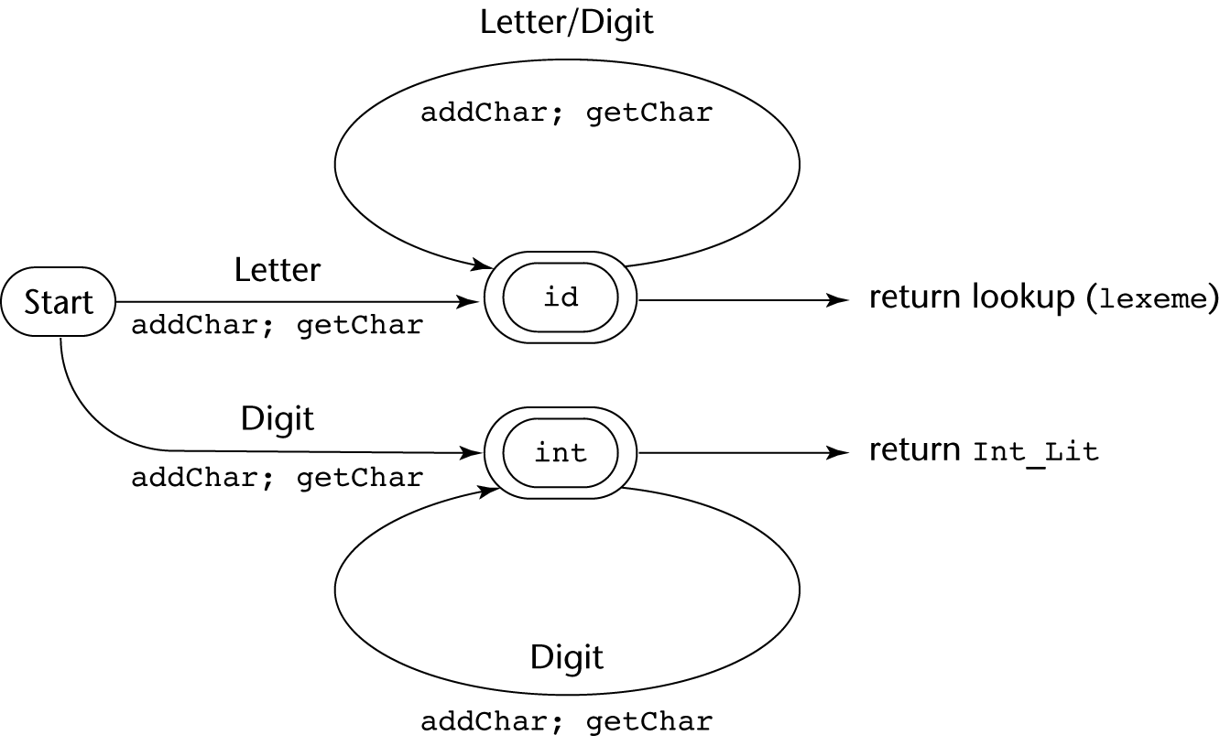
Figure 4.1
A state diagram to recognize names, reserved words, and integer literals
CS 304 – Programming Languages – Ch. 4

Slide 7
The Parsing Problem
Parsing == Syntax Analysis
Parsers
  Construct parse trees for language constructs
  Usually, the parse tree is not explicitly constructed
Goals of Syntax Analysis
  Check programs for syntax errors
    Detect, Inform, Recover
  Produce parse trees
    Or at least enough info to trace them
    Used as the basis for translation
CS 304 – Programming Languages – Ch. 4

Slide 8
The Parsing Problem
Top-Down Parsers
Bottom-Up Parsers
One token lookahead
  Efficiency
CS 304 – Programming Languages – Ch. 4

Slide 9
The Parsing Problem
a, b, … - Terminal Symbols
A, B, … - Nonterminal Symbols
W, X, Y, … - Terminal or Nonterminal Symbols
w, x, y, … - Strings of Terminals
α, β, … - Strings of Terminals and Nonterminals
For PLs:
  Terminals : Numbers, commas, …
  Nonterminals : <while_stms>, <expr>, …
Sentences of a language are strings of terminals
  Programs are strings of terminals also !
CS 304 – Programming Languages – Ch. 4

Slide 10
Top-Down Parsers
  Trace a leftmost derivation
  Build and traverse the parse tree in preorder
  Given a sentential form (produced by leftmost derivations), find the next sentential form (in the leftmost derivation)
  Choose the correct RHS form
    Example:
LL Algorithms
  Recursive-Descent Parser
    Syntax analyzer based on BNF description
  Top-Down Table Parser
    Use parsing table, not a BNF
CS 304 – Programming Languages – Ch. 4

Slide 11
Bottom-Up Parsers
Construct parse trees from the leaves
  Given a right sentential form α, determine if α is a RHS of some rule
  If so, replace α with LHS of the rule
  Reverse of a rightmost derivation
  Reduce the RHS into a LHS in the sentential form
LR Algorithms
  left-to-right scan with rightmost derivation
CS 304 – Programming Languages – Ch. 4

Slide 12
The Complexity of Parsing
Depends on the length of the input string
Parsing algorithms for arbitrary grammars are inefficient
  O(n^3)
Sacrifice generality for efficiency
  Achieve O(n)
CS 304 – Programming Languages – Ch. 4

Slide 13
Recursive-Descent Parsing (RDP)
Collection of programs that are recursive
Produces a parse tree in a top-down order
  Syntax of many expressions can be specified with recursion
  E.g., Scheme
EBNF is ideally suited for RDP
  <if_stmt> → if <logic_expr> <stmt> [else <stmt>]
  <ident_list> → ident {, ident}
  or
  <ident_list> → {ident}⁺
CS 304 – Programming Languages – Ch. 4

Slide 14
Recursive-Descent Parsing (RDP)
RD Parser has a subprogram for each nonterminal symbol in the grammar
  RD parsing subprogram is a parser for the language generated from the nonterminal
  Start symbol generates the whole language
  Consider the grammar:
    <expr> → <term> {(+ | -) <term>}
    <term> → <factor> {(* | /) <factor>
    <factor> → (<expr>) | <id>
CS 304 – Programming Languages – Ch. 4

Slide 15
Recursive-Descent Parsing (RDP)
    <expr> → <term> {(+ | -) <term>}
    <term> → <factor> {(* | /) <factor>
    <factor> → (<expr>) | <id>
RD subprogram for a rule with a single RHS:
  Compare each terminal symbol in RHS with the nextToken
    Match or do not match
  For each nonterminal, call subprogram associated with that nonterminal symbol
  Continue until all symbols received by lexer match the EBNF
CS 304 – Programming Languages – Ch. 4

Slide 16
Recursive-Descent Parsing (RDP)
    <expr> → <term> {(+ | -) <term>}
void expr() {
term();
while (nextToken == PLUS_CODE ||
nextToken == MINUS_CODE) {
lex();
term();
}
}
/* Assured that the nextToken has the leftmost
input token */
CS 304 – Programming Languages – Ch. 4

Slide 17
Recursive-Descent Parsing (RDP)
RD subprogram for a rule with multiple RHS:
  Need to choose the correct RHS !!!
void factor() {
if (nextToken == ID_CODE)
lex();
else if (nextToken == LEFT_PARENT_CODE) {
lex();
expr();
if (nextToken == RIGHT_PARENT_CODE) {
lex();
}
else
error();
}
else
error();
}
    <factor> → (<expr>) | <id>
CS 304 – Programming Languages – Ch. 4

Slide 18
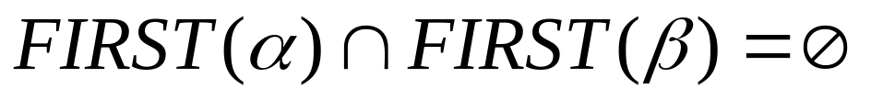
Recursive-Descent Parsing (RDP)
LL Grammar Class
  Equally powerful – Describe identical classes of languages
  Left recursion must be removed from the grammar
    Both direct and indirect left recursion
    Why? Example:
  Left recursion is not a problem for bottom-up parsers
  Pairwise disjointness test
    Ensure FIRST sets are different so that the correct RHS can be chosen
    For a rule : A→ α | β
CS 304 – Programming Languages – Ch. 4

Slide 19
Recursive-Descent Parsing (RDP)
To remedy situations when the intersection of FIRST sets is not empty:
  Left factoring
Or you can simply use EBNF
CS 304 – Programming Languages – Ch. 4

Slide 20
Bottom-Up Parsing
Left-recursive rules are not a problem for bottom-up parsers
Also, grammars for bottom-up parsers normally do not include metasymbols (like EBNF)
Consider the following grammar G1:
Example of a rightmost derivation of id + id * id:
E → E + T | T
T → T * F | F
F → ( E ) | id
CS 304 – Programming Languages – Ch. 4

Slide 21
Bottom-Up Parsing
Reverse of a rightmost derivation
Start with the input sentence, work your way up to the start symbol
Find RHS to be rewritten by a rule into a LHS
  Multiple RHSs may exist
  E + T * id has three RHSs
  Some rewrites may be incorrect
  Handle :
  The correct RHS in the right sentential form to rewrite into previous right sentential form
CS 304 – Programming Languages – Ch. 4

Slide 22
Bottom-Up Parsing
The task of the bottom-up parser:
  Find a handle of any given right sentential form that can be generated by its associated grammar
  Def : β is a handle of a right sentential form γ = αβw iff
  S =>* rm αAw => rm αβw
  Def : β is a phrase of a right sentential form γ iff
  S =>* γ => α₁Αα₂ =>+ α₁βα₂
  Def : β is a simple phrase of a right sentential form γ iff
  S =>* γ => α₁Αα₂ => α₁βα₂
CS 304 – Programming Languages – Ch. 4

Slide 23
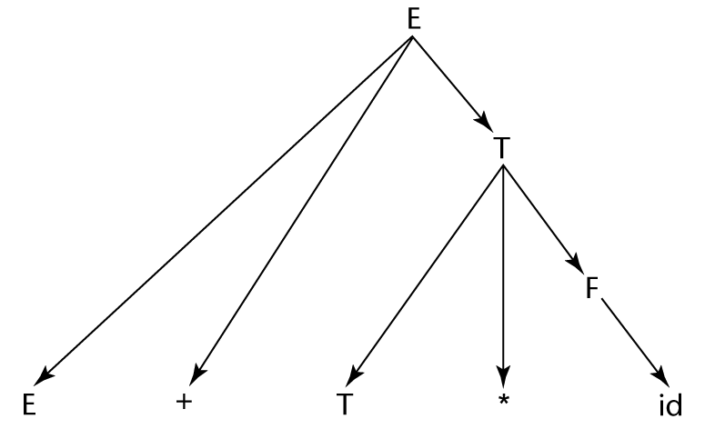
Figure 4.2
A parse parse tree for E + T * id
Three different phrases, one simple phrase
CS 304 – Programming Languages – Ch. 4

Slide 24
Bottom-Up Parsing
  Why do we need phrases?
The handle of a rightmost sentential form is the leftmost simple phrase
  Intuitive way to find a handle
  But, need grammar and a parse tree!
    Not practical for a parser !
  Process:
    Find the handle
    Rewrite it to the corresponding RHS
    Prune / reduce handle from the parse tree
CS 304 – Programming Languages – Ch. 4

Slide 25
Bottom-Up Parsing
Shift-Reduce Algorithms
  Two most common actions of bottom-up parsers
  Shift:
    Moves the next input token onto a parser’s stack
  Reduce:
    Replaces RHS on top of the parser’s stack by its corresponding LHS
  Bottom-up parses are Pushdown Automata (PDA)
    Pushdown stack as the memory
    Left-to-right scan of the input
    They can represent context-sensitive grammars
  PDAs can also be used as language recognizers
CS 304 – Programming Languages – Ch. 4

Slide 26
Bottom-Up Parsing : LR Parsers
LR :
  Left-to-right scan of input strings
  Rightmost derivation (well, actually a reverse of a rigthmost derivation)
  Use Parsing Table
    Or code sometimes
  Canonical LR : D. Knuth
    Disadvantage: Inefficient !
  Several variations of canonical LR:
    Less computer resources needed for table creation
    Handle smaller classes of grammars than the cannonical LR
CS 304 – Programming Languages – Ch. 4

Slide 27
Bottom-Up Parsing : LR Parsers
Advantages of LR Parsers:
  Work for nearly all grammars that describe programming languages
  Work on a larger class of grammars than other bottom-up algorithms, yet they are equally efficient
  Can detect syntax errors as soon as it is possible
  LR class of grammars is a superset of the class of grammars parsable by LL parsers
Disadvantage:
  Difficult to construct (by hand) the parsing table
    There exist programs to automatically produce the table from the grammar description
CS 304 – Programming Languages – Ch. 4

Slide 28
Bottom-Up Parsing : LR Parsers
Use states and state transitions
  Depending on the current sentential form
  Relatively small number of different parsing situations
  Parse stack :
  S₀X₁S₁X₂S_{2 …} X_{m}S_{m} (top)
  LR parser configuration:
  S₀X₁S₁X₂S_{2 …} X_{m}S_{m ,} a_{i}a_{i+1 …} a_{n}$
‘$’ is a delimiter character
  Indicates the end of the input string
CS 304 – Programming Languages – Ch. 4

Slide 29

Figure 4.3
The structure of an LR parser
CS 304 – Programming Languages – Ch. 4

Slide 30
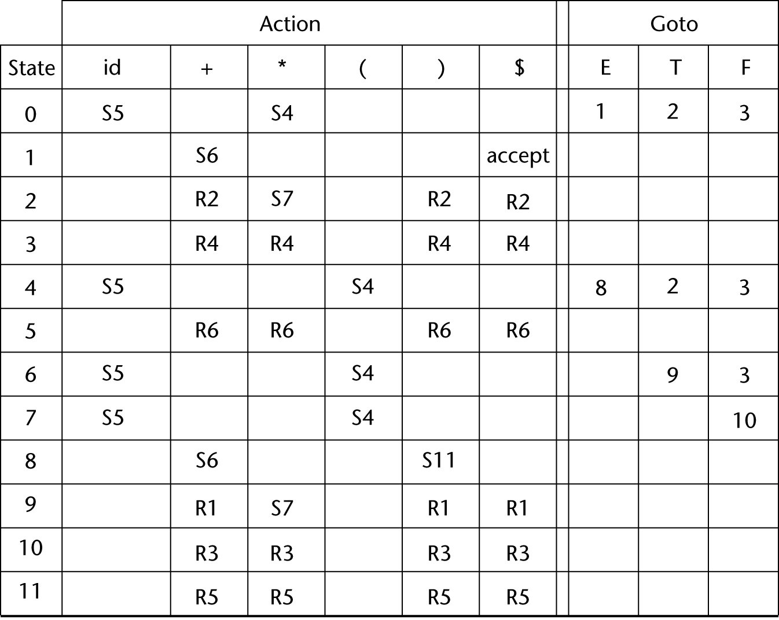
Figure 4.4
The LR parsing table for an arithmetic expression grammar
E → E + T
E → T
T → T * F
T → F
F → ( E )
F → id
CS 304 – Programming Languages – Ch. 4

Slide 31
Bottom-Up Parsing : LR Parsers
LR parsing table has two parts: ACTION and GOTO
ACTION :
  Row labels : state symbols
  Column labels : terminal symbols
  Given the current parser state and the next input token, parse table specifies what to do
  Shift or Reduce
  Shift the next input symbol onto a parse stack
  Reduce to the LHS of the rule corresponding to the handle
CS 304 – Programming Languages – Ch. 4

Slide 32
Bottom-Up Parsing : LR Parsers
GOTO :
  Row labels : state symbols
  Column labels : nonterminal symbols
  Indicates which state symbol should be pushed onto a parse stack after the reduction is complete
CS 304 – Programming Languages – Ch. 4

Slide 33
Bottom-Up Parsing : LR Parsers
The initial configuration of an LR parser:
  (S_{0 ,} a₁a_{2 …} a_{n}$)
The parser’s actions:
1) if ACTION[S_{m ,} a_{i}] = Shift S, the next configuration:
  (S₀X₁S₁X₂S_{2 …} X_{m}S_{m}a_{i}S, a_{i+1…} a_{n}$)
2) if ACTION[S_{m ,} a_{i}] = Reduce A → β and
S = GOTO[S_{m-r ,} a] where r = length(β) :
  (S₀X₁S₁X₂S_{2 …} X_{m-r}S_{m-r}AS, a_{i}a_{i+1…} a_{n}$)
CS 304 – Programming Languages – Ch. 4

Slide 34
Bottom-Up Parsing : LR Parsers
3) if ACTION[S_{m ,} a_{i}] = Accept
  Parse tree is complete, no errors found
4) if ACTION[S_{m ,} a_{i}] = Error
  Parser calls an error-handling routine
Grammar rules for LR parsers are numbered
Example: Consider the following grammar:
E → E + T
E → T
T → T * F
T → F
F → ( E )
F → id
CS 304 – Programming Languages – Ch. 4

Slide 35
Figure 4.4
The LR parsing table for an arithmetic expression grammar
E → E + T
E → T
T → T * F
T → F
F → ( E )
F → id
CS 304 – Programming Languages – Ch. 4

