Slide 1
Names, Bindings, Type Checking and Scope
Chapter 5
CS 304 – Programming Languages – Ch. 5

Slide 2
Introduction
von Neumann’s Architecture
  Memory cells
  Processor
  Data path
    In programs, memory cells are represented as variables
Variables
  name
  address
  type ( ➔ size)
  value
  lifetime
  scope
CS 304 – Programming Languages – Ch. 5

Slide 3
Names
or Identifiers
  Not the same as variables !
Design issues for names:
  Maximum length?
  Are connector characters allowed?
  Are names case sensitive?
  Are special words reserved words or keywords?
Length
  - FORTRAN I: maximum 6
  - COBOL: maximum 30
  - FORTRAN 90 and ANSI C: maximum 31
  - Ada: no limit, and all are significant
  - C++: no limit, but implementors often impose one
  Why?
CS 304 – Programming Languages – Ch. 5

Slide 4
Names
Connectors
  “-”, “_”,…
  Pascal, Modula-2, and FORTRAN 77 don't allow
  Others do
Case sensitivity
  C, C++, Java, and Modula-2 names are case sensitive
  The names in other languages are not
  Disadvantage: readability (names that look alike are different)
    worse in Modula-2 because predefined names are mixed case (e.g. WriteCard)
    Not so bad if you have “statement completion” feature in your compiler
CS 304 – Programming Languages – Ch. 5

Slide 5
Special Words
Name actions of a PL to be performed
Keywords
  is a word that is special only in certain contexts
  In FORTRAN:
    REAL is a keyword and it could also be a variable name
  Disadvantage: poor readability
Reserved Words
  is a special word that cannot be used as a user-defined name
Predefined names
  INTEGER and FLOAT in Ada
  Library function names (e.g., std::cin)
CS 304 – Programming Languages – Ch. 5

Slide 6
Variables
A name for a memory location that has a type and size (and value?)
An abstraction of memory cells in the computer
Variables are more than names
Attributes that characterize a variable:
  name, address, value, type, lifetime, and scope
CS 304 – Programming Languages – Ch. 5

Slide 7
Variables
Name
  not all variables have them
Address
  the memory address with which it is associated
  A variable may have different addresses at different times during execution
  A variable may have different addresses at different places in a program
  If two variable names can be used to access the same memory location, they are called aliases
  Aliases are harmful to readability
CS 304 – Programming Languages – Ch. 5

Slide 8
Variables
How aliases can be created:
  Pointers, reference variables, Pascal variant records, C and C++ unions, and FORTRAN EQUIVALENCE (and through parameters - discussed in Chapter 8)
  Some of the original justifications for aliases are no longer valid; e.g. memory reuse in FORTRAN
    replace them with dynamic allocation
Type
  determines the range of values of variables and the set of operations that are defined for values of that type
    in the case of floating point, type also determines the precision
  Ex: int (16 bit) : -32, 768 to 32, 676
CS 304 – Programming Languages – Ch. 5

Slide 9
Variables
Value
  the contents of the location with which the variable is associated
  Abstract memory cell :
    the physical cell or collection of cells associated with a variable
The l-value of a variable
  is its address
  need this for a PL concept to appear on the LHS in an assignment statement
The r-value of a variable
  is its value (value of the RHS in an assignment statement)
CS 304 – Programming Languages – Ch. 5

Slide 10
Binding
Def: A binding is an association, such as between an attribute and an entity, or between an operation and a symbol
Def: Binding time is the time at which a binding takes place.
  “*” usually bound to the multiplication operator at language design time
  Variables can be bound to certain types at compile time
CS 304 – Programming Languages – Ch. 5

Slide 11
Possible binding times
1. Language design time
  e.g., bind operator symbols to operations
2. Language implementation time
  e.g., bind floating pt. type to a representation
3. Compile time
  e.g., bind a variable to a type in C or Java
4. Link Time
  e.g., “cin” is bound to an appropriate static library (namespaces in C++)
5. Load time
  e.g., bind a FORTRAN 77 variable to a memory cell (or a C static variable)
6. Runtime
  e.g., bind a nonstatic local variable to a memory cell
CS 304 – Programming Languages – Ch. 5

Slide 12
Binding of Attributes to Variables
Def: A binding is static if it occurs before run time and remains unchanged throughout program execution.
Def: A binding is dynamic if it occurs during execution or can change during execution of the program.
  Note: these do not describe physical bindings of vars into storage cells
    Paging causes these to be bound and unbound quite often!
CS 304 – Programming Languages – Ch. 5

Slide 13
Type Bindings
  In typed languages, a variable must be bound to a data type
  How to specify types and when to bind?
Variable declarations
  Explicit Declaration
    Statement that lists variable names and specifies their types
    Most common form of declarations
  Implicit Declaration
    Means of associating variables with types through default conventions (instead of declarations)
    Basic, PL/I, FORTRAN (I,J,K are implicitly integer variables)
    Prevent compiler from preventing type errors
      May in turn reduce reliability
    Perl tries to avoid these problems with special name requirements
CS 304 – Programming Languages – Ch. 5

Slide 14
Type Bindings
In C and C++:
Declarations
  Specify types, but do not cause storage allocation
Definitions
  Specify attributes and cause storage allocation
  For a specific name in a C program:
    May have any number of compatible declarations
    May have only a single definition
    Reason: provide type of variable to other entities (functions)
      Just like function prototypes
CS 304 – Programming Languages – Ch. 5

Slide 15
Type Bindings
Dynamic Type Binding
  Types are not specified by declarations
  Variable is bound to a type during execution of assignment statement
    Type of variable becomes the type of the expression on the RHS
  Ex: Javascript, APL. SNOBOL
  Dynamic binding provides a great deal of flexibility
    Make lists and use them on any types (e.g., LISP)
    Similar to Templates in C++ (but no type declarations)
  Disadvantages:
    Compiler cannot check for type errors at compile time
    Dynamic type binding is costly (execution time)
    Coercion may / may not be a desirable effect
  Often implemented using pure interpretation
CS 304 – Programming Languages – Ch. 5

Slide 16
Type Bindings
Type Inference
  Inferring the type of an expression
  Example : ML (Machine Learning) – Milner et. al., 1990
  fun circumf(r) = 3.14 * r * r;
  fun times10(x) = 10 * x;
  fun square(x) = x * x
  fun square(x:int) = x * x
  fun square(x) = (x:int) * x
  fun square(x) : int = x * x
  fun square(x) = x * (x:int)
CS 304 – Programming Languages – Ch. 5

Slide 17
Storage Bindings and Lifetime
Memory Allocation
  Reserving a memory cell to which a variable is bound from a pool of available memory
Memory Deallocation
  Returning the memory cell unbound from a variable into the pool of available memory
Lifetime of a Variable
  Time during which the variable is bound to a specific memory location
    Static, Stack-Dynamic, Explicit / Implicit Heap-Dynamic variables according to their lifetimes
CS 304 – Programming Languages – Ch. 5

Slide 18
Storage Bindings and Lifetime
Static Variables
  Bound to memory cells before execution begins and remain bound to the same memory cell throughout execution
    Global and history-sensitive variables
    e.g. all FORTRAN 77 variables, C static variables
Advantage:
  Efficiency (direct addressing, history-sensitive subprogram support, no run-time allocation and deallocation overhead)
Disadvantage:
  Lack of flexibility (no recursion)
  Cannot share storage among the variables
CS 304 – Programming Languages – Ch. 5

Slide 19
Storage Bindings and Lifetime
2. Stack-dynamic variables
Storage bindings are created for variables when their declaration statements are elaborated, but whose types are statically bound
  In Java, if scalar variable is used, all attributes except address are statically bound
    e.g. local variables in Pascal, Java, C++ and C subprograms
    run-time stack, run-time elaboration
Advantage:
  allows recursion; conserves storage
Disadvantages:
  Overhead of allocation and deallocation
  Subprograms cannot be history sensitive
  Inefficient references (indirect addressing)
CS 304 – Programming Languages – Ch. 5

Slide 20
Storage Bindings and Lifetime
3. Explicit heap-dynamic variables
Allocated and deallocated by explicit directives, specified by the programmer, which take effect during execution
  Allocated / deallocated from the heap
  Referenced only through pointers or references
  Bound to types at compile time, bound to storage at run-time
  e.g. dynamic objects in C++ (via new and delete)
  all objects in Java (except primitive scalar types)
  Often used in dynamic structures (e.g., linked-lists)
Advantage:
  provides for dynamic storage management
Disadvantage:
  inefficient and unreliable (C’s malloc)
CS 304 – Programming Languages – Ch. 5

Slide 21
Storage Bindings and Lifetime
4. Implicit heap-dynamic variables
  Bound to heap storage only when they are assigned values
  Allocation and deallocation caused by assignment statements
    e.g. all variables in APL
    strings and arrays in Perl and Javascript
    Dynamic type-binding
Advantage:
  flexibility
Disadvantages:
  Inefficient, because all attributes are dynamic
  Loss of error detection
CS 304 – Programming Languages – Ch. 5

Slide 22
Type Checking
Generalize the concept of operands and operators to include subprograms and assignments
Def: Type checking is the activity of ensuring that the operands of an operator are of compatible types
Def: A compatible type is one that is either legal for the operator, or is allowed under language rules to be implicitly converted, by compiler-generated code, to a legal type.
  This automatic conversion is called a coercion.
Def: A type error is the application of an operator to an operand of an inappropriate type
CS 304 – Programming Languages – Ch. 5

Slide 23
Type Checking
If all type bindings are static, nearly all type checking can be static
If type bindings are dynamic, type checking must be dynamic
  Which one is better?
  Some static typed languages still must use dynamic typing
    Variant Records (Ada, Pascal), Union (C++), EQUIVALENCE (FORTRAN)
Def: A programming language is strongly typed if type errors are always detected
Advantage:
  allows the detection of the misuses of variables that result in type errors
CS 304 – Programming Languages – Ch. 5

Slide 24
Type Checking
1. FORTRAN 77 is not: parameters, EQUIVALENCE
2. Pascal is not: variant records
3. Modula-2 is not: variant records, WORD type
4. C and C++ are not: parameter type checking can be avoided; unions are not type checked
5. Ada is, almost (UNCHECKED_CONVERSION is loophole) (Java is similar)
Coercion rules strongly affect strong typing—they can weaken it considerably (C++ versus Ada)
6. ML is strongly typed !!!
CS 304 – Programming Languages – Ch. 5

Slide 25
Type Compatibility
Def: Type compatibility by name means the two variables have compatible types if they are in either the same declaration or in declarations that use the same type name
Easy to implement but highly restrictive:
  Subranges of integer types are not compatible with integer types
  Formal parameters must be the same type as their corresponding actual parameters (Pascal)
Def: Type compatibility by structure means that two variables have compatible types if their types have identical structures
  More flexible, but harder to implement
CS 304 – Programming Languages – Ch. 5

Slide 26
Type Compatibility
Consider the problem of two structured types:
  - Suppose they are circularly defined
  - Are two record types compatible if they are structurally the same but use different field names?
  - Are two array types compatible if they are the same except that the subscripts are different? (e.g. [1..10] and [-5..4])
  - Are two enumeration types compatible if their components are spelled differently?
  - With structural type compatibility, you cannot differentiate between types of the same structure (e.g. different units of speed, both float)
CS 304 – Programming Languages – Ch. 5

Slide 27
Type Compatibility
Language examples:
Pascal: usually structure, but in some cases name is used (formal parameters)
  type
    type1 = array [1..10] of integer;
    type2 = array [1..10] of integer;
    type3 = type2;
  declaration equivalence
C: structure, except for records and unions
  except when they are defined in two separate files (structural type equivalence)
C++ : name
  typedefs
Ada: restricted form of name – derived types and subtypes
  Derived types allow types with the same structure to be different
  Anonymous types are all unique, even in:
  A, B : array (1..10) of INTEGER:
FORTRAN AND COBOL – structure (no type names!)
OOP – inheritance?
CS 304 – Programming Languages – Ch. 5

Slide 28
Scope
Def: The scope of a variable is the range of statements over which it is visible
Def: The nonlocal variables of a program unit are those that are visible but not declared there
The scope rules of a language determine how references to names are associated with variables
CS 304 – Programming Languages – Ch. 5

Slide 29
Scope
Static scope
  Based on program text
To connect a name reference to a variable, you (or the compiler) must find the declaration
Search process: search declarations, first locally, then in increasingly larger enclosing scopes, until one is found for the given name
Enclosing static scopes (to a specific scope) are called its static ancestors; the nearest static ancestor is called a static parent
CS 304 – Programming Languages – Ch. 5

Slide 30
Scope
Variables can be hidden from a unit by having a "closer" variable with the same name
C++ and Ada allow access to these "hidden" variables
Blocks
  a method of creating static scopes inside program units--from ALGOL 60
  A.K.A. “compound statements” in C and C++
Examples:
C and C++:
for (...) {
int index;
...
}
Ada: declare LCL : FLOAT;
begin
...
end
CS 304 – Programming Languages – Ch. 5

Slide 31
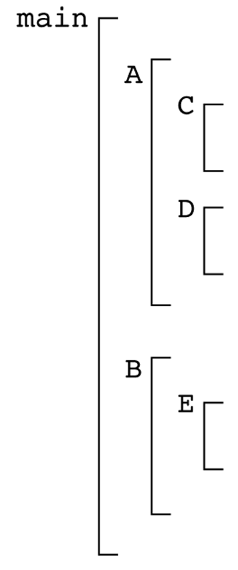
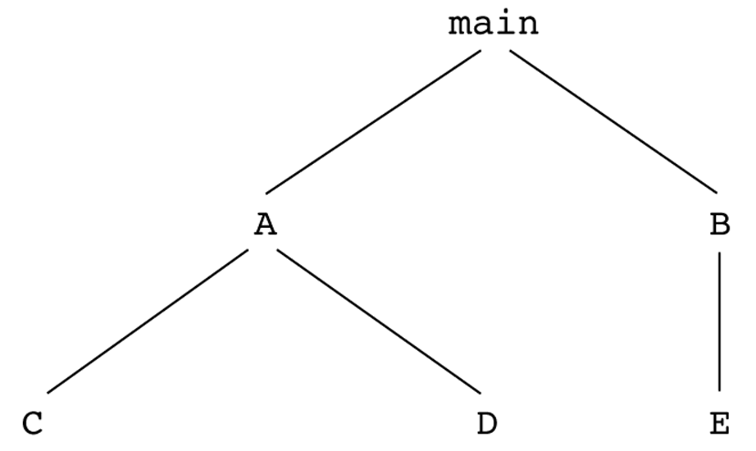
Scope
Evaluation of Static Scoping
  Consider the example:
  Assume
    MAIN calls A and B
    A calls C and D
    B calls A and E
CS 304 – Programming Languages – Ch. 5

Slide 32
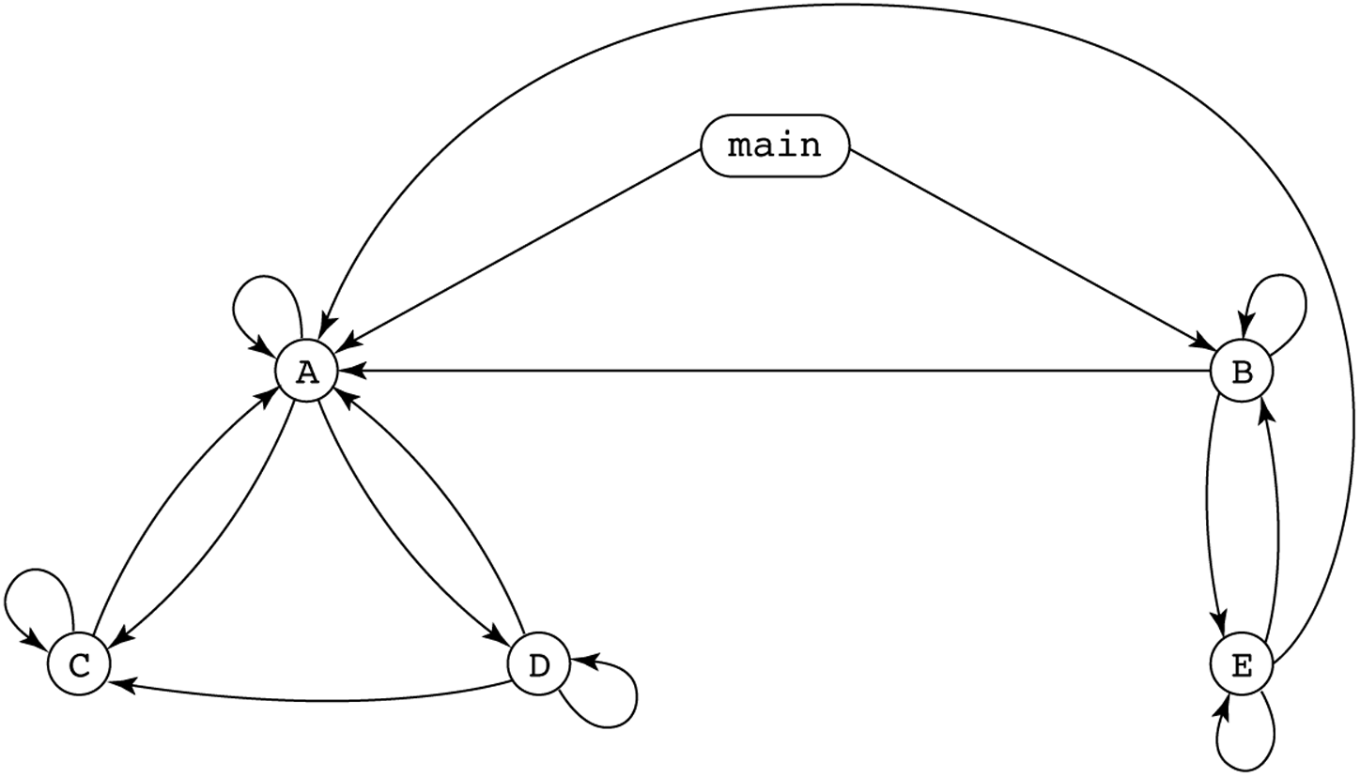
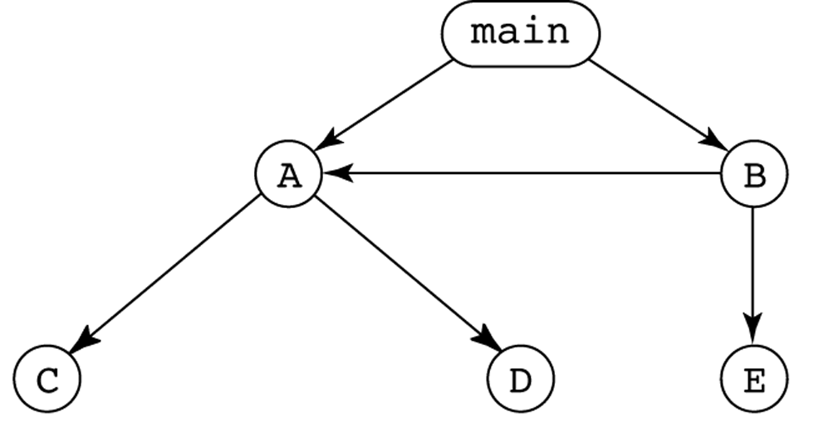
CS 304 – Programming Languages – Ch. 5

Slide 33
Scope
Suppose the spec is changed so that D must now access some data in B
  Solutions:
  1. Put D in B (but then C can no longer call it and D cannot access A's variables)
  2. Move the data from B that D needs to MAIN (but then all procedures can access them)
  Same problem for procedure access!
  Overall: static scoping often encourages many globals
CS 304 – Programming Languages – Ch. 5

Slide 34
Scope
Too much data access
  Globals visible everywhere, no way to protect them
  Globals are harmful to readability
    Declarations are too far from their uses
  Programmers tend to use far more globals than necessary
  To remedy problems of static scoping:
    Encapsulation constructs
    e.g., Classes
CS 304 – Programming Languages – Ch. 5

Slide 35
Scope
Dynamic scope
  Based on calling sequences of program units, not their textual layout (temporal versus spatial)
References to variables are connected to declarations by searching back through the chain of subprogram calls that forced execution to this point
Search process:
  Look in the caller for variable declarations
  Up to the main calling function
CS 304 – Programming Languages – Ch. 5

Slide 36
Scope
Example:
MAIN
- declaration of x
SUB1
- declaration of x -
...
call SUB2
...
SUB2
...
- reference to x -
...
...
call SUB1
...
MAIN calls SUB1
SUB1 calls SUB2
SUB2 uses x
Static scoping - reference to x is to MAIN's x
Dynamic scoping - reference to x is to SUB1's x
CS 304 – Programming Languages – Ch. 5

Slide 37
Dynamic Scoping
Evaluation of Dynamic Scoping:
Advantage:
  convenience
  No need to pass variables !!!
Disadvantage:
  poor readability (caller’s local vars visible in the called fnct)
  no way to determine scope statically
  longer access time to nonlocal vars
Scope and lifetime are sometimes closely related, but are different concepts!!
  Consider a static variable in a C or C++ function
CS 304 – Programming Languages – Ch. 5

Slide 38
Referencing Environments
Def: The referencing environment of a statement is the collection of all names that are visible in the statement
In a static scoped language, that is the local variables plus all of the visible variables in all of the enclosing scopes
  See book example (p. 235)
A subprogram is active if its execution has begun but has not yet terminated
In a dynamic-scoped language, the referencing environment is the local variables plus all visible variables in all active subprograms
  See book example (p. 236)
CS 304 – Programming Languages – Ch. 5

Slide 39
Named Constants
Def: A named constant is a variable that is bound to a value only when it is bound to storage
Advantages: readability and modifiability
The binding of values to named constants can be either static (called manifest constants) or dynamic
Languages:
  Pascal: literals only
  Modula-2 and FORTRAN 90: constant-valued expressions
  Ada, C++, and Java: expressions of any kind
CS 304 – Programming Languages – Ch. 5

Slide 40
Variable Initialization
Def: The binding of a variable to a value at the time it is bound to storage is called initialization
  Initialization is often done on the declaration statement
  e.g., Ada
  SUM : FLOAT := 0.0;
CS 304 – Programming Languages – Ch. 5

