Slide 1
Data Types
Chapter 6
CS 304 – Fall 2003 – Ch. 6

Slide 2
Introduction
Data types allow for versatility in programming
  FORTRAN (<90)
    Primitive types, arrays (linked lists and binary trees)
  COBOL
    Structs and decimal values (precise)
  PL/I
    Integer and Floating-Point types with higher accuracy
  ALGOL 68
    Highly orthogonal – User-Defined Types (typedefs : modifiable)
  Ada 83
    user-defined types, types are abstractions of problem-space variables
    Abstract Data Types : ADTs
CS 304 – Fall 2003 – Ch. 6

Slide 3
Introduction
Arrays and Records
  most common structured (non-scalar) data types
  specified by operators that form expressions
  Example: C type operators
    brackets, parentheses, asterisks
    arrays, functions, pointers
Descriptor
  collection of attributes of a variable
  Static attributes – descriptors required at compile time
    Symbol tables
  Dynamic attributes – descriptors used for type checking and allocation/deallocation operations
CS 304 – Fall 2003 – Ch. 6

Slide 4
Primitive Data Types
Design Issues for all data types:
1. What is the syntax of references to variables?
2. What operations are defined and how are they specified?
Primitive Data Types
  Types not defined in terms of other data types
  Used to define other (complex) data types
  May be supported in the hardware
CS 304 – Fall 2003 – Ch. 6

Slide 5
Numeric Types
Integers
  Almost always an exact reflection of the hardware, so the mapping is trivial
  There may be many different integer types in a language
    Signed/Unsigned, short, int, long
  Usually stored in the two’s complement representation
    Negative ints are complemented, then 1 is added to them
    Allows for easy arithmetic
CS 304 – Fall 2003 – Ch. 6

Slide 6
Numeric Types
Floating Point
  Model real numbers, but only as approximations
  Languages for scientific use support at least two floating-point types; sometimes more
  Usually exactly like the hardware, but not always; some languages allow accuracy specs in code
    e.g. (Ada)
    type SPEED is digits 7 range 0.0..1000.0;
    type VOLTAGE is delta 0.1 range -12.0..24.0;
  Problem: Loss of accuracy, finite amount of space
    Cannot represent PI
CS 304 – Fall 2003 – Ch. 6

Slide 7
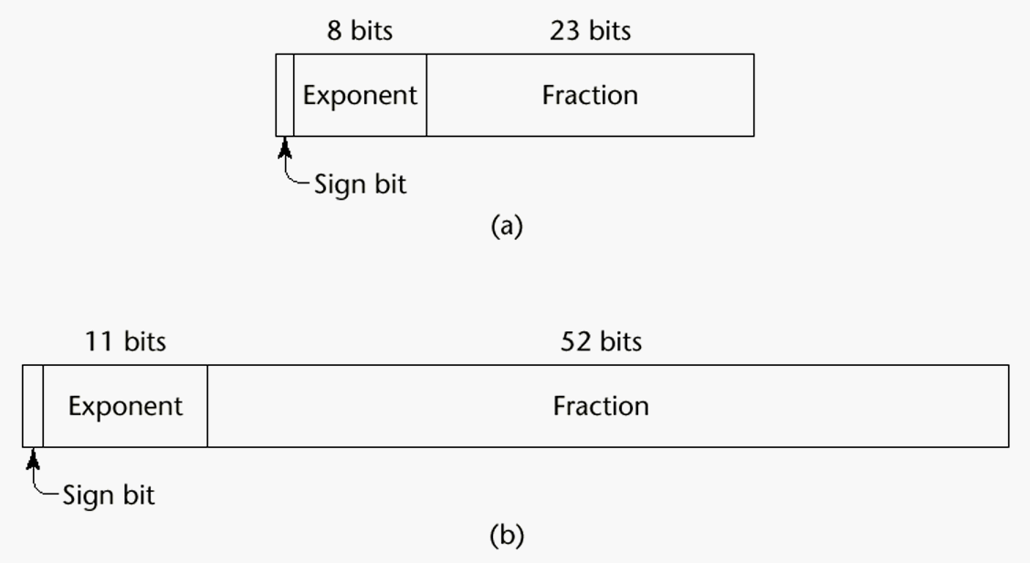
Numeric Types
CS 304 – Fall 2003 – Ch. 6

Slide 8
Numeric Types
Decimal 4b
  For business applications (money)
  Store a fixed number of decimal digits (coded)
  Advantage: accuracy
  Disadvantages: limited range, wastes memory
Boolean
  Most languages have them
    C uses integer values for booleans
  Could be implemented as bits, but often as bytes
  Advantage: readability
  Disadvantage: representation
CS 304 – Fall 2003 – Ch. 6

Slide 9
Numeric Types
Character
  Usually stored as small positive ints
  Mapping of numbers to printable characters
  ASCII and EBCDIC
  Unicode characters : 16 bits
    Include characters for most od the world’s languages
    Java uses Unicode exclusively
CS 304 – Fall 2003 – Ch. 6

Slide 10
Character String Types
Character String Types
  Values are sequences of characters
  Design issues:
    1. Is it a primitive type or just a special kind of array?
    2. Is the length of objects static or dynamic?
  Operations:
    - Assignment
    - Comparison (=, >, etc.)
    - Catenation
    - Substring reference
    - Pattern matching
CS 304 – Fall 2003 – Ch. 6

Slide 11
Character String Types
Examples:
Pascal
  Not primitive; assignment and comparison only (of packed arrays)
Ada, FORTRAN 77, FORTRAN 90 and BASIC
  Somewhat primitive
  Assignment, comparison, catenation, substring reference
  FORTRAN has an intrinsic for pattern matching
    e.g. (Ada)
    N := N1 & N2 (catenation)
    N(2..4) (substring reference)
CS 304 – Fall 2003 – Ch. 6

Slide 12
Character String Types
C and C++
  Not primitive
  Use char arrays and a library of functions that provide operations
SNOBOL4 (a string manipulation language)
  Primitive
  Many operations, including elaborate pattern matching
Perl
  Patterns are defined in terms of (loose) regular expressions
  A very powerful facility!
  e.g.,
    /[A-Za-z][A-Za-z\d]+/
Java - String class (not arrays of char)
  StringBuffer also, for non-constant Strings
CS 304 – Fall 2003 – Ch. 6

Slide 13
Character String Types
String Length Options:
1. Static - FORTRAN 77, Ada, COBOL
  e.g. (FORTRAN 90)
  CHARACTER (LEN = 15) NAME;
2. Limited Dynamic Length - C and C++
  actual length is indicated by a null character
3. Dynamic - SNOBOL4, Perl, Javascript
Evaluation (of character string types):
  Aid to writability
  As a primitive type with static length, they are inexpensive to provide--why not have them?
  Dynamic length is nice, but is it worth the expense?
CS 304 – Fall 2003 – Ch. 6

Slide 14
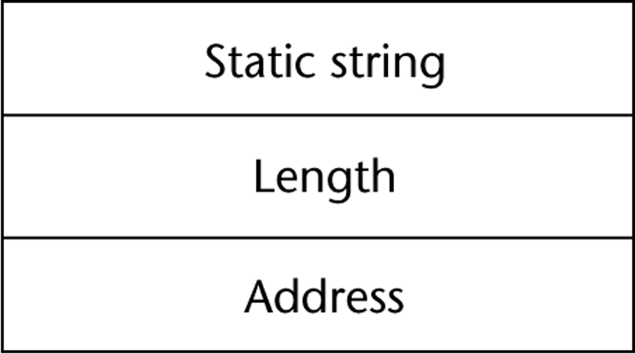
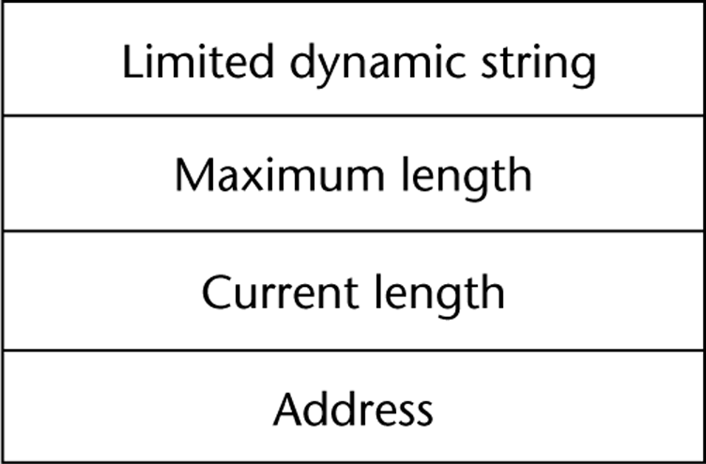
Character String Types Implementation
Implementation:
Static length
  compile-time descriptor
  simplest implementation
Limited dynamic length
  may need a run-time descriptor for length (but not in C and C++ : null-terminating character)
CS 304 – Fall 2003 – Ch. 6

Slide 15
Character String Types Implementation
Dynamic length
  need run-time descriptor; allocation/deallocation is the biggest implementation problem
  Run-time descriptor need not include maximum length
  Dynamic allocation approaches:
  Linked-list approach
    grows and shrinks freely, but links may occupy large amount of storage
    string operations may be slow due to the pointer chasing
  Adjacent storage cells approach
    simpler, but may need to move the complete string into other storage when it grows
    faster and simpler string operations
CS 304 – Fall 2003 – Ch. 6

Slide 16
User-Defined Ordinal Types
An ordinal type is one in which the range of possible values can be easily associated with the set of positive integers
  Enumeration and Subrange types
1. Enumeration Types
  Types where the user enumerates all of the possible values, which are symbolic constants
  enum RelationType = {LESS, EQUAL, GREATER}
  Primary Design Issue:
    Should a literal constant be allowed to be in more than one type definition?
    If so, how to check for the type of the occurrence of the literal?
CS 304 – Fall 2003 – Ch. 6

Slide 17
User-Defined Ordinal Types
Pascal
  cannot reuse constants
  can be used for array subscripts, for variables, case selectors
  NO input or output
  can be compared
type Days = (Sun, Mon, Tue, Wed, Thu, Fri, Sat);
var weekDay : Days;
…
weekDay := Tue;
if weekDay > Sun …
CS 304 – Fall 2003 – Ch. 6

Slide 18
User-Defined Ordinal Types
Ada
  constants can be reused (overloaded literals)
  disambiguate with context or type_name (one of them)
  can be used as in Pascal
  CAN be input and output
C and C++
  like Pascal, except they can be input and output as integers
  Enumeration types are converted into integers
Java does not include an enumeration type
  But classes can implement Enumeration interface
CS 304 – Fall 2003 – Ch. 6

Slide 19
User-Defined Ordinal Types
Evaluation (of enumeration types):
a. Aid to readability
  e.g. no need to code a color as a number
b. Aid to reliability
  e.g. compiler can check operations and ranges of values
CS 304 – Fall 2003 – Ch. 6

Slide 20
User-Defined Ordinal Types
2. Subrange Type
  an ordered contiguous subsequence of an ordinal type
  Primary Design Issue: How can they be used?
Examples:
Pascal
  Subrange types behave as their parent types
  can be used as for variables and array indices
    e.g. type pos = 0 .. MAXINT;
CS 304 – Fall 2003 – Ch. 6

Slide 21
User-Defined Ordinal Types
Ada
  Subtypes are not new types, just constrained existing types (so they are compatible); can be used as in Pascal, plus case constants
  e.g.
    subtype POS_TYPE is INTEGER range 0..1000;
Evaluation of enumeration types:
  Aid to readability
  Reliability
    restricted ranges add error detection
CS 304 – Fall 2003 – Ch. 6

Slide 22
User-Defined Ordinal Types
Implementation of user-defined ordinal types
  Enumeration types are implemented as integers
  Subrange types are the parent types with code inserted (by the compiler) to restrict assignments to subrange variables
CS 304 – Fall 2003 – Ch. 6

Slide 23
Arrays
An array is an aggregate of homogeneous data elements in which an individual element is identified by its position in the aggregate, relative to the first element.
Design Issues:
1. What types are legal for subscripts?
2. Are subscripting expressions in element references range checked?
3. When are subscript ranges bound?
4. When does allocation take place?
5. What is the maximum number of subscripts?
6. Can array objects be initialized?
7. Are any kind of slices allowed?
CS 304 – Fall 2003 – Ch. 6

Slide 24
Arrays
Indexing
  A mapping from indices to elements
map(array_name, index_value_list) → an element
Syntax
  FORTRAN, PL/I, Ada use parentheses
  Most others use brackets
CS 304 – Fall 2003 – Ch. 6

Slide 25
Arrays
Element types
Subscript Types:
  FORTRAN, C
    int only
  Pascal
    any ordinal type (int, boolean, char, enum)
  Ada
    int or enum (includes boolean and char)
  Java
    integer types only
CS 304 – Fall 2003 – Ch. 6

Slide 26
Arrays
Four Categories of Arrays
  based on subscript binding and binding to storage
1. Static
  range of subscripts and storage bindings are static
    e.g. FORTRAN 77, some arrays in Ada
  Advantage: execution efficiency (no allocation or deallocation)
2. Fixed stack dynamic
  range of subscripts is statically bound, but storage is bound at elaboration time
    e.g. Pascal locals and C locals that are not static
  Advantage: space efficiency
CS 304 – Fall 2003 – Ch. 6

Slide 27
Arrays
3. Stack dynamic
  range and storage are dynamic, but fixed from then on for the variable’s lifetime
    e.g. Ada declare blocks
  declare
  STUFF : array (1..N) of FLOAT;
  begin
  ...
  end;
  Advantage:
    flexibility - size need not be known until the array is about to be used
CS 304 – Fall 2003 – Ch. 6

Slide 28
Arrays
4. Heap dynamic
  subscript range and storage bindings are dynamic and not fixed
    e.g. (FORTRAN 90)
  INTEGER, ALLOCATABLE, ARRAY (:,:) :: MAT
  (Declares MAT to be a dynamic 2-dim array)
  ALLOCATE (MAT (10, NUMBER_OF_COLS))
  (Allocates MAT to have 10 rows and
  NUMBER_OF_COLS columns)
  DEALLOCATE MAT
  (Deallocates MAT’s storage)
  In APL & Perl, arrays grow and shrink as needed
  In Java, all arrays are objects (heap-dynamic)
CS 304 – Fall 2003 – Ch. 6

Slide 29
Arrays
Number of subscripts
  FORTRAN I allowed up to three
  FORTRAN 77 allows up to seven
  C, C++, and Java allow just one, but elements can be arrays
  Others - no limit
Array Initialization
  Usually just a list of values that are put in the array in the order in which the array elements are stored in memory
  int testScores = {79, 83, 99};
CS 304 – Fall 2003 – Ch. 6

Slide 30
Arrays
1. FORTRAN - uses the DATA statement, or put the values in / ... / on the declaration
2. C and C++ - put the values in braces; can let the compiler count them
  e.g. int stuff [] = {2, 4, 6, 8};
3. Ada - positions for the values can be specified
  e.g.
  SCORE : array (1..14, 1..2) :=
  (1 => (24, 10), 2 => (10, 7),
  3 =>(12, 30), others => (0, 0));
4. Pascal and Modula-2 do not allow array initialization
CS 304 – Fall 2003 – Ch. 6

Slide 31
Array Operations
1. APL - many, see book (p. 216-217)
2. Ada
  assignment; RHS can be an aggregate constant or an array name
  catenation; for all single-dimensioned arrays
  relational operators (= and /= only)
3. FORTRAN 90
  intrinsics (subprograms) for a wide variety of array operations (e.g., matrix multiplication, vector dot product)
CS 304 – Fall 2003 – Ch. 6

Slide 32
One-Dimensional Array at the Logical Level
A one-dimensional array is a structured composite data type made up of a finite, fixed size (known at compile time) collection of homogeneous (all of the same data type) elements having relative positions and to which there is direct access (any element can be accessed immediately).
Array operations (creation, storing a value, retrieving a value) are performed using a declaration and indexes.
CS 304 – Fall 2003 – Ch. 6

Slide 33
Implementation Example
This ACCESSING FUNCTION gives position of values[Index]
Address(Index) = BaseAddress + Index * SizeOfElement
float values[5]; // assume element size is 4 bytes
Base Address
7000 7004 7008 7012 7016
values[0] values[1] values[2] values[3] values[4]
Indexes
CS 304 – Fall 2003 – Ch. 6

Slide 34
One-Dimensional Arrays in C++
The index must be of an integral type (char, short, int, long, or enum).
The index range is always 0 through the array size minus 1.
Arrays cannot be assigned one to another, and cannot be the return type of a function.
CS 304 – Fall 2003 – Ch. 6

Slide 35
Passing Arrays as Parameters
  In C++, arrays are always passed by reference, and & is not used with the formal parameter type.
  Whenever an array is passed as a parameter, its base address is sent to the called function.
  Because arrays are always passed as reference parameters, you can protect the actual parameter from unintentional changes by using const in formal parameter list and function prototype.
  float SumValues ( const float values[ ],
  int numOfValues );
CS 304 – Fall 2003 – Ch. 6

Slide 36
Two-Dimensional Array at the Logical Level
A two-dimensional array is a structured composite data type made up of a finite, fixed size collection of homogeneous elements having relative positions and to which there is direct access.
Array operations (creation, storing a value, retrieving a value) are performed using a declaration and a pair of indexes (called row and column) representing the component’s position in each dimension.
CS 304 – Fall 2003 – Ch. 6

Slide 37
EXAMPLE -- To keep monthly high temperatures for 50 states in a two-dimensional array.
const int NUM_STATES = 50 ;
const int NUM_MONTHS = 12 ;
int stateHighs [ NUM_STATES ] [ NUM_MONTHS ] ;
[ 0 ]
[ 1 ]
[ 2 ]
.
. stateHighs [2] [7]
.
[ 48 ]
[ 49 ]
[0] [1] [2] [3] [4] [5] [6] [7] [8] [9] [10] [11]
row 2,
col 7
might be
Arizona’s
high for
August
66 64 72 78 85 90 99 115 98 90 88 80
CS 304 – Fall 2003 – Ch. 6

Slide 38
const int NUM_STATES = 50 ; const int NUM_MONTHS = 12 ; int stateHighs [ NUM_STATES ] [ NUM_MONTHS ] ;
STORAGE
rows columns
In memory, C++ stores arrays in row order. The first row is followed by the second row, etc.
Base Address
8000
8024
8048
. . .
12 highs for state 0 12 highs for state 1 etc.
Alabama Alaska
first row second row
CS 304 – Fall 2003 – Ch. 6

Slide 39
Implementation Level View
stateHighs[ 0 ] [ 0 ]
stateHighs[ 0 ] [ 1 ]
stateHighs[ 0 ] [ 2 ]
stateHighs[ 0 ] [ 3 ]
stateHighs[ 0 ] [ 4 ]
stateHighs[ 0 ] [ 5 ]
stateHighs[ 0 ] [ 6 ]
stateHighs[ 0 ] [ 7 ]
stateHighs[ 0 ] [ 8 ]
stateHighs[ 0 ] [ 9 ]
stateHighs[ 0 ] [10 ]
stateHighs[ 0 ] [11 ]
stateHighs[ 1 ] [ 0 ]
stateHighs[ 1 ] [ 1 ]
stateHighs[ 1 ] [ 2 ]
stateHighs[ 1 ] [ 3 ]
.
.
.
Base Address 8000
To locate an element such as
stateHighs [ 2 ] [ 7]
the compiler needs to know
that there are 12 columns
in this two-dimensional array.
At what address will
stateHighs [ 2 ] [ 7 ] be found?
Assume 2 bytes for type int.
CS 304 – Fall 2003 – Ch. 6

Slide 40
Two-Dimensional Array Parameters
Just as with a one-dimensional array, when a two- (or higher) dimensional array is passed as a parameter, the base address of the actual array is sent to the function.
The size of all dimensions except the first must be included in the function heading and prototype.
The sizes of those dimensions for the formal parameter must be exactly the same as in the actual array.
CS 304 – Fall 2003 – Ch. 6

Slide 41
Use the two-dimensional stateHighs array to fill a one-dimensional stateAverages array
const int NUM_STATES = 50 ;
const int NUM_MONTHS = 12 ;
int stateHighs [ NUM_STATES ] [ NUM_MONTHS ] ;
int stateAverages [ NUM_STATES ] ;
[ 0 ]
? [ 1 ]
? [ 2 ]
.
.
.
[ 48 ]
[ 49 ]
[0] [1] [2] [3] [4] [5] [6] [7] [8] [9] [10] [11]
Alaska
Arizona
43 42 50 55 60 78 79 80 77 72 63 40
66 64 72 78 85 90 99 115 98 90 88 80
CS 304 – Fall 2003 – Ch. 6

Slide 42
Declaring Multidimensional Arrays
EXAMPLE USING TYPEDEF
const int NUM_DEPTS = 5; // mens, womens, childrens, electronics, linens
const int NUM_MONTHS = 12 ;
const int NUM_STORES = 3 ; // White Marsh, Owings Mills, Towson
typedef long MonthlySalesType [NUM_DEPTS] [NUM_MONTHS] [NUM_STORES];
MonthlySalesType monthlySales;
CS 304 – Fall 2003 – Ch. 6

Slide 43
const int NUM_DEPTS = 5; // mens, womens, childrens, electronics, linens
const int NUM_MONTHS = 12 ;
const int NUM_STORES = 3 ; // White Marsh, Owings Mills, Towson
typedef long MonthlySalesType [NUM_DEPTS] [NUM_MONTHS] [NUM_STORES] ;
MonthlySalesType monthlySales;
monthlySales[3][7][0]
sales for electronics in August at White Marsh
3 STORES
sheets
5 DEPTS
rows
12 MONTHS columns
CS 304 – Fall 2003 – Ch. 6

Slide 44
Slices
A slice is some substructure of an array
  A referencing mechanism
Slice Examples:
1. FORTRAN 90
  INTEGER CUBE(1:3, 1:3, 1:4)
  INTEGER MAT (1 : 4, 1 : 4)
  MAT(1 : 4, 1) - the first column
  MAT(2, 1 : 4) - the second row
2. Ada - single-dimensioned arrays only
  LIST(4..10)
CS 304 – Fall 2003 – Ch. 6

Slide 45
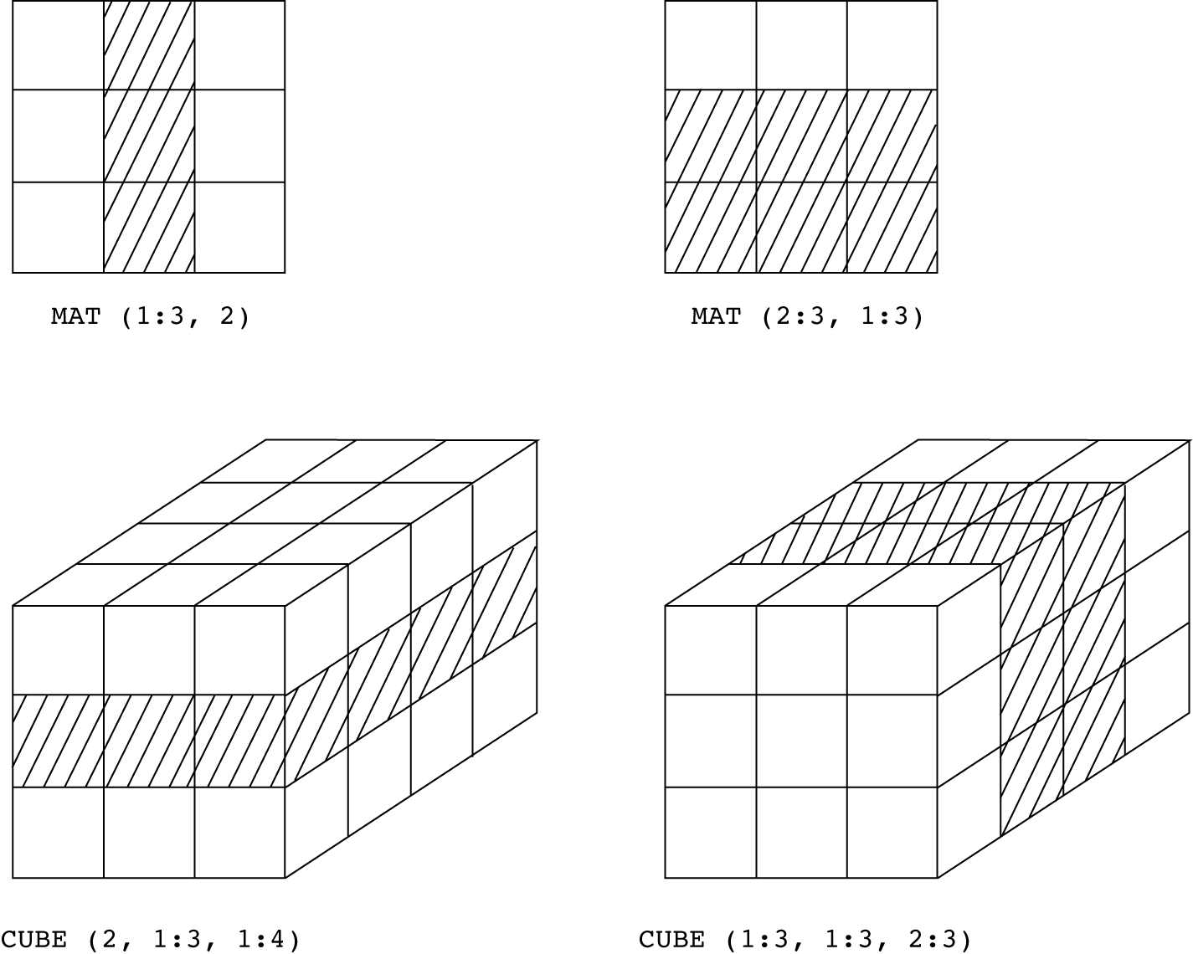
CS 304 – Fall 2003 – Ch. 6

Slide 46
Implementation of Array Types
  More compile-time effort than we need for simple types
  At run-time, array access code is executed to gain access to array elements
  Compute Access Function to access an array element
Access function maps subscript expressions to an address in the array
  If lower bound is 1:
    address(list[k]) = address(list[1]) + (k-1)*element_size
  If lower bound is M:
    address(list[k]) = address(list[M]) + (k-M)*element_size
  Arrays need a compile-time (static) descriptor
    for access function construction
    Run-time descriptor is needed only for range checks
CS 304 – Fall 2003 – Ch. 6
Notes:
M*N (0.0)
Address(A[i][j])=adrress(A[0][0]) + I * row_size + j * elem_size
= address (A[0][0]) + i * n * elem_size
If striting w/k
Address(A[i][j])=
Address[k][k]+(i-k)*elem_size
+(j-k)(elem_size)

Slide 47
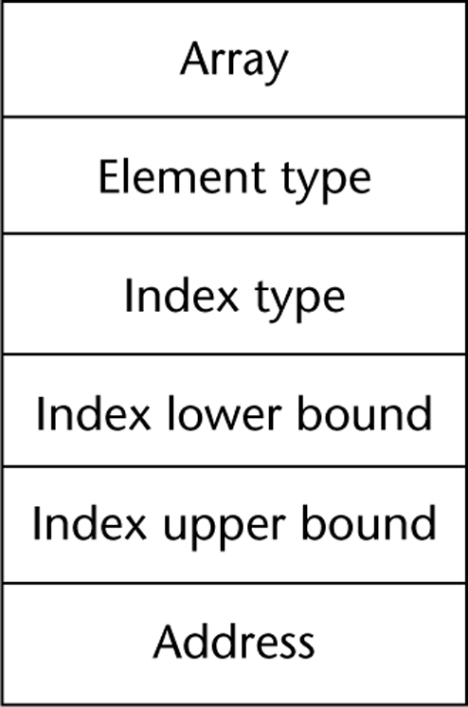
CS 304 – Fall 2003 – Ch. 6

Slide 48
Multidimensional Arrays
Need to know how arrays are stored
  Row major order (by rows)
  Column major order (by columns)
    See previous C++ examples…
  Access function needs to know how array elements are stored
  If row major order, lower bound of 1:
    address(list[i,j]) = address(list[1,1]) +
    (((i – 1) * rowSize) + (j – 1)) * elementSize
  Access to array elements with several subscripts is costly!
CS 304 – Fall 2003 – Ch. 6

Slide 49
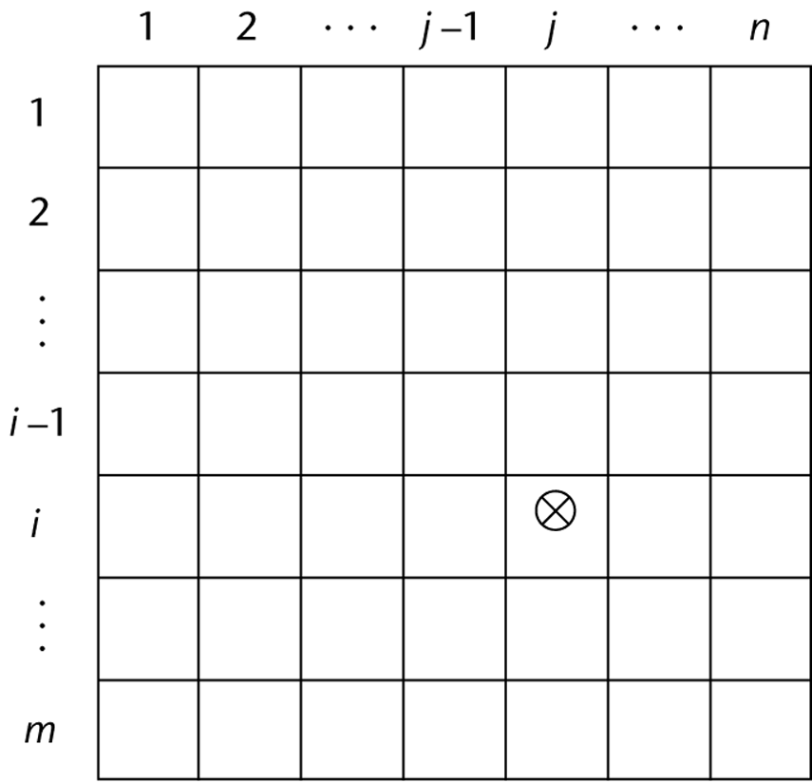
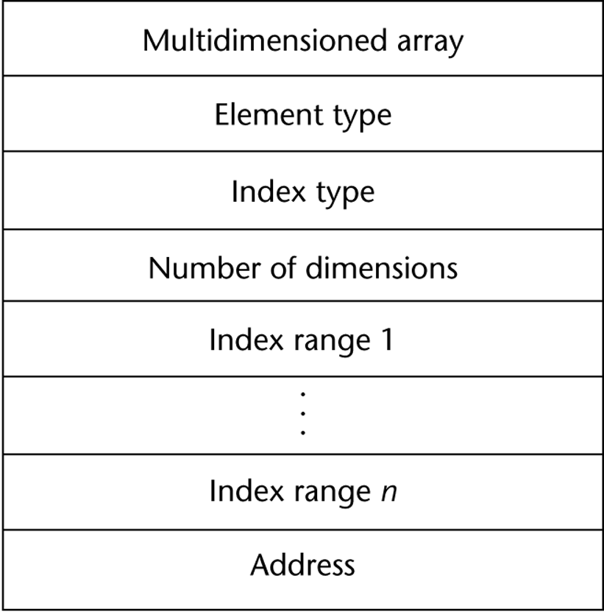
CS 304 – Fall 2003 – Ch. 6

Slide 50
Associative Arrays
Unordered collection of data elements that are indexed by an equal number of values called keys
  Each element is essentially a pair (key, value) : A.K.A. HASHING
Design Issues:
  1. What is the form of references to elements?
  2. Is the size static or dynamic?
Structure and Operations in Perl
  Names begin with %
  Literals are delimited by parentheses, e.g.,
  %hi_temps = ("Monday" => 77, "Tuesday" => 79,…);
  Subscripting is done using braces and keys, e.g.,
  $hi_temps{"Wednesday"} = 83;
  Elements can be removed with delete, e.g.,
  delete $hi_temps{"Tuesday"};
Implementation : Hashing Functions
CS 304 – Fall 2003 – Ch. 6

Slide 51
Record Types
A record is a possibly heterogeneous aggregate of data elements in which the individual elements are identified by names
  Similar to arrays, but for non-homogeneous types
  Elements are not directly accessed by indices
    Fields are named with identifiers
    Provide access to individual elements of the record
Design Issues:
  1. What is the form of references?
  2. What unit operations are defined?
CS 304 – Fall 2003 – Ch. 6

Slide 52
Record Types
Record Definition Syntax
  COBOL uses level numbers to show nested records; others use recursive definitions
  C and C++ use structures (structs) for records
Record Field References
  1. COBOL
  field_name OF record_name_1 OF ... OF record_name_n
  2. Others (dot notation)
  record_name_1.record_name_2. ... .record_name_n.field_name
Elliptical and Fully Qualified References:
  Fully qualified references must include all record names
  Elliptical references allow leaving out record names as long as the reference is unambiguous
  Pascal and Modula-2 provide a with clause to abbreviate references
CS 304 – Fall 2003 – Ch. 6

Slide 53
Record Types
Record Operations
1. Assignment
  Pascal, Ada, and C allow it if the types are identical
  In Ada, the RHS can be an aggregate constant
2. Initialization
  Allowed in Ada, using an aggregate constant
3. Comparison
  In Ada, = and /=; one operand can be an aggregate constant
4. MOVE CORRESPONDING
  In COBOL - it moves all fields in the source record to fields with the same names in the destination record
CS 304 – Fall 2003 – Ch. 6

Slide 54
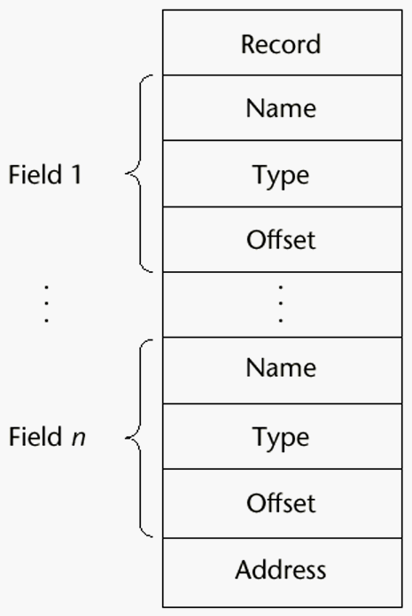
Record Types
Comparing records and arrays
1. Access to array elements is much slower than access to record fields, because subscripts are dynamic (field names are static)
2. Dynamic subscripts could be used with record field access, but it would disallow type checking and it would be much slower
CS 304 – Fall 2003 – Ch. 6

Slide 55
Union Types
A union is a type whose variables are allowed to store different type values at different times during execution
Design Issues for unions:
  1. What kind of type checking, if any, must be done?
  2. Should unions be integrated with records?
Free Unions
  No language support for type checking
  Complete freedom from type checking while programming
Discriminated Unions
  unions that include a type indicator
CS 304 – Fall 2003 – Ch. 6

Slide 56
Union Types
Pascal - both discriminated and nondiscriminated unions
  e.g.
  type intreal = record tagg : Boolean of true : (blint : integer); false : (blreal : real); end;
Problem with Pascal’s design: type checking is ineffective
  Reasons:
  a. User can create inconsistent unions (because the tag can be individually assigned)
  var blurb : intreal;
  x : real;
  blurb.tagg := true; {it is an integer }
  blurb.blint := 47; {ok }
  blurb.tagg := false; {it is a real }
  x := blurb.blreal; {assigns an integer to a real }
CS 304 – Fall 2003 – Ch. 6

Slide 57
Union Types
b. The tag is optional!
  Now, only the declaration and the second and last assignments are required to cause trouble
Algol 68 - discriminated unions
  Use a hidden tag to maintain the current type
  Tag is implicitly set by assignment
  This runtime type selection is a safe method of accessing union objects
CS 304 – Fall 2003 – Ch. 6

Slide 58
Union Types
Ada - discriminated unions
  Reasons they are safer than Pascal & Modula-2:
  a. Tag must be present
  b. It is impossible for the user to create an inconsistent union (because tag cannot be assigned by itself--All assignments to the union must include the tag value)
C and C++ - free unions (no tags)
  Not part of their records
  No type checking of references
Java has neither records nor unions
Evaluation - potentially unsafe in most languages
  not in Ada, however
CS 304 – Fall 2003 – Ch. 6

Slide 59
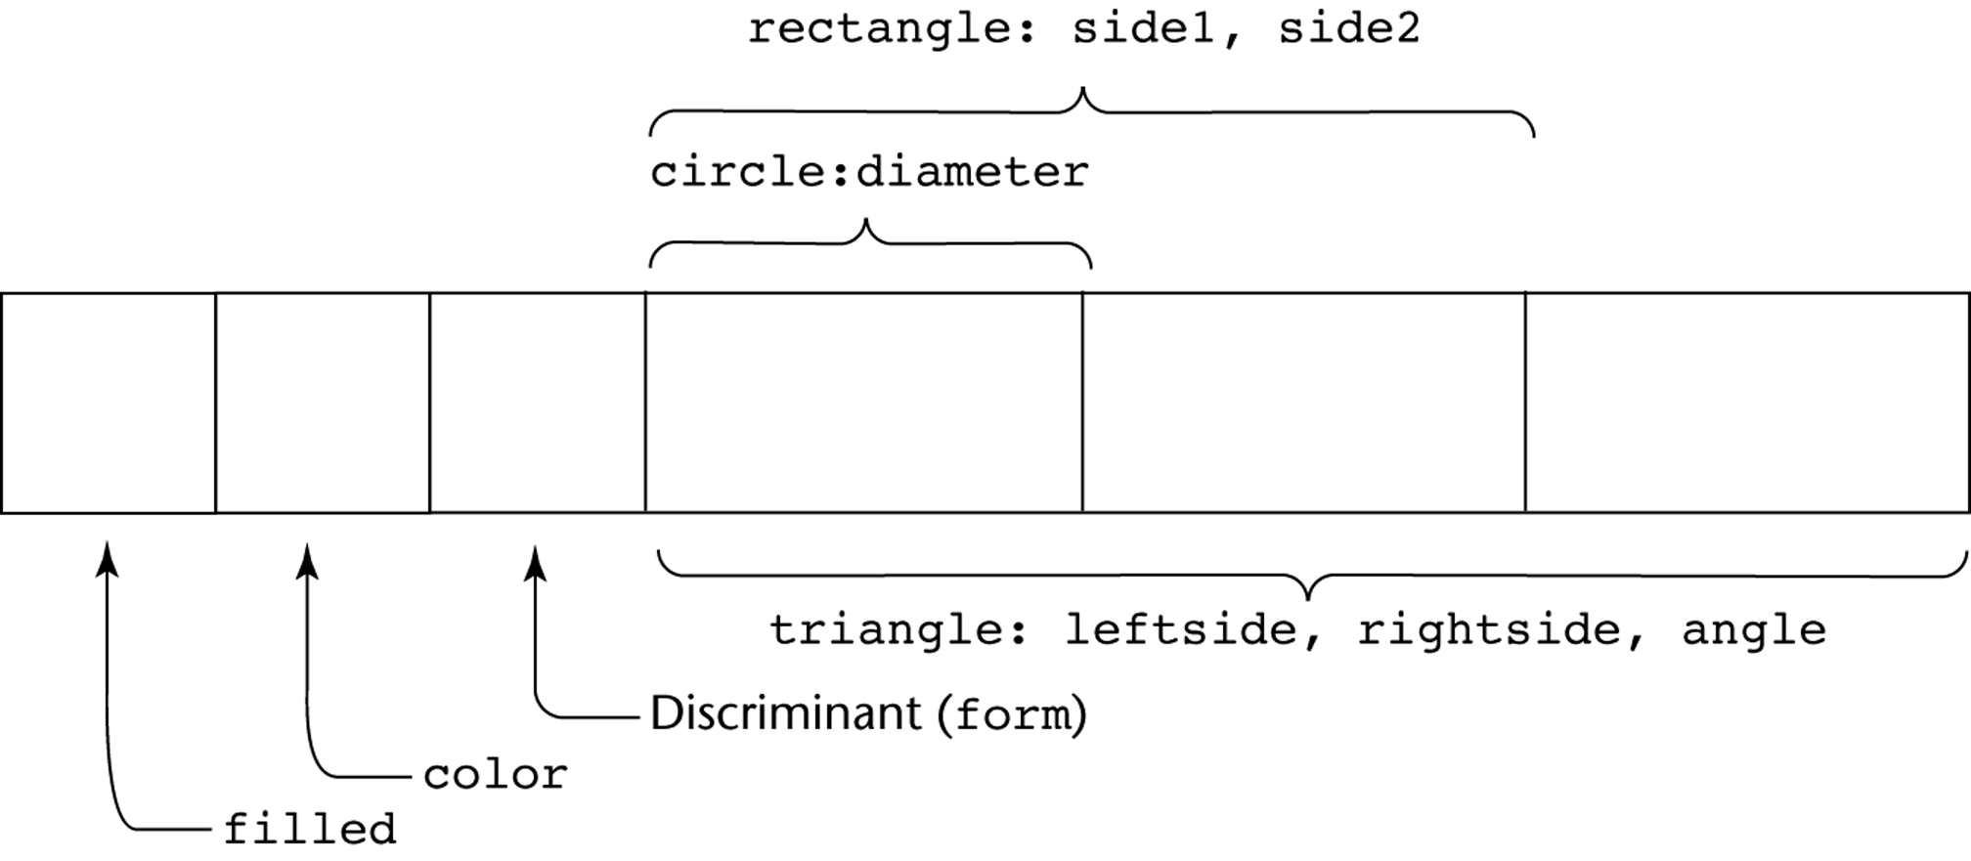
CS 304 – Fall 2003 – Ch. 6

Slide 60
Set Types
A set is a type whose variables can store unordered collections of distinct values from some ordinal type
Design Issue:
  What is the maximum number of elements in any set base type?
Examples:
1. Pascal
  No maximum size in the language definition
  (not portable, poor writability if max is too small)
  Operations: union (+), intersection (*), difference (-), =, <>, superset (>=), subset (<=), in
CS 304 – Fall 2003 – Ch. 6

Slide 61
Set Types
2. Modula-2 and Modula-3
  Additional operations: INCL, EXCL, / (symmetric set difference (elements in one but not both operands))
3. Ada
  does not include sets, but defines in as set membership operator for all enumeration types
4. Java
  includes a class for set operations
Evaluation
  If a language does not have sets, they must be simulated, either with enumerated types or with arrays
  Arrays are more flexible than sets, but have much slower operations
Implementation
  Usually stored as bit strings and use logical operations for the set operations
CS 304 – Fall 2003 – Ch. 6

Slide 62
Pointer Types
A pointer type is a type in which the range of values consists of memory addresses and a special value, nil (or null)
Uses:
  1. Addressing flexibility
  2. Dynamic storage management
Design Issues:
  1. What is the scope and lifetime of pointer variables?
  2. What is the lifetime of heap-dynamic variables?
  3. Are pointers restricted to pointing at a particular type?
  4. Are pointers used for dynamic storage management, indirect addressing, or both?
  5. Should a language support pointer types, reference types, or both?
CS 304 – Fall 2003 – Ch. 6

Slide 63
Pointer Types
Fundamental Pointer Operations:
  1. Assignment of an address to a pointer
    So that a variable may be manipulated via the pointer
  2. Dereferencing (explicit versus implicit dereferencing)
    For accessing the values of data to which the pointer is pointing
Example:
  Consider a pointer variable ptr that is bound to memory address 7080, where a value of 206 is stored
  e.g.,
    int x = 206;
    int j;
    int *ptr = &x;
    int *ptr1;
  Now, what happens if : ptr1 = ptr;
  j = *ptr;
CS 304 – Fall 2003 – Ch. 6

Slide 64
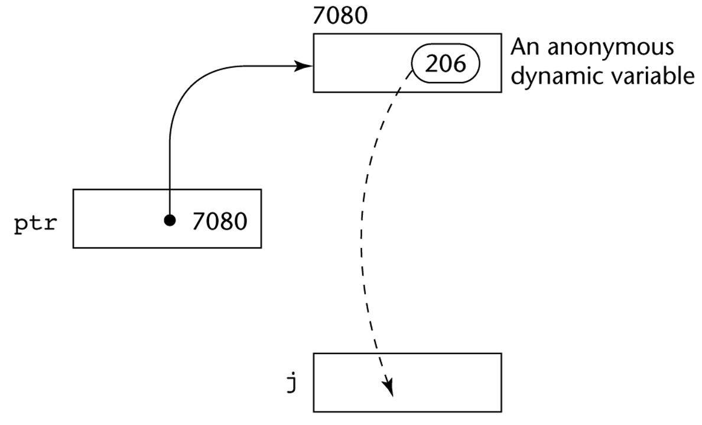
CS 304 – Fall 2003 – Ch. 6

Slide 65
Pointer Types
Problems with pointers:
1. Dangling pointers
  A pointer points to a heap-dynamic variable that has been deallocated
  Dangerous
Creating a dangling pointer :
  a. Allocate a heap-dynamic variable and set a pointer to point at it
  b. Set a second pointer to the value of the first pointer
  c. Deallocate the heap-dynamic variable, using the first pointer
CS 304 – Fall 2003 – Ch. 6

Slide 66
Pointer Types
2. Lost Heap-Dynamic Variables
  A heap-dynamic variable that is no longer referenced by any program pointer
  Wasteful
Creating a lost heap-dynamic variable:
  a. Pointer p1 is set to point to a newly created heap-dynamic variable
  b. p1 is later set to point to another newly created heap-dynamic variable
The process of losing heap-dynamic variables is called memory leakage
CS 304 – Fall 2003 – Ch. 6
Notes:
10/24/2012

Slide 67
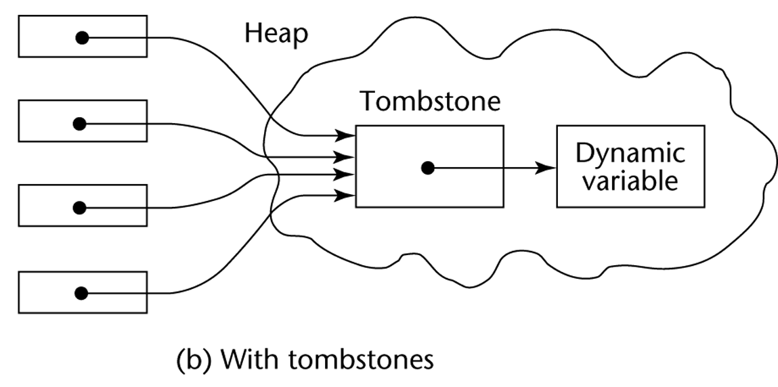
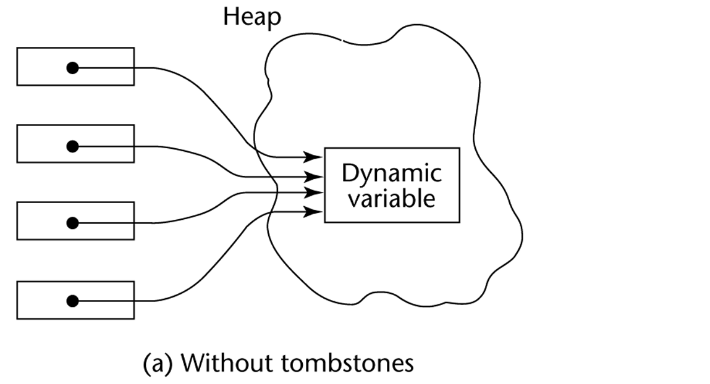
Solutions to Dangling Pointer Problem
Tombstones:
Lock-and-key:
Maintain pointers as (key, address) pairs
Heap-Dynamic variables also have associated integer keys
  Match must exist before access is allowed
CS 304 – Fall 2003 – Ch. 6

Slide 68
Pointer Types
1. Pascal
  Used for dynamic storage management only
  Explicit dereferencing
  Dangling pointers are possible (dispose)
  Dangling objects are also possible
2. Ada
  A little better than Pascal and Modula-2
  Some dangling pointers are disallowed because dynamic objects can be automatically deallocated at the end of pointer's scope
  All pointers are initialized to null
  Similar dangling object problem (but rarely happens)
CS 304 – Fall 2003 – Ch. 6

Slide 69
Pointer Types
3. C and C++
  Used for dynamic storage management and addressing
  Explicit dereferencing and address-of (&) operator
  Can do address arithmetic in restricted forms
  Domain type need not be fixed (void * )
e.g.
  float stuff[100];
  float *p;
  p = stuff;
  *(p+5) is equivalent to stuff[5] and p[5]
  *(p+i) is equivalent to stuff[i] and p[i]
  void * - can point to any type and can be type checked (cannot be dereferenced)
CS 304 – Fall 2003 – Ch. 6

Slide 70
Pointer Types
4. FORTRAN 90 Pointers
  Can point to heap and non-heap variables
  Implicit dereferencing
  Special assignment operator for non-dereferenced references
e.g.
  REAL, POINTER :: ptr (POINTER is an attribute)
  ptr => target (where target is either a pointer or a non-pointer with the TARGET attribute))
  The TARGET attribute is assigned in the declaration, as in:
  INTEGER, TARGET :: NODE
  There is a special assignment when dereferencing is not wanted
  e.g.,
  pointer => target
CS 304 – Fall 2003 – Ch. 6

Slide 71
Reference Types
5. C++ Reference Types
  Constant pointers that are implicitly dereferenced
  Used for parameters
  Advantages of both pass-by-reference and pass-by-value
6. Java - Only references
  No pointer arithmetic
  Can only point at objects (which are all on the heap)
  No explicit deallocator (garbage collection is used)
    Means there can be no dangling references!
  Dereferencing is always implicit
CS 304 – Fall 2003 – Ch. 6

Slide 72
Pointer Types
Evaluation of pointers:
1. Dangling pointers and dangling objects are problems, as is heap management
2. Pointers are like goto's
  they widen the range of cells that can be accessed by a variable
TRUE or FALSE:
3. Pointers are necessary
  so we can't design a language without them ???
CS 304 – Fall 2003 – Ch. 6

Slide 73
Smart Pointers
  Smart pointers are objects that look and feel like pointers, but are smarter ☺
  Example of a smart pointer is auto_ptr, which is included in the standard C++ library, in the header <memory>
  template <class T> class auto_ptr
  {
  T* ptr;
  public:
  explicit auto_ptr(T* p = 0) : ptr(p) {}
  ~auto_ptr() {delete ptr;}
  T& operator*() {return *ptr;}
  T* operator->() {return ptr;}
  // ...
  };
CS 304 – Fall 2003 – Ch. 6

Slide 74
Smart Pointers
“Smartness” in the destructor: the destructor takes care of deleting the pointer
For the user of auto_ptr, this means that instead of writing:
  void foo()
  {
  MyClass* p(new MyClass);
  p->DoSomething();
  delete p;
  }
You can write:
  void foo()
  {
  auto_ptr<MyClass> p(new MyClass);
  p->DoSomething();
  }
  And trust p to cleanup after itself.
What does this buy you?
CS 304 – Fall 2003 – Ch. 6

Slide 75
Smart Pointers
Less bugs
  Automatic cleanup
  Smart pointers that clean after themselves can save a few lines of code
  The importance : reducing the probability for bugs
    you don't need to remember to free the pointer, and so there is no chance you will forget about it.
Automatic initialization
  You don't need to initialize the auto_ptr to NULL, since the default constructor does that for you. This is one less thing for the programmer to forget.
Dangling pointers
  A common pitfall of regular pointers is the dangling pointer: a pointer that points to an object that is already deleted. The following code illustrates this situation:
MyClass* p(new MyClass);
MyClass* q = p;
delete p;
p->DoSomething(); // Watch out! p is now dangling!
p = NULL; // p is no longer dangling
q->DoSomething(); // Ouch! q is still dangling!
CS 304 – Fall 2003 – Ch. 6

Slide 76
Smart Pointers
For auto_ptr, this is solved by setting its pointer to NULL when it is copied:
template <class T>
auto_ptr<T>& auto_ptr<T>::operator=(auto_ptr<T>& rhs)
{
if (this != &rhs) {
delete ptr;
ptr = rhs.ptr;
rhs.ptr = NULL;
}
return *this;
}
CS 304 – Fall 2003 – Ch. 6

Slide 77
Smart Pointers
Other smart pointers may do other things when they are copied
Possible strategies for handling the statement q = p, where p and q are smart pointers:
  Create a new copy
    of the object pointed by p, and have q point to this copy
  Ownership transfer:
    Let both p and q point to the same object, but transfer the responsibility for cleaning up ("ownership") from p to q
  Reference counting:
    Maintain a count of the smart pointers that point to the same object, and delete the object when this count becomes zero. So the statement q = p causes the count of the object pointed by p to increase by one
  Reference linking:
    The same as reference counting, only instead of a count, maintain a circular doubly linked list of all smart pointers that point to the same object
  Copy on write:
    Use reference counting or linking as long as the pointed object is not modified. When it is about to be modified, copy it and modify the copy
CS 304 – Fall 2003 – Ch. 6

Slide 78
Smart Pointers
Exception Safety
  Let's take another look at this simple example:
  void foo() {
  MyClass* p(new MyClass);
  p->DoSomething();
  delete p;
  }
  What happens if DoSomething() throws an exception?
    All the lines after it will not get executed and p will never get deleted!
    If we're lucky, this leads only to memory leaks. However, MyClass may free some other resources in its destructor (file handles, threads, transactions) and so not calling it my cause severe resource locks.
  If we use a smart pointer:
    p will be cleaned up whenever it gets out of scope, whether it was during the normal path of execution or during the stack unwinding caused by throwing an exception.
CS 304 – Fall 2003 – Ch. 6

Slide 79
Smart Pointers
But isn't it possible to write exception safe code with regular pointers?
  Sure, but it is so painful… Here is what you would do in this simple case:
  void foo()
  {
  MyClass* p;
  try {
  p = new MyClass;
  p->DoSomething();
  delete p;
  }
  catch (...) {
  delete p;
  throw;
  }
  }
  Now imagine what would happen if we had some if's and for's in there...
CS 304 – Fall 2003 – Ch. 6

Slide 80
Smart Pointers
Garbage collection
  Since C++ does not provide automatic garbage collection like some other languages, smart pointers can be used for that purpose.
  Simplest garbage collection scheme is reference counting or reference linking, but it’s quite possible to implement more sophisticated garbage collection schemes with smart pointers
Efficiency
  Smart pointers can be used to make more efficient use of available memory and to shorten allocation and deallocation time.
  A common strategy for using memory more efficiently is copy on write (COW):
    This means that the same object is shared by many COW pointers as long as it is only read and not modified.
    When some part of the program tries to modify the object ("write"), the COW pointer creates a new copy of the object and modifies this copy instead of the original object.
    The standard string class is commonly implemented using COW semantics (see the <string> file)
string s("Hello");
string t = s; // t and s point to the same buffer of // characters
t += " there!"; // a new buffer is allocated for t before
// appending " there!", so s is unchanged.
CS 304 – Fall 2003 – Ch. 6

Slide 81
Heap Management
  A complex Run-Time process
  Single-sized vs. Variable-sized heap cells
  Single-sized cells:
    LISP : every cell contains a pointer
    Deallocation : when should it be performed:
Deallocation methods:
  Reference Counters – Eager Approach
    Additional cell for the count of references to the object
    Problems:
      Significant space for reference counters
      Expensive to maintain reference counters
      Circular connections : how to handle the counter variables?
  Mark-Sweep – Lazy Approach
    Every heap cell has an additional status bit
    Trace all pointers that are not garbage
    Those that are not traced are garbage
    When to start collecting garbage?
CS 304 – Fall 2003 – Ch. 6

Slide 82
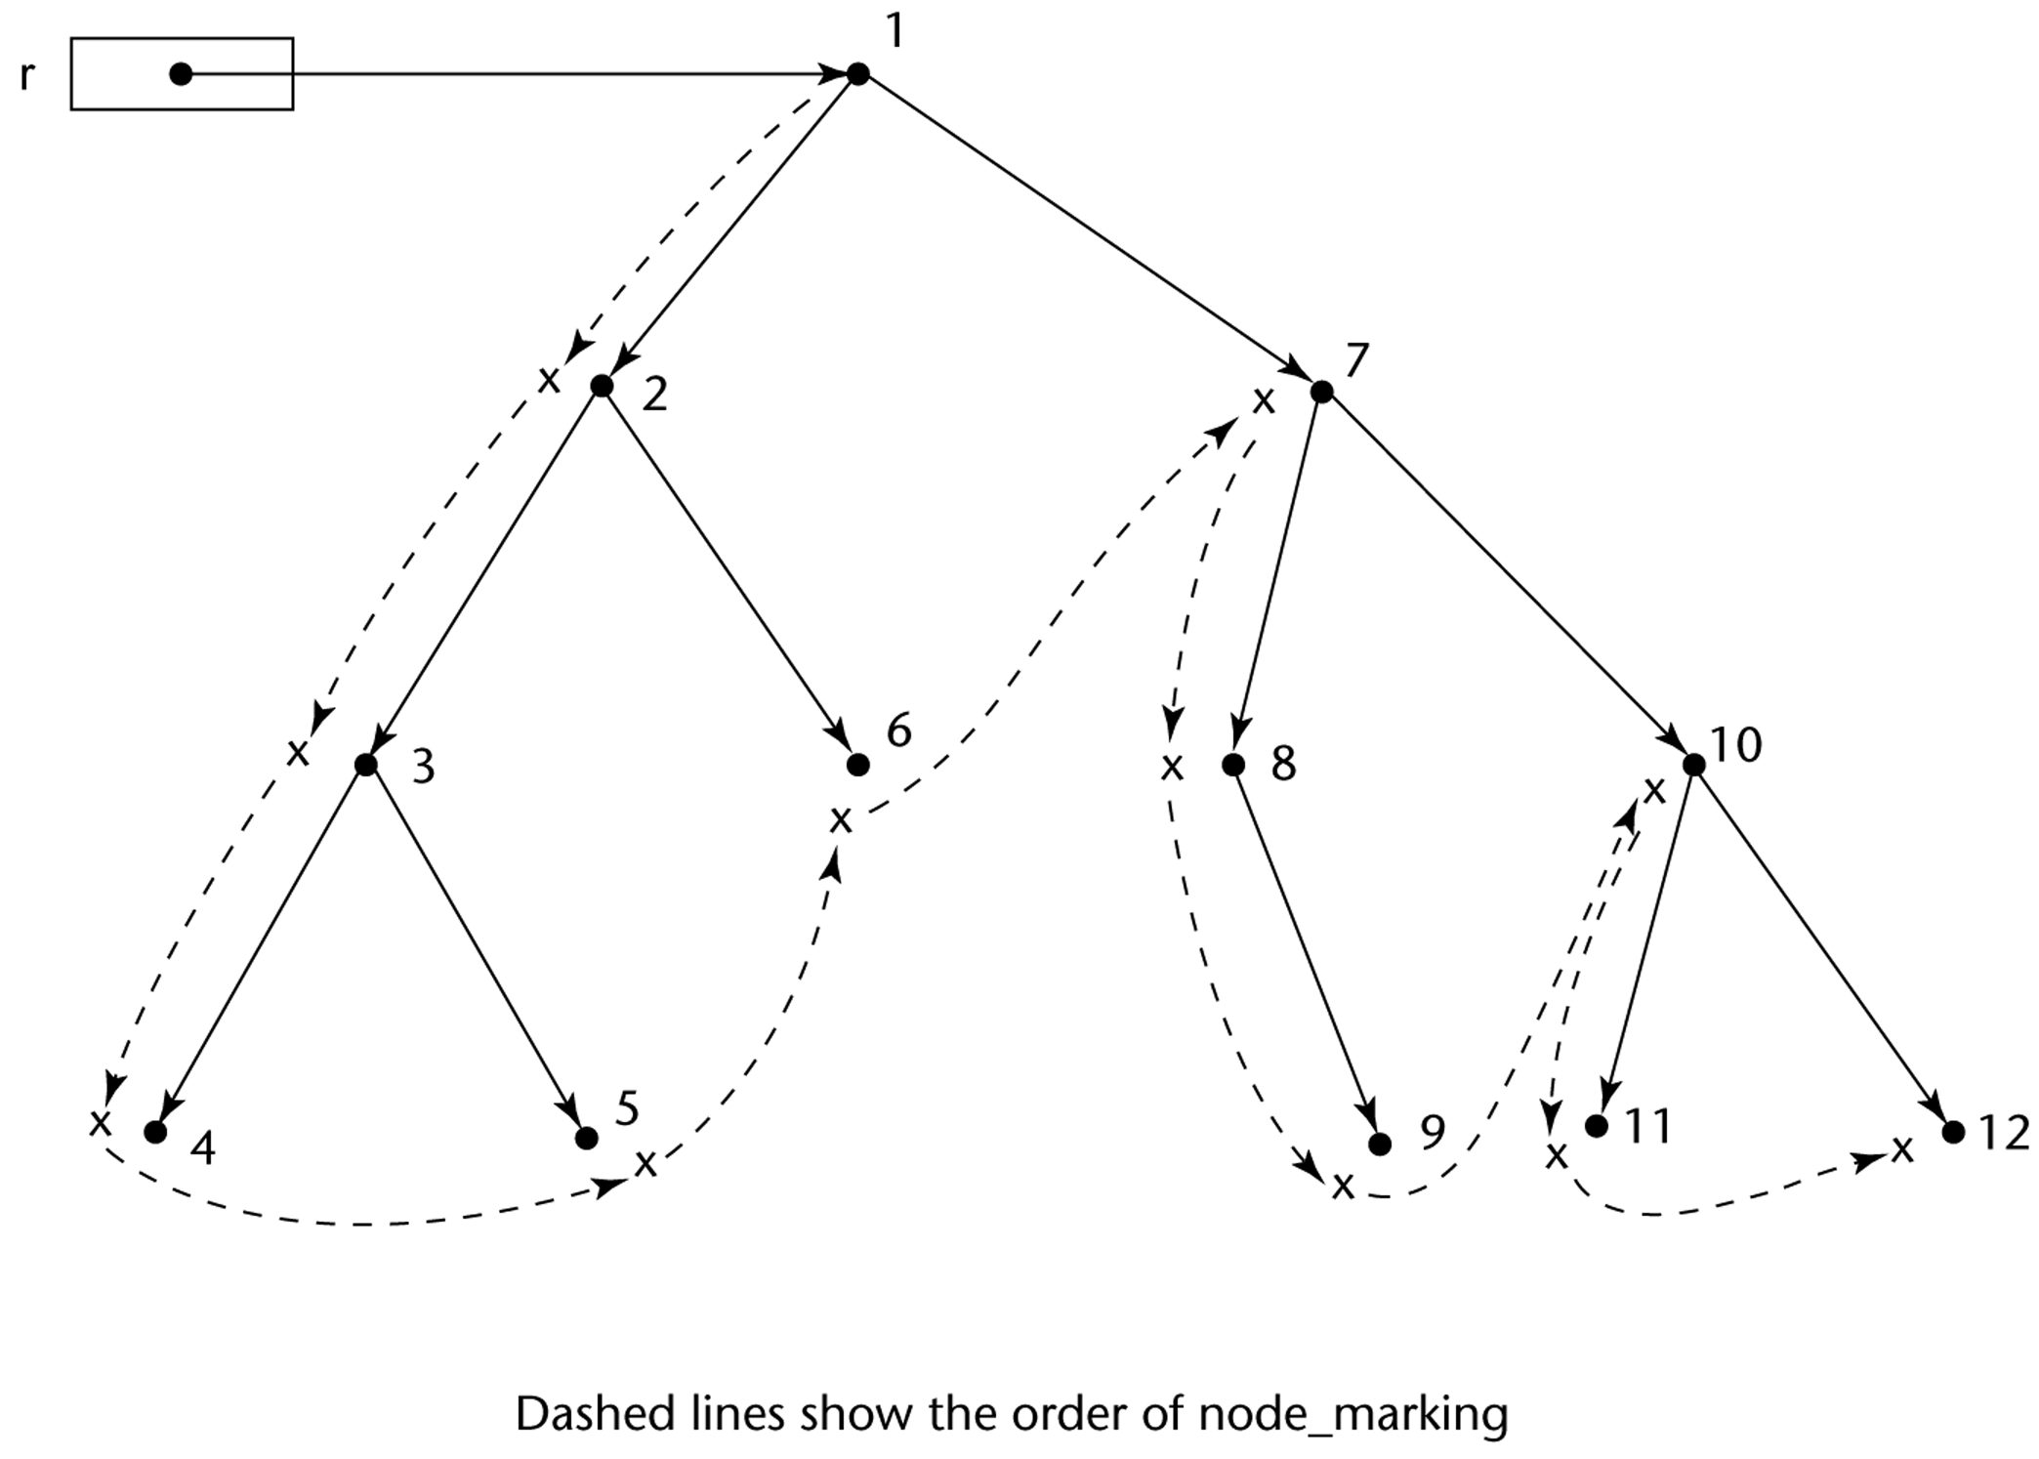
Heap Management
Variable-sized cells have additional problems:
The initial setting of the indicators of all cells in the heap to indicate that they are garbage is difficult
  Require cells to have the cell size as the first field
The marking process is non-trivial
Maintaining the list of available space is additional overhead
  List becomes a long list of various-size segments
  Requests cause the list to be searched for sufficiently large blocks
CS 304 – Fall 2003 – Ch. 6

