Slide 1
Statement-Level Control Structures
Chapter 8

Slide 2
Introduction
Levels of Control Flow:
  1. Within expressions
  2. Among program units
  3. Among program statements
Evolution:
  FORTRAN I control statements were based directly on IBM 704 hardware
  Much research and argument in the 1960s about the issue
  One important result: It was proven that all flowcharts can be coded with only two-way selection and pretest logical loops
Def: A control structure is a control statement and the statements whose execution it controls
Overall Design Question:
  What control statements should a language have, beyond selection and pretest logical loops?

Slide 3
Compound statements
Introduced by ALGOL 60 in the form of begin...end
A block is a compound statement that can define a new scope (with local variables)

Slide 4
Selection Statements
Design Issues:
  1. What is the form and type of the control expression?
  2. What is the selectable segment form (single statement, statement sequence, compound statement)?
  3. How should the meaning of nested selectors be specified?
Single-Way Examples
FORTRAN IF: IF (boolean_expr) statement
  Problem: can select only a single statement; to select more, a goto must be used, as in the following example
  IF (.NOT. condition) GOTO 20
  ...
  ...
  20 CONTINUE

Slide 5
Selection Statements
ALGOL 60 if:
  if (boolean_expr) then
  begin
  ...
  end
Two-way Selector Examples
ALGOL 60 if:
  if (boolean_expr)
  then statement (the then clause)
  else statement (the else clause)
The statements could be single or compound

Slide 6
Selection Statements
Nested Selectors
  e.g. (Pascal) if ... then
  if ... then
  ...
  else ...
  Which then gets the else?
  Pascal's rule: else goes with the nearest then
ALGOL 60's solution - disallow direct nesting
if ... then if ... then
begin begin
if ... if ... then ...
then ... end
else ... else ...
end

Slide 7
Selection Statements
FORTRAN 77, Ada, Modula-2 solution – closing special words
e.g. (Ada)
if ... then if ... then
if ... then if ... then
... ...
else end if
... else
end if ...
end if end if
Advantage: flexibility and readability
Modula-2 uses the same closing special word for all control structures (END)
  This results in poor readability

Slide 8
Selection Statements
Multiple Selection Constructs
Design Issues:
  1. What is the form and type of the control expression?
  2. What segments are selectable (single, compound, sequential)?
  3. Is the entire construct encapsulated?
  4. Is execution flow through the structure restricted to include just a single selectable segment?
  5. What is done about unrepresented expression values?
Early Multiple Selectors:
1. FORTRAN arithmetic IF (a three-way selector)
IF (arithmetic expression) N1, N2, N3
Bad aspects:
  Not encapsulated (selectable segments could be anywhere)
  Segments require GOTOs
2. FORTRAN computed GOTO and assigned GOTO

Slide 9
Selection Statements
Modern Multiple Selectors
1. Pascal case (from Hoare's contribution to ALGOL W)
case expression of
constant_list_1 : statement_1;
...
constant_list_n : statement_n
end
Design choices:
  1. Expression is any ordinal type (int, boolean, char, enum)
  2. Segments can be single or compound
  3. Construct is encapsulated
  4. Only one segment can be executed per execution of the construct
  5. In Wirth's Pascal, result of an unrepresented control expression value is undefined (In 1984 ISO Standard, it is a runtime error)
Many dialects now have otherwise or else clause

Slide 10
Selection Statements
2. The C and C++ switch
  switch (expression) {
  constant_expression_1 : statement_1;
  ...
  constant_expression_n : statement_n;
  [default: statement_n+1]
  }
Design Choices: (for switch)
  1. Control expression can be only an integer type
  2. Selectable segments can be statement sequences, blocks, or compound statements
  3. Construct is encapsulated
  4. Any number of segments can be executed in one execution of the construct (there is no implicit branch at the end of selectable segments)
  5. default clause is for unrepresented values (if there is no default, the whole statement does nothing)
Design choice 4 is a trade-off between reliability and flexibility (convenience)
  To avoid it, the programmer must supply a break statement for each segment

Slide 11
Selection Statements
3. Ada's case is similar to Pascal's case, except:
  1. Constant lists can include:
  - Subranges e.g., 10..15
  - Boolean OR operators e.g., 1..5 | 7 | 15..20
  2. Lists of constants must be exhaustive
  - Often accomplished with others clause
  - This makes it more reliable
Multiple Selectors can appear as direct extensions to two-way selectors, using else-if clauses (ALGOL 68, FORTRAN 77, Modula-2, Ada)
Ada:
  if ...
  then ...
  elsif ...
  then ...
  elsif ...
  then ...
  else ...
  end if
  Far more readable than deeply nested if's
  Allows a boolean gate on every selectable group

Slide 12
Iterative Statements
The repeated execution of a statement or compound statement is accomplished either by iteration or recursion
  Here we look at iteration, because recursion is unit-level control
General design issues for iteration control statements:
  1. How is iteration controlled?
  2. Where is the control mechanism in the loop?
Counter-Controlled Loops
Design Issues:
  1. What is the type and scope of the loop var?
  2. What is the value of the loop var at loop termination?
  3. Should it be legal for the loop var or loop parameters to be changed in the loop body, and if so, does the change affect loop control?
  4. Should the loop parameters be evaluated only once, or once for every iteration?

Slide 13
Iterative Statements
1. FORTRAN 77 and 90
  Syntax: DO label var = start, finish [, stepsize]
  Stepsize can be any value but zero
  Parameters can be expressions
Design choices:
  1. Loop var can be INTEGER, REAL, or DOUBLE
  2. Loop var always has its last value
  3. The loop var cannot be changed in the loop, but the parameters can; because they are evaluated only once, it does not affect loop control
  4. Loop parameters are evaluated only once
FORTRAN 90’s Other DO
Syntax:
  [name:] DO variable = initial, terminal [, stepsize]
  …
  END DO [name]
  Loop var must be an INTEGER

Slide 14
Iterative Statements
2. ALGOL 60
  Syntax: for var := <list_of_stuff> do statement
  where <list_of_stuff> can have:
  - list of expressions
  - expression step expression until expression
  - expression while boolean_expression
  for index := 1 step 2 until 50,
  60, 70, 80,
  index + 1 until 100 do
  (index = 1, 3, 5, 7, ..., 49, 60, 70, 80, 81, 82, ..., 100)
ALGOL 60 Design choices:
  1. Control expression can be int or real; its scope is whatever it is declared to be
  2. Control var has its last assigned value after loop termination
  3. The loop var cannot be changed in the loop, but the parameters can, and when they are, it affects loop control
  4. Parameters are evaluated with every iteration, making it very complex and difficult to read

Slide 15
Iterative Statements
4. Ada
  Syntax:
  for var in [reverse] discrete_range loop
  ...
  end loop
Ada Design choices:
  1. Type of the loop var is that of the discrete range; its scope is the loop body (it is implicitly declared)
  2. The loop var does not exist outside the loop
  3. The loop var cannot be changed in the loop, but the discrete range can; it does not affect loop control
  4. The discrete range is evaluated just once

Slide 16
Iterative Statements
5. C
  Syntax:
  for ([expr_1] ; [expr_2] ; [expr_3]) statement
  The expressions can be whole statements, or even statement sequences, with the statements separated by commas
  The value of a multiple-statement expression is the value of the last statement in the expression
  e.g.,
  for (i = 0, j = 10; j == i; i++) ...
  If the second expression is absent, it is an infinite loop
C Design Choices:
  1. There is no explicit loop var
  2. Irrelevant
  3. Everything can be changed in the loop
  4. Pretest
  5. The first expression is evaluated once, but the other two are evaluated with each iteration
  This loop statement is the most flexible

Slide 17
Iterative Statements
6. C++
  Differs from C in two ways:
  1. The control expression can also be Boolean
  2. The initial expression can include variable definitions (scope is from the definition to the end of the function in which it is defined)
7. Java
  Differs from C++ in two ways:
  1. Control expression must be Boolean
  2. Scope of variables defined in the initial expression is only the loop body

Slide 18
Logically-Controlled Loops
Design Issues:
  1. Pretest or postest?
  2. Should this be a special case of the counting loop statement (or a separate statement)?
Language Examples:
1. Pascal has separate pretest and posttest logical loop statements (while-do and repeat-until)
2. C and C++ also have both, but the control expression for the posttest version is treated just like in the pretest case (while - do and do - while)
3. Java is like C, except the control expression must be Boolean (and the body can only be entered at the beginning--Java has no goto)
4. Ada has a pretest version, but no posttest
5. FORTRAN 77 and 90 have neither

Slide 19
User-Located Loop Control Mechanisms
Design issues:
  1. Should the conditional be part of the exit?
  2. Should the mechanism be allowed in an already controlled loop?
  3. Should control be transferable out of more than one loop?
Examples:
1. Ada - conditional or unconditional; for any loop; any number of levels
  for ... loop LOOP1:
  ... while ... loop
  exit when ... ...
  ... LOOP2:
  end loop for ... loop
  ...
  exit LOOP1 when ..
  ...
  end loop LOOP2;
  ...
  end loop LOOP1;
2. C , C++, and Java - break
  Unconditional; for any loop or switch; one level only (Java’s can have a label
  There is also has a continue statement for loops; it skips the remainder of this iteration, but does not exit the loop

Slide 20
User-Located Loop Control Mechanisms
3. FORTRAN 90 - EXIT
  Unconditional; for any loop, any number of levels
  FORTRAN 90 also has CYCLE, which has the same semantics as C's continue
Iteration Based on Data Structures
  Concept: use order and number of elements of some data structure to control iteration
  Control mechanism is a call to a function that returns the next element in some chosen order, if there is one; else exit loop
  C's for can be used to build a user-defined iterator
  e.g. for (p=hdr; p; p=next(p)) { ... }
  Perl has a built-in iterator for arrays and hashes
  e.g., foreach $name (@names) { print $name }

Slide 21
Unconditional Branching
Problem: readability
  Some languages do not have them: e.g., Modula-2 and Java
Label forms:
  1. Unsigned int constants: Pascal (with colon) FORTRAN (no colon)
  2. Identifiers with colons: ALGOL 60, C
  3. Identifiers in << ... >>: Ada
  4. Variables as labels: PL/I
    Can be assigned values and passed as parameters
    Highly flexible, but make programs impossible to read and difficult to implement
  Restrictions on Pascal's gotos:
    A statement group is either a compound statement or the body of a repeat-until
    The target of a goto cannot be a statement in a statement group that is not active
    Means the target can never be in a statement group that is at the same level or is nested more deeply than the one with the goto
    An important remaining problem: the target can be in any enclosing subprogram scope, as long as the statement is not in a statement group
    This means that a goto can terminate any number of subprograms

Slide 22
Guarded Commands
  Dijkstra, 1975
Purpose: to support a new programming methodology (verification during program development)
1. Selection: if <boolean> -> <statement>
[] <boolean> -> <statement>
...
[] <boolean> -> <statement>
fi
Semantics:
  When this construct is reached, evaluate all boolean expressions
  If more than one are true, choose one nondeterministically
  If none are true, it is a runtime error
  Idea: if the order of evaluation is not important, the program should not specify one
  See book examples

Slide 23
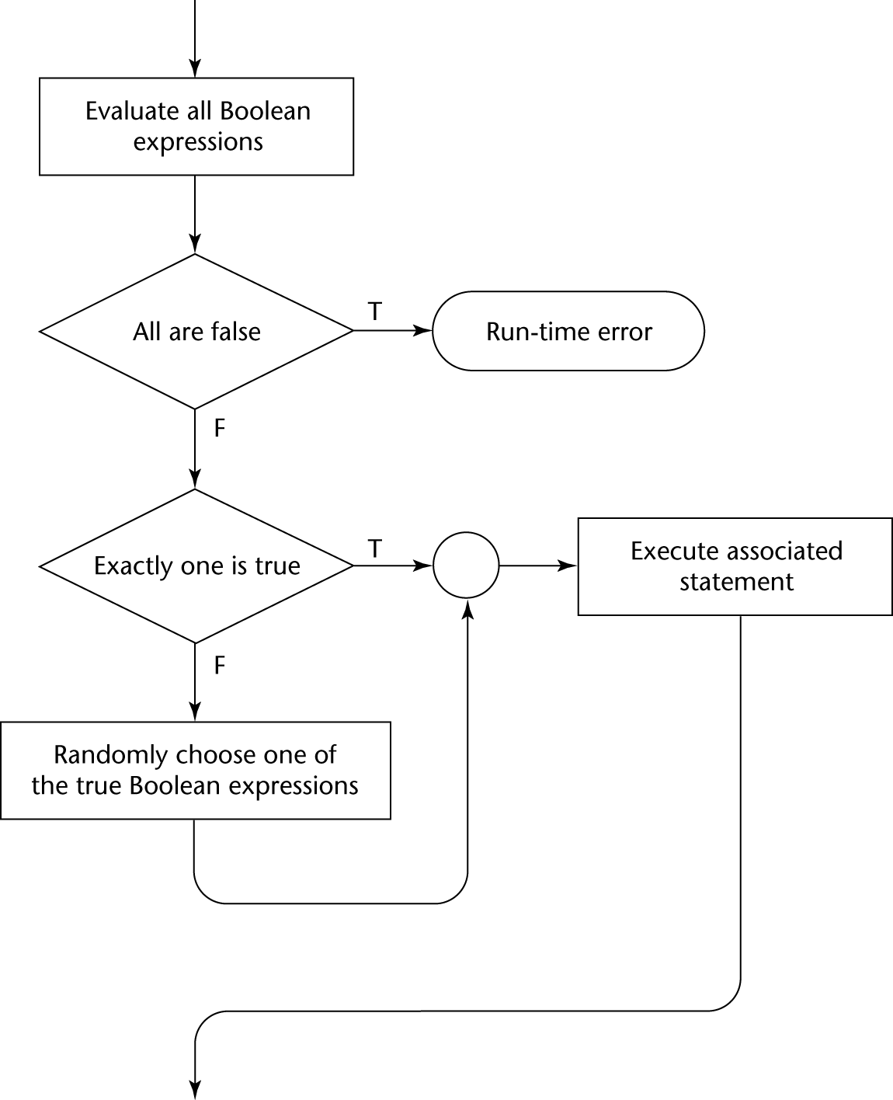
Figure 8.1
Flowgraph of the approach used with Dijkstra’s selector statement

Slide 24
Guarded Commands
2. Loops do <boolean> -> <statement>
[] <boolean> -> <statement>
...
[] <boolean> -> <statement>
od
Semantics: For each iteration:
  Evaluate all boolean expressions
  If more than one are true, choose one nondeterministically; then start loop again
  If none are true, exit loop
  See book example
Connection between control statements and program verification is intimate
  Verification is impossible with gotos
  Verification is possible with only selection and logical pretest loops
  Verification is relatively simple with only guarded commands
Chapter Conclusion:
  Choice of control statements beyond selection and logical pretest loops is a trade-off between language size and writability

Slide 25
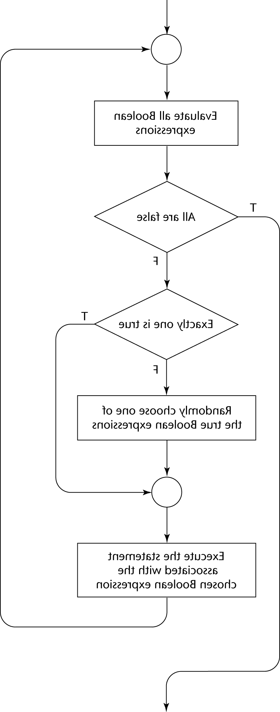
Figure 8.2
Flowgraph of the approach used with Dijkstra’s loop statement

