Slide 1
Subprograms
Chapter 9

Slide 2
Introduction
Fundamental Characteristics of Subprograms
  1. A subprogram has a single entry point
  2. The caller is suspended during execution of the called subprogram
  3. Control always returns to the caller when the called subprogram’s execution terminates
Basic definitions:
  A subprogram definition is a description of the actions of the subprogram abstraction
  A subprogram call is an explicit request that the subprogram be executed
  A subprogram header is the first line of the definition, including the name, the kind of subprogram, and the formal parameters
  The parameter profile of a subprogram is the number, order, and types of its parameters
  The protocol of a subprogram is its parameter profile plus, if it is a function, its return type

Slide 3
Parameters
A subprogram declaration provides the protocol, but not the body, of the subprogram
A formal parameter is a dummy variable listed in the subprogram header and used in the subprogram
An actual parameter represents a value or address used in the subprogram call statement
Actual/Formal Parameter Correspondence:
1. Positional
2. Keyword
  e.g. SORT(LIST => A, LENGTH => N);
  Advantage: order is irrelevant
  Disadvantage: user must know the formal parameter’s names
Default Values:
  e.g. procedure SORT(LIST : LIST_TYPE;
  LENGTH : INTEGER := 100);
  ...
  SORT(LIST => A);
Procedures provide user-defined statements
Functions provide user-defined operators

Slide 4
Subprograms
Design Issues for Subprograms
1. What parameter passing methods are provided?
2. Are parameter types checked?
3. Are local variables static or dynamic?
4. What is the referencing environment of a passed subprogram?
5. Are parameter types in passed subprograms checked?
6. Can subprogram definitions be nested?
7. Can subprograms be overloaded?
8. Are subprograms allowed to be generic?
9. Is separate or independent compilation supported?

Slide 5
Local referencing environments
If local variables are stack-dynamic:
  Advantages:
  a. Support for recursion
  b. Storage for locals is shared among some subprograms
  Disadvantages:
  a. Allocation/deallocation time
  b. Indirect addressing
  c. Subprograms cannot be history sensitive
Static locals are the opposite
Language Examples:
1. FORTRAN 77 and 90 - most are static, but can have either (SAVE forces static)
2. C - both
  variables declared to be static are
  default is stack dynamic
3. Pascal, Modula-2, and Ada - dynamic only

Slide 6
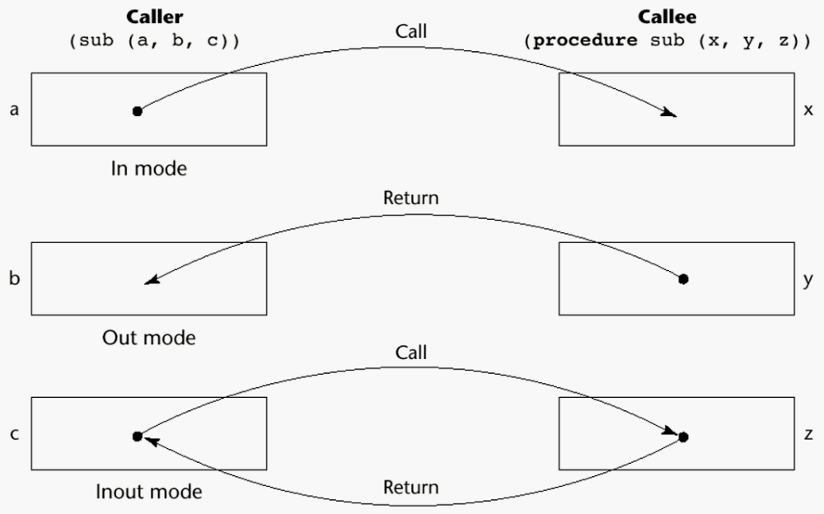
Figure 9.1
The three semantics models of parameter passing when physical
moves are used

Slide 7
Parameters and Parameter Passing
Semantic Models: in mode, out mode, inout mode
Conceptual Models of Transfer:
  1. Physically move a value
  2. Move an access path
Implementation Models:
1. Pass-by-value (in mode)
  Either by physical move or access path
  Disadvantages of access path method:
    Must write-protect in the called subprogram
    Accesses cost more (indirect addressing)
  Disadvantages of physical move:
    Requires more storage
    Cost of the moves

Slide 8
Parameters and Parameter Passing
2. Pass-by-result (out mode)
  Local’s value is passed back to the caller
  Physical move is usually used
  Disadvantages:
    a. If value is passed, time and space
    b. In both cases, order dependence may be a problem
    e.g.
  procedure sub1(y: int, z: int);
  ...
  sub1(x, x);
    Value of x in the caller depends on order of assignments at the return
3. Pass-by-value-result (inout mode)
  Physical move, both ways
  Also called pass-by-copy
  Disadvantages:
    Those of pass-by-result
    Those of pass-by-value

Slide 9
Parameters and Parameter Passing
4. Pass-by-reference (inout mode)
  Pass an access path
  Also called pass-by-sharing
  Advantage: passing process is efficient
  Disadvantages:
  a. Slower accesses
  b. Can allow aliasing:
    i. Actual parameter collisions:
    e.g.
    procedure sub1(a: int, b: int);
    ...
    sub1(x, x);
    ii. Array element collisions:
    e.g.
    sub1(a[i], a[j]); /* if i = j */
    Also, sub2(a, a[i]);
    iii. Collision between formals and globals
  Root cause of all of these is: The called subprogram is provided wider access to nonlocals than is necessary
  Pass-by-value-result does not allow these aliases (but has other problems!)

Slide 10
Parameters and Parameter Passing
5. Pass-by-name (multiple mode)
  By textual substitution
  Formals are bound to an access method at the time of the call, but actual binding to a value or address takes place at the time of a reference or assignment
  Purpose: flexibility of late binding
  Resulting semantics:
    If actual is a scalar variable, it is pass-by-reference
    If actual is a constant expression, it is pass-by-value
    If actual is an array element, it is like nothing else
    e.g.
    procedure sub1(x: int; y: int);
    begin
    x := 1;
    y := 2;
    x := 2;
    y := 3;
    end;
    sub1(i, a[i]);

Slide 11
Parameters and Parameter Passing
If actual is an expression with a reference to a variable that is also accessible in the program, it is also like nothing else
  e.g. (assume k is a global variable)
  procedure sub1(x: int; y: int; z: int);
  begin
  k := 1;
  y := x;
  k := 5;
  z := x;
  end;
  sub1(k+1, j, i);
Disadvantages of pass by name:
  Very inefficient references
  Too tricky; hard to read and understand

Slide 12
Parameters and Parameter Passing
Language Examples:
1. FORTRAN
  Before 77, pass-by-reference
  77 - scalar variables are often passed by value-result
2. ALGOL 60
  Pass-by-name is default; pass-by-value is optional
3. ALGOL W
  Pass-by-value-result
4. C
  Pass-by-value
5. Pascal and Modula-2
  Default is pass-by-value; pass-by-reference is optional

Slide 13
Parameters and Parameter Passing
6. C++
  Like C, but also allows reference type actual parameters; the corresponding formal parameters can be pointers to constants, which provide the efficiency of pass-by-reference with in-mode semantics
7. Ada
  All three semantic modes are available
  If out, it cannot be referenced
  If in, it cannot be assigned
8. Java
  Like C, except references instead of pointers

Slide 14
Parameters and Parameter Passing
Type checking parameters
  Now considered very important for reliability
FORTRAN 77 and original C
  none
Pascal, Modula-2, FORTRAN 90, Java, and Ada
  it is always required
ANSI C and C++
  choice is made by the user

Slide 15
Parameters and Parameter Passing
Implementing Parameter Passing
ALGOL 60 and most of its descendants use the run-time stack
  Value - copy it to the stack; references are indirect to the stack
  Result - same
  Reference - regardless of form, put the address in the stack
  Name - run-time resident code segments or subprograms evaluate the address of the parameter; called for each reference to the formal; these are called thunks
    Very expensive, compared to reference or value-result
Ada
  Simple variables are passed by copy (value-result)
  Structured types can be either by copy or reference
  This can be a problem, because
    a) Of aliases (reference allows aliases, but value-result does not)
    b) Procedure termination by error can produce different actual parameter results
  Programs with such errors are “erroneous”

Slide 16
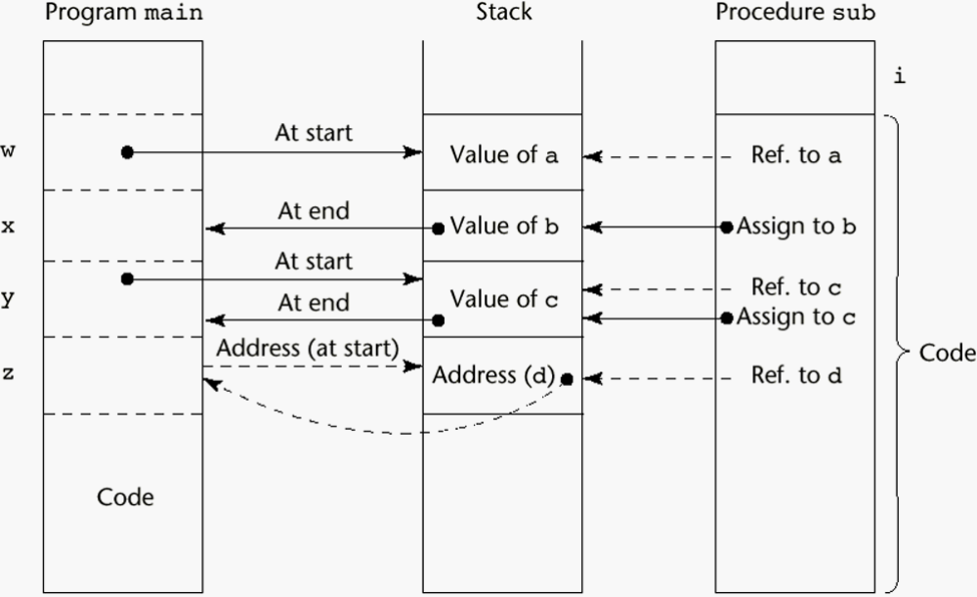
Figure 9.2
One possible stack implementation of the common parameter-passing methods

Slide 17
Multidimensional Arrays as Parameters
If a multidimensional array is passed to a subprogram and the subprogram is separately compiled, the compiler needs to know the declared size of that array to build the storage mapping function
C and C++
  Programmer is required to include the declared sizes of all but the first subscript in the actual parameter
  This disallows writing flexible subprograms
  Solution: pass a pointer to the array and the sizes of the dimensions as other parameters; the user must include the storage mapping function, which is in terms of the size parameters (See example in the book)
Pascal
  Not a problem (declared size is part of the array’s type)
Ada
  Constrained arrays - like Pascal
  Unconstrained arrays - declared size is part of the object declaration (See book example)
Pre-90 FORTRAN
  Formal parameter declarations for arrays can include passed parameters
  e.g.
    SUBPROGRAM SUB(MATRIX, ROWS, COLS, RESULT)
    INTEGER ROWS, COLS
    REAL MATRIX (ROWS, COLS), RESULT
    ...
    END

Slide 18
Design Considerations for Parameter Passing
1. Efficiency
2. One-way or two-way
  These two are in conflict with one another!
  Good programming => limited access to variables, which means one-way whenever possible
  Efficiency => pass by reference is fastest way to pass structures of significant size

Slide 19
Parameters that are Subprogram Names
Issues:
1. Are parameter types checked?
  Early Pascal and FORTRAN 77 do not
  Later versions of Pascal, Modula-2, and FORTRAN 90 do
  Ada does not allow subprogram parameters
  C and C++ - pass pointers to functions; parameters can be type checked
2. What is the correct referencing environment for a subprogram that was sent as a parameter?
  Possibilities:
  a. It is that of the subprogram that enacts it.
  - Shallow binding
  b. It is that of the subprogram that declared it.
  - Deep binding
  c. It is that of the subprogram that passed it.
  - Ad hoc binding (Has never been used)

Slide 20
Parameters that are Subprogram Names
  For static-scoped languages, deep binding is most natural
  For dynamic-scoped languages, shallow binding is most natural
  Example:
  sub1
  sub2
  sub3
  call sub4(sub2)
  sub4(subx)
  call subx
  call sub3
  What is the referencing environment of sub2 when it is called in sub4?

Slide 21
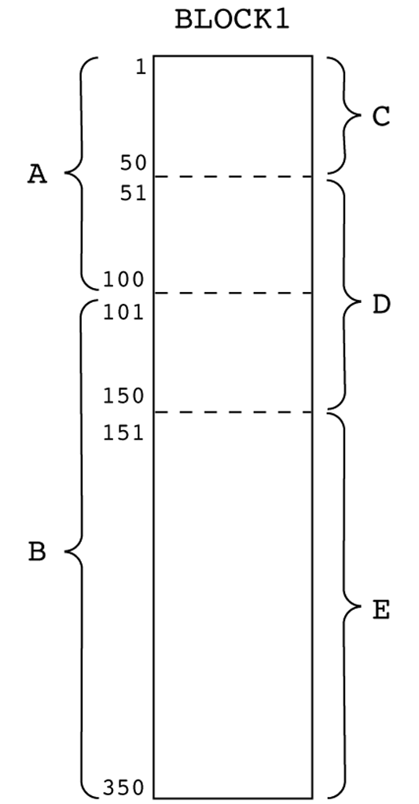
Figure 9.3
Two views of a COMMON block

Slide 22
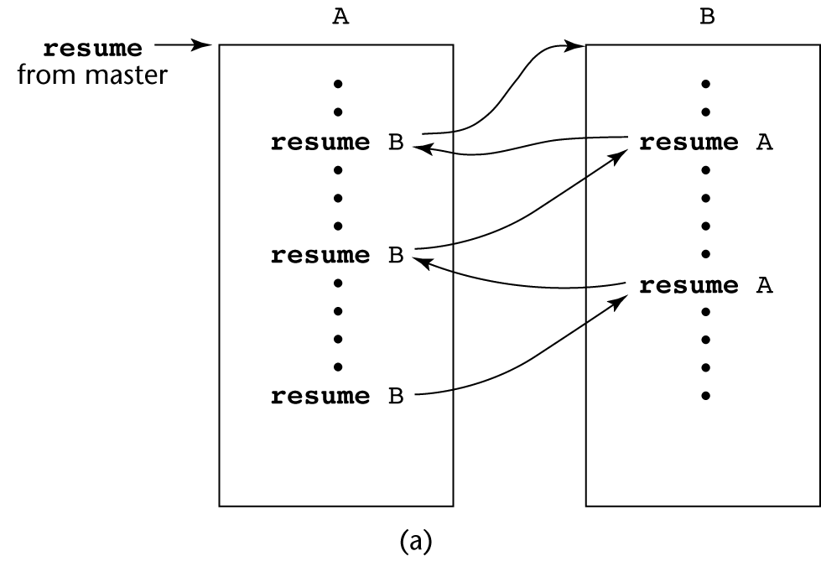
Figure 9.4a
Two possible execution control sequences for two coroutines without loops

Slide 23
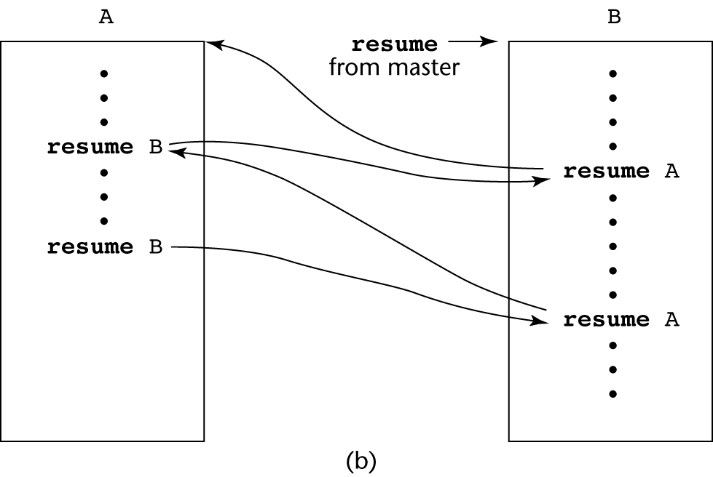
Figure 9.4b
Two possible execution control sequences for two coroutines without loops

Slide 24
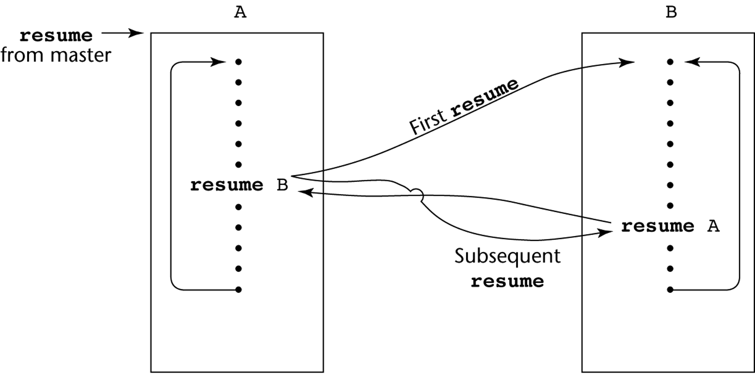
Figure 9.5
Coroutine execution sequence with loops

