Slide 1
Chapter 5: More on the Selection Structure

Slide 2
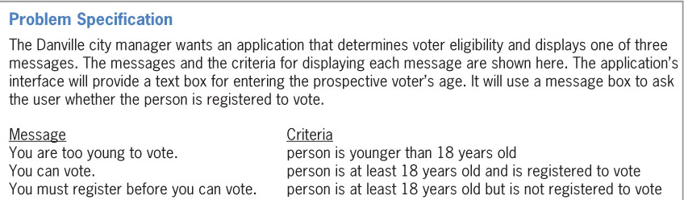
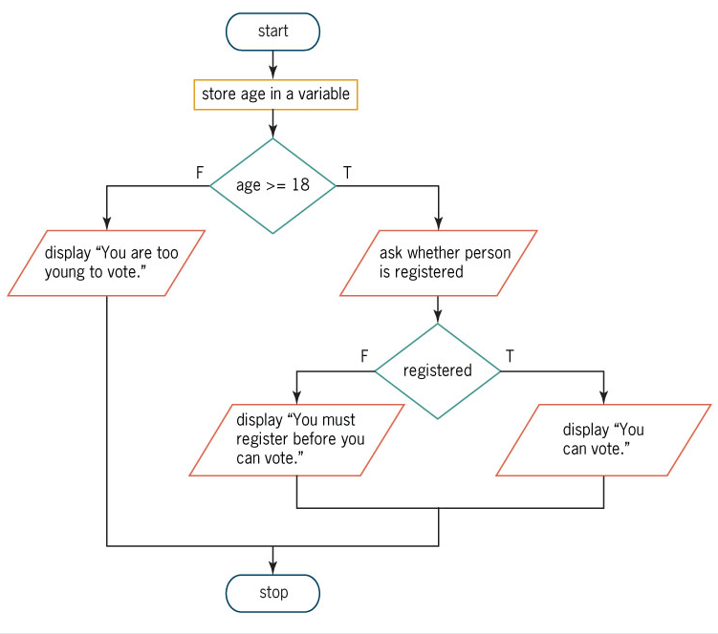
Flowcharting a Nested Selection Structure
Figure 5-6 Problem specification and a correct solution for the voter eligibility problem

Slide 3
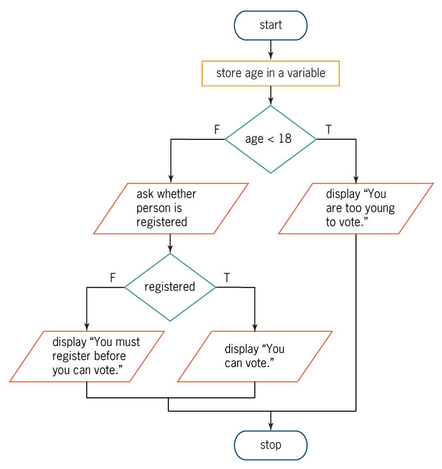
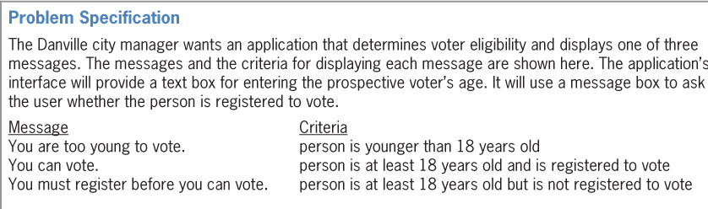
Flowcharting a Nested Selection Structure (cont.)
Figure 5-7 Another correct solution for the voter eligibility problem

Slide 4
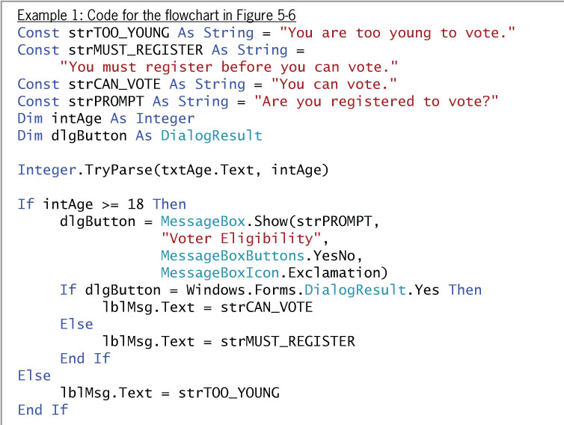
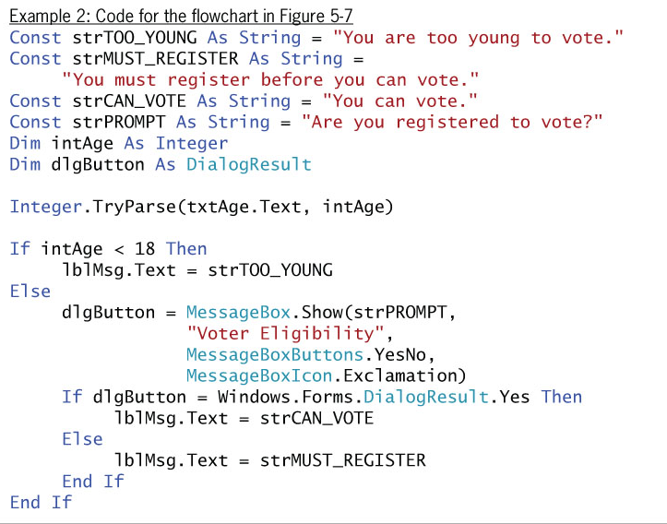
Coding a Nested Selection Structure
Figure 5-8 Code for the flowcharts in Figures 5-6 and 5-7

Slide 5
YouDoit
Complete You Do It 1 on page 265

Slide 6
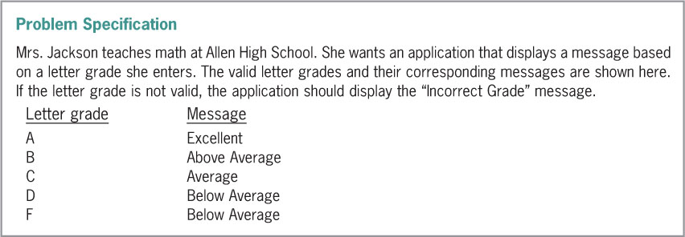
Multiple-Alternative Selection Structures
When you need to choose from several different options, use a multiple-alternative selection structure
Also called an extended selection structure
Figure 5-20 Problem specification for the Allen High School problem

Slide 7
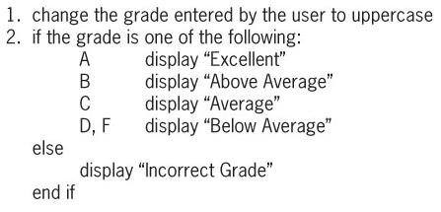
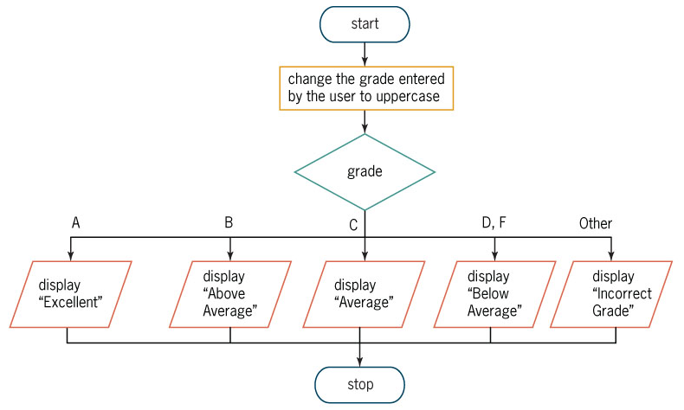
Multiple-Alternative Selection Structures (cont.)
Figure 5-21 Pseudocode and flowchart containing a multiple-alternative selection structure

Slide 8
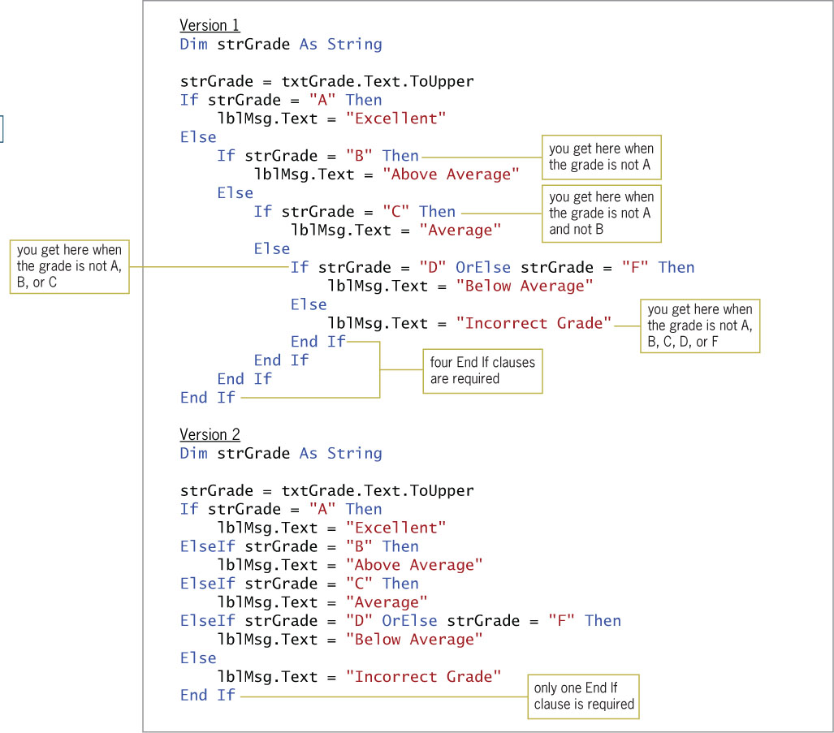
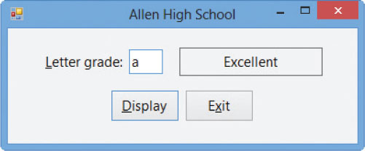
Multiple-Alternative Selection Structures (cont.)

Slide 9
Multiple-Alternative Selection Structures

Slide 10
Complete You Do It 2
You Do It 2 page 275

Slide 11
The Select Case Statement
Select Case statement
Used when a multiple-alternative selection structure has many paths from which to choose
It’s simpler and clearer to code the selection structure rather than several If…Then…Else statements

Slide 12
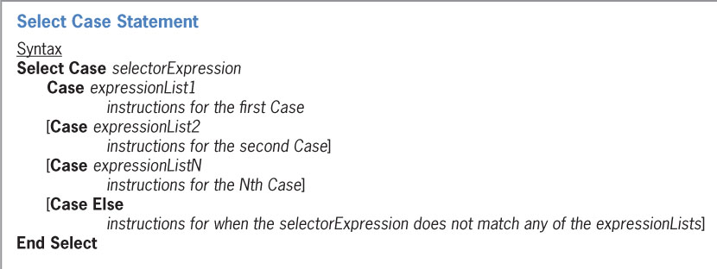
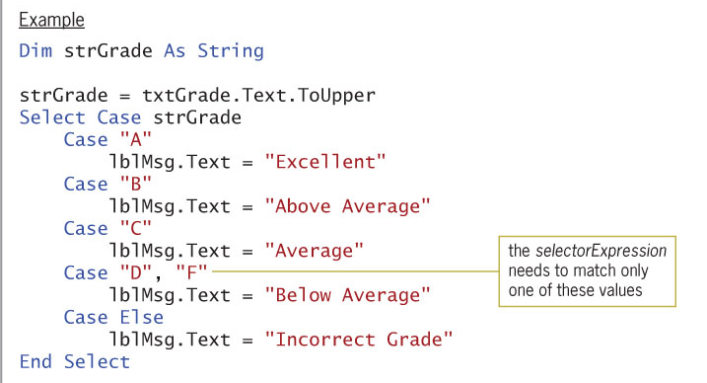
The Select Case Statement (cont.)
Figure 5-24 Syntax and an example of the Select Case statement

Slide 13
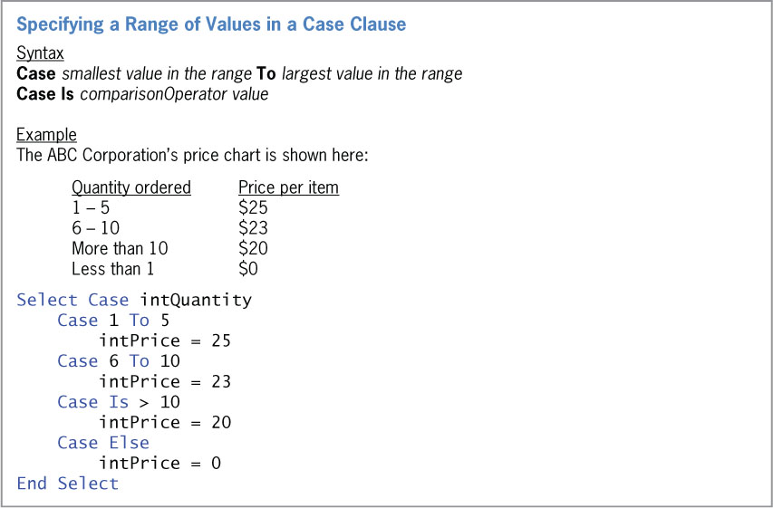
The Select Case Statement (cont.)
Specifying a Range of Values in a Case Clause
Figure 5-25 Syntax and an example of specifying a range of values

Slide 14
Homework
Try You Do it 3 on page 279
Exercise 11 page 286
Exercise 12 page 286
Exercise 16 Page 287

