Slide 1
Chapter 5: More on the Selection Structure
Part 2

Slide 2
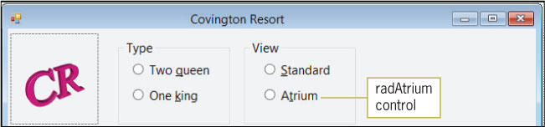
Modifying the Covington Resort Application (cont.)
Adding a Radio Button to the Interface
Radio button
Limits the user to only one choice from a group of two or more related but mutually exclusive choices
The three-character ID for a radio button’s name is rad
Figure 5-38 Atrium radio button added to the View group box

Slide 3
Modifying the Covington Resort Application (cont.)
Adding a Radio Button to the Interface (cont.)
The automatically selected radio button is called the default radio button
Represents the user’s most likely choice
The first button in the group
Checked property
Set to True to designate the default radio button

Slide 4
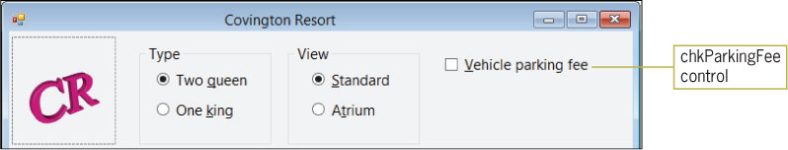
Modifying the Covington Resort Application (cont.)
Adding a Check Box to the Interface
Unlike radio buttons, check boxes provide one or more independent and nonexclusive items from which the user can choose
Any number of check boxes on a form can be selected at the same time
The three-character ID for a check box’s name is chk
Figure 5-39 Vehicle parking fee check box added to the interface

Slide 5
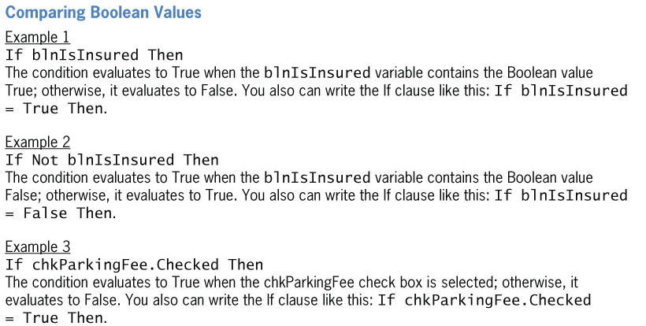
Modifying the Calculate Button’s Code (cont.)
Comparing Boolean Values
Figure 5-45 Examples of comparing Boolean values (continues)

Slide 6
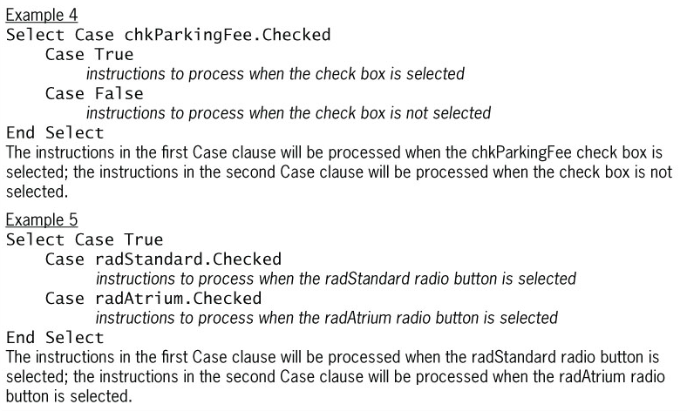
Modifying the Calculate Button’s Code (cont.)
(continued)
Figure 5-45 Examples of comparing Boolean values

Slide 7
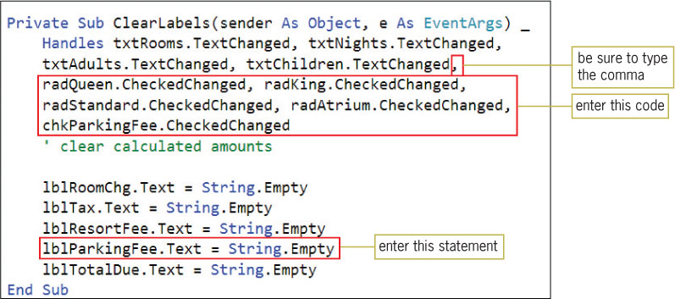
Modifying the ClearLabels Procedure
CheckedChanged event
Occurs when the value in a control’s Checked property changes
Figure 5-50 ClearLabels procedure

Slide 8
Lesson B Summary
To limit the user to only one choice in a group of two or more related but mutually exclusive choices:
Use the RadioButton tool to add two or more radio buttons to the form
To include two groups of radio buttons on a form, at least one of the groups must be placed within a container, such as a group box
To allow the user to select any number of choices from a group of one or more independent and nonexclusive choices:
Use the CheckBox tool to add one or more check box controls to the form

Slide 9
Lesson B Summary (cont.)
To determine whether a radio button or check box is selected or unselected:
Use the Checked property of the radio button or check box
The property will contain the Boolean value True if the control is selected; otherwise, it will contain the Boolean value False
To process code when the value in the Checked property of a radio button or check box changes:
Enter the code in the radio button’s or check box’s CheckedChanged event procedure

Slide 10
Lesson C Objectives
After studying Lesson C, you should be able to:
Determine the success of the TryParse method
Generate random numbers
Show and hide a control while an application is running

Slide 11
Using the TryParse Method for Data Validation
TryParse method
Converts a string to a number of a specific data type
With successful conversion:
The TryParse method stores the number in the variable specified in the method’s NumericVariableName argument
With unsuccessful conversion:
TryParse stores the number 0 in the variable

Slide 12
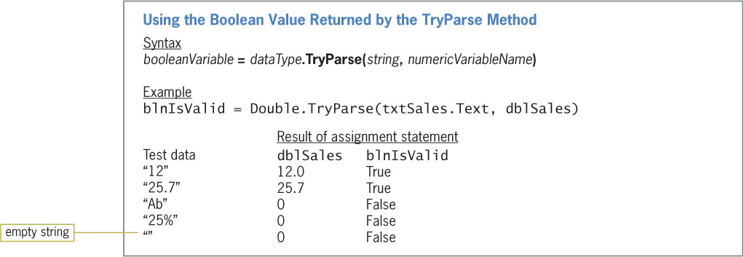
Using the TryParse Method for Data Validation (cont.)
Figure 5-58 Syntax and an example of using the Boolean value returned by the TryParse method

Slide 13
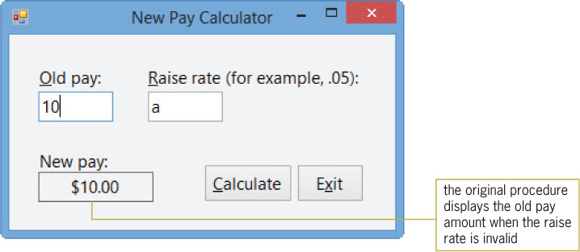
Using the TryParse Method for Data Validation (cont.)
Figure 5-59 Sample run of the original Click event procedure

Slide 14
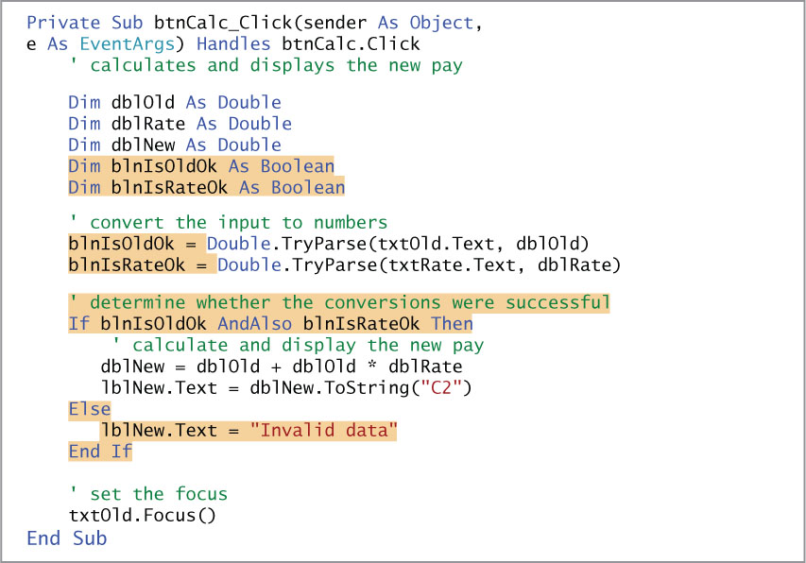
Using the TryParse Method for Data Validation (cont.)
Figure 5-60 Modified btnCalc_Click procedure

Slide 15
Generating Random Integers
Pseudo-random number generator
A device that produces a sequence of numbers that meet certain statistical requirements for randomness
Create a Random object by declaring it in a Dim statement
Use the Random.Next method to generate random integers

Slide 16
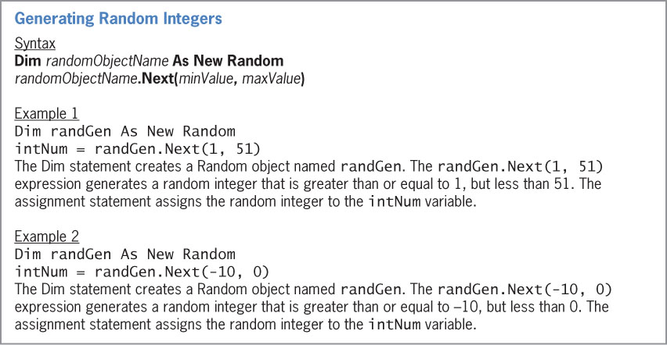
Generating Random Integers (cont.)
Figure 5-61 Syntax and examples of generating random integers

Slide 17
Lesson C Summary
To determine whether the TryParse method converted a string to a number of the specified data type:
Use the syntax booleanVariable = dataType.TryParse(string, numericVariableName)
The TryParse method returns the Boolean value True when the string can be converted to the numeric dataType
Otherwise, it returns the Boolean value False

Slide 18
Lesson C Summary (cont.)
To generate random integers:
Create a Random object to represent the pseudo-random number generator
The syntax for creating a Random object is Dim randomObjectName As New Random
Use the Random.Next method to generate a random integer
The method’s syntax is randomObjectName.Next(minValue, maxValue)
The Random.Next method returns an integer that is greater than or equal to minValue, but less than maxValue
The Random.Next method’s return value is assigned to a variable

