Slide 1
Presentation initial
Nishtha Arora

Slide 2
library(readr) library(themes360info)
## Warning: ! Preferred font, ITC Franklin Gothic, not found. Using Libre Franklin as a ## fallback. ## ℹ Specify a different font to use with 360info themes by calling ## register_360fonts() or by setting options("themes360info.franklin.pref") to ## either "itc" or "libre" (or "none" to disable automatic font loading).
library(readxl) library(tidyverse)
## ── Attaching core tidyverse packages ──────────────────────── tidyverse 2.0.0 ── ## ✔ dplyr 1.1.1 ✔ purrr 1.0.1 ## ✔ forcats 1.0.0 ✔ stringr 1.5.0 ## ✔ ggplot2 3.4.1 ✔ tibble 3.2.1 ## ✔ lubridate 1.9.2 ✔ tidyr 1.3.0 ## ── Conflicts ────────────────────────────────────────── tidyverse_conflicts() ── ## ✖ dplyr::filter() masks stats::filter() ## ✖ dplyr::lag() masks stats::lag() ## ℹ Use the conflicted package (<http://conflicted.r-lib.org/>) to force all conflicts to become errors
library(hrbrthemes)
## NOTE: Either Arial Narrow or Roboto Condensed fonts are required to use these themes. ## Please use hrbrthemes::import_roboto_condensed() to install Roboto Condensed and ## if Arial Narrow is not on your system, please see https://bit.ly/arialnarrow
library(ggthemes) library(lubridate) library(sf)
## Linking to GEOS 3.11.0, GDAL 3.5.3, PROJ 9.1.0; sf_use_s2() is TRUE
library(rgeos)
## Loading required package: sp ## rgeos version: 0.6-2, (SVN revision 693) ## GEOS runtime version: 3.11.0-CAPI-1.17.0 ## Please note that rgeos will be retired during 2023, ## plan transition to sf functions using GEOS at your earliest convenience. ## GEOS using OverlayNG ## Linking to sp version: 1.6-0 ## Polygon checking: TRUE ## ## ## Attaching package: 'rgeos' ## ## The following object is masked from 'package:dplyr': ## ## symdiff
library(pdftools)
## Using poppler version 22.02.0
library(kableExtra)
## ## Attaching package: 'kableExtra' ## ## The following object is masked from 'package:dplyr': ## ## group_rows
library(packcircles) library(bookdown)

Slide 3
DECRIMANALIZING SUICIDE
Worldwide Public Health Problem
over 700,000 deaths from suicide worldwide in 2019
decriminalizing suicide is a boon or a bane?
still 20 countries that have criminalized suicide
History
With the advancement of science in the 19th and 20th century, it was discovered that suicidal tendencies are caused by biological factors as well and hence, continents like Europe and North America revoked the laws reagrding crimanlizng suicide.
Motivation, Significance & Objectives
For every one completed suicide, 20 more attempts are made. Identification of potential suicide victims via these attempts can result in help-seeking and prevention of suicide but crimanlizing it, hinders the help-seeking and also results in inaccurate tracking of suicides. Also, there are data gaps in data round the world for a particular year, years or season which could be a result of no. of factors like, a change in the government, a sudden technology advancement, a low economy country, major events, etc.

Slide 4
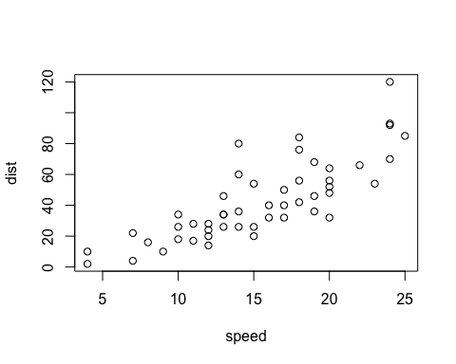
A scatterplot.

Slide 5
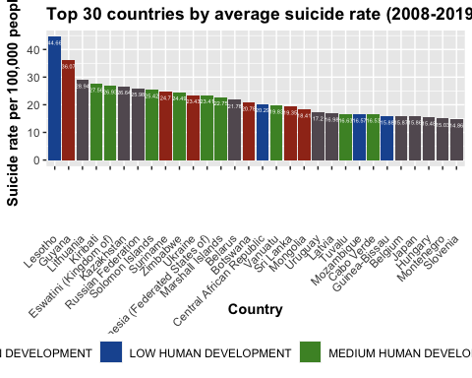
Initial Visualizations
## Rows: 182 Columns: 11 ## ── Column specification ──────────────────────────────────────────────────────── ## Delimiter: "," ## chr (2): Entity, Development status ## dbl (9): avg_rate, HDI_rank_2021, HDI_Value, Life_expectancy, Expected_years... ## ## ℹ Use `spec()` to retrieve the full column specification for this data. ## ℹ Specify the column types or set `show_col_types = FALSE` to quiet this message.

Slide 6
References
Grolemund, Y. X. J. J. a. G. (2023, May 15). 4.4 PowerPoint presentation | R Markdown: The Definitive Guide. https://bookdown.org/yihui/rmarkdown/powerpoint-presentation.html

