Slide 1



kin
NEW ERA OF BANKING · EQUITY CROWDFUNDING
Bank Like You
Own It.
Mobile-first banking, built for the Caribbean. Send money home instantly, with zero hidden fees.
TARGET RAISE £350,000 – £500,000
COMPANY NO. 15297454
360 SaaS Ltd · CONFIDENTIAL · 360saas.co.uk

Slide 2




THE PROBLEM
Banking has failed the Caribbean
Over 200 million adults across Latin America and the Caribbean remain unbanked or underbanked. Legacy infrastructure has ignored the region for decades.
High, punishing fees
Sparse branch networks
Minimum-balance walls
Costly remittances
Charges eat into low-income households and the remittances families depend on.
Basic banking can mean hours of travel to reach the nearest physical branch.
Strict minimum-balance rules lock out the majority of would-be customers.
Sending money home averages 6–9% of the amount — a tax on the diaspora.
Low penetration + high mobile adoption + a remittance-driven economy = ideal conditions for a digital challenger.
360 SaaS Ltd · CONFIDENTIAL · 360saas.co.uk
02

Slide 3
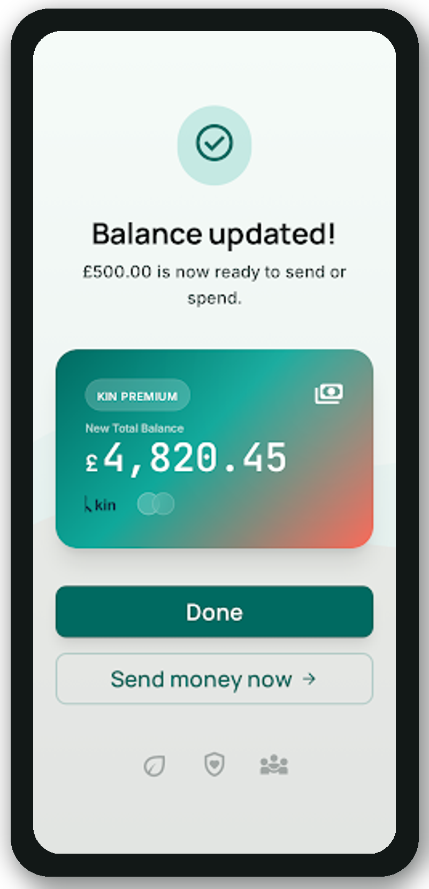





THE SOLUTION
A bank that fits in your pocket
Instant onboarding
Open an account from any smartphone in minutes — no branch visit, no paperwork.
Low-to-zero fees
A fee structure designed around the underbanked, not against them.
Cheap remittances
Integrated transfers at a fraction of the 6–9% the incumbents charge.
Built-in money skills
Financial-literacy tools woven directly into the app experience.
Multi-currency
Made for a diaspora moving money across the US, UK, Canada and home.
360 SaaS Ltd · CONFIDENTIAL · 360saas.co.uk
03

Slide 4


MARKET OPPORTUNITY
A blue-ocean, remittance-driven market
200M+
$100B+
75%+
6–9%
Unbanked adults across LATAM & the Caribbean
Annual remittance flows into the region
Mobile penetration across the Caribbean
Average fee on every remittance sent
Digital-banking adoption accelerating across the region post-COVID
Regulatory climate increasingly favourable to fintech challengers
Diaspora hubs in the US, UK & Canada as built-in acquisition channels
No dominant mobile-banking player has yet emerged region-wide
360 SaaS Ltd · CONFIDENTIAL · 360saas.co.uk
04

Slide 5








BUSINESS MODEL
Five ways Kin earns — B2C
REVENUE STREAMS
TARGET CUSTOMERS
Transaction fees — On everyday payments and transfers
Unbanked & underbanked adults across the Caribbean
Remittance spread — Undercutting the 6–9% incumbent rates
Diaspora families sending and receiving remittances
Interchange — Revenue on every card transaction
Young, mobile-first users who want modern banking
Premium tiers — Paid accounts with added features
Small business owners needing basic financial tools
Lending — Credit revenue post-licensing phase
360 SaaS Ltd · CONFIDENTIAL · 360saas.co.uk
05

Slide 6




TRACTION & PROGRESS
Pre-seed, and already moving
£0
500+
UK Reg
Active
External funding raised to date
Early beta sign-ups from the diaspora
FCA-compliant regulatory framework
Product development in progress
Built on a solid foundation
UK-registered company (No. 15297454) with a clear regulatory pathway
500+ early beta sign-ups from Caribbean diaspora communities
In-house development, design & marketing via 360 SaaS Ltd
Experienced technical team with hands-on fintech expertise
360 SaaS Ltd · CONFIDENTIAL · 360saas.co.uk
06

Slide 7



USE OF FUNDS
Where £500,000 goes
We're raising £350,000 – £500,000 to build, launch and scale Kin Banking across the region.
App development & infrastructure
40% £200,000
Regulatory & compliance (FCA)
25% £125,000
£500K TOTAL RAISE
Marketing & user acquisition
20% £100,000
Operations & team
15% £75,000
360 SaaS Ltd · CONFIDENTIAL · 360saas.co.uk
07

Slide 8

THE TEAM
Operators who ship
CR
Camarlo Richards
O
Omar
CO-FOUNDER · CEO
CO-FOUNDER · CTO
Entrepreneur and digital-agency founder. Leads business strategy, partnerships and growth. Founder of 360 SaaS Ltd.
Technical lead driving platform architecture, development and delivery through 360 SaaS Ltd.
About 360 SaaS Ltd A UK-based digital agency specialising in fintech and mobile-app development — providing the capability to build and launch Kin Banking efficiently.
360 SaaS Ltd · CONFIDENTIAL · 360saas.co.uk
08

Slide 9


WHY CROWDCUBE
The launchpad for UK fintech
Crowdcube has a proven record of backing challengers before they became household names. The Caribbean is a similar blue-ocean opportunity — and we want our diaspora community to own a piece of Kin from day one.
Revolut
Monzo
Plum
Raised early capital on Crowdcube
Community-funded via Crowdcube
AI savings app, started on Crowdcube
Now valued at $33B+
Now serving millions
Scaled across Europe
We want our early users and diaspora community to own a piece of Kin Banking from day one. We're requesting fee flexibility as a pre-revenue, pre-seed company with a compelling market opportunity.
360 SaaS Ltd · CONFIDENTIAL · 360saas.co.uk
09

Slide 10
kin
OWN A PIECE OF THE CARIBBEAN'S SMART BANK
Back Kin. Bank the unbanked.
Join us in building mobile-first banking for 200 million people the legacy system left behind.
CONTACT
EMAIL
WEB
Camarlo Richards
camarlo@360saas.co.uk
360saas.co.uk
TARGET RAISE £350,000 – £500,000 · Equity Crowdfunding
360 SaaS Ltd · Company No. 15297454 · CONFIDENTIAL

