Slide 1
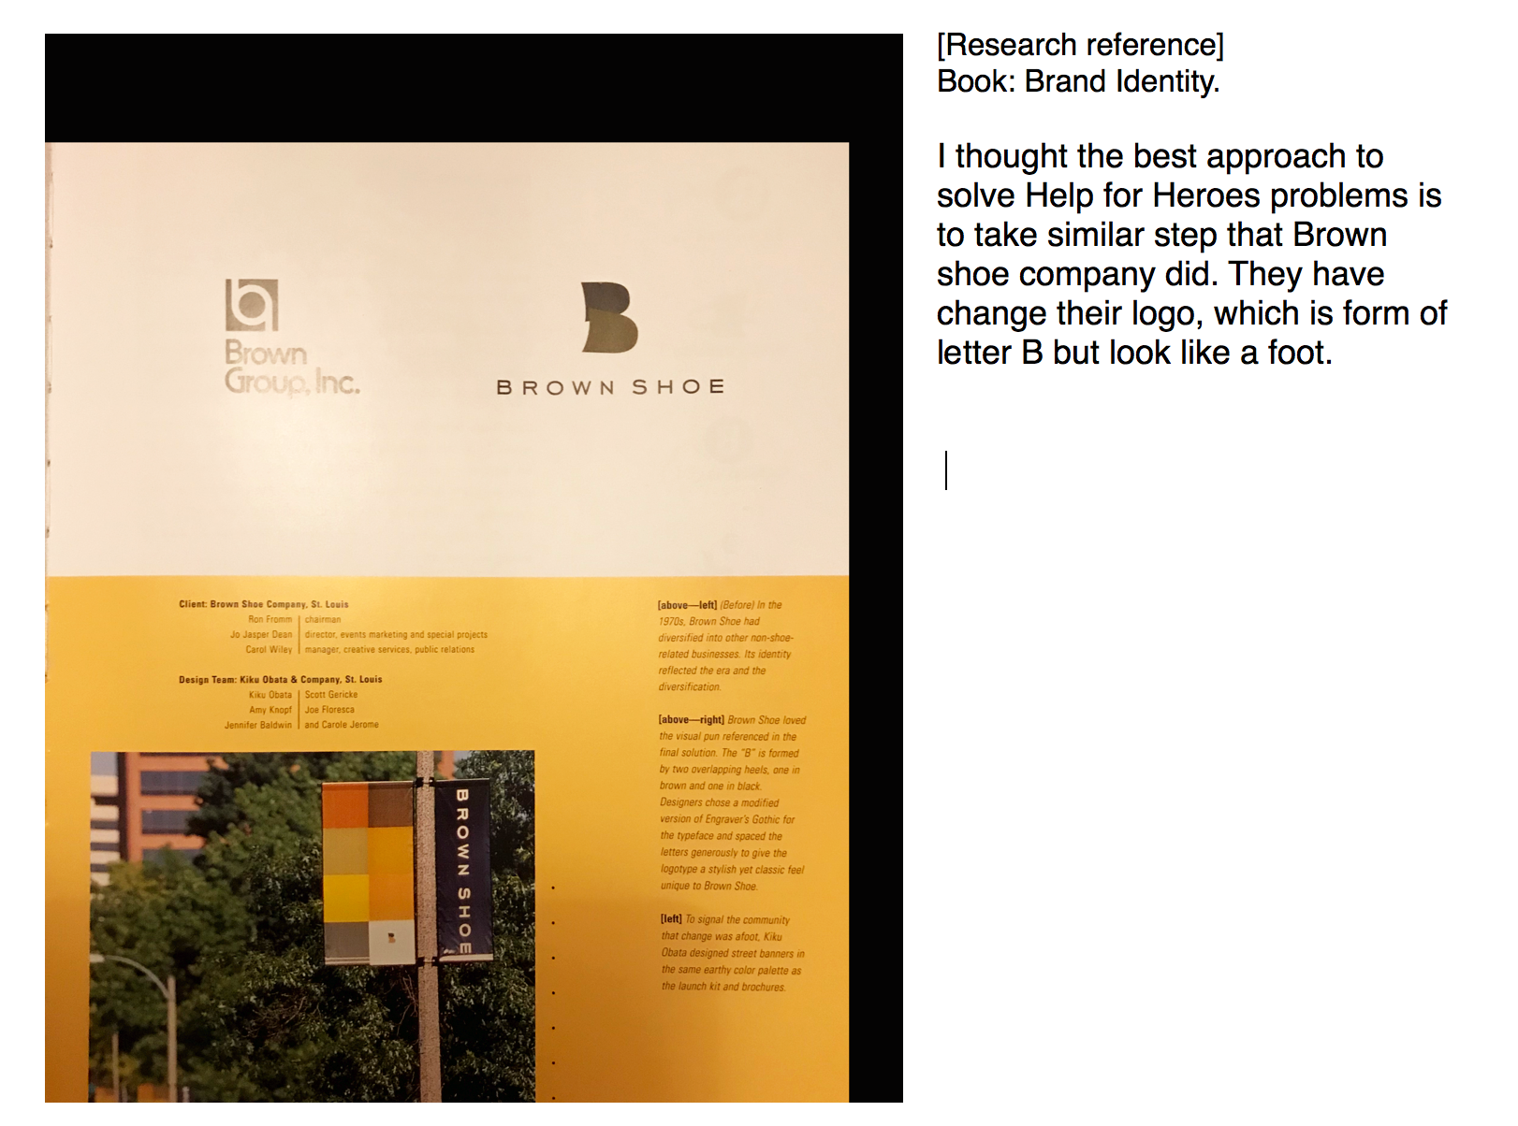

Slide 2
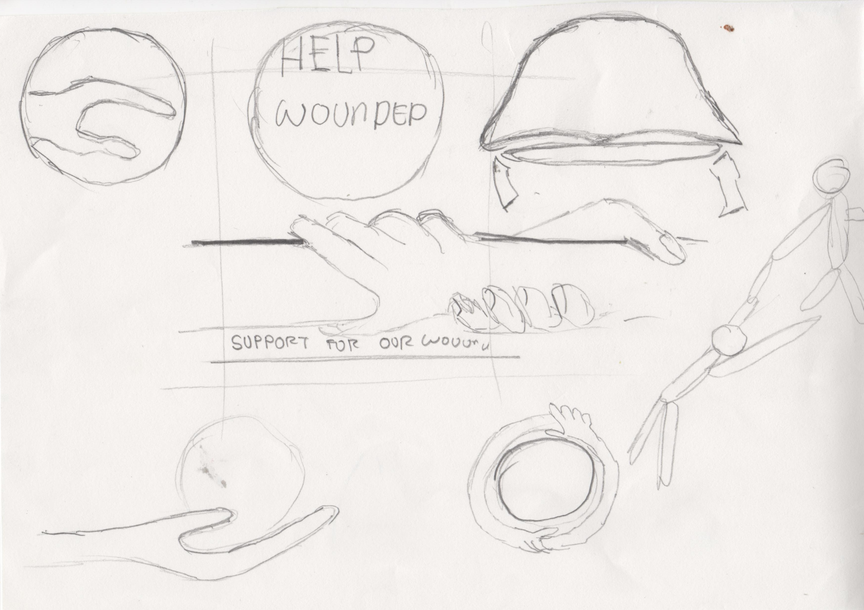
I have sketch some of my ideas on a paper.

Slide 3
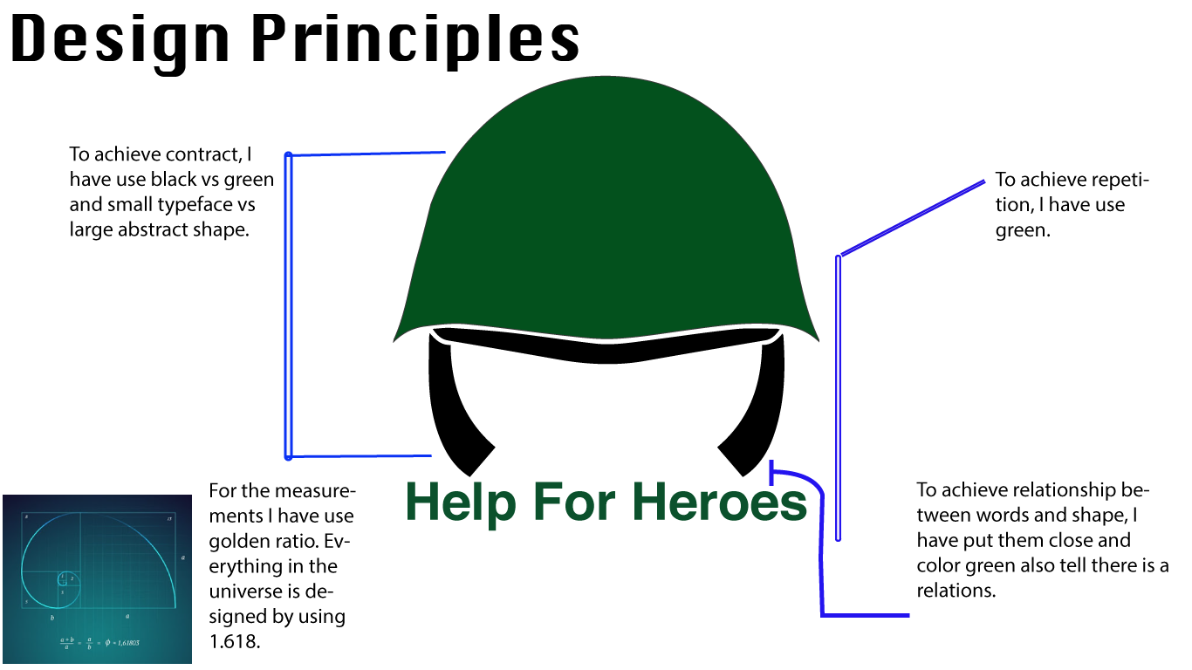
Helmet represent soldiers.
Green represent their goal which is to restore their health.. Example: pharmaceutical use green to tell they have something that will help to cure.
Black represent important.

