Slide 1
ARC · CIRCLE · USDC
Creator payments,
settled by milestone.
LIVE PROOF
0.25
USDC released
Arc Creator Settlement v0.3
Arc Testnet
Block 59,934,707
Receipt verified
A working Arc Testnet escrow with Circle Wallets, programmable USDC releases, and public onchain receipts.
Notes:
Open with the shipped result: the product is live on Arc Testnet and a milestone payment has been verified onchain.
[Sources]
- https://github.com/3624341/arc-creator-settlement
- https://arc-creator-settlement-v0-2.vercel.app
- https://testnet.arcscan.app/tx/0xdf8a7711dcbe31f07bc1f61d1492d07a0b490f45dd3b0566eaddce5deb6eb856
[/Sources]

Slide 2
ARC CREATOR SETTLEMENT · V0.3
Cross-border project work still settles outside the agreement
The contract, delivery approval, payment rail, and proof of payment usually live in separate systems.
01
Agreement
Terms live in chat, docs, or a marketplace database.
02
Delivery
Milestones are approved manually and inconsistently.
03
Payment
Bank rails add delay, FX friction, and reconciliation.
04
Proof
Receipts are platform records—not independently verifiable.
Notes:
Frame the problem as operational fragmentation, not only payment speed.
[Sources]
- https://github.com/3624341/arc-creator-settlement
- https://arc-creator-settlement-v0-2.vercel.app
- https://testnet.arcscan.app/tx/0xdf8a7711dcbe31f07bc1f61d1492d07a0b490f45dd3b0566eaddce5deb6eb856
[/Sources]

Slide 3
ARC CREATOR SETTLEMENT · V0.3
One escrow makes milestone releases verifiable
1
2
3
4
5
Create
Fund
Submit
Release
Verify
→
→
→
→
Client defines creator, value, and four milestones.
USDC moves into the Arc escrow.
Creator marks a milestone delivered.
Client approves; USDC transfers onchain.
A public receipt reads the confirmed transaction.
The same state powers settlement operations and the public receipt.
Notes:
Walk through the end-to-end product flow shown in the live demo.
[Sources]
- https://github.com/3624341/arc-creator-settlement
- https://arc-creator-settlement-v0-2.vercel.app
- https://testnet.arcscan.app/tx/0xdf8a7711dcbe31f07bc1f61d1492d07a0b490f45dd3b0566eaddce5deb6eb856
[/Sources]

Slide 4
ARC CREATOR SETTLEMENT · V0.3
Arc settles; Circle authorizes the wallet
CLIENT
APPLICATION
ARC TESTNET
PUBLIC PROOF
Circle user-owned wallet
Approves USDC operations
Next.js + API routes
Contract and receipt UX
EscrowFactory + Escrow
USDC milestone state
ArcScan + receipt URL
Independent verification
→
→
→
No seed phrase is handled by the app. The server uses Circle credentials; secrets never enter the browser bundle.
Notes:
Explain the actual architecture and the boundary between user authorization, server credentials, and Arc contracts.
[Sources]
- https://github.com/3624341/arc-creator-settlement
- https://arc-creator-settlement-v0-2.vercel.app
- https://testnet.arcscan.app/tx/0xdf8a7711dcbe31f07bc1f61d1492d07a0b490f45dd3b0566eaddce5deb6eb856
[/Sources]

Slide 5
VERIFIED IMPLEMENTATION
The v0.3 path is deployed and exercised end to end
1 USDC
0.25 USDC
Escrow funded
Milestone released
4
19 + 2
Milestones encoded
Web + Solidity tests
Notes:
Use only verified project facts: deployed escrow, funded amount, released milestone, and passing tests.
[Sources]
- https://github.com/3624341/arc-creator-settlement
- https://arc-creator-settlement-v0-2.vercel.app
- https://testnet.arcscan.app/tx/0xdf8a7711dcbe31f07bc1f61d1492d07a0b490f45dd3b0566eaddce5deb6eb856
[/Sources]

Slide 6
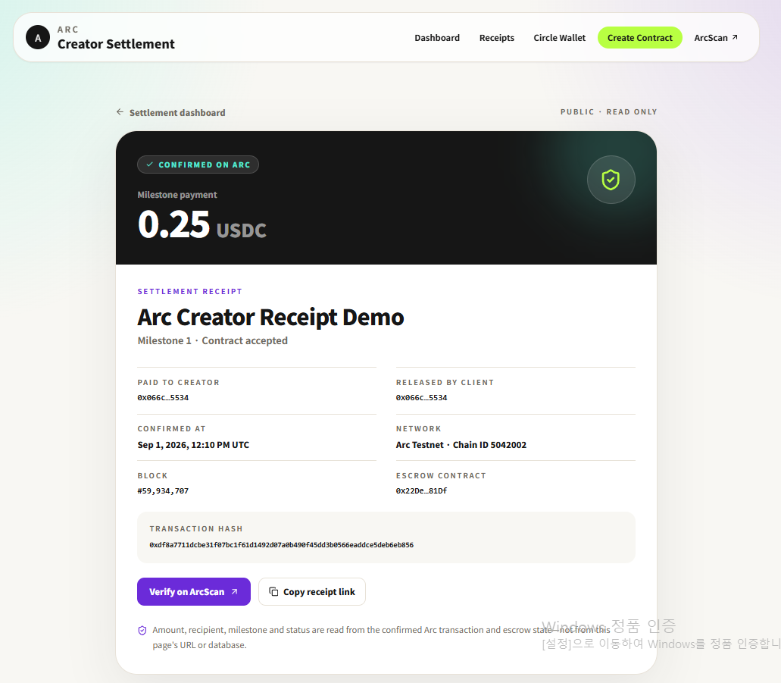
ONCHAIN EVIDENCE
A confirmed Arc transaction becomes a readable public receipt
PAYMENT RELEASED
0.25 USDC
Transaction
0xdf8a7711…eb856
Escrow
0x22De463e…D81Df
Block 59,934,707
Notes:
Show the public receipt. Amount, milestone, recipient, block, escrow, and transaction hash are read from confirmed Arc data.
[Sources]
- https://github.com/3624341/arc-creator-settlement
- https://arc-creator-settlement-v0-2.vercel.app
- https://testnet.arcscan.app/tx/0xdf8a7711dcbe31f07bc1f61d1492d07a0b490f45dd3b0566eaddce5deb6eb856
[/Sources]

Slide 7
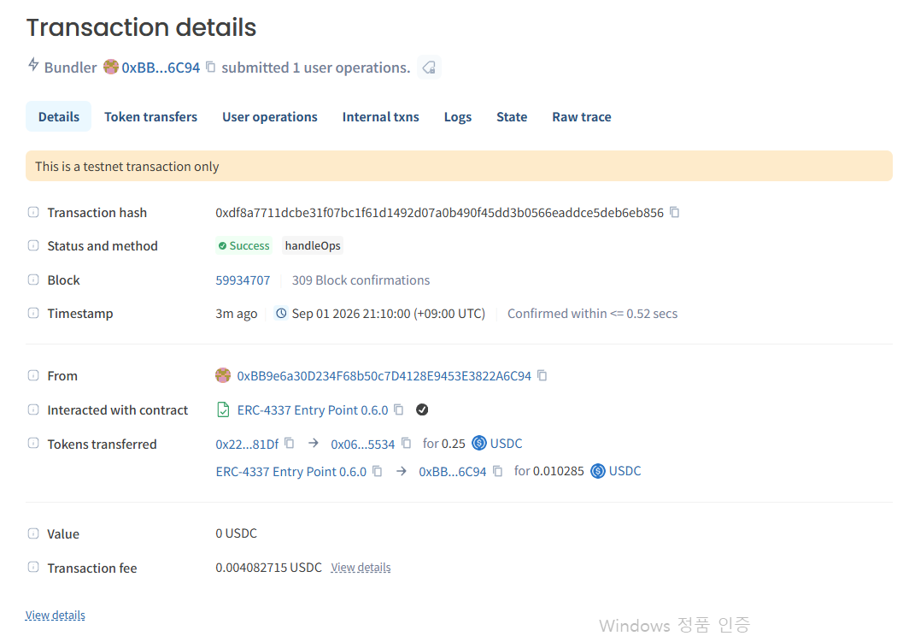
CHAIN-LEVEL PROOF
ArcScan independently confirms the USDC transfer
SUCCESS
0.25 USDC
to creator wallet
Transaction fee
0.004082715 USDC
Confirmed in <0.52 sec
Notes:
Use ArcScan as independent confirmation. The screenshot shows success, token transfer, block, timestamp, and fee.
[Sources]
- https://github.com/3624341/arc-creator-settlement
- https://arc-creator-settlement-v0-2.vercel.app
- https://testnet.arcscan.app/tx/0xdf8a7711dcbe31f07bc1f61d1492d07a0b490f45dd3b0566eaddce5deb6eb856
[/Sources]

Slide 8
ARC CREATOR SETTLEMENT · V0.3
The MVP is a product surface, not a contract-only demo
01
Circle Wallet
02
Settlement dashboard
Reload or create a user-owned Arc wallet and display USDC balance.
Approve, deposit, submit, and release each milestone.
03
Public receipts
04
Recovery-safe setup
Share a read-only link that anyone can verify against ArcScan.
Entity-secret recovery workflow is tested and excluded from Git.
Notes:
Summarize the working surfaces demonstrated in the video and repository.
[Sources]
- https://github.com/3624341/arc-creator-settlement
- https://arc-creator-settlement-v0-2.vercel.app
- https://testnet.arcscan.app/tx/0xdf8a7711dcbe31f07bc1f61d1492d07a0b490f45dd3b0566eaddce5deb6eb856
[/Sources]

Slide 9
ARC CREATOR SETTLEMENT · V0.3
The next grant phase converts proof into reusable infrastructure
0–4 weeks
4–10 weeks
10–18 weeks
18–30 weeks
Harden settlement
Add observability
Prototype funding
Review + pilot
Role checks, state validation, failure UX, deterministic deployment.
Indexed events, operational views, reusable marketplace APIs.
Circle Gateway exploration for cross-chain USDC entry.
Focused security review and controlled creator marketplace pilot.
Outcome: a settlement primitive that marketplaces can integrate—not another closed payment ledger.
Notes:
Close the roadmap with concrete post-v0.3 work. Gateway is planned, not claimed as implemented.
[Sources]
- https://github.com/3624341/arc-creator-settlement
- https://arc-creator-settlement-v0-2.vercel.app
- https://testnet.arcscan.app/tx/0xdf8a7711dcbe31f07bc1f61d1492d07a0b490f45dd3b0566eaddce5deb6eb856
[/Sources]

Slide 10
The proof exists.
Now make it reusable.
Arc Creator Settlement v0.3
Live demo
arc-creator-settlement-v0-2.vercel.app
GitHub
github.com/3624341/arc-creator-settlement
Arc Testnet · Chain ID 5042002
Notes:
End with the requested decision: support the hardening, observability, Gateway prototype, and pilot phase.
[Sources]
- https://github.com/3624341/arc-creator-settlement
- https://arc-creator-settlement-v0-2.vercel.app
- https://testnet.arcscan.app/tx/0xdf8a7711dcbe31f07bc1f61d1492d07a0b490f45dd3b0566eaddce5deb6eb856
[/Sources]

