Slide 1
MSBD 5018 - Natural Language Processing
Introduction
Instructor: Yangqiu Song
Slides credits: Hongning Wang, Marti Hearst, Percy Liang, Noah Smith

Slide 2
Logistics
Instructor: Yangqiu Song
Email: yqsong@cse.ust.hk
Canvas (https://canvas.ust.hk)
Lecture notes
Assignments
Projects

Slide 3
Goals of this Course
Learn about the problems and possibilities of natural language analysis:
What are the major issues?
What are the major solutions?
How well do they work?
How do they work?
At the end you should:
Agree that language is subtle and interesting!
Feel some ownership over the algorithms
Be able to assess NLP problems
Know which solutions to apply when, and how
Be able to read papers in the field

Slide 4
Today
Why NLP is difficult
How to solve it (in general)?
What we’ll do in this course

Slide 5
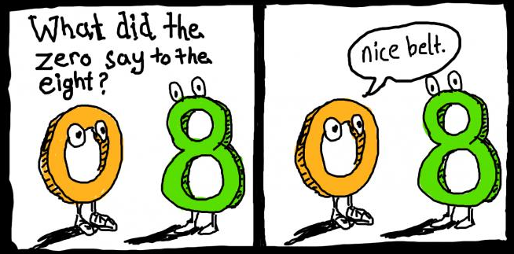
Natural Language
Understanding language is a very complex thing
But something that humans are amazingly good at

Slide 6
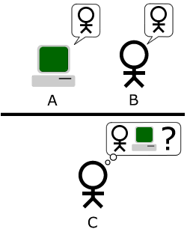
Artificial Intelligence: Turing Test
Replacement of “Can machines think?”
Behavioral test
not just natural language understanding
Natural language conversation
Imitation game (1950)
Human?
Computer?
Notes:
The Turing test is a test of a machine's ability to exhibit intelligent behavior equivalent to, or indistinguishable from, that of a human. Alan Turing proposed that a human evaluator would judge natural language conversations between a human and a machine that is designed to generate human-like responses. The evaluator would be aware that one of the two partners in conversation is a machine, and all participants would be separated from one another. The conversation would be limited to a text-only channel such as a computer keyboard and screen so that the result would not be dependent on the machine's ability to render words as speech.^{[2]} If the evaluator cannot reliably tell the machine from the human (Turing originally suggested that the machine would convince a human 70% of the time after five minutes of conversation), the machine is said to have passed the test. The test does not check the ability to give correct answers to questions, only how closely answers resemble those a human would give.
The test was introduced by Alan Turing in his 1950 paper "Computing Machinery and Intelligence," while working at The University of Manchester (Turing, 1950; p. 460).^{[3]} It opens with the words: "I propose to consider the question, 'Can machines think?'" Because "thinking" is difficult to define, Turing chooses to "replace the question by another, which is closely related to it and is expressed in relatively unambiguous words."^{[4]} Turing's new question is: "Are there imaginable digital computers which would do well in the imitation game?"^{[5]} This question, Turing believed, is one that can actually be answered. In the remainder of the paper, he argued against all the major objections to the proposition that "machines can think".^{[6]}
Since Turing first introduced his test, it has proven to be both highly influential and widely criticised, and it has become an important concept in the philosophy of artificial intelligence.^{[1][7]}

Slide 7
The AI Winter
AI winter: 1974–80 and 1987–93
1966: the failure of machine translation,
1970: the abandonment of connectionism,
1971–75: DARPA's frustration with the Speech Understanding Research program at Carnegie Mellon University,
1973: the large decrease in AI research in the United Kingdom in response to the Lighthill report,
1973–74: DARPA's cutbacks to academic AI research in general,
1987: the collapse of the Lisp machine market,
1988: the cancellation of new spending on AI by the Strategic Computing Initiative,
1993: expert systems slowly reaching the bottom, and
1990s: the quiet disappearance of the fifth-generation computer project's original goals.

Slide 8
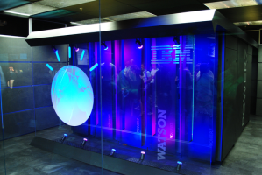
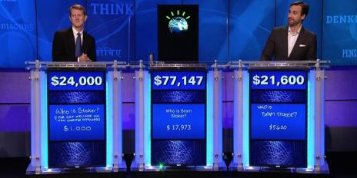
Enabled by Big Data
1971–75: DARPA's frustration with the Speech Understanding
“Watson is a question answering (QA) computing system that IBM built to apply advanced
natural language processing,
information retrieval,
knowledge representation,
automated reasoning, and
machine learning technologies
to the field of open domain question answering.”
In 2011, Watson competed on Jeopardy! against former winners Brad Rutter and Ken Jennings. Watson received the first place prize of $1 million.
https://en.wikipedia.org/wiki/Watson_(computer)

Slide 9
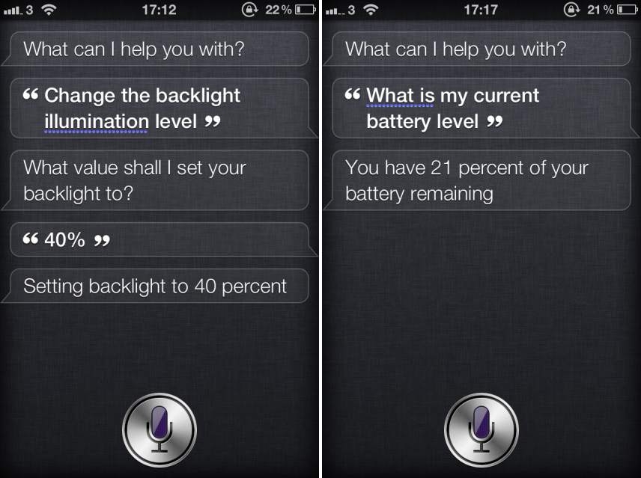
Enabled by Big Data

Slide 10
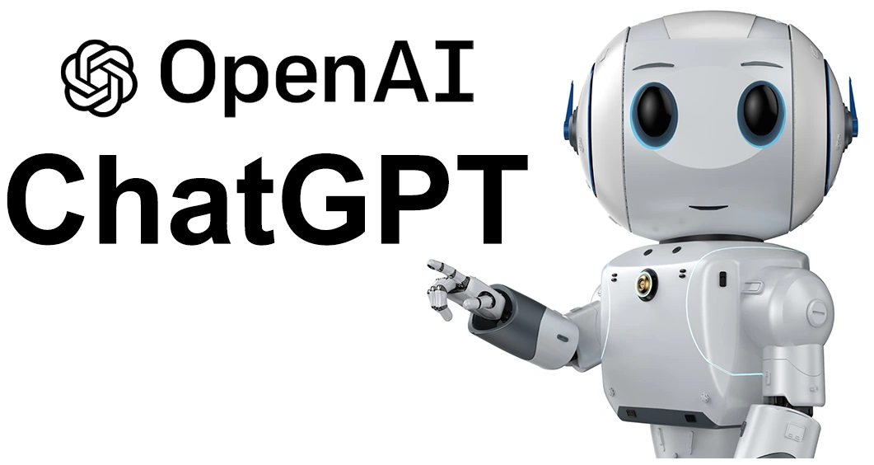
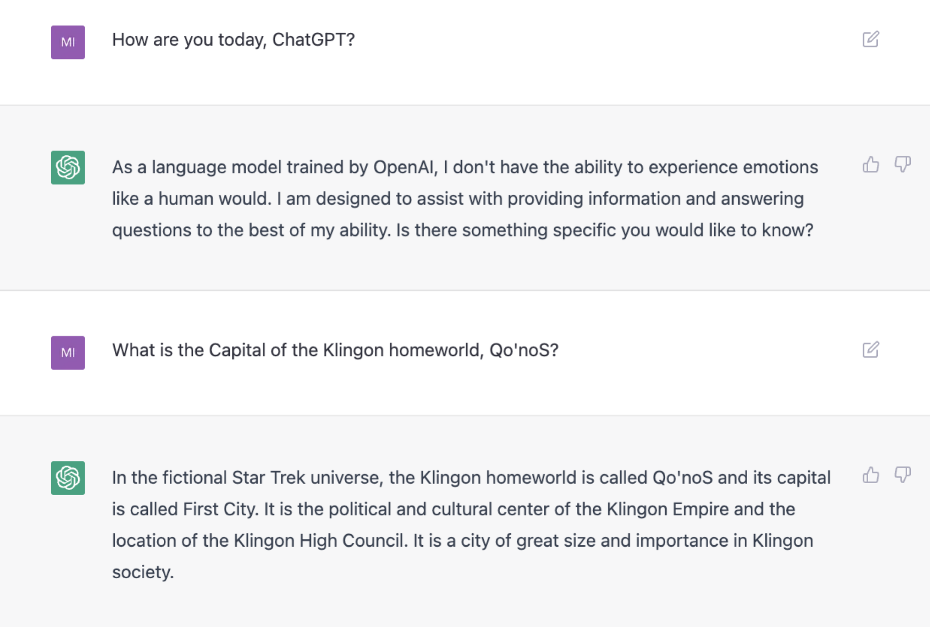
Enabled by Big Data and Powerful Machines and Algorithms

Slide 11
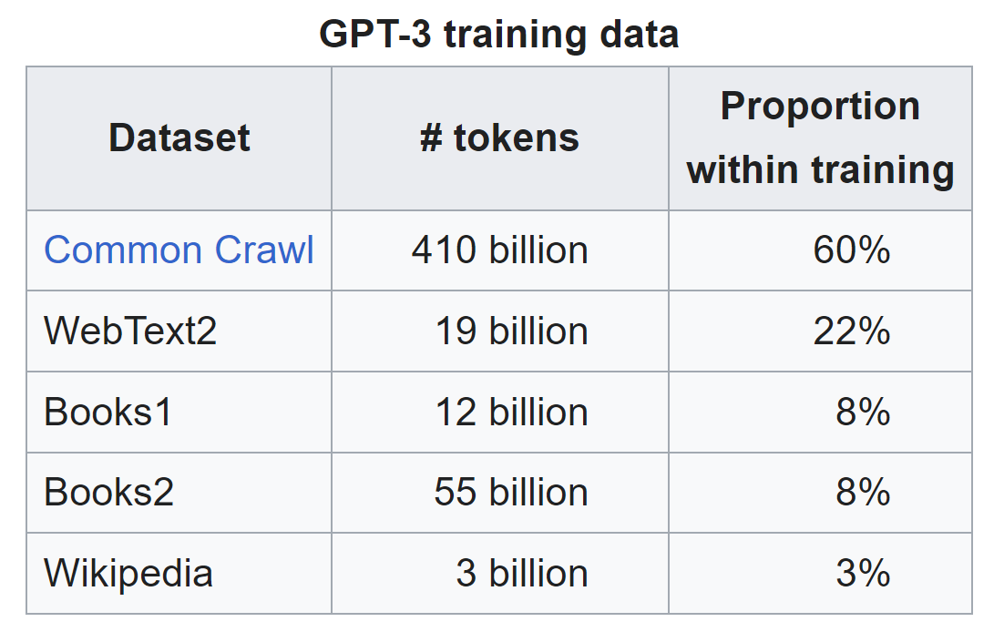
How Big Data Are
Thorsten Brants, Ashok C. Popat, Peng Xu, Franz J. Och, Jeffrey Dean. Large Language Models in Machine Translation. ACL, 2007
http://www.aclweb.org/anthology/D07-1090.pdf
2 Trillion Tokens by Google
Using 1,500 CPUs, 1 day
Jacob Devlin, Ming-Wei Chang, Kenton Lee, Kristina Toutanova. BERT: Pre-training of Deep Bidirectional Transformers for Language Understanding. 2018
https://arxiv.org/abs/1810.04805
3.3 Billion Tokens by Google: 1,000 times less than 2007 but more powerful
Using 16 TPUs (64 Chips), 4 days
ChatGPT: Optimizing Language Models for Dialogue. 2023
https://openai.com/blog/chatgpt/

Slide 12
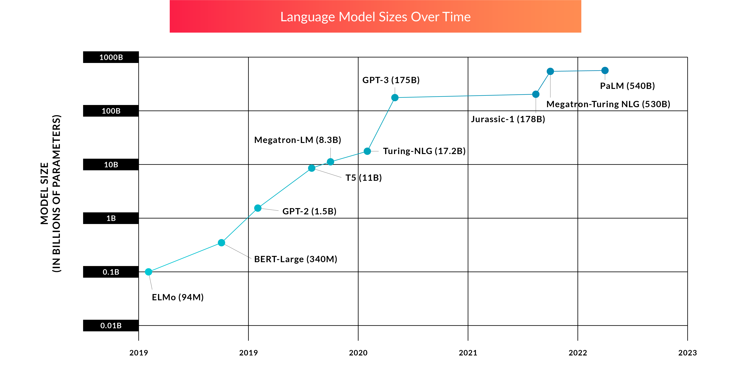
Large Language Models！

Slide 13
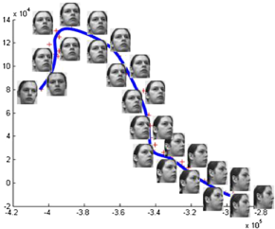
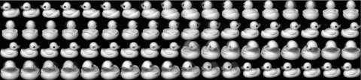
What’s Special about Human Language?
A human language is a discrete/symbolic/categorical signaling system
With very minor exceptions for expressive signaling
(“I loooove it.” “Whoomppaaa”)
Large vocabulary, symbolic encoding of words creates a problem for machine learning – sparsity!
Face
Toy

Slide 14
Why is NLP Difficult?
Variability and ambiguity everywhere
cat
company
fruit
tree
Meaning
Variability
Ambiguity
Language
cat
feline
kitty
moggy
apple

Slide 15
Words are Ambiguous (have multiple meanings)
I know that.
I know that block.
I know that blocks the sun.
I know that block blocks the sun.

Slide 16
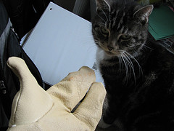
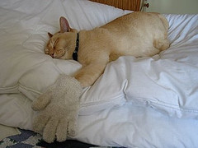
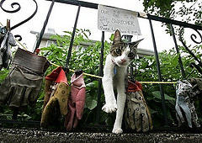
More Examples of Ambiguity
Get the cat with the gloves.

Slide 17
Language Subtleties
Adjective order and placement
A big black dog
A big black scary dog
A big scary dog
A scary big dog
A black big dog
Antonyms
Which sizes go together?
Big and little
Big and small
Large and small
Large and little

Slide 18
Levels of Linguistic Analysis: Analogy with Programming Languages
Pragmatics: what does it do?
implemented the
right algorithm
Semantics: what does it mean?
no implementation bugs
Syntax: what is grammatical?
no compiler errors
Morphology: basic unit of words
naming your world

Slide 19
Analogy with Programming Languages
Syntax: no compiler errors
Semantics: no implementation bugs
Pragmatics: implemented the right algorithm
Different syntax, same semantics (5):
2 + 3 <-> 3 + 2
Good semantics, bad pragmatics:
correct implementation of deep neural network
for estimating coin flip prob.

Slide 20
How to do natural language processing?

Slide 21
The Role of Memorization
Children learn words quickly
As many as 9 words/day
Often only need one exposure to associate meaning with word
Can make mistakes, e.g., overgeneralization
“I goed to the store.”
Exactly how they do this is still under study

Slide 22
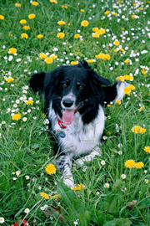
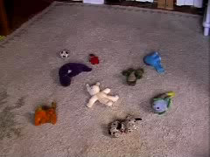
The Role of Memorization
Dogs can do word association too!
Rico, a border collie in Germany
Knows the names of each of 100 toys
Can retrieve items called out to him with over 90% accuracy.
Can also learn and remember the names of unfamiliar toys after just one encounter, putting him on a par with a three-year-old child.
https://en.wikipedia.org/wiki/Rico_(dog)

Slide 23
But there is too much to memorize!
establish
establishment
the church of England as the official state church.
disestablishment
antidisestablishment
antidisestablishmentarian
antidisestablishmentarianism
is a political philosophy that is opposed to the separation of church and state.

Slide 24
Rules and Memorization
Current thinking in psycholinguistics is that we use a combination of rules and memorization
However, this is very controversial
Mechanism:
If there is an applicable rule, apply it
However, if there is a memorized version, that takes precedence. (Important for irregular words.)
Artists paint “still lifes”
Not “still lives”
Past tense of
think → thought
blink → blinked

Slide 25
Representation of Meaning
I know that block blocks the sun.
How do we represent the meanings of “block”?
How do we represent “I know”?
How does that differ from “I know that.”?
Who is “I”?
How do we indicate that we are talking about earth’s sun vs. some other planet’s sun?
When did this take place? What if I move the block? What if I move my viewpoint? How do we represent this?

Slide 26
How to tackle these problems?
The field was stuck for quite some time.
A new approach started around 1990
Well, not really new, but the first time around, in the 50’s, they didn’t have the text, disk space, or GHz
Main idea: combine memorizing and rules
How to do it:
Get large text collections (corpora)
Compute statistics over the words in those collections
Surprisingly effective
Even better now with the Web

Slide 27
NLP ?= Machine Learning
To be successful, a machine learner needs bias/assumptions; for NLP, that might be linguistic theory/representations.
Computer representation of language is not directly observable.
Early connections to information theory (1940s)
Symbolic, probabilistic, and connectionist ML have all seen NLP as a source of inspiring applications.

Slide 28
NLP ?= Linguistics
NLP must contend with NL data as found in the world
NLP ≈ computational linguistics
Linguistics has begun to use tools originating in NLP!
Noah Smith@UW, CSE490U

Slide 29
Desiderata for NLP Methods (ordered arbitrarily)
Sensitivity to a wide range of the phenomena and constraints in human language
Generality across different languages, genres, styles, and modalities
Computational efficiency at construction time and runtime
Strong formal guarantees (e.g., convergence, statistical efficiency, consistency, robustness, etc.)
High accuracy when judged against expert annotations and/or task-specific performance
Noah Smith@UW, CSE490U

Slide 30
Fields with Connections to NLP
Machine learning
Linguistics (including psycho-, socio-, descriptive, and theoretical)
Cognitive science
Information theory
Logic
Theory of computation
Data science
Social and political science
Psychology
Economics
Education

Slide 31
Fields with Connections to Machine Learning
NLP
Data mining/Data science
Bioinformatics
Fintech
Computer vision
Multimedia analysis
Social and political science
Psychology
Economics
Education

Slide 32
Machine learning for NLP
mid-1970s: HMMs for speech recognition → probabilistic models
early 2000s: conditional random fields for part-of-speech tagging → structured prediction
early 2000s: latent Dirichlet allocation for modeling text documents → topic modeling
mid 2010s: sequence-to-sequence models for machine translation → neural networks with memory/state
2020: large language models → in-context learning; instruction tuning; generation-based AI
We will select some of the important topics

Slide 33

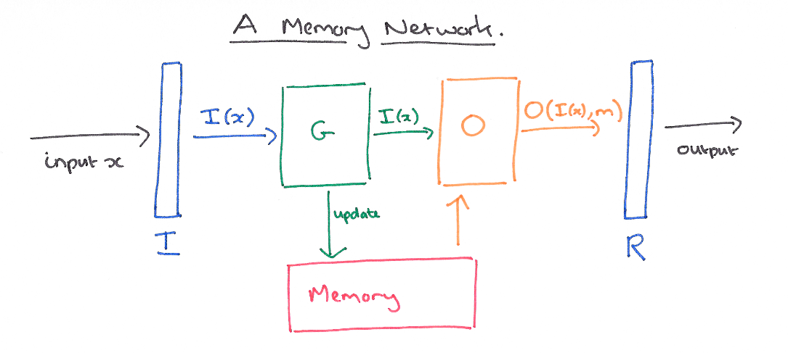
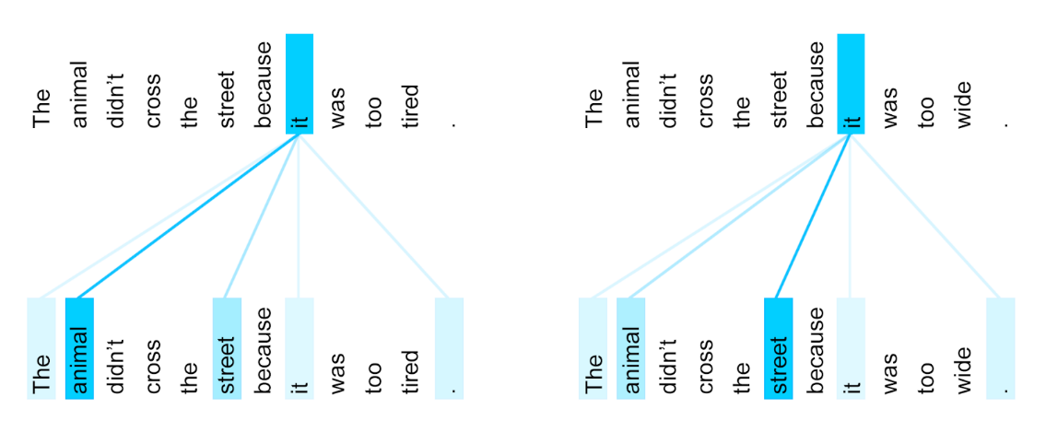
Nowadays: Deep learning for NLP
Sequence models
Memory models
Attention models

Slide 34
Real-World Applications of NLP
Spelling suggestions/corrections
Grammar checking
Information extraction
Text categorization
Automated customer service
Conversational agents
Question answering
Speech recognition (limited)
Machine translation
Social media analysis
Rich visual understanding
Mining legal, medical, or scholarly literature

Slide 35
What We’ll Do in this Course
Learn fundamental machine learning models for NLP
Classification models
Language models
Sequence labeling models
Advance NLP tasks using deep learning
Use NLTK (Natural Language ToolKit) and Tensorflow/PyTorch to try out various algorithms
Some assignment will be to do some exercises

Slide 36
What We’ll Do in this Course
Adopt a large text collection
Use a wide range of NLP techniques to process it
Release the results for others to use

Slide 37
How to analyze a big collection?
Your ideas go here with a project
Some free computational resources to use
https://www.kaggle.com/docs/notebooks
https://www.kaggle.com/dansbecker/running-kaggle-kernels-with-a-gpu

Slide 38
Course Information
Work load and grading:
Assignments (10%)
Reading notes
Group Projects and Presentation (50%)
Project (40%): a team-based project
Up to 3 students in each group
Due: in the 12th week
In-class Presentation (10%): present what you have done in the project/survey
Individual Project (40%)
Similar to this project, with some modifications
Evaluating Large Language Models
https://stanford-cs324.github.io/winter2022/projects/CS324_P1.pdf
Due: in the 14th week
Academic integrity policy
Late submission: score got reduced (time based)
Plagiarism: all involved parties will get zero

Slide 39
15 minutes break

