Slide 1
MSBD 5018 - Natural Language Processing
Vector Space Model
Instructor: Yangqiu Song
Slides credits: Hongning Wang, Percy Liang

Slide 2


Frequency Distributions
How can we identify the words of a text that are most informative about the topic and genre of the text?
You might go about finding the 50 most frequent words of a book
On Feb. 8, Dong Nguyen announced that he would be removing his hit game Flappy Bird from both the iOS and Android app stores, saying that the success of the game is something he never wanted. Some fans of the game took it personally, replying that they would either kill Nguyen or kill themselves if he followed through with his decision.
Frank Lantz, the director of the New York University Game Center, said that Nguyen's meltdown resembles how some actors or musicians behave. "People like that can go a little bonkers after being exposed to this kind of interest and attention," he told ABC News. "Especially when there's a healthy dose of Internet trolls."
7 February 2014 is going to be a great day in the history of Russia with the upcoming XXII Winter Olympics 2014 in Sochi. As the climate in Russia is subtropical, hence you would love to watch ice capped mountains from the beautiful beaches of Sochi. 2014 Winter Olympics would be an ultimate event for you to share your joys, emotions and the winning moments of your favourite sports champions. If you are really an obsessive fan of Winter Olympics games then you should definitely book your ticket to confirm your presence in winter Olympics 2014 which are going to be held in the provincial town, Sochi. Sochi Organizing committee (SOOC) would be responsible for the organization of this great international multi sport event from 7 to 23 February 2014.
Mobile Games
Sports
Flappy Bird
Russia
iOS
Olympics
Winter
Android
apps
champions
Sochi
stores
game
mountains
beaches
musicians
sports

Slide 3
Corpus based Approach
Distributional semantics
The distributional hypothesis in linguistics is derived from the semantic theory of language usage, i.e. words that are used and occur in the same contexts tend to purport similar meanings.
The basic idea of distributional semantics can be summed up in the so-called Distributional hypothesis: linguistic items with similar distributions have similar meanings.
We will mention distributed representation based neural language models in later classes

Slide 4
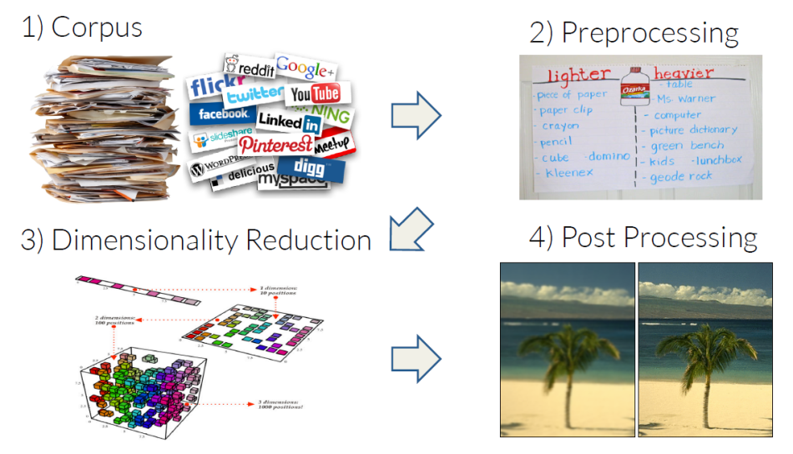
Corpus based Approach

Slide 5
Context of Words
Let's try to keep the kitchen .
We used WordNet to the synset of cat.
What does mean?

Slide 6
Let's try to keep the kitchen .
Observation: context can tell us a lot about word meaning
Context: local window around a word occurrence (for now)
Roots in linguistics:
Distributional hypothesis [Harris, 1954]:
Semantically similar words occur in similar contexts
“If A and B have almost identical environments we say that they are synonyms.”
"You shall know a word by the company it keeps." [Firth, 1957]
Pros: data-driven, easy to implement
Cons: ambiguity

Slide 7
Intuition of distributional word similarity
Nida example:
From context words humans can guess tesgüino means
an alcoholic beverage like beer
Intuition for algorithm:
Two words are similar if they have similar word contexts.
A bottle of tesgüino is on the table
Everybody likes tesgüino
Tesgüino makes you drunk
We make tesgüino out of corn.
Dan Jurafsky

Slide 8
Different Kinds of Vector Models
Sparse vector representations
Weighted word co-occurrence matrices
Dense vector representations:
Singular value decomposition (and Latent Semantic Analysis)
Neural-network-inspired models (word embeddings)

Slide 9
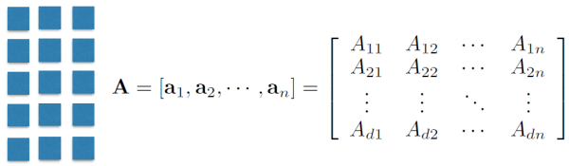
A Little Linear Algebra
Matrix: A collection of vectors

Slide 10
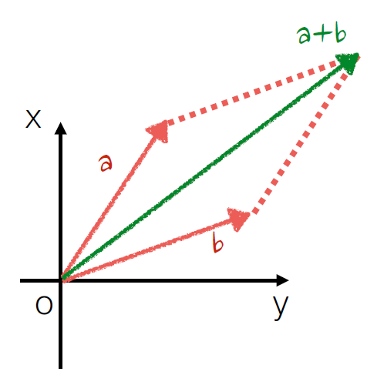
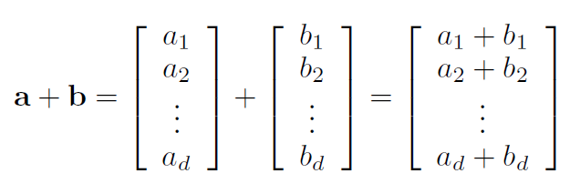
Vector Operations
Addition
Can vectors with different dimensionalities be added together?
The resultant thing is a vector or a scalar?

Slide 11
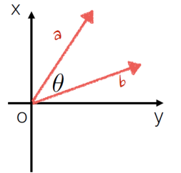
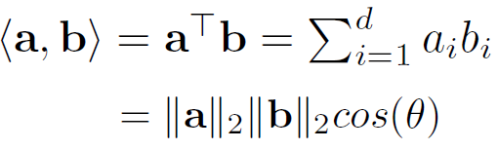

Vector Operations
Inner product
Can inner product be operated on vectors with different dimensionalities?
The resultant thing is a vector or a scalar?

Slide 12
Vector Norm
The resultant thing is a vector or a scalar?
Can vector norms be negative?

Slide 13
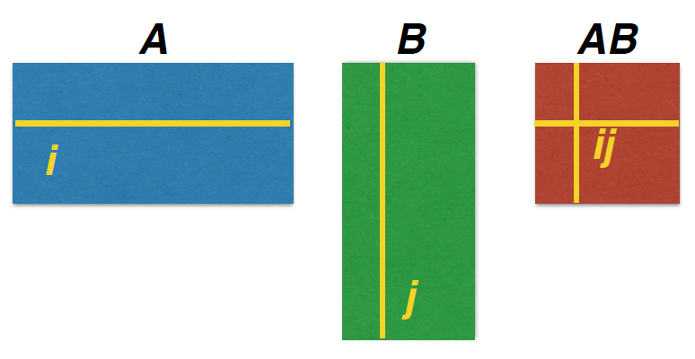
Matrix Multiplication
What is the dimensionality requirement for matrix multiplication?
What is the dimensionality of the resultant matrix?

Slide 14
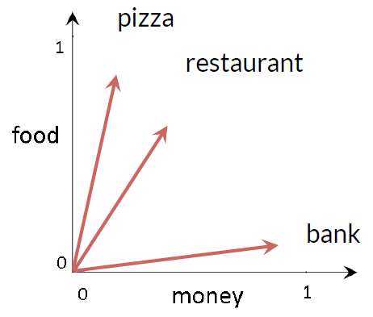
Back to Distributional Representation
Vector Space Model (VSM)
Represent each word with its context words

Slide 15
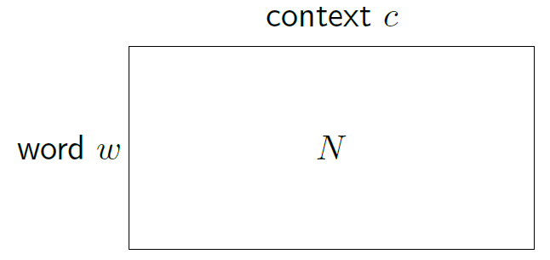
Context Vector Construction
Form a word-context matrix of counts (data)
clean
1
1
1
1
kitchen
try
Let's
keep
Let's try to keep the kitchen clean.

Slide 16
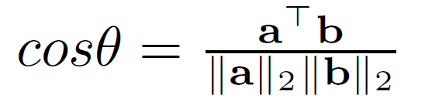
Similarity between Words

Slide 17
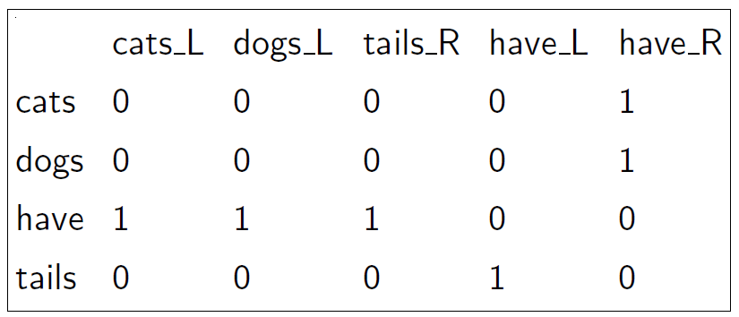
Features for Part-of-speech Induction
Matrix: contexts (2) = words on left, words on right
Doc1: Cats have tails.
Doc2: Dogs have tails.

Slide 18
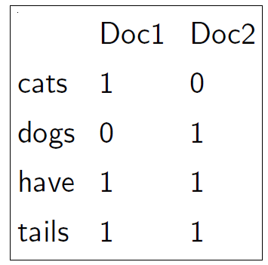
Document Representation
Matrix: contexts = documents that word appear in
Doc1: Cats have tails.
Doc2: Dogs have tails.

Slide 19
Document Vector Space Model
All documents are projected into this concept space
Finance
|D₂-D₄|
D₂
D₄
D₃
Sports
D₅
D₁
Education

Slide 20
Is This Just as Simple as Counting?
What if I give you a raw document?

Slide 21
Let’s take a look at a document
On Feb. 8, Dong Nguyen announced that he would be removing his hit game Flappy Bird from both the iOS and Android app stores, saying that the success of the game is something he never wanted. Some fans of the game took it personally, replying that they would either kill Nguyen or kill themselves if he followed through with his decision.
Frank Lantz, the director of the New York University Game Center, said that Nguyen's meltdown resembles how some actors or musicians behave. "People like that can go a little bonkers after being exposed to this kind of interest and attention," he told ABC News. "Especially when there's a healthy dose of Internet trolls."

Slide 22
Document Tokenization
Regular expressions
\\w+: so-called -> ‘so’, ‘called’
\\s+: It’s -> ‘It’s’ instead of ‘It’, ‘’s’
Statistical methods
Explore rich features to decide where the boundary of a word is
Apache OpenNLP (http://opennlp.apache.org/)
Stanford NLP Parser (http://nlp.stanford.edu/software/lex-parser.shtml)
Online Demo
Stanford (http://corenlp.run/)
UIUC/UPenn (http://cogcomp.org/curator/demo/index.html)

Slide 23
Bag-of-words Representation
Term as the basis for vector space
Doc1: Text mining is to identify useful information.
Doc2: Useful information is mined from text.
Doc3: Apple is delicious.
 | text | information | identify | mining | mined | is | useful | to | from | apple | delicious
Doc1 | 1 | 1 | 1 | 1 | 0 | 1 | 1 | 1 | 0 | 0 | 0
Doc2 | 1 | 1 | 0 | 0 | 1 | 1 | 1 | 0 | 1 | 0 | 0
Doc3 | 0 | 0 | 0 | 0 | 0 | 1 | 0 | 0 | 0 | 1 | 1
Assumption
Words are independent from each other
Pros
Simple
Cons
Basis vectors are clearly not linearly independent!
Grammar and order are missing

Slide 24
Bag-of-Words with N-grams
N-grams: a contiguous sequence of n tokens from a given text
“Text mining is to identify useful information.”
Bi-grams: “text_mining”, “mining_is”, “is_to”, “to_identify” , “identify_useful”, “useful_information”, “information_.”
Pros: capture local dependency and order
Cons: increase the vocabulary size

Slide 25
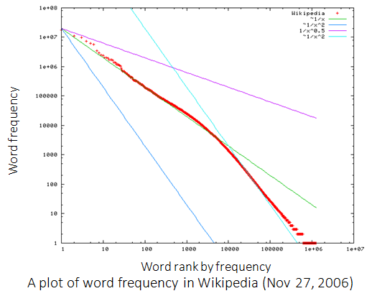
Statistics of Words in Corpus
Zipf’s law
Frequency of a word is inversely proportional to its rank in the frequency table

Slide 26
Zipf’s Law Tells Us
Head words take large portion of occurrences, but they are semantically meaningless
E.g., the, a, an, we, do, to
Tail words take major portion of vocabulary, but they rarely occur in documents
E.g., dextrosinistral
The rest is most representative
To be included in the controlled vocabulary
In the Brown Corpus of American English text, the word "the" is the most frequently occurring word, and by itself accounts for nearly 7% of all word occurrences; the second-place word "of" accounts for slightly over 3.5% of words.

Slide 27
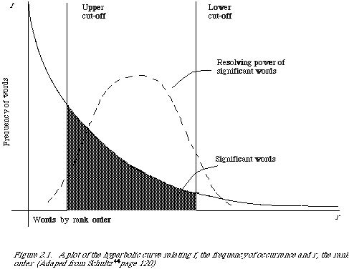
Better Document Representation
Remove non-informative words
Remove rare words

Slide 28
Stopwords
Useless words for document analysis
Not all words are informative
Remove such words to reduce vocabulary size
No universal definition
Risk: break the original meaning and structure of text
E.g., this is not a good option -> option
to be or not to be -> null

Slide 29
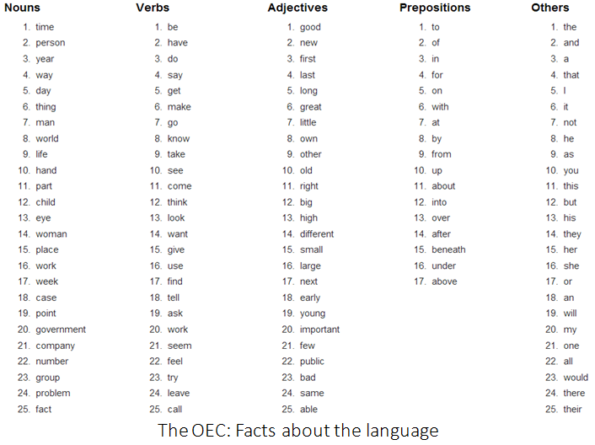

Slide 30
Stemming
Reduce inflected or derived words to their root form
Plurals, adverbs, inflected word forms
E.g., ladies -> lady, referring -> refer, forgotten -> forget
Solutions (for English)
Porter stemmer: patterns of vowel-consonant sequence
Krovetz stemmer: morphological rules
Risk: lose precise meaning of the word
E.g., lay -> lie (a false statement? or be in a horizontal position?)

Slide 31
Summary of Preprocessing
Example: ‘Text mining is to identify useful information.’
Tokenization:
D1: ‘Text’, ‘mining’, ‘is’, ‘to’, ‘identify’, ‘useful’, ‘information’, ‘.’
Stemming/normalization:
D1: ‘text’, ‘mine’, ‘is’, ‘to’, ‘identify’, ‘use’, ‘inform’, ‘.’
N-gram construction:
D1: ‘text-mine’, ‘mine-is’, ‘is-to’, ‘to-identify’, ‘identify-use’, ‘use-inform’, ‘inform-.’
Stopword/controlled vocabulary filtering:
D1: ‘text-mine’, ‘to-identify’, ‘identify-use’, ‘use-inform’
Optional

Slide 32
Term Weighting
Term as the basis for vector space
Doc1: Text mining is to identify useful information.
Doc2: Useful information is mined from text.
Doc3: Apple is delicious.
“Repeated occurrences” are less informative than the “first occurrence”
Information about semantic does not increase proportionally with number of term occurrence
 | text | information | identify | mining | mined | is | useful | to | from | apple | delicious
Doc1 | 1 | 1 | 1 | 1 | 0 | 1 | 1 | 1 | 0 | 0 | 0
Doc2 | 1 | 1 | 0 | 0 | 1 | 1 | 1 | 0 | 1 | 0 | 0
Doc3 | 0 | 0 | 0 | 0 | 0 | 1 | 0 | 0 | 0 | 1 | 1

Slide 33
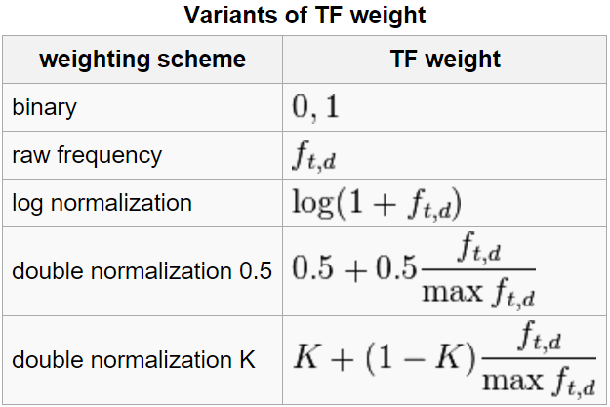
Term Frequency Weights
Examples of weighting terms
Number of times term t appearing in document d

Slide 34


Norm. TF
1
Raw TF
Norm. TF
Raw TF

Slide 35
Document Frequency Weighting
Idea: a term is more discriminative if it occurs only in fewer documents

Slide 36
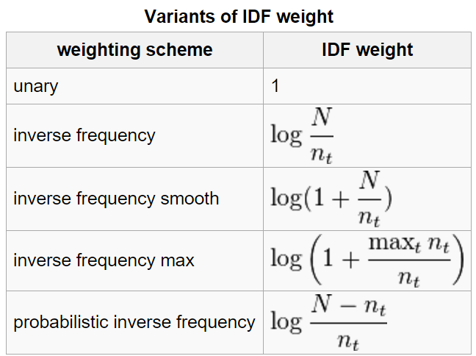
Inverse Document Frequency
Examples of IDF
Non-linear scaling
Total number of docs in collection
Number of docs containing term t

Slide 37
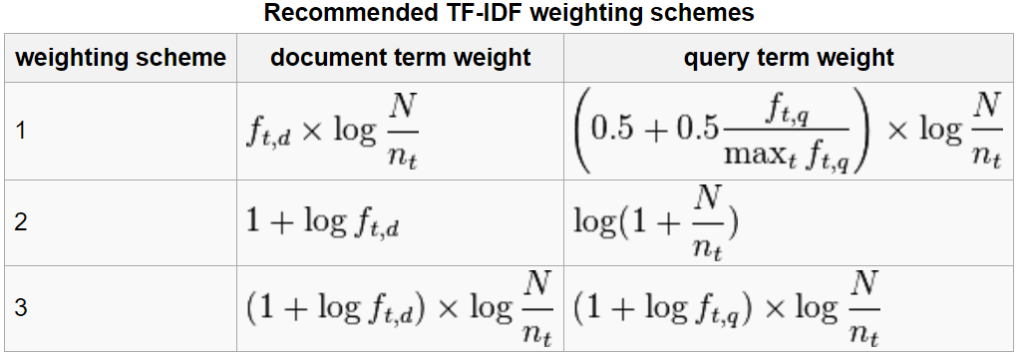
TFIDF
Term frequency–Inverse document frequency
Higher tf: more frequently a word appearing in a document
Higher idf: less frequently a word appearing in a corpus

Slide 38
Document Similarity
Finance
TF-IDF space
Euclidean Distance
Cosine Similarity
D₁
The choice of angle
The choice of Euclidean distance
D₂
D₆
Sports
Finance
D₂
TF-IDF space
D₁
D₆
Sports

Slide 39
Cosine as a Similarity Metric
-1: vectors point in opposite directions
+1: vectors point in same directions
0: vectors are orthogonal

Slide 40
Summary of Vector Space Model
Pros:
Empirically effective!
Intuitive
Easy to implement
Well-studied/mostly evaluated
Warning: many variants of TF-IDF!
Cons
Assume term independence
Lack of “predictive adequacy”
Arbitrary term weighting
Arbitrary similarity measure
Lots of parameter tuning!
Any improvements?

