Slide 1
MSBD 5018 - Natural Language Processing
Introduction to Classification
Instructor: Yangqiu Song
Slides credits: Hongning Wang, Marti Hearst, Barbara Rosario

Slide 2
Today
Classification
Text categorization (and other applications)
Various issues regarding classification
Clustering vs. classification, binary vs. multi-way, flat vs. hierarchical classification…
Feature Selection

Slide 3
Classification
Goal: Assign ‘objects’ from a universe to two or more classes or categories
Examples:
Problem Object Categories
Tagging Word POS
Sense Disambiguation Word The word’s senses
Information retrieval Document Relevant/not relevant
Sentiment classification Document Positive/negative
Author identification Document Authors

Slide 4
Author identification
They agreed that Mrs. X should only hear of the departure of the family, without being alarmed on the score of the gentleman's conduct; but even this partial communication gave her a great deal of concern, and she bewailed it as exceedingly unlucky that the ladies should happen to go away, just as they were all getting so intimate together.
Gas looming through the fog in divers places in the streets, much as the sun may, from the spongey fields, be seen to loom by husbandman and ploughboy. Most of the shops lighted two hours before their time--as the gas seems to know, for it has a haggard and unwilling look. The raw afternoon is rawest, and the dense fog is densest, and the muddy streets are muddiest near that leaden-headed old obstruction, appropriate ornament for the threshold of a leaden-headed old corporation, Temple Bar.
Jane Austen (1775-1817), Pride and Prejudice
or
Charles Dickens (1812-70), Bleak House ?
Notes:
Mrs. Bennet

Slide 5
Language identification
Tutti gli esseri umani nascono liberi ed eguali in dignità e diritti. Essi sono dotati di ragione e di coscienza e devono agire gli uni verso gli altri in spirito di fratellanza.
Alle Menschen sind frei und gleich an Würde und Rechten geboren. Sie sind mit Vernunft und Gewissen begabt und sollen einander im Geist der Brüderlichkeit begegnen.
Universal Declaration of Human Rights, UN, in 363 languages

Slide 6
Classification
Goal: Assign ‘objects’ from a universe to two or more classes or categories
Examples:
Problem Object Categories
Author identification Document Authors
Language identification Document Language
Text categorization Document Topics

Slide 7
Text categorization
Topic categorization: classify the document into semantics topics
The U.S. swept into the Davis Cup final on Saturday when twins Bob and Mike Bryan defeated Belarus's Max Mirnyi and Vladimir Voltchkov to give the Americans an unsurmountable 3-0 lead in the best-of-five semi-final tie. | One of the strangest, most relentless hurricane seasons on record reached new bizarre heights yesterday as the plodding approach of Hurricane Jeanne prompted evacuation orders for hundreds of thousands of Floridians and high wind warnings that stretched 350 miles from the swamp towns south of Miami to the historic city of St. Augustine.
Sports or Weather?

Slide 8
Text categorization
http://news.google.com/
Reuters
Collection of (21,578) newswire documents.
For research purposes: a standard text collection to compare systems and algorithms
135 valid topics categories

Slide 9
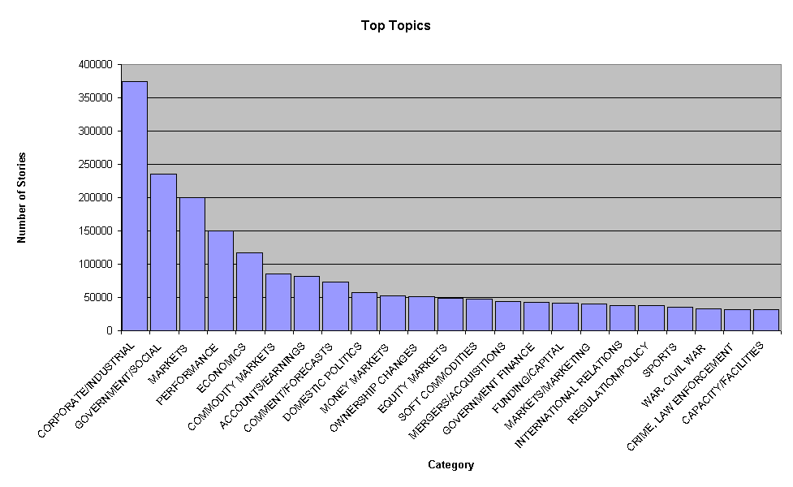
Reuters
Top topics in Reuters

Slide 10
Reuters
<REUTERS TOPICS="YES" LEWISSPLIT="TRAIN" CGISPLIT="TRAINING-SET" OLDID="12981" NEWID="798">
<DATE> 2-MAR-1987 16:51:43.42</DATE>
<TOPICS><D>livestock</D><D>hog</D></TOPICS>
<TITLE>AMERICAN PORK CONGRESS KICKS OFF TOMORROW</TITLE>
<DATELINE> CHICAGO, March 2 - </DATELINE><BODY>The American Pork Congress kicks off
tomorrow, March 3, in Indianapolis with 160 of the nations pork producers from 44 member states determining industry positions on a number of issues, according to the National Pork Producers Council, NPPC.
Delegates to the three day Congress will be considering 26 resolutions concerning various issues, including the future direction of farm policy and the tax law as it applies to the agriculture sector. The delegates will also debate whether to endorse concepts of a national PRV (pseudorabies virus) control and eradication program, the NPPC said.
A large trade show, in conjunction with the congress, will feature the latest in technology in all areas of the industry, the NPPC added. Reuter
&#3;</BODY></TEXT></REUTERS>

Slide 11
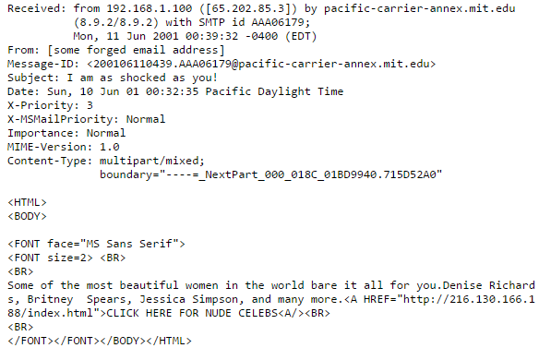
Text Categorization
Recognizing spam emails
Spam=True/False

Slide 12

Sentiment Classification
Sentiment analysis

Slide 13
Classification vs. Clustering
Classification assumes labeled data: we know how many classes there are and we have examples for each class (labeled data).
Classification is supervised
In Clustering we don’t have labeled data; we just assume that there is a natural division in the data and we may not know how many divisions (clusters) there are
Clustering is unsupervised

Slide 14
Classification
Class1
Class2

Slide 15
Classification
Class1
Class2

Slide 16
Classification
Class1
Class2

Slide 17
Classification
Class1
Class2

Slide 18
Clustering

Slide 19
Clustering

Slide 20
Clustering

Slide 21
Clustering

Slide 22
Clustering

Slide 23
Categories (Labels, Classes)
Labeling data
2 problems:
Decide the possible classes (which ones, how many)
Domain and application dependent
http://news.google.com
Label text
Difficult, time consuming, inconsistency between annotators

Slide 24
Binary vs. multi-way classification
Binary classification: two classes
Multi-way classification: more than two classes
Sometime it can be convenient to treat a multi-way problem like a binary one: one class versus all the others, for all classes

Slide 25
Flat vs. Hierarchical classification
Flat classification: relations between the classes undetermined
Hierarchical classification: hierarchy where each node is the sub-class of its parent’s node

Slide 26
Single- vs. multi-category classification
In single-category text classification each text belongs to exactly one category (multi-class learning)
In multi-category text classification, each text can have zero or more categories (multi-label learning)

Slide 27
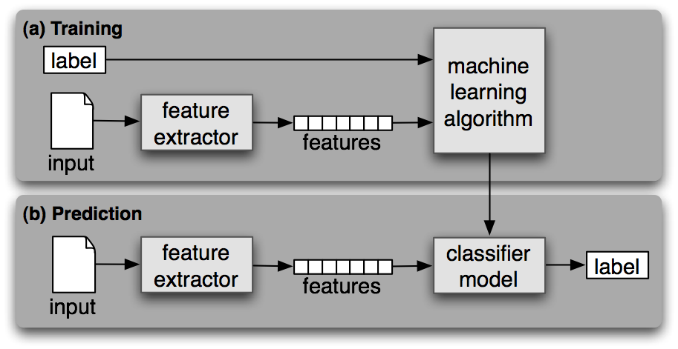
General Pipeline of Classification

Slide 28
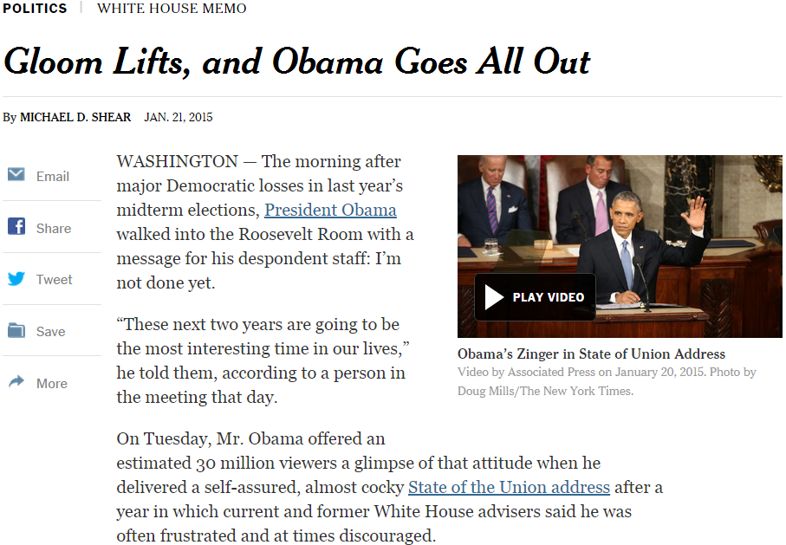

General steps for text categorization
Feature construction and selection
Model specification
Model estimation and selection
Evaluation
Political News
Sports News
Entertainment News
Consider:
1.1 How to represent the text documents?
1.2 Do we need all those features?

Slide 29
Feature construction for text categorization
Vector space representation
Standard procedure in document representation
Features
N-gram, POS tags, named entities, topics
Feature value
Binary (presence/absence)
TF-IDF (many variants)

Slide 30
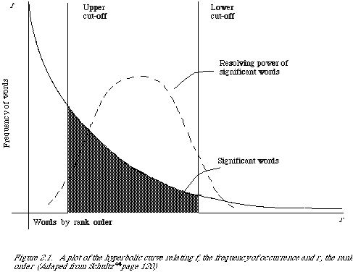
A Typical Corpus
How many unigram+bigram are there in our controlled vocabulary?
130K on Yelp_small
How many review documents do we have there for training?
629K Yelp_small
Very sparse feature representation!

Slide 31
Feature Selection
A small corpus can have millions of unigram+bigram features
Select the most informative features for model training
Reduce the feature space
Improve the final classification performance
Improve training/testing efficiency
Less tuning time
Fewer training data

Slide 32

Feature selection methods
Filter method
Evaluate the features independently from the classifier and other features
No indication of a classifier’s performance on the selected features
No dependency among the features
Feasible for very large feature set
Usually used as a preprocessing step
R. Kohavi, G.H. John/Artijicial Intelligence 97 (1997) 273-324

Slide 33
Feature scoring metrics
Document frequency
Rare words: non-influential for global prediction, reduce vocabulary size
riskier to remove head words
safer to remove rare words

Slide 34
General steps for text categorization
Feature construction and selection
Model specification
Model estimation and selection
Evaluation
Political News
Sports News
Entertainment News
Consider:
2.1 What is the unique property of this problem?
2.2 What type of classifier we should use?

Slide 35
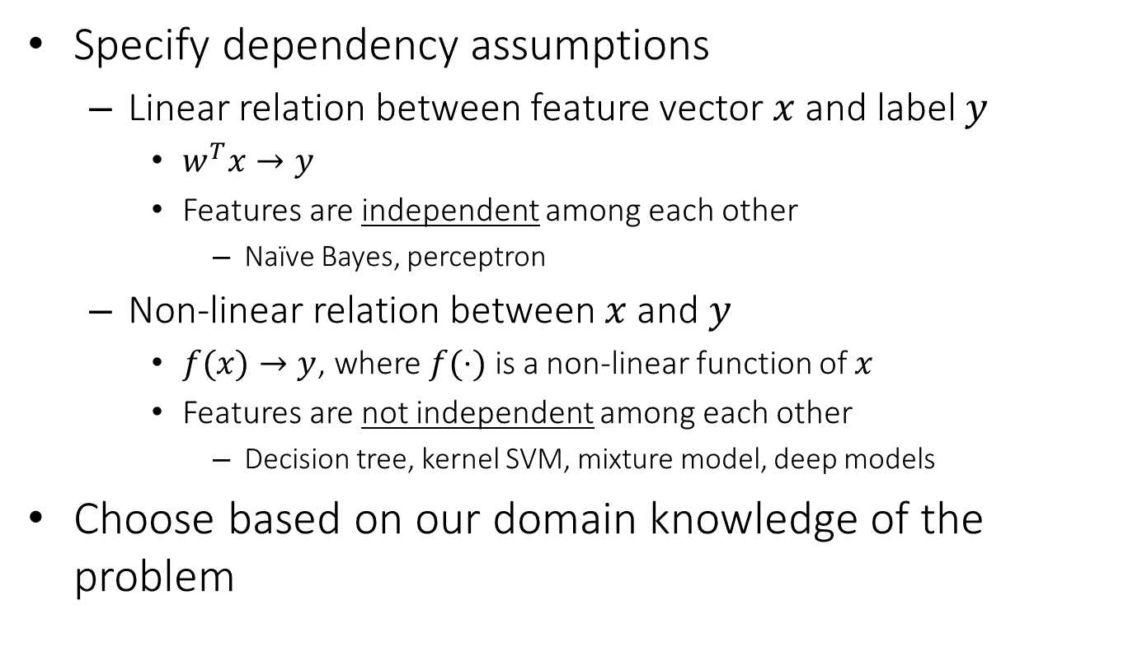
Model specification
Specify dependency assumptions
Linear relation between feature vector $x$ and label $y$
$w^{T}x→y$
Features are independent among each other
Naïve Bayes, perceptron
Non-linear relation between $x$ and $y$
$f(x)→y$, where $f(⋅)$ is a non-linear function of $x$
Features are not independent among each other
Decision tree, kernel SVM, mixture model, deep models
Choose based on our domain knowledge of the problem
We will discuss these choices later

Slide 36
General steps for text categorization
Feature construction and selection
Model specification
Model estimation and selection
Evaluation
Political News
Sports News
Entertainment News
Consider:
3.1 How to estimate the parameters in the selected model?
3.2 How to control the complexity of the estimated model?

Slide 37
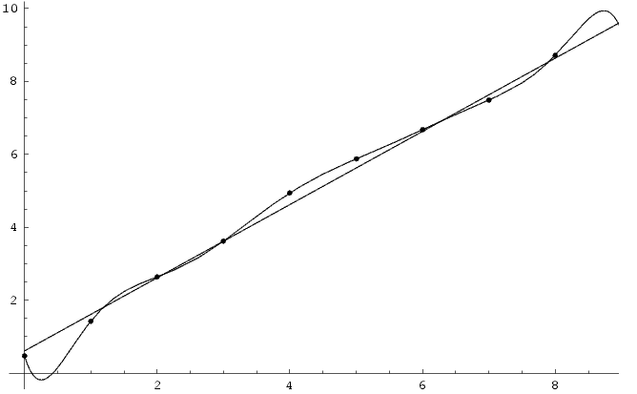
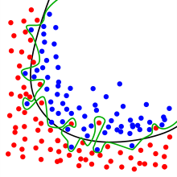
Empirical loss minimization
Overfitting
Good empirical loss, terrible generalization loss
High model complexity -> prune to overfit noise
Over-complicated dependency assumption: polynomial
Underlying dependency: linear relation

Slide 38
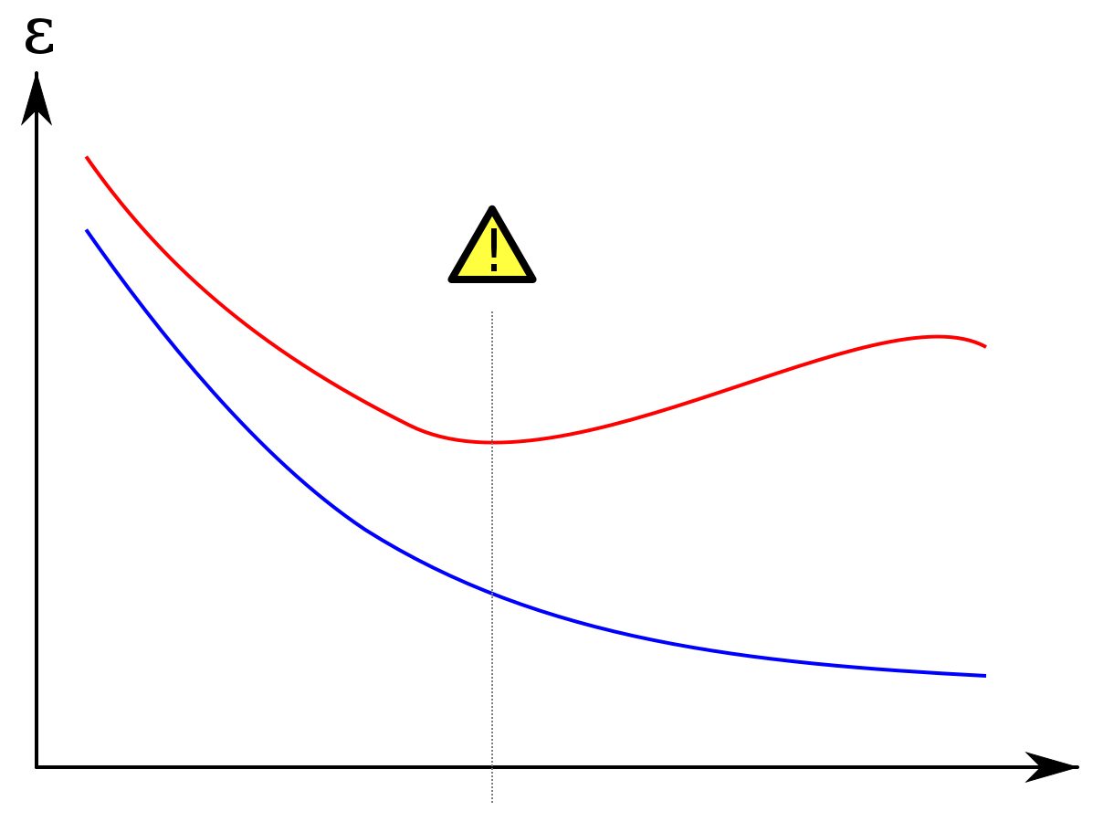
Generalization loss minimization
Avoid overfitting
Measure model complexity as well
Model selection and regularization
Error
Error on testing set
Error on training set
Model complexity

Slide 39
Generalization loss minimization
Cross validation
Avoid noise in train/test separation
k-fold cross-validation
Partition all training data into k equal size disjoint subsets;
Leave one subset for validation and the other k-1 for training;
Repeat step (2) k times with each of the k subsets used exactly once as the validation data.

Slide 40
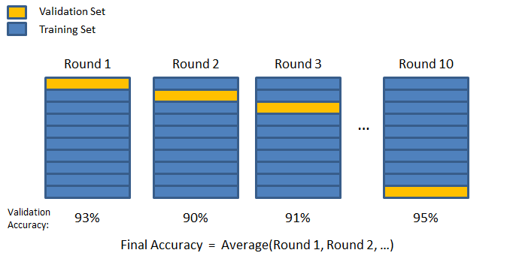
Generalization loss minimization
Cross validation
Avoid noise in train/test separation
k-fold cross-validation

Slide 41
Generalization loss minimization
Cross validation
Avoid noise in train/test separation
k-fold cross-validation
Choose the model (among different models or same model with different settings) that has the best average performance on the validation sets
Some statistical test is needed to decide if one model is significantly better than another

Slide 42
General steps for text categorization
Feature construction and selection
Model specification
Model estimation and selection
Evaluation
Political News
Sports News
Entertainment News
Consider:
4.1 How to judge the quality of learned model?
4.2 How can you further improve the performance?

Slide 43
Testing, evaluation of the classifier
After choosing the parameters of the classifiers (i.e. after training it) we need to test how well it’s doing on a test set (not included in the training set)
Calculate misclassification on the test set

Slide 44
Baselines
First step: get a baseline
Help determine how hard the task is
Help know what a “good” accuracy is
Weak baseline: most frequent label classifier
Gives all test instances whatever label was most common in the training set
E.g. for spam filtering, might label everything as “not spam”
Accuracy might be very high if the problem is skewed
E.g. calling everything “not spam” gets 66%, so a classifier that gets 70% isn’t very good…
For real research, usually use previous work as a (strong) baseline

Slide 45
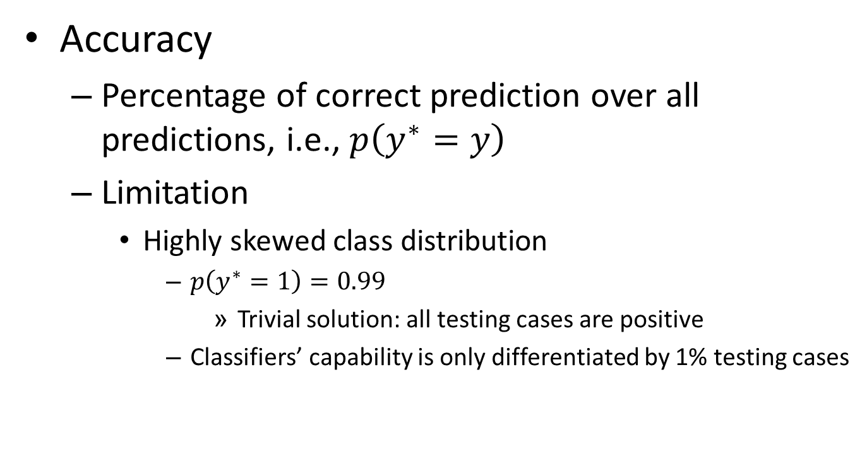
Classification evaluation
Accuracy
Percentage of correct prediction over all predictions, i.e., $p\left(y^{∗}=y\right)$
Limitation
Highly skewed class distribution
$p\left(y^{∗}=1\right)=0.99$
Trivial solution: all testing cases are positive
Classifiers’ capability is only differentiated by 1% testing cases

Slide 46
Evaluating classifiers
Contingency table for the evaluation of a binary classifier
 | GREEN is correct | RED is correct
GREEN was assigned | a | b
RED was assigned | c | d
Accuracy = (a+d)/(a+b+c+d)
Precision: P_GREEN = a/(a+b), P_ RED = d/(c+d)
Recall: R_GREEN = a/(a+c), R_ RED = d/(b+d)

Slide 47
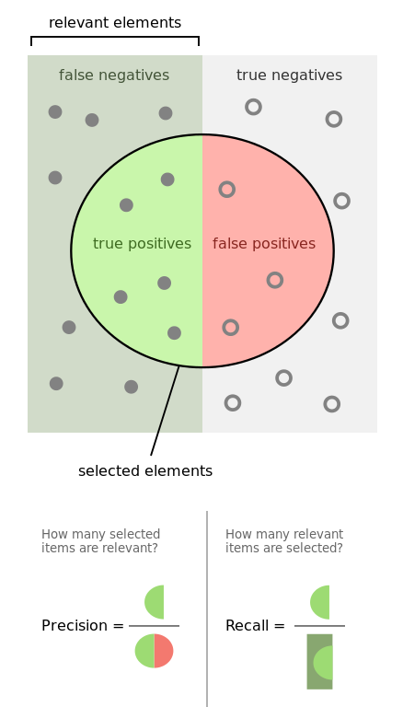
Evaluation of Binary Classification
Precision
Fraction of predicted positive documents that are indeed positive, i.e., P(gold = 1 | prediction = 1)
Recall
Fraction of positive documents that are predicted to be positive, i.e., P(prediction = 1 | gold = 1)
https://en.wikipedia.org/wiki/Precision_and_recall
https://en.wikipedia.org/wiki/F1_score

Slide 48
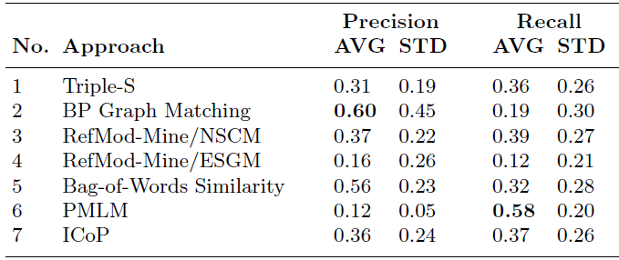
Precision and recall trade off
Precision decreases as the number of documents predicted to be positive increases (unless in perfect classification), while recall keeps increasing
These two metrics emphasize different perspectives of a classifier
Precision: prefers a classifier to recognize fewer documents, but highly accurate
Recall: prefers a classifier to recognize more documents

Slide 49
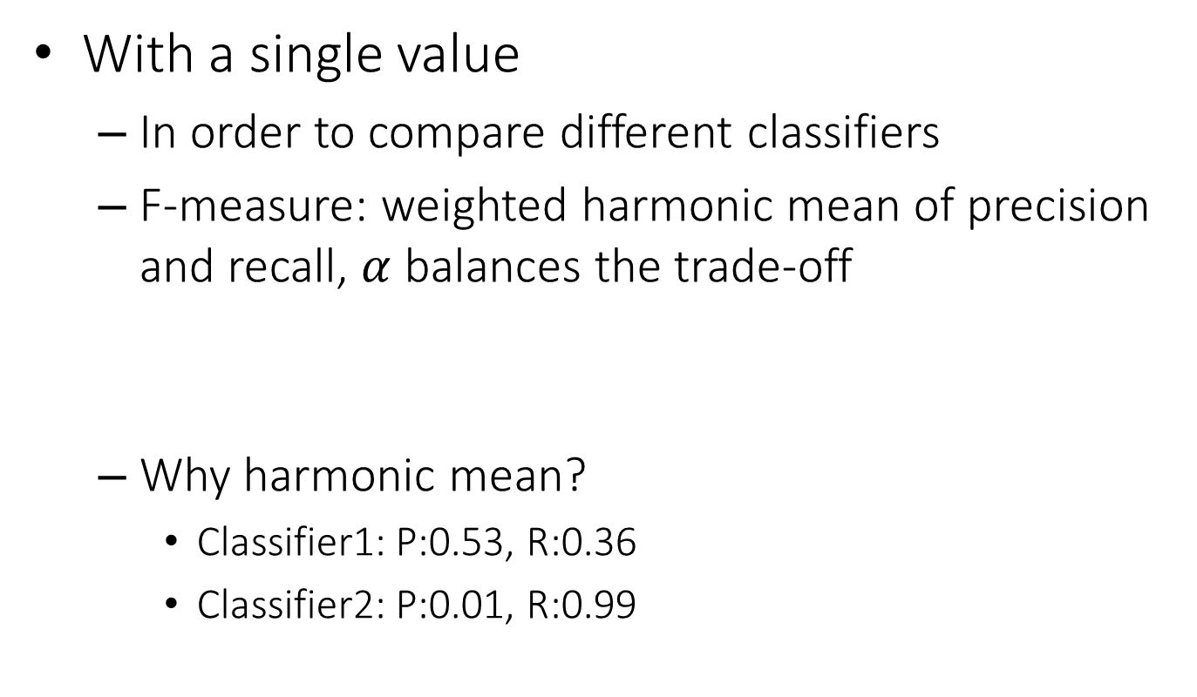


Summarizing precision and recall
With a single value
In order to compare different classifiers
F-measure: weighted harmonic mean of precision and recall, $α$ balances the trade-off
Why harmonic mean?
Classifier1: P:0.53, R:0.36
Classifier2: P:0.01, R:0.99
$$F=\frac{1}{α\frac{1}{P}+\left(1−α\right)\frac{1}{R}}$$
$$\left(F_{1}=\frac{2}{\frac{1}{P}+\frac{1}{R}} \right)$$
Equal weight between precision and recall
Harmonic | Average
0.429 | 0.445
0.019 | 0.500

Slide 50



Summarizing precision and recall
With a curve
Order all the testing cases by the classifier’s prediction score (assuming the higher the score is, the more likely it is positive);
Scan through each testing case: treat all cases above it as positive (including itself), below it as negative; compute precision and recall;
Plot precision and recall computed for each testing case in step (2).
Break-even point: precision value when p = r

Slide 51
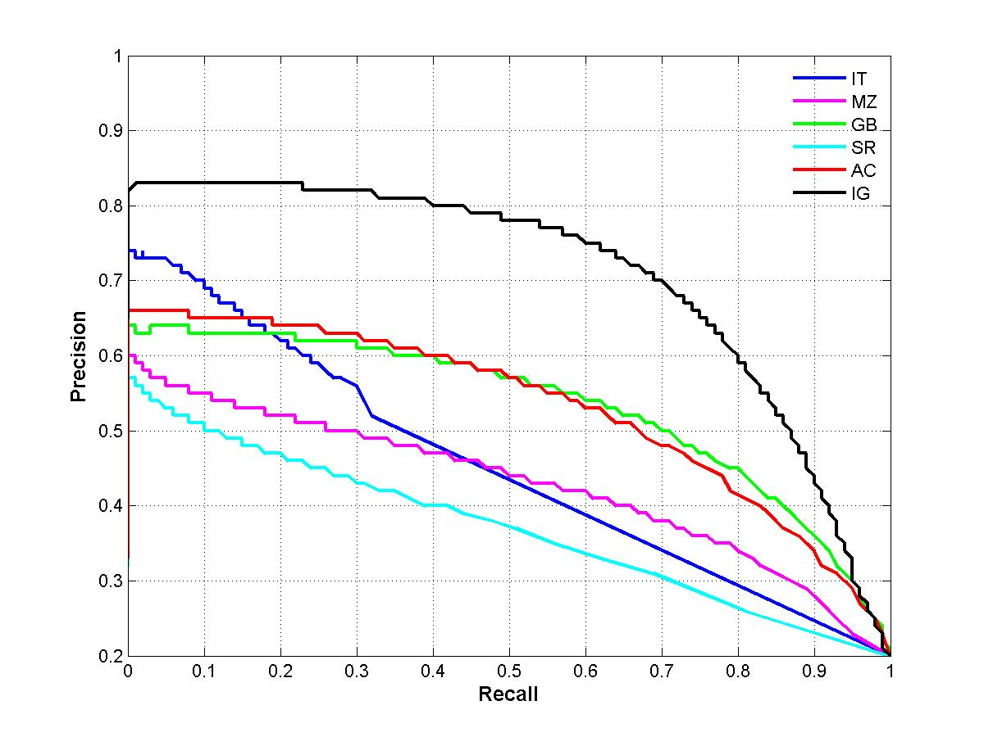
Summarizing precision and recall
With a curve
A.k.a., precision-recall curve
Area Under Curve (AUC)
Under each recall level, we prefer a higher precision

Slide 52
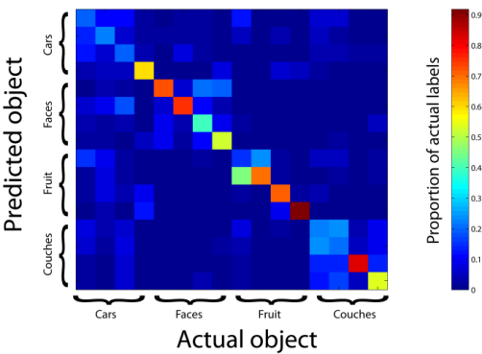
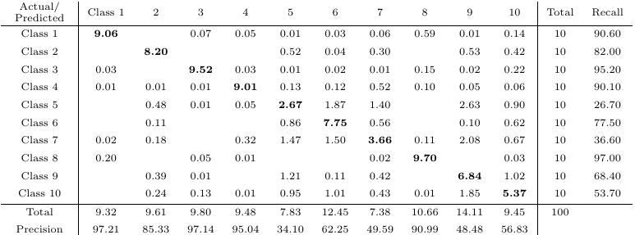
Multi-class Categorization
Confusion matrix
A generalized contingency table for precision and recall

Slide 53
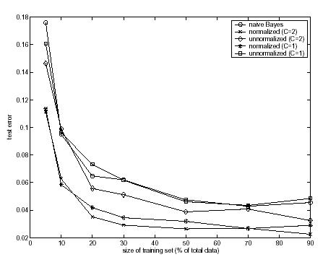
Training size
The more the better! (usually)
Results for text classification*

Slide 54
What you should know
General steps for text categorization
Text feature construction
Feature selection methods
Model specification and estimation
Evaluation metrics

