Slide 1
MSBD 5018 - Natural Language Processing
CNN and RNN
Instructor: Yangqiu Song
Slides credits: Dan Roth

Slide 2
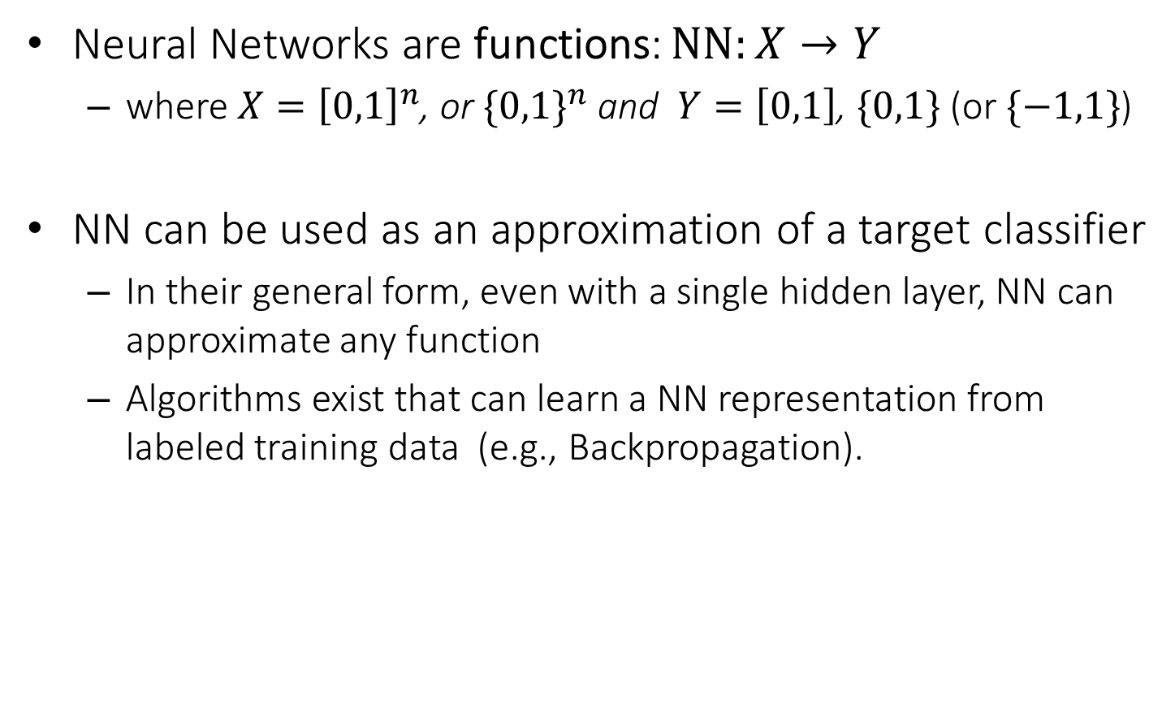
Neural Networks
Neural Networks are functions: $NN:X→Y$
where $X={\left[0,1\right]}^{n}$, or ${\{0,1\}}^{n}$ and $Y=\left[0,1\right]$, $\{0,1\}$ (or $\{−1,1\}$)
NN can be used as an approximation of a target classifier
In their general form, even with a single hidden layer, NN can approximate any function
Algorithms exist that can learn a NN representation from labeled training data (e.g., Backpropagation).

Slide 3
Multi-Layer Neural Networks
Multi-layer network were designed to overcome the computational (expressivity) limitation of a single threshold element.
The idea is to stack several
layers of threshold elements,
each layer using the output of
the previous layer as input.
activation
Output
Hidden
Input

Slide 4
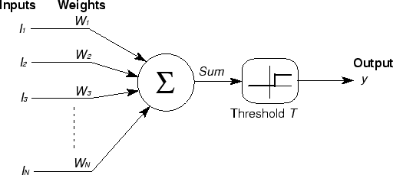






Basic Unit in Multi-Layer Neural Network
Linear Unit: $o_{j}=\vec{w}.\vec{x}$ multiple layers of linear functions produce linear functions. We want to represent nonlinear functions.
Note: Here we use a slightly different notation for dot product $\vec{w}.\vec{x}$
Threshold units: $o_{j}=sgn(\vec{w}.\vec{x}−b)$ are not differentiable, hence unsuitable for gradient descent
$$o_{k}$$
activation
Output
$$w_{jk}$$
$$h_{j}$$
Hidden
$$w_{ij}$$
Input
$$x_{i}$$

Slide 5
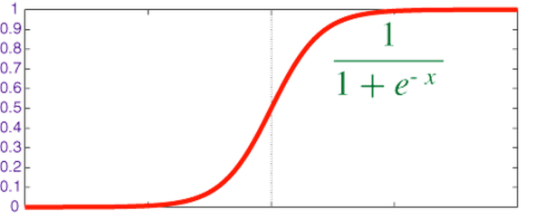

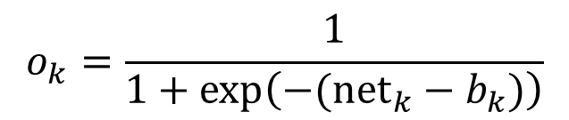

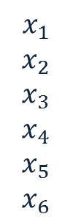



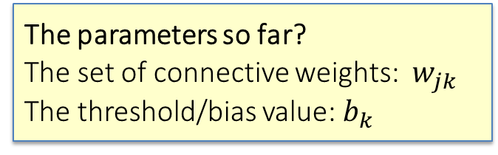

Model Neuron (Logistic, slightly different notations)
Neuron is modeled by a unit $k$ connected by weighted links $w_{jk}$ to other units $j$.
Note: we use a different kind of index of $w$ to indicate different neurons
Use a non-linear, differentiable output function such as the sigmoid or logistic function
Net input to a unit is defined as:
Output of a unit is defined as:
$$x_{1}$$
$$x_{2}$$
$$x_{3}$$
$$x_{4}$$
$$x_{5}$$
$$x_{6}$$
$$w_{17}$$
$${net}_{7}$$
$$o_{7}$$
The parameters so far?
The set of connective weights: $w_{jk}$ The threshold/bias value: $b_{k}$
$$w_{67}$$
$${net}_{k}=∑w_{jk}.x_{j}$$
$$o_{k}=\frac{1}{1+exp\left(−({net}_{k}−b_{k})\right)}$$

Slide 6
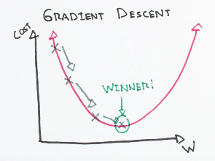
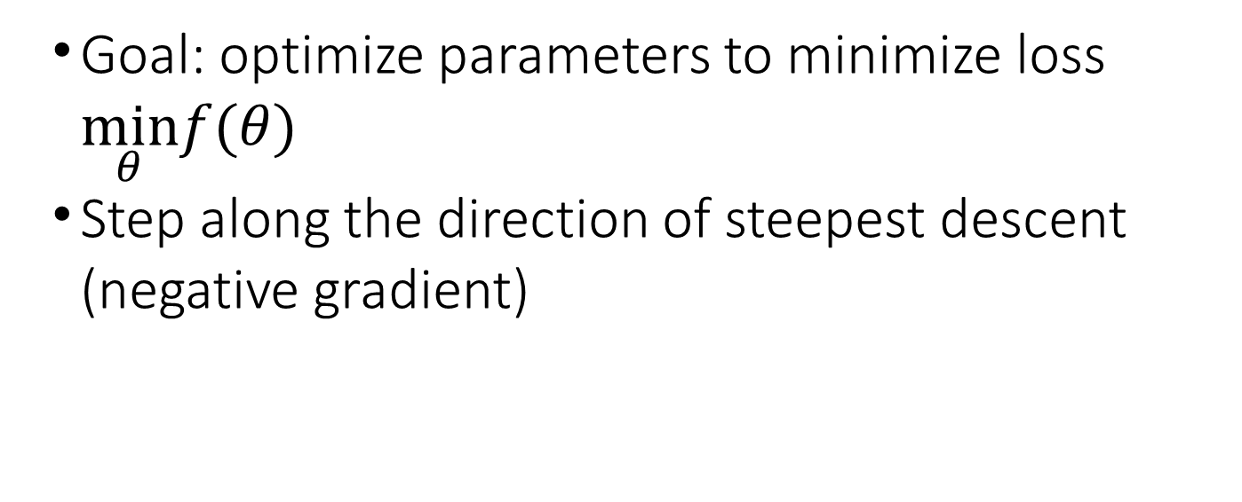
Gradient Descent
Goal: optimize parameters to minimize loss $\min_{θ}f(θ)$
Step along the direction of steepest descent (negative gradient)

Slide 7
Mini-Batch Methods

Slide 8
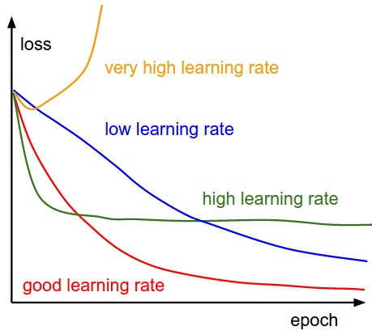
Learning Rates
Higher learning rates will decay the loss faster, but they get stuck at worse values of loss (green line). This is because there is too much “energy” in the optimization and the parameters are bouncing around chaotically, unable to settle in a nice spot in the optimization landscape.

Slide 9
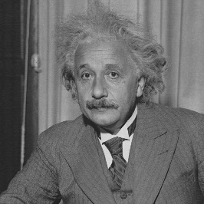
Receptive Fields
The receptive field of an individual sensory neuron is the particular region of the sensory space (e.g., the body surface, or the retina) in which a stimulus will trigger the firing of that neuron.
Designing “proper” receptive fields for the input Neurons is a significant challenge.
Consider a task with image inputs
Receptive fields should give expressive features from the raw input to the system
How would you design the receptive fields for this problem?

Slide 10
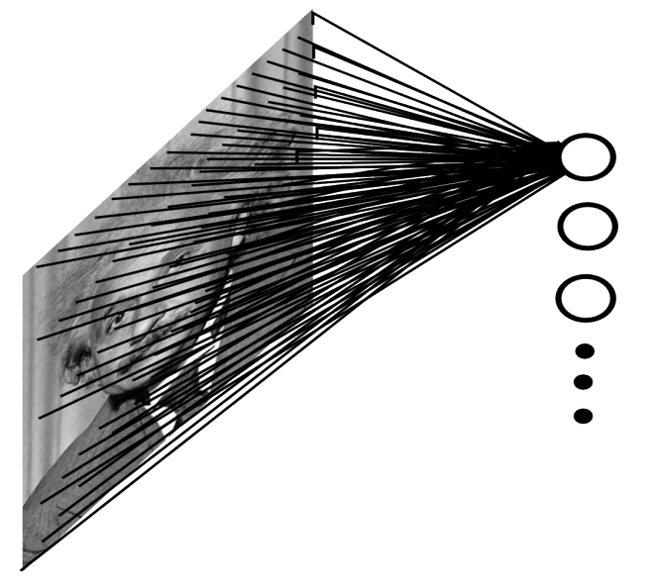
A fully connected layer:
Example:
100x100 images
1000 units in the input
Problems:
10^7 edges!
Spatial correlations lost!
Variables sized inputs.
Slide Credit: Marc'Aurelio Ranzato

Slide 11
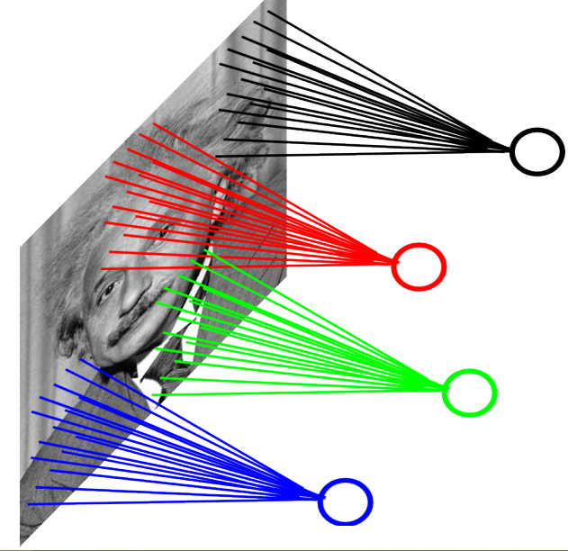
Consider a task with image inputs:
A locally connected layer:
Example:
100x100 images
1000 units in the input
Filter size: 10x10
Local correlations preserved!
Problems:
10^5 edges
This parameterization is good
when input image is registered
(e.g., face recognition).
Variable sized inputs, again.
Slide Credit: Marc'Aurelio Ranzato

Slide 12
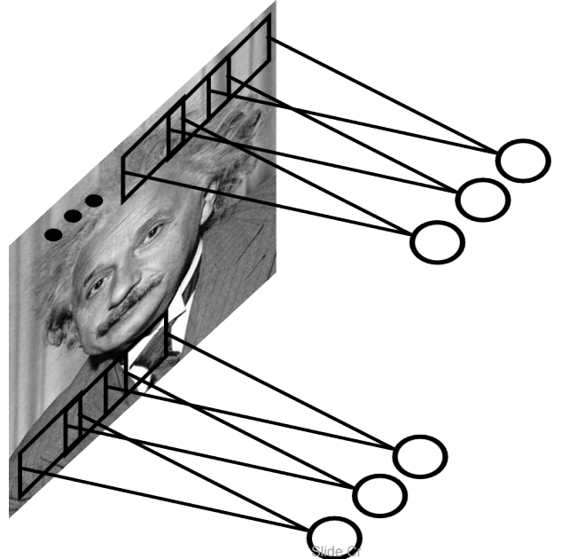
Convolutional Layer
A solution:
Filters to capture different patterns in the input space.
Share parameters across different locations (assuming input is stationary)
Convolutions with learned filters
Filters will be learned during training.
The issue of variable-sized inputs will be
resolved with a pooling layer.
So what is a convolution?

Slide 13
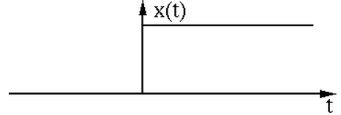
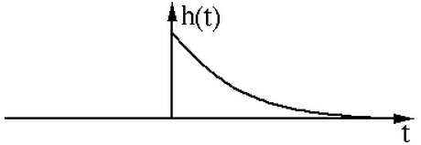
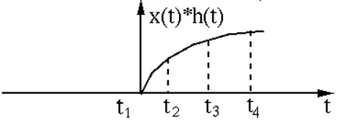
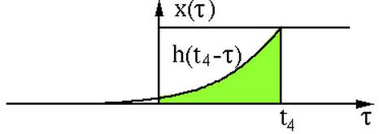
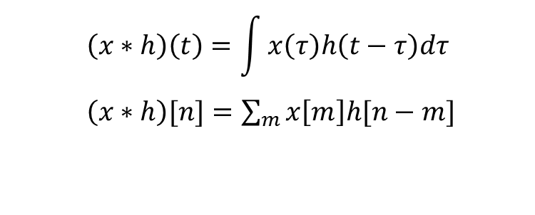

Convolution Operator
Convolution operator: $∗$
takes two functions and gives another function
One dimension:
$$\left(x∗h\right)\left(t\right)=\int{x\left(τ\right)h\left(t−τ\right)dτ}$$
$\left(x∗h\right)[n]=\sum_{m}{x\left[m\right]h[n−m]}$
“Convolution” is very similar to “cross-correlation”, except that in convolution one of the functions is flipped.

Slide 14
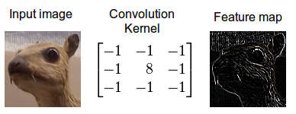
Convolution Operator (2)
Convolution in two dimension:
The same idea: flip one matrix and slide it on the other matrix
Example: edge detection kernel:
Try other kernels: http://setosa.io/ev/image-kernels/

Slide 15
Demo of CNN
https://setosa.io/ev/image-kernels/

Slide 16
Convolutional Layer
The convolution of the input (vector/matrix) with weights (vector/matrix) results in a response vector/matrix.
We can have multiple filters in each convolutional layer, each producing an output.
If it is an intermediate layer, it can have multiple inputs!
Convolutional Layer
Filter
Filter
Filter
One can add nonlinearity at the output of convolutional layer
Filter

Slide 17
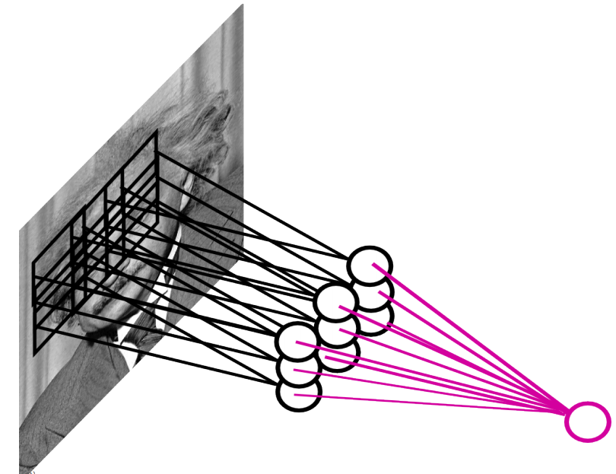
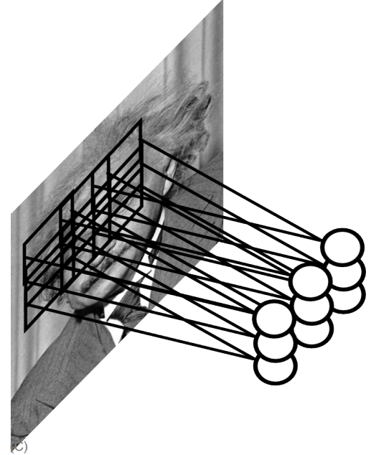
Pooling Layer
How to handle variable sized inputs?
A layer which reduces inputs of different size, to a fixed size.
Pooling
Slide Credit: Marc'Aurelio Ranzato

Slide 18
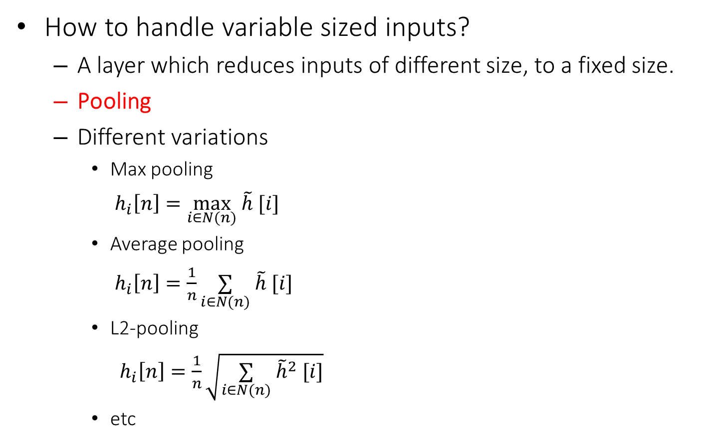
Pooling Layer
How to handle variable sized inputs?
A layer which reduces inputs of different size, to a fixed size.
Pooling
Different variations
Max pooling
$h_{i}\left[n\right]=\max_{i∈N(n)} \tilde{h} [i]$
Average pooling
$h_{i}\left[n\right]=\frac{1}{n}\underset{i∈N(n)}{∑} \tilde{h} [i]$
L2-pooling
$h_{i}\left[n\right]=\frac{1}{n}\sqrt{\underset{i∈N(n)}{∑} {\tilde{h}}^{2} [i]}$
etc

Slide 19
Convolutional Nets
One stage structure:
Whole system:
Convol.
Pooling
Stage 1
Stage 2
Stage 3
Fully Connected Layer
Input Image
Class Label

Slide 20
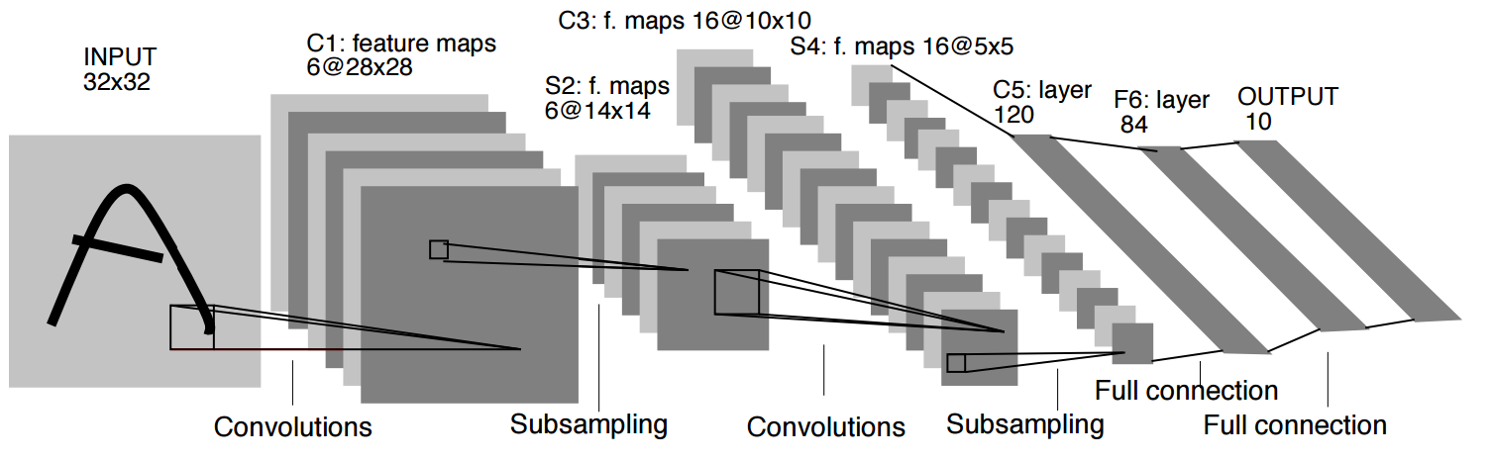
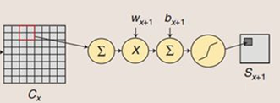
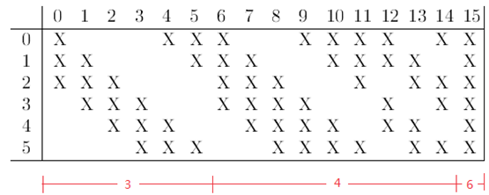
An example system (LeNet)
(32-5+1)×(32-5+1)= 28×28
Parameters: 120×(5×5×16+1) = 48120
Parameters(RBF): 84×10=840
Parameters: (5*5+1)*6=156
(Conv+bias)*channels
Parameters: (5×5×3+1)×6+
(5×5×4+1)×9+5×5×6+1 = 1516
Parameters: 16×2 = 32
Parameters: (120+1)×84=10164
Parameters: (1+1)*6=12
(Conv+bias)*channels

Slide 21





Training a ConvNet
The same procedure from Back-propagation applies here.
Remember in backprop we started from the error terms in the last stage, and passed them back to the previous layers, one by one.
$$x_{i}$$
$$y_{i}$$
$$δ_{last−layer}=\frac{∂E_{d}}{∂y_{last−layer}}$$
Convol.
Pooling
$$δ_{first−layer}=\frac{∂E_{d}}{∂y_{first−layer}}$$
$$E_{d}$$
Input Image
Stage 1
Stage 2
Stage 3
Fully Connected Layer
Class Label

Slide 22


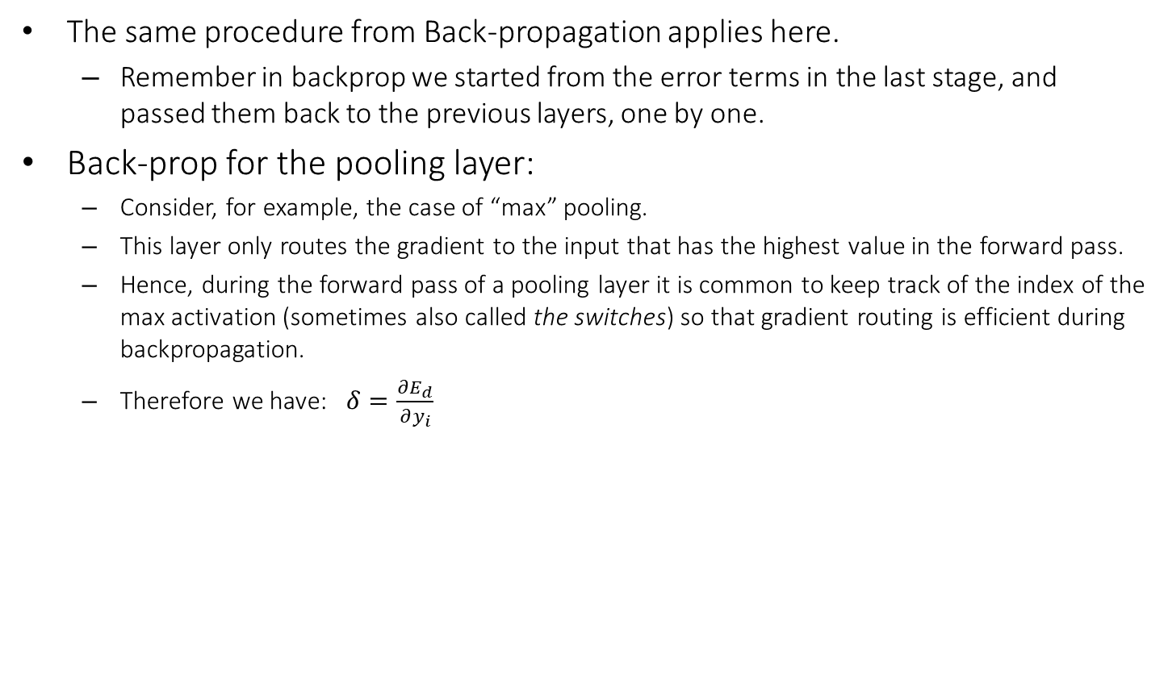


Training a ConvNet
The same procedure from Back-propagation applies here.
Remember in backprop we started from the error terms in the last stage, and passed them back to the previous layers, one by one.
Back-prop for the pooling layer:
Consider, for example, the case of “max” pooling.
This layer only routes the gradient to the input that has the highest value in the forward pass.
Hence, during the forward pass of a pooling layer it is common to keep track of the index of the max activation (sometimes also called the switches) so that gradient routing is efficient during backpropagation.
Therefore we have: $δ=\frac{∂E_{d}}{∂y_{i}}$
$$x_{i}$$
$$y_{i}$$
$$δ_{last−layer}=\frac{∂E_{d}}{∂y_{last−layer}}$$
Convol.
Pooling
$$δ_{first−layer}=\frac{∂E_{d}}{∂y_{first−layer}}$$
$$E_{d}$$
Input Image
Stage 1
Stage 2
Stage 3
Fully Connected Layer
Class Label

Slide 23

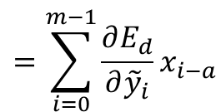

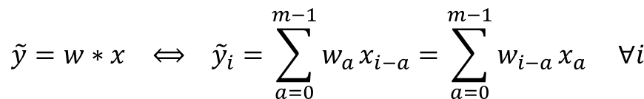
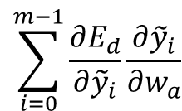


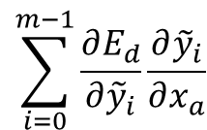








Training a ConvNet
Back-prop for the convolutional layer:
$$\tilde{y}=w∗x ⟺ {\tilde{y}}_{i}=\sum_{a=0}^{m−1}{w_{a}}x_{i−a}=\sum_{a=0}^{m−1}{w_{i−a}}x_{a} ∀i$$
We derive the update rules for a 1D convolution, but the idea is the same for bigger dimensions.
The convolution
$$y=f\left(\tilde{y}\right) ⟺ {y_{i}=f(\tilde{y}}_{i}) ∀i$$
A differentiable nonlinearity
$$\frac{∂E_{d}}{∂w_{a}}=$$
$$\sum_{i=0}^{m−1}{\frac{∂E_{d}}{∂{\tilde{y}}_{i}}\frac{∂{\tilde{y}}_{i}}{∂w_{a}}}$$
$$=\sum_{i=0}^{m−1}{\frac{∂E_{d}}{∂{\tilde{y}}_{i}}x_{i−a}}$$
Now we have everything in this layer to update the filter
Now we can repeat this for each stage of ConvNet.
$$\frac{∂E_{d}}{∂{\tilde{y}}_{i}}=$$
$$\frac{∂E_{d}}{∂y_{i}}\frac{∂y_{i}}{∂{\tilde{y}}_{i}}$$
$$=\frac{∂E_{d}}{∂y_{i}}f′(\tilde{y})$$
$$\sum_{i=0}^{m−1}{\frac{∂E_{d}}{∂{\tilde{y}}_{i}}\frac{∂{\tilde{y}}_{i}}{∂x_{a}}}$$
$$=\sum_{i=0}^{m−1}{\frac{∂E_{d}}{∂{\tilde{y}}_{i}}w_{i−a}}$$
We need to pass the gradient to the previous layer
$$δ= \frac{∂E_{d}}{∂x_{a}}=$$
$$x_{i}$$
$$y_{i}$$
$$δ_{last−layer}=\frac{∂E_{d}}{∂y_{last−layer}}$$
Convol.
Pooling
$$δ_{first−layer}=\frac{∂E_{d}}{∂y_{first−layer}}$$
$$E_{d}$$
Input Image
Stage 1
Stage 2
Stage 3
Fully Connected Layer
Class Label

Slide 24
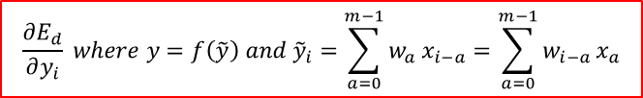


Training a ConvNet
The same procedure from Back-propagation applies here.
Remember in backprop we started from the error terms in the last stage, and passed them back to the previous layers, one by one.
Back-prop for the pooling layer:
Consider, for example, the case of “max” pooling.
This layer only routes the gradient to the input that has the highest value in the forward pass.
Hence, during the forward pass of a pooling layer it is common to keep track of the index of the max activation (sometimes also called the switches) so that gradient routing is efficient during backpropagation.
$$\frac{∂E_{d}}{∂{\tilde{y}}_{i}}$$
$$\frac{∂E_{d}}{∂y_{i}} where y=f\left(\tilde{y}\right) and {\tilde{y}}_{i}=\sum_{a=0}^{m−1}{w_{a}}x_{i−a}=\sum_{a=0}^{m−1}{w_{i−a}}x_{a}$$
$$\frac{∂E_{d}}{∂x_{a}}$$
$$δ_{last−layer}=\frac{∂E_{d}}{∂y_{last−layer}}$$
$$x_{i}$$
Convol.
$$y_{i}$$
Pooling
$$δ_{first−layer}=\frac{∂E_{d}}{∂y_{first−layer}}$$
$$E_{d}$$
Input Image
Stage 1
Stage 2
Stage 3
Fully Connected Layer
Class Label

Slide 25
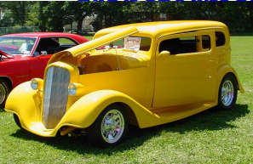
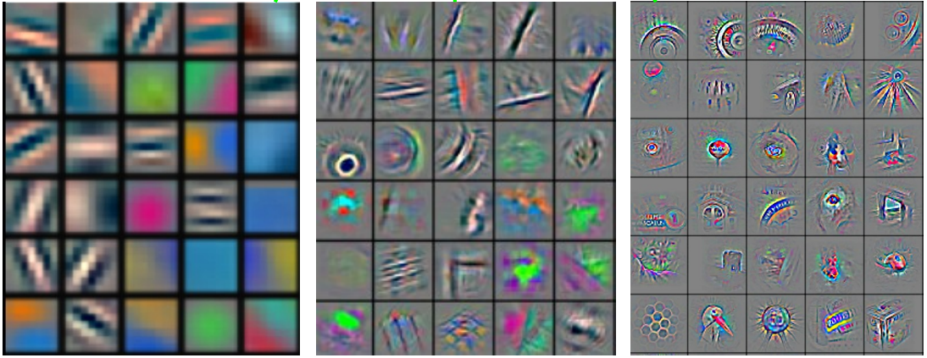
Convolutional Nets
Stage 1
Stage 2
Stage 3
Fully Connected Layer
Input Image
Class Label
Feature visualization of convolutional net trained on ImageNet from [Zeiler & Fergus 2013]

Slide 26
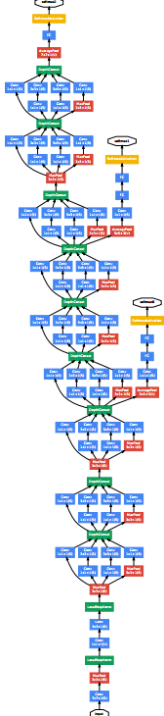
ConvNet roots
Fukushima, 1980s designed network with same basic structure but did not train by backpropagation.
The first successful applications of Convolutional Networks by Yann LeCun in 1990's (LeNet)
Was used to read zip codes, digits, etc.
Many variants nowadays, but the core idea is the same
Example: a system developed in Google (GoogLeNet)
Compute different filters
Compose one big vector from all of them
Layer this iteratively
See more: http://arxiv.org/pdf/1409.4842v1.pdf

Slide 27
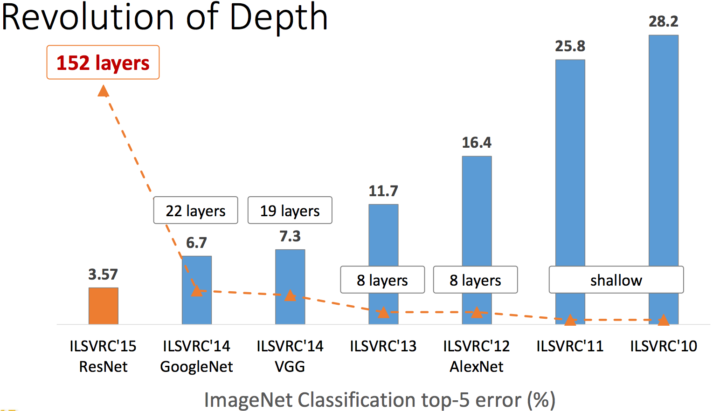
Depth matters
Slide from [Kaiming He 2015]

Slide 28
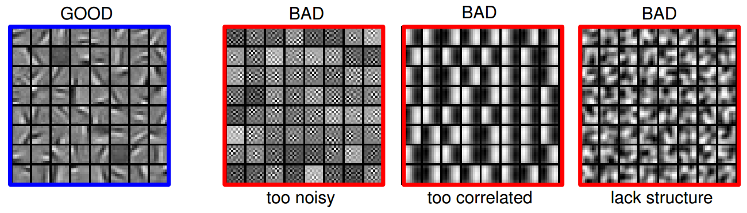
Practical Tips
Before large scale experiments, test on a small subset of the data and check the error should go to zero.
Overfitting on small training
Visualize features (feature maps need to be uncorrelated) and have high variance
Bad training: many hidden units ignore the input and/or exhibit strong correlations.
Figure Credit: Marc'Aurelio Ranzato

Slide 29
Debugging
Training diverges:
Learning rate may be too large → decrease learning rate
BackProp is buggy → numerical gradient checking
Loss is minimized but accuracy is low
Check loss function: Is it appropriate for the task you want to solve? Does it have degenerate solutions?
NN is underperforming / under-fitting
Compute number of parameters → if too small, make network larger
NN is too slow
Compute number of parameters → Use distributed framework, use GPU, make network smaller
Many of these points apply to many machine learning models, no just neural networks.

Slide 30
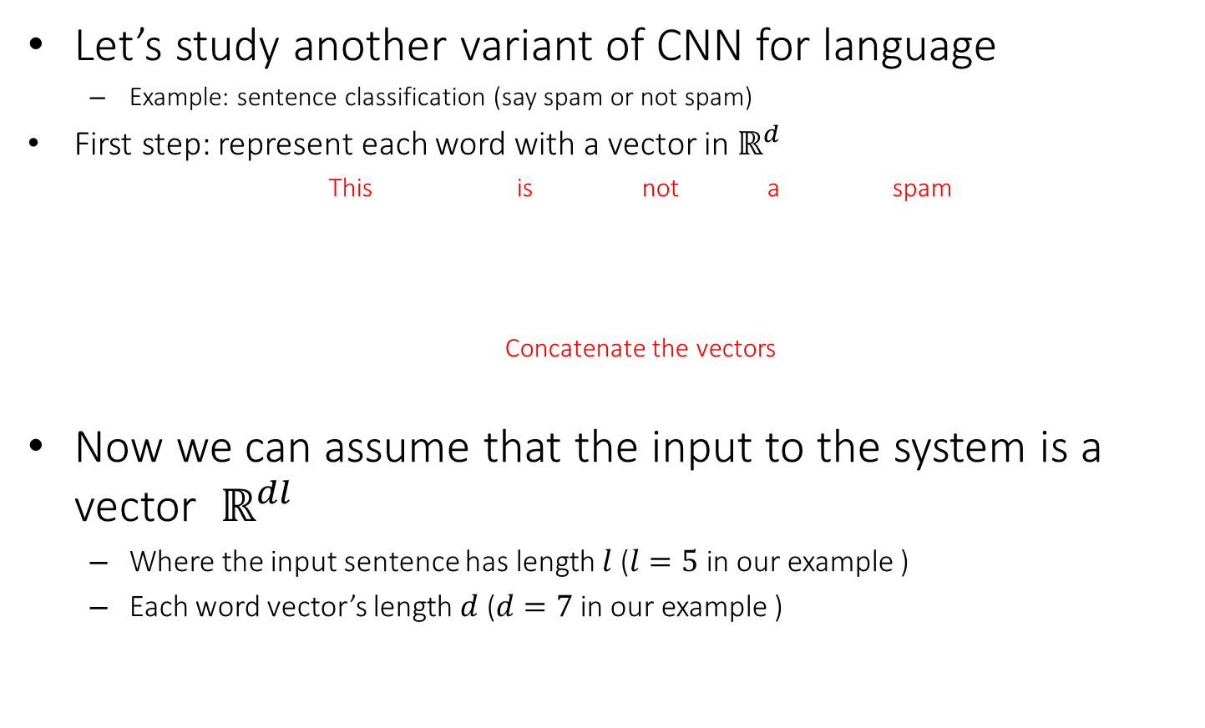
CNN for text (sequence) inputs
Let’s study another variant of CNN for language
Example: sentence classification (say spam or not spam)
First step: represent each word with a vector in $ℝ^{d}$
This is not a spam
Concatenate the vectors
Now we can assume that the input to the system is a vector $ℝ^{dl}$
Where the input sentence has length $l$ ($l=5$ in our example )
Each word vector’s length $d$ ($d=7$ in our example )
O O O O O O O
O O O O O O O
O O O O O O O
O O O O O O O
O O O O O O O
O O O O O O O O O O O O O O O O O O O O O O O O O O O O O O O O O O O

Slide 31






Convolutional Layer on vectors
Think about a single convolutional layer
A bunch of vector filters
Each defined in $ℝ^{dh}$
Where $h$ is the number of the words the filter covers
Size of the word vector $d$
Find its (modified) convolution with the input vector
Result of the convolution with the filter
Convolution with a filter that spans 2 words, is operating on all of the bi-grams (vectors of two consecutive word, concatenated): “this is”, “is not”, “not a”, “a spam”.
Regardless of whether it is grammatical (not appealing linguistically)
O O O O O O O O O O O O O O
O O O O O O O O O O O O O O
O O O O O O O O O O O O O O
O O O O O O O O O O O O O O
O O O O O O O O O O O O O O
O O O O O O O O O O O O O O O O O O O O O O O O O O O O O O O O O O O
O O O O O O O O O O O O O O O O O O O O O O O O O O O O O O O O O O O
O O O O O O O O O O O O O O O O O O O O O O O O O O O O O O O O O O O
O O O O O O O O O O O O O O O O O O O O O O O O O O O O O O O O O O O
O O O O O O O O O O O O O O O O O O O O O O O O O O O O O O O O O O O
$$c_{1}=f(w.x_{1:hd})$$
$$c_{2}=f(w.x_{(d+1):(d+hd) })$$
$$c_{4}=f(w.x_{(3d+1):(3d+hd)})$$
$$c_{3}=f(w.x_{(2d+1):\left(2d+hd\right)})$$
$$c=[c_{1}, …., c_{n−h+1}]$$
O O O O

Slide 32
Convolutional Layer on vectors
This is not a spam
Get word vectors for each words
O O O O O O O
O O O O O O O
O O O O O O O
O O O O O O O
O O O O O O O
Concatenate vectors
O O O O O O O O O O O O O O O O O O O O O O O O O O O O O O O O O O O
*
Perform convolution with each filter
O O O O O O O
O O O O O O O O O O O O O O
Filter bank
O O O O O O O O O O O O O O
O O O O O O O O O O O O O O O O O O O O O
O O O O O O O O O O O O O O O O O O O O O
How are we going to handle the variable sized response vectors?
Pooling!
O O O O O
O O O O
Set of response vectors
#of filters
O O O O
O O O
O O O
#words - #length of filter + 1

Slide 33
Convolutional Layer on vectors
This is not a spam
Get word vectors for each words
Now we can pass the fixed-sized vector to a logistic unit (softmax), or give it to multi-layer network (last session)
O O O O O O O
O O O O O O O
O O O O O O O
O O O O O O O
O O O O O O O
Concatenate vectors
O O O O O O O O O O O O O O O O O O O O O O O O O O O O O O O O O O O
*
Perform convolution with each filter
O O O O O O O
O O O O O O O O O O O O O O
Filter bank
O O O O O O O O O O O O O O
O O O O O O O O O O O O O O O O O O O O O
O O O O O O O O O O O O O O O O O O O O O
Some choices for pooling:
k-max, mean, etc
Pooling on filter responses
O O O O O
O O O
O O O O
O O O
#of filters
O O O O
O O O
O O O
O O O
O O O
O O O
#words - #length of filter + 1

Slide 34
Recurrent Neural Networks
General ideas
Can we use more historical words?
Can parameters be shared?

Slide 35
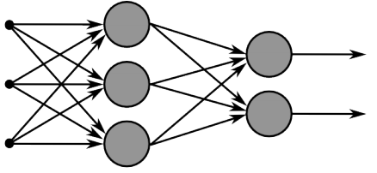
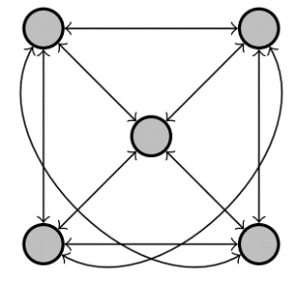
Recurrent Neural Networks
Multi-layer feed-forward NN: DAG
Just computes a fixed sequence of
non-linear learned transformations to convert an input patter into an output pattern
Recurrent Neural Network: Digraph
Has cycles.
Cycle can act as a memory;
The hidden state of a recurrent net can carry along information about a “potentially” unbounded number of previous inputs.
They can model sequential data in a much more natural way.

Slide 36
Equivalence between RNN and Feed-forward NN
Assume that there is a time delay of 1 in using each connection.
The recurrent net is just a layered net that keeps reusing the same weights.
time=3
W1 W2 W3 W4
w1 w4
time=2
W1 W2 W3 W4
w2 w3
time=1
W1 W2 W3 W4
time=0

Slide 37
Recurrent Neural Networks
Training a general RNN’s can be hard
Here we will focus on a special family of RNN’s
Prediction on chain-like input:
Language model
POS tagging words of a sentence
Sentiment classification
$X,h=$ This is a sample sentence .
Y$=$ is a sample sentence . <EOS>
$X=$ This is a sample sentence .
Y$=$ DT VBZ DT NN NN .
$X=$ This is a sample sentence .
Y$=$ Positive/Negative

Slide 38
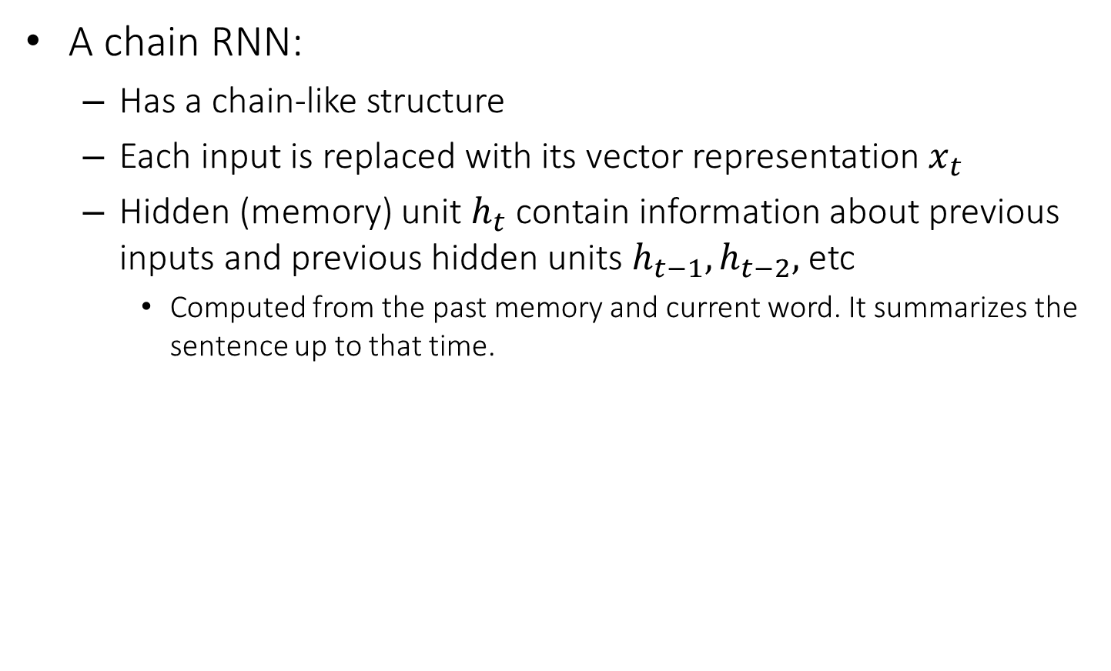
Recurrent Neural Networks
A chain RNN:
Has a chain-like structure
Each input is replaced with its vector representation $x_{t}$
Hidden (memory) unit $h_{t}$ contain information about previous inputs and previous hidden units $h_{t−1},h_{t−2},$ etc
Computed from the past memory and current word. It summarizes the sentence up to that time.
$x_{t−1}$ $x_{t}$ $x_{t+1}$
O O O O O
O O O O O
O O O O O
Input layer
O O O O O
O O O O O
O O O O O
Memory layer
$h_{t−1}$ $h_{t}$ $h_{t+1}$

Slide 39

Recurrent Neural Networks
A popular way of formalizing it:
$$h_{t}=f(W_{h}h_{t−1}+W_{i}x_{t})$$
Where $f$ is a nonlinear, differentiable (why?) function.
Outputs?
Many options; depending on problem and computational resource
$x_{t−1}$ $x_{t}$ $x_{t+1}$
O O O O O
O O O O O
O O O O O
O O O O O
O O O O O
O O O O O
$h_{t−1}$ $h_{t}$ $h_{t+1}$

Slide 40




Recurrent Neural Networks
Prediction for $x_{t}$, with $h_{t}$
Prediction for $x_{t}$, with $h_{t},{…, h}_{t−τ}$
Prediction for the whole chain
$$y_{t}=softmax\left(W_{o}h_{t} \right)$$
$$y_{t}=softmax\left(\sum_{i=0}^{τ}{α^{i}W_{o}^{t−i}h_{t−i}}\right)$$
$$y_{T}=softmax\left(W_{o}h_{T} \right)$$
$x_{t−1}$ $x_{t}$ $x_{t+1}$
O O O O O
O O O O O
O O O O O
O O O O O
O O O O O
O O O O O
$h_{t−1}$ $h_{t}$ $h_{t+1}$
$y_{t−1}$ $y_{t}$ $y_{t+1}$

Slide 41





Training RNNs
How to train such model?
Generalize the same ideas from back-propagation
Total output error: $E\left(\vec{y}, \vec{t}\right)=\sum_{t=1}^{T}{E_{t}\left(y_{t}{, t}_{t}\right)}$
Reminder:
$$y_{t}=softmax\left(W_{o}h_{t} \right)$$
$$h_{t}=f(W_{h}h_{t−1}+W_{i}x_{t})$$
Parameters?
$W_{o}$, $W_{i}$, $W_{h}$ +
vectors for input
$$\frac{∂E}{∂W}=\sum_{t=1}^{T}{\frac{∂E_{t}}{∂W}}$$
$$\frac{∂E_{t}}{∂W}=\sum_{k=1}^{t}{\frac{∂E_{t}}{∂y_{t}}\frac{∂y_{t}}{∂h_{t}}\frac{∂h_{t}}{∂h_{t−k}}\frac{∂h_{t−k}}{∂W}}$$
This sometimes is called “Backpropagation Through Time”, since the gradients are propagated back through time.
$x_{t−1}$ $x_{t}$ $x_{t+1}$
O O O O O
O O O O O
O O O O O
O O O O O
O O O O O
O O O O O
$h_{t−1}$ $h_{t}$ $h_{t+1}$
$y_{t−1}$ $y_{t}$ $y_{t+1}$
Backpropagation for RNN

Slide 42





Recurrent Neural Network
Reminder:
$$y_{t}=softmax\left(W_{o}h_{t} \right)$$
$$h_{t}=f(W_{h}h_{t−1}+W_{i}x_{t})$$
$$\frac{∂E_{t}}{∂W}=\sum_{k=1}^{t}{\frac{∂E_{t}}{∂y_{t}}\frac{∂y_{t}}{∂h_{t}}\frac{∂h_{t}}{∂h_{t−k}}\frac{∂h_{t−k}}{∂W}}$$
$$diag\left[a_{1}, …, a_{n}\right]=\left[\begin{matrix}a_{1} & 0 & 0 \\ 0 & ⋱ & 0 \\ 0 & 0 & a_{n}\end{matrix}\right]$$
$$\frac{∂h_{t}}{∂h_{t−1}}=W_{h}diag\left[f^{′}(W_{h}h_{t−1}+W_{i}x_{t})\right]$$
$$\frac{∂h_{t}}{∂h_{t−k}}=\prod_{j=t−k+1}^{t}{\frac{∂h_{j}}{∂h_{j−1}}}=\prod_{j=t−k+1}^{t}{W_{h}diag\left[f^{′}(W_{h}h_{t−1}+W_{i}x_{t})\right]}$$
$x_{t−1}$ $x_{t}$ $x_{t+1}$
O O O O O
O O O O O
O O O O O
O O O O O
O O O O O
O O O O O
$h_{t−1}$ $h_{t}$ $h_{t+1}$
$y_{t−1}$ $y_{t}$ $y_{t+1}$

Slide 43



Vanishing/exploding gradients
$$\frac{∂h_{t}}{∂h_{t−k}}=\prod_{j=t−k+1}^{t}{W_{h}diag\left[f^{′}(W_{h}h_{t−1}+W_{i}x_{t})\right]}$$
Vanishing gradients are quite prevalent and a serious issue.
A real example
Training a feed-forward network
y-axis: sum of the gradient norms
Earlier layers have exponentially
smaller sum of gradient norms
This will make training earlier
layers much slower.
$$||\frac{∂h_{t}}{∂h_{k}}||≤\prod_{j=t−k+1}^{t}{\left\|W_{h}\right\|\left\|diag\left[f^{′}(W_{h}h_{t−1}+W_{i}x_{t})\right]\right\|≤\prod_{j=t−k+1}^{t}{αβ=}{\left(αβ\right)}^{k}}$$
Gradient can become very small or very large quickly, and the locality assumption of gradient descent breaks down (Vanishing gradient) [Bengio et al 1994]

Slide 44

Vanishing/exploding gradients
In an RNN trained on long sequences (e.g. 100 time steps) the gradients can easily explode or vanish.
So RNNs have difficulty dealing with long-range dependencies.
Many methods proposed for reducing the effect of vanishing gradients; although it is still a problem
Introduce shorter path between long connections
Abandon stochastic gradient descent in favor of a much more sophisticated Hessian-Free (HF) optimization
Add fancier modules that are robust to handling long memory; e.g. Long Short Term Memory (LSTM)
http://colah.github.io/posts/2015-08-Understanding-LSTMs/
A very good explanatiom of LSTM
One trick to handle the exploding-gradients:
Clip gradients with bigger sizes:
Define $g=\frac{∂E}{∂W}$
If $\left\|g\right\|≥threshold$ then
$g←\frac{threshold}{\left\|g\right\|}g$

Slide 45



Bi-directional RNN
One of the issues with RNN:
Hidden variables capture only one side context
A bi-directional structure
$x_{t−1}$ $x_{t}$ $x_{t+1}$
O O O O O
O O O O O
O O O O O
$$h_{t}=f(W_{h}h_{t−1}+W_{i}x_{t})$$
$h_{t−1}$ $h_{t}$ $h_{t+1}$
$${\tilde{h}}_{t}=f({\tilde{W}}_{h}{\tilde{h}}_{t+1}+{\tilde{W}}_{i}x_{t})$$
$$y_{t}=softmax\left(W_{o}h_{t}+{\tilde{W}}_{o}{\tilde{h}}_{t}\right)$$
O O O O O
O O O O O
O O O O O
O O O O O
O O O O O
O O O O O
${\tilde{h}}_{t−1}$ ${\tilde{h}}_{t}$ ${\tilde{h}}_{t+1}$
$y_{t−1}$ $y_{t}$ $y_{t+1}$

Slide 46

Stack of bi-directional networks
Use the same idea and make your model further complicated:

