Slide 1
Parallelizing a 2D advection solver on both CPU and GPU
Zhiyuan Huang u6656110 COMP8755
Supervisor: Peter Strazdins

Slide 2
Parallel computing
Large program divided into small tasks, solve tasks independently, combine the results afterwards.
CPU parallelization (limited number of powerful cores)
GPU parallelization (tremendous cores with limited power)
Parallel computing has been widely used in many area including machine learning, high performance computing, etc.

Slide 3
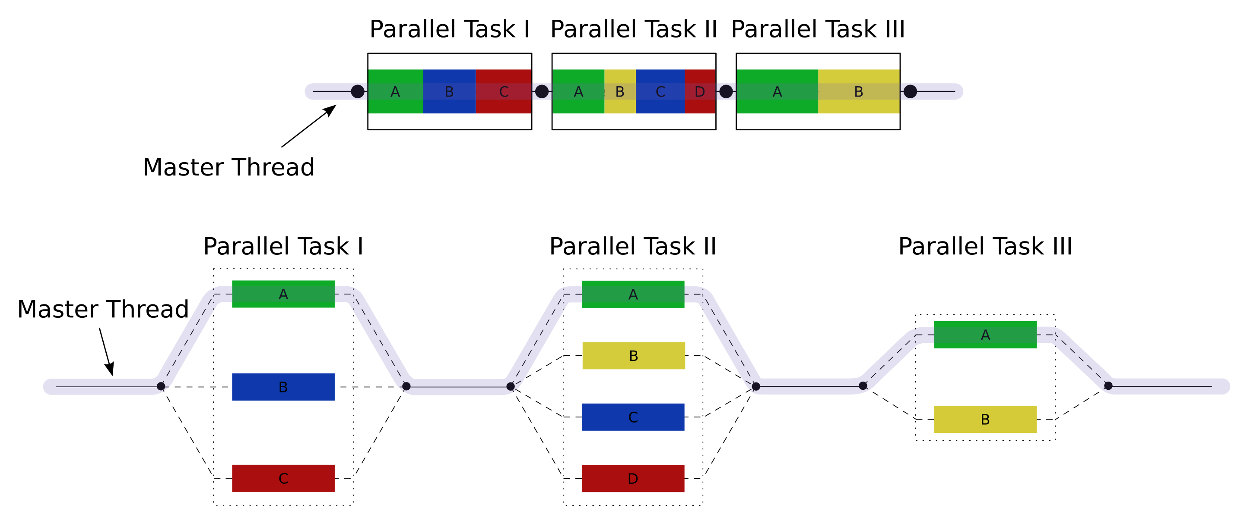
Parallel computing model
Blaise Barney. (2020). OPENMP. [Image] Available at: https://computing.llnl.gov/tutorials/openMP/ [4/11/2020]

Slide 4
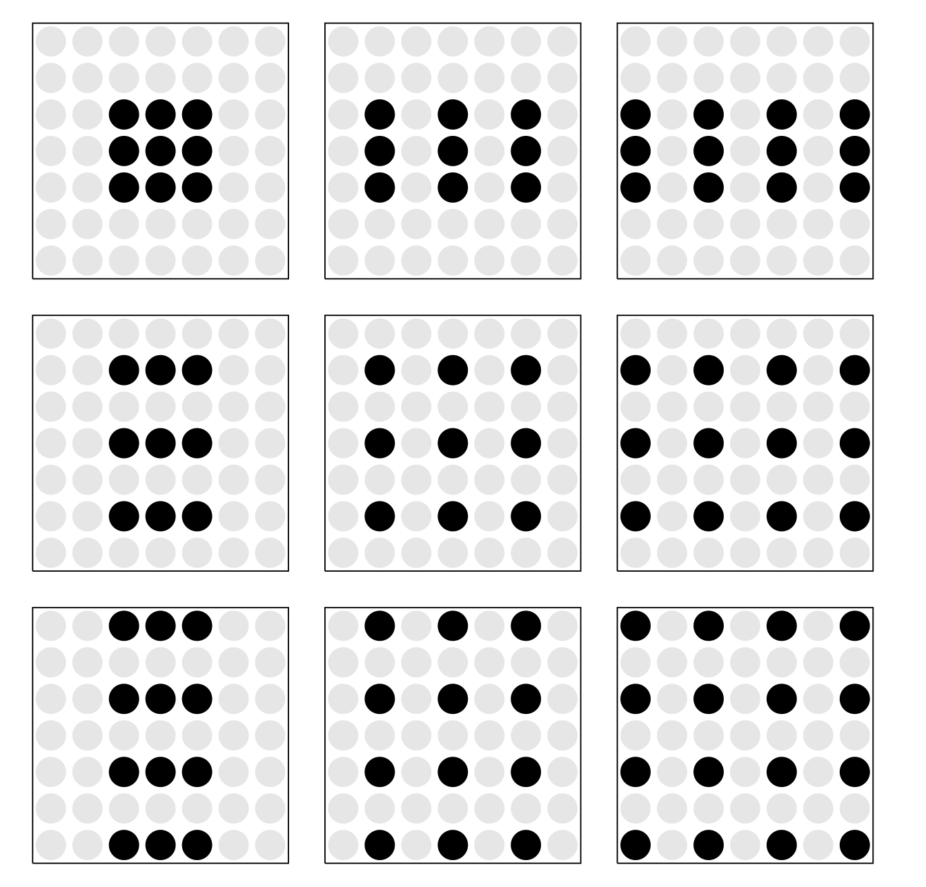
Stencil computing
A program used to solve partial differential equations using stencil computation technique.
A depiction of the nodes used in each stencil. From left to right, top to bottom the stencils depicted are NN, WN, FN, NW, WW, FW, NF, WF and FF.
Peter Strazdins, C. L. J. R. M. J. R., Brendan Harding and Armstrong, R. C.,2016. A robust technique to make a 2d advection solver tolerant to soft faults. Procedia Computer Science, 80, 10 (2016), 1917–1926.

Slide 5
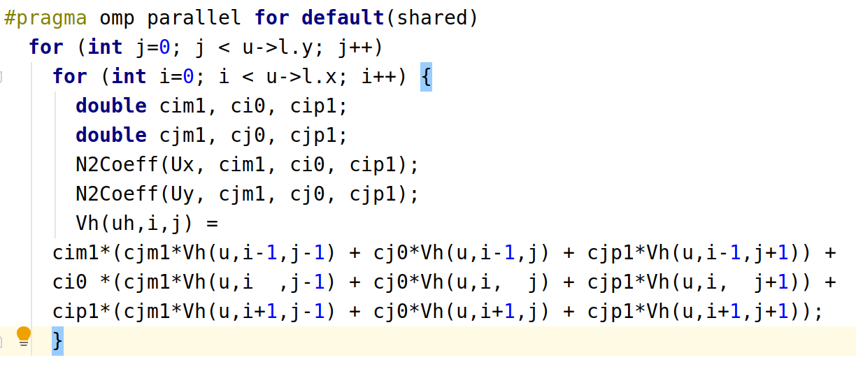
OpenMP implementation

Slide 6
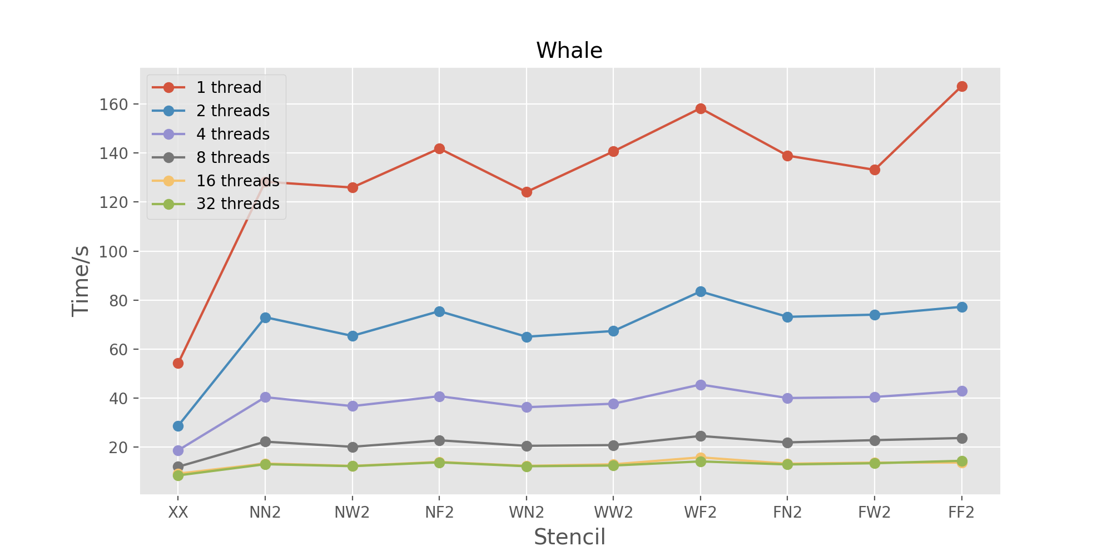
OpenMP parallelization results (CPU)
Conclusions:
(1) When doubling the thread number, the time elapsed reduced nearly 50%, which means we have parallelized almost all the time consuming part.
(2) When threads number increases, the time reduced ratio decreases, might result from cache misses.

Slide 7
CUDA implementation
Row-wise: Every thread calculate elements in a row
Column wise: Every thread calculate elements in a column
Block-wise: Every thread calculate elements in a block
Element-wise: Every thread calculate one element in a block and then calculate element in the same position in the next block

Slide 8
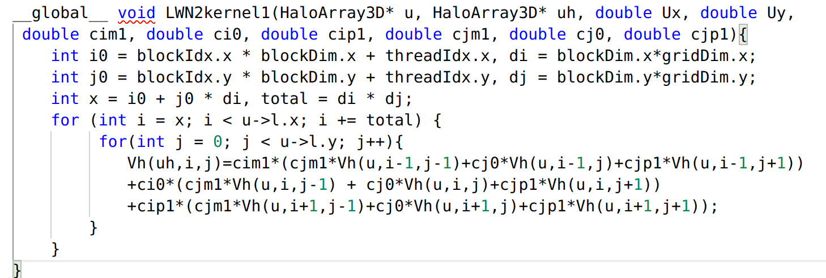
CUDA implementation: Row-wise

Slide 9
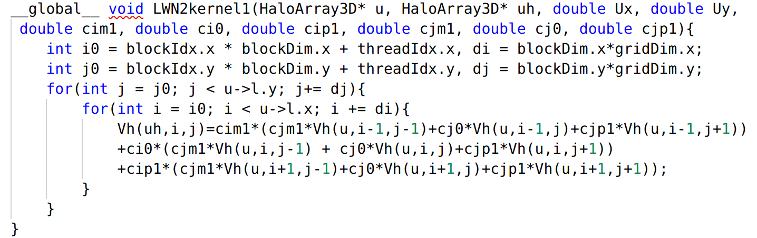
CUDA implementation: Element-wise

Slide 10
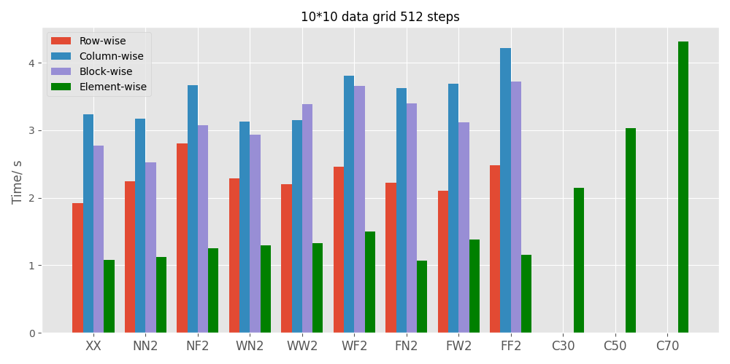
CUDA parallelization results (GPU)
Element-wise implementation shows best performance. Not only faster than other implementation, but also get results for combined stencils (C30, C50, C70). Threads use least resources in element-wise implementation.

Slide 11
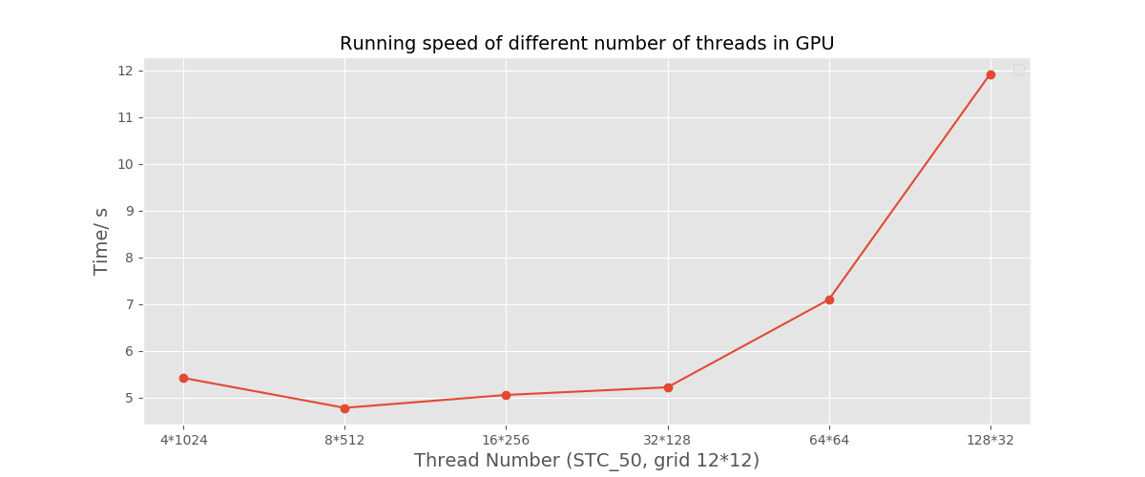
CUDA parallelization results (GPU)
Conclusions:
(1) Thread dimensions have significant impact on program performance
(2) Thread number less than 128 in a thread block will greatly decrease running speed.

Slide 12
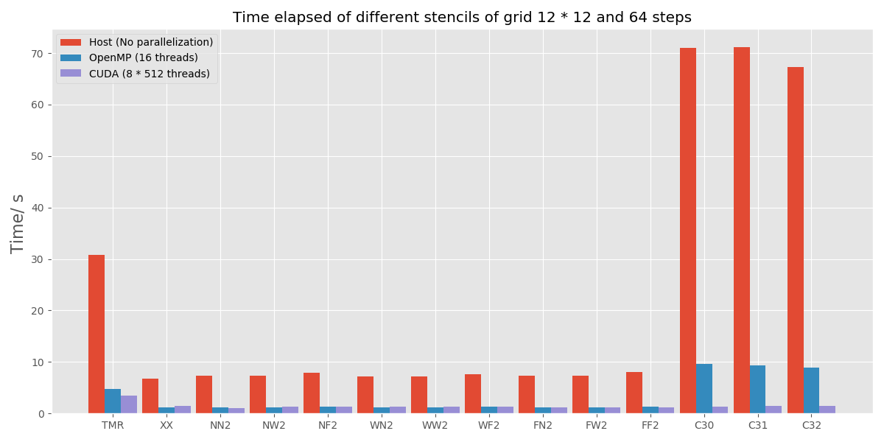
CUDA and OpenMP results comparison
Both OpenMP and CUDA show great ability to optimize the program. CUDA is better for parallelizing this program

Slide 13
Q & A
For more details, you can see my project repo on gitlab:
https://gitlab.cecs.anu.edu.au/u6656110/comp8755-weather-project
My thesis is available at:
https://www.overleaf.com/read/yyywvqwjrnng

