Slide 1
Latest Trends in Wireless Sensor Network
Real Time Package Tracking and Monitoring using wireless sensor Network

Slide 2
Programming Wireless Sensor Networks: Fundamental Concepts and State of the Art (2011)
Classifies programming approaches for wireless sensor networks(WSN) based upon its applications to real world.
Gives examples of programming approaches and samples for each group in WSN application domain.
Refer the below diagram for the WSN application group classification.

Slide 3
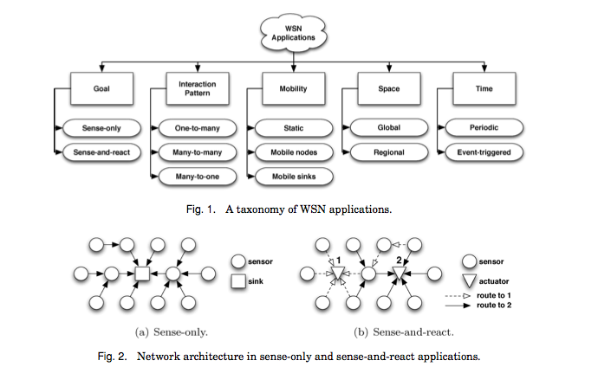

Slide 4
Localization Algorithms in Wireless Sensor Networks: Current Approaches and Future Challenges (2010)
Node localization is required to report the origin of events, assist group querying of sensors, routing and to answer questions on the network coverage
Presents overview of the schemes proposed by different scholars for the improvement of localization in wireless sensor networks
Future research directions and challenges for improving node localization in wireless sensor networks are also discussed.

Slide 5
Efficient Coverage Algorithms for Wireless Sensor Networks
Deals with power management of wireless sensor networks (Complexity in selective replacement of sensors that have ran out of energy).
Proposes three centralized and one distributed efficient coverage algorithms to obtain an improved monitoring quality over time.

Slide 6
A Study on Greenhouse Automatic Control System Based on Wireless Sensor Network (2009)
The System collects temperature of leaves and humidity on leaves of crop and also temperature and humidity of the greenhouse environment.
Based upon the information collected from the leaves and indoor environment, the temperature of the indoor environment is controlled to prevent the damages to crop.
System components are: temperature sensor, humidity sensor, leaf temperature sensor, leaf humidity sensor, Zigbee based wireless sensor node, relay nodes for automatic control, and data server to store greenhouse information.

Slide 7
Monitoring Volcanic Eruptions with a Wireless Sensor Network
Describes experiences using a wireless sensor network to monitor volcanic eruptions with low-frequency acoustic sensors.
The network collected infrasonic (low-frequency acoustic) signals at 102 Hz, transmitting data over a 9 km wireless link to a remote base station
Nodes were time-synchronized using a separate GPS receiver, and data was later correlated with that acquired at a nearby wired sensor array.
In addition to continuous sampling, paper describes a distributed event detector that automatically triggers data transmission when a well-correlated signal is received by multiple nodes.

Slide 8
Tracking Trash (2012)
Used active self reporting tags to follow the journey of 2,000 objects through the waste management system of Seattle.
Collected data is used to define measures of efficiency for what could be called the ‘removal chain’.
Find the next diagram for system overview of the network.

Slide 9
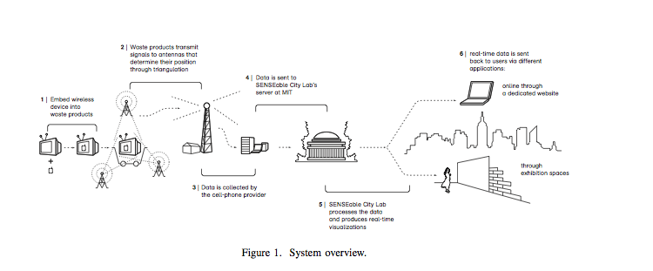

Slide 10
Related Projects
Harvard
Hour Glass:
Provides an Infrastructure for Connecting Sensor Networks and Applications
http://www.eecs.harvard.edu/~syrah/hourglass/index.shtml
Harvard Sensor Networks Lab:
Have various research project related sensors
And investigates software solutions for efficient, high-data-rate, adaptive wireless sensor networking systems
http://fiji.eecs.harvard.edu

Slide 11
Related Projects
MIT
SENSEable City Laboratory:
The real-time city is now real!
http://senseable.mit.edu
Libelium
They provide solutions using wireless sensor networks. They are in various fields even in logistics.
http://www.libelium.com/libeliumworld/articles/0-10

