Slide 1
Real Time Package Monitoring System
RIT 2013

Slide 2
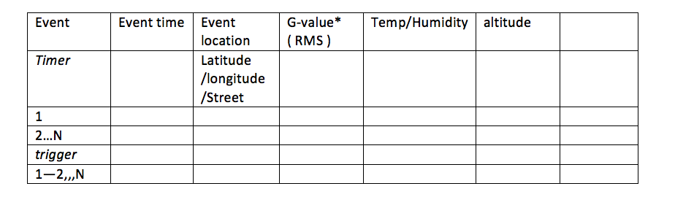
SHOCK
1.Summary
The RMS- is root mean square that is a combined G- value of three axis-

Slide 3
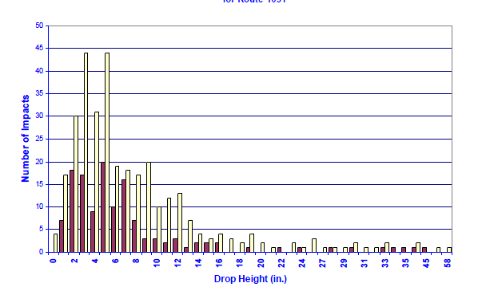
2. Drop frequency-Height
Do we have to calibrate the Drop height?
Yes, we will calibrate the drop height. That is related to package size. G-value etc
How no.of.heights (vs.) Drop Height?
Frequency vs drop height. E.g. The package dropped 3 times under drop height 16 inch….

Slide 4
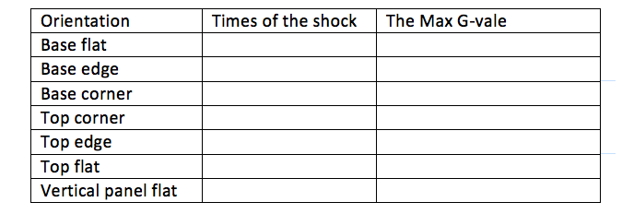
3. Orientation
Is it the x, y, z values of shock sensor?
Yes, Flat-> one axis ; edge-> 2 axis ; corner ->3 axis; RMS value for EDGE and CORNER

Slide 5
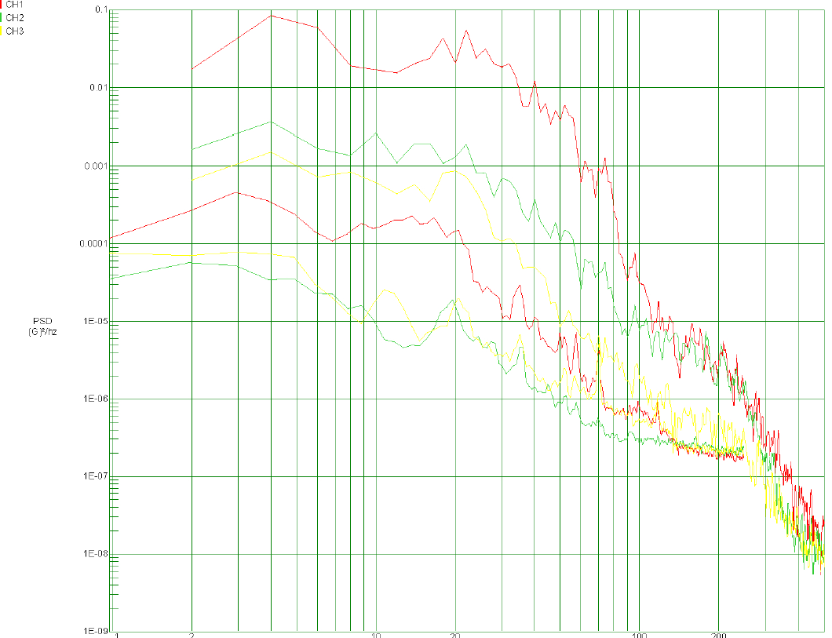
4. G-time curve – Vibration
PSD-Frequency
Need x-axis and Y-axis legends.
What is PSD?
Y-PSD ( Power spectrum density), X-Frequency (Hz); the curve can be derived from Matlab or FFT calculation

