Slide 1
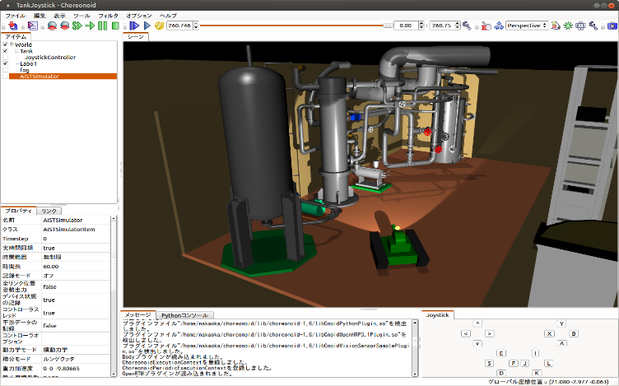
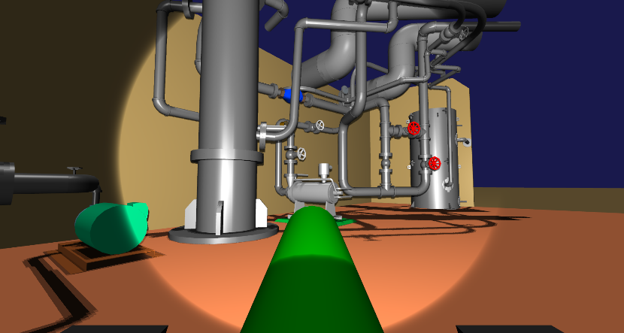
A set of robot control software
Teleoperation interface
Network connection
(TCP/IP)
Communication problems？
Simulation PC
Teleoperation PC

