Slide 1
CAPSTONE • TEAM PRESENTATION
Predictive Maintenance & Machine Failure Analysis
From operating measurements to validated failure-risk predictions
Keeshaun Cobb • Brett Harrison • Wynn Nguyen • Zach Lee
Working analytical prototype | Public synthetic AI4I dataset
CIS 480 | AI4I Predictive Maintenance | October 18, 2026

Slide 2
M08 DEMO DAY
The decision: can measurements flag failures?
STAKEHOLDER • Hypothetical maintenance manager
NEED • Identify failure-risk records without relying on overall accuracy alone
INPUT • Machine type, temperatures, rotational speed, torque, tool wear
OUTPUT • Failure predictions, comparative metrics, and model interpretation
BOUNDARY • Research prototype; no automatic maintenance action
CIS 480 | AI4I Predictive Maintenance | October 18, 2026

Slide 3
M08 DEMO DAY
Research questions & success criteria
01 How do measurements differ between failure and non-failure records?
02 Which available measurements are most informative for the model?
03 Does classification detect failures better than a no-failure baseline?
ACCEPTANCE • Reproducible clean data; no IDs or failure flags as predictors; held-out evaluation; recall, precision, F1 and error counts reported.
CIS 480 | AI4I Predictive Maintenance | October 18, 2026

Slide 4
M08 DEMO DAY
The working MVP: reproducible pipeline
PUBLIC AI4I CSV → VALIDATE & CLEAN → SELECT PREDICTORS
↓
STRATIFIED TRAIN / TEST SPLIT → MODEL FITTING
↓
BASELINE & CLASSIFIER METRICS → INTERPRETATION
10,000 raw rows → 27 records excluded by documented consistency rule → 9,973 retained.
Identifiers and failure-mode flags are not model inputs.
CIS 480 | AI4I Predictive Maintenance | October 18, 2026

Slide 5
M08 DEMO DAY
Exploratory analysis: what to visualize
TABLEAU DRAFT — preliminary, not final validated output
Zach’s workbook contains four exploratory worksheets:
• Air Temp Vs Process Temp
• Torque Vs Rotate Speed (Type H)
• Torque Vs Rotate Speed (Type L)
• Torque Vs Rotate Speed (Type M)
These views explore relationships between operating measurements and machine type. They do NOT establish failure-rate differences or model accuracy. Workbook uses a temporary local .hyper connection; reconnect to the cleaned CSV before live demonstration.
CIS 480 | AI4I Predictive Maintenance | October 18, 2026

Slide 6
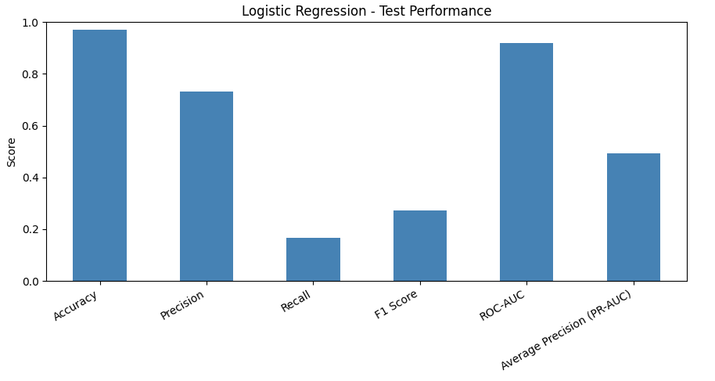
M08 DEMO DAY
Model performance: Logistic Regression
Held-out test: 1,995 records / 66 failures. Accuracy 97.04% • Precision 73.33% • Recall 16.67% • F1 27.16%. Confusion matrix: TN 1,925 / FP 4 / FN 55 / TP 11. Default threshold: 0.50.
CIS 480 | AI4I Predictive Maintenance | October 18, 2026

Slide 7
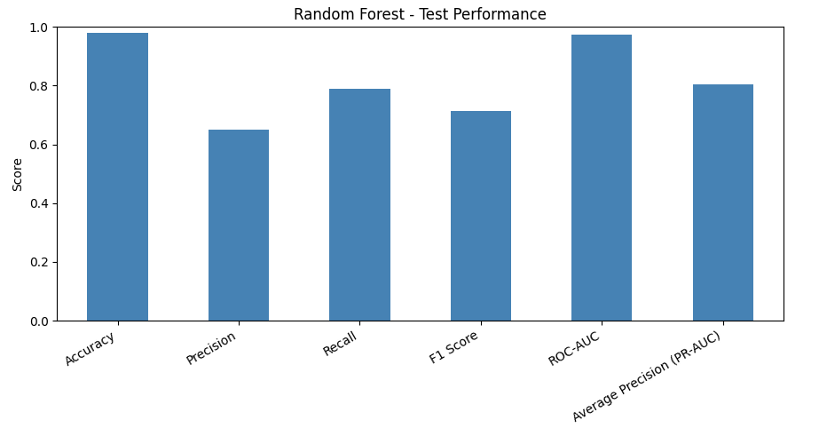
M08 DEMO DAY
Model performance: Random Forest
Held-out test: 1,995 records / 66 failures. Accuracy 97.89% • Precision 65.00% • Recall 78.79% • F1 71.23%. Confusion matrix: TN 1,901 / FP 28 / FN 14 / TP 52. Default threshold: 0.50.
CIS 480 | AI4I Predictive Maintenance | October 18, 2026

Slide 8
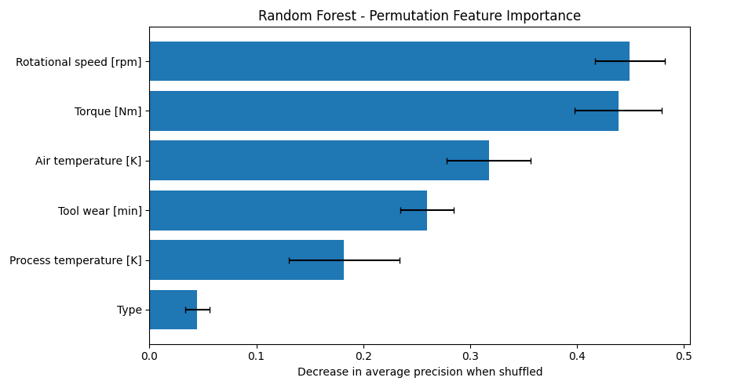
M08 DEMO DAY
Which features matter to Random Forest?
Permutation importance (average-precision scoring): rotational speed 0.4496; torque 0.4386; air temperature 0.3175; tool wear 0.2597; process temperature 0.1820; machine type 0.0448. Predictive association ≠ causation.
CIS 480 | AI4I Predictive Maintenance | October 18, 2026

Slide 9
M08 DEMO DAY
What the evidence supports — and does not
SUPPORTED • On one held-out stratified split, Random Forest detects 52/66 failures; Logistic Regression detects 11/66. RF makes 28 false alarms vs. 4 for LR. Both use six permitted operating predictors.
NOT ESTABLISHED • Real-machine generalization, advance warning time, operational cost-effectiveness, causal drivers, or live Tableau reproducibility. The Tableau workbook is preliminary and points to a temporary local data connection.
NEXT CHECK • Reconnect Tableau to cleaned data; independently rerun notebooks; tune decision threshold on validation data.
CIS 480 | AI4I Predictive Maintenance | October 18, 2026

Slide 10
M08 DEMO DAY
Handoff, team ownership & next decision
KEESHAUN • Presentation, outline, evidence integration and submission coordination
BRETT • Cleaning utilities, Logistic Regression and Random Forest notebooks, model outputs
WYNN • Model interpretation, stakeholder implications and limitations
ZACH • Preliminary Tableau workbook (four exploratory worksheets)
RECOMMENDATION • Advance Random Forest as the research prototype, not a production alert system.
HANDOFF • Verify repository run instructions, reconnect Tableau, record test evidence and request team review.
EVIDENCE • https://github.com/37216110/cis480_capstone
CIS 480 | AI4I Predictive Maintenance | October 18, 2026

