Slide 1
Programming Language : Lua
Member Name: Yixin Li Jiahui Wang
Date: Apr 29, 2019

Slide 2
Content:
1. Introduction
2. Basic grammar
3. Programming
4. Summary

Slide 3
Introduction
Lua is a scripting language that was first developed at the Pontificla Catholic University of Rio De Janerio in Brazil.
Lua was created because back in those days when computer languages were not very flexible.
Lua was created to make it simpler and faster to modify the entire program.
Lua has helped many large programs with its simplicity and portability.
Lua has been continuously modified and updated to be widely used. Besides being a leading scripting languages in gaming, it hasall kinds of industrial applications including robotics, image processing, literate programming, and so on.

Slide 4
Basic grammar
Control Structure
Data Type
Subprograms

Slide 5
Control Structure
The control structure in Lua is fairly straight forward and common as in many popular languages.
There are two types of control structure: ”if-then-else” for conditional and for, while, repeat for iteration.
All the control structure ends with a key word ”end”, except that for repeat, we need no ”end” for the iteration but with a key word ”until”.

Slide 6
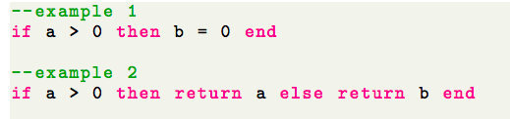
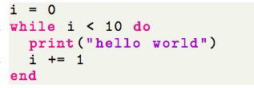

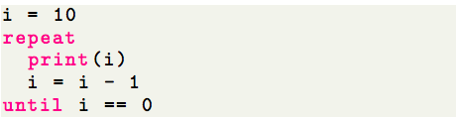
Example of control structure
if-then-else:
for loop:
while loop:
repeat-until:

Slide 7
Data type
Lua is a dynamically typed language.
Variables do not need define the type before assignment.
However, a value type can be stored in a variable and pass as a parameter or as a return value.
There are eight data types in the Lua. These include nil, boolean, number, string, table, function, userdata and thread.
We can use type() to check the type of value.

Slide 8

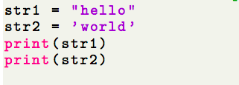
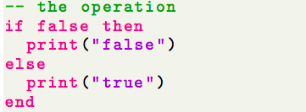
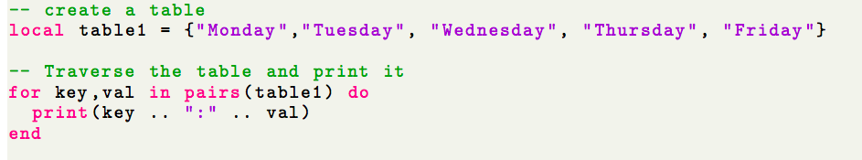
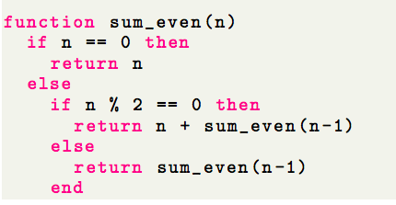
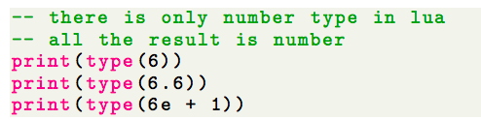
Example of Data Type
nil
boolean
function
string
table
number

Slide 9
Subprograms
Lua does not build any special mechanism to perform the functions of normal package.
Lua stores all global variables for each file in regular Lua tables, called environment.
Users will be able to access the functions from other files as well as functions in libraries by accessing the global variables and functions by simply use “require” key word to “import” by the package name.Lua creates an table for environment itself, called G, so one would be able to access all packages by setting the current (use a local variable) environment equal to G.

Slide 10
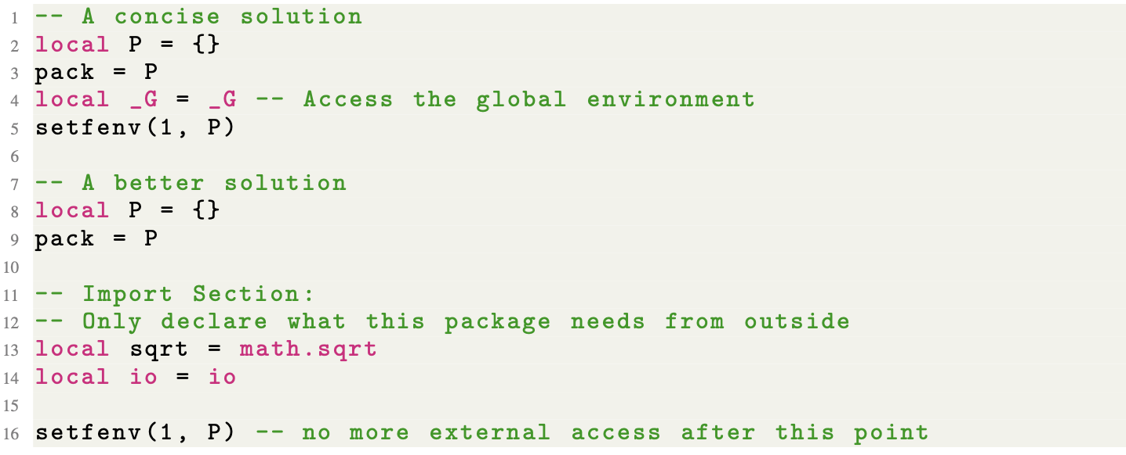
Lua Environment _G

Slide 11
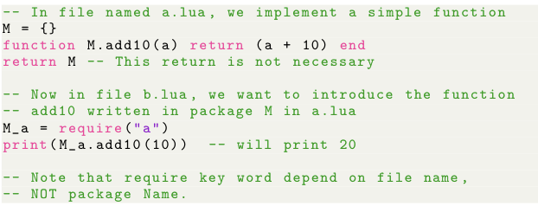
Example of subprograms
write and use packages

Slide 12
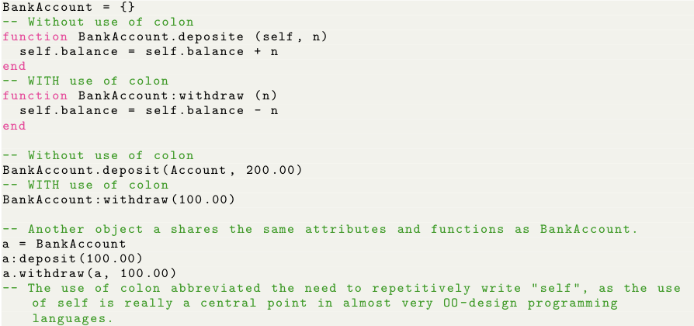
Example of subprograms
Object-Oriented-Programming

Slide 13
Program: Game 2048
Rules
How to play
Example
Advantages of use Lua
Summary of program

Slide 14
Rules
The rule of game “2048” is you need to control all the blocks to move in the same direction.
Two blocks with the same number collide and merge into their sum.
After each operation, a 2 or 4 will be randomly generated.
Finally, a "2048" block is won.
2048 use 4*4 grid. Initialized the game, give two numbers on the grid at the beginning.
When player move one time, it will random generate a number.

Slide 15
How to play
First, compile and run the program.
Second, use command to move the number on the grid
When you get 2048, you win
When the grid is full and can’t move, you lose then game over
The command as follows:
left: move all number to the left
right: move all number to the right
up: move all number to the top of the grid
down: move all number to the bottom of the grid
exit: terminal the game

Slide 16

Thank you for listening!

