Slide 1
Introduction to Functional Programming in F#
Cameron Kazmierski
Jueping Wang

Slide 2
.NET Framework
Allow developers using one language to interact with other languages
It provides services like thread management, garbage collection, type-safety, exception handling, and more
Provides a set of APIs and types for common functionality.

Slide 3
Why F#?
Before F# emerged, C# and Visual Basic were the two main languages in the .NET Framework ecosystem
They are OOP!
F# was designed specifically to bring together the utility of functional programming with the .NET library
F# became the perfect complement to C\# and Visual Basic in the .NET Framework.
F# is a powerful computing language for manipulatingdata, such as in the fields of data analysis, data visualizations, and high-performance analytics

Slide 4
Project – HTML Extraction
HTML Extraction will create a UofA Computer Science department directory. This program will extract all peoples’ information from the following links:
https://www.cs.arizona.edu/about/faculty
https://www.cs.arizona.edu/about/staff
https://www.cs.arizona.edu/about/graduate-students
There is a csv file that will be created after the program finishes. The csv file contains all the peoples’ information that arranged by office floor

Slide 5
DEMO

Slide 6
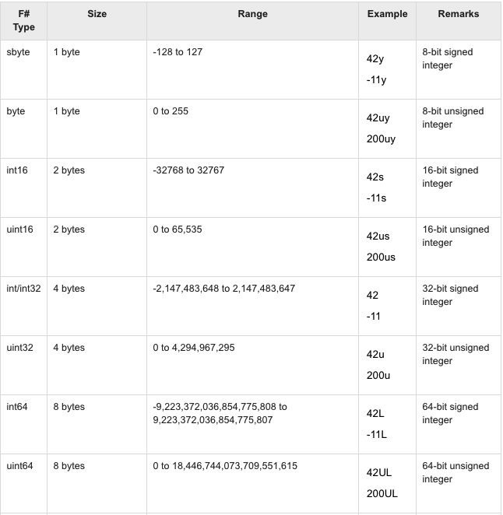
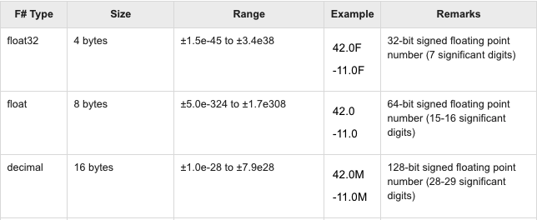
Data Type In F#

Slide 7
Data Type In F#
Like Haskell, F# has List.
F# has Array !!!
Easier to modify the value by index
F# provides mutable data type. we can change the states at the running time.

Slide 8
Control-structures
F# is very similar to Haskell
Pattern Matching and guard
If-else and if - else if - then
F# provides For-Loop and While Loop
The syntax is very similar to Python, Java and C#

Slide 9
Function Composition
Compare to Haskell, Function Composition is much easier F#
Friendly Syntax
value |> func1 |> func2 F# syntax
(func2 . Func1) value Haskell syntax
func2 ( Func1(value) ); Java syntax

Slide 10
Option Type
The option type in F# is used when an actual value might not exist for a named value or variable
Option type is defined with two cases Some and None.
It is Similar to Data.Maybe in Haskell, BUT it is very easy to use in F# and more readable compared to Haskell .

Slide 11
Summary
As functional programming, F# has a lots of similarities to Haskell
F# is more friendly on syntax compared to Haskell
F# easy to read and easy to maintain the codes
It support more Data types

Slide 12
Thank you

