Slide 1



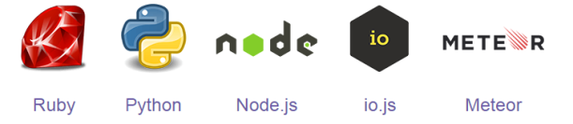




CLIENT
SERVER FRONT END
(Runs as Apache User)
SERVER BACK ENDS
(Each Runs as an Authenticated User)
Per-User NGINX (PUN)
Zero Install
Requires only a modern web browser
Functions
User Authentication
Reverse Proxy
Passenger
IPC Sockets
HTTPS/WSS

Slide 2
CLIENT
SERVER FRONT END
(Runs as Apache User)
SERVER BACK ENDS
(Each Runs as an Authenticated User)
Per-User NGINX (PUN)
Zero Install
Requires only a modern web browser
Functions
User Authentication
Reverse Proxy
Passenger
IPC Sockets
HTTPS/WSS
Interactive
Jobs
HTTP/WS
Interactive HPC (iHPC)
VNC Server + Websockify
COMSOL Server
Jupyter Notebook Server
RStudio Server

Slide 3



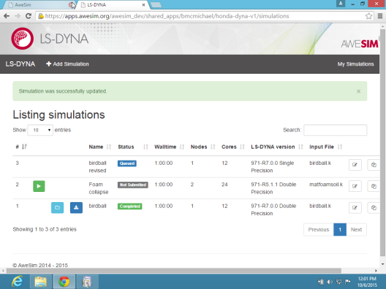

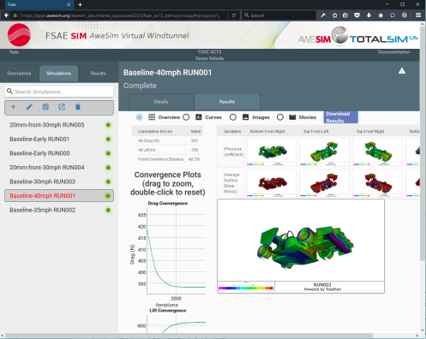

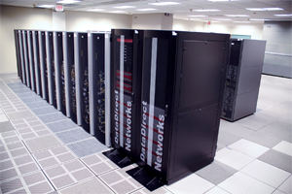
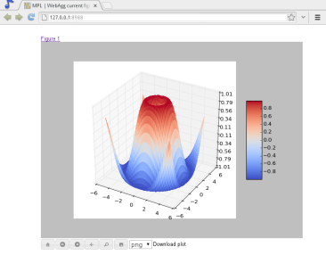
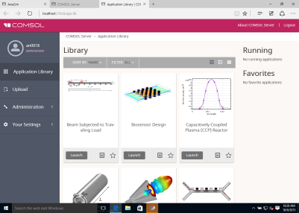
USER
INFRASTRUCTURE
SERVERS RUNNING AS USER
1. per-user Nginx (PUN)
Federated Authentication
Passenger
AppKit
Zero-Install
Requires only a modern browser
Single Sign-On
Reverse Proxy
mod_auth_openidc
mod_lua
2. Interactive HPC
HTTPS/WSS

Slide 4
Reverse Proxy
Client
PUNs
Interactive HPC

