Slide 1
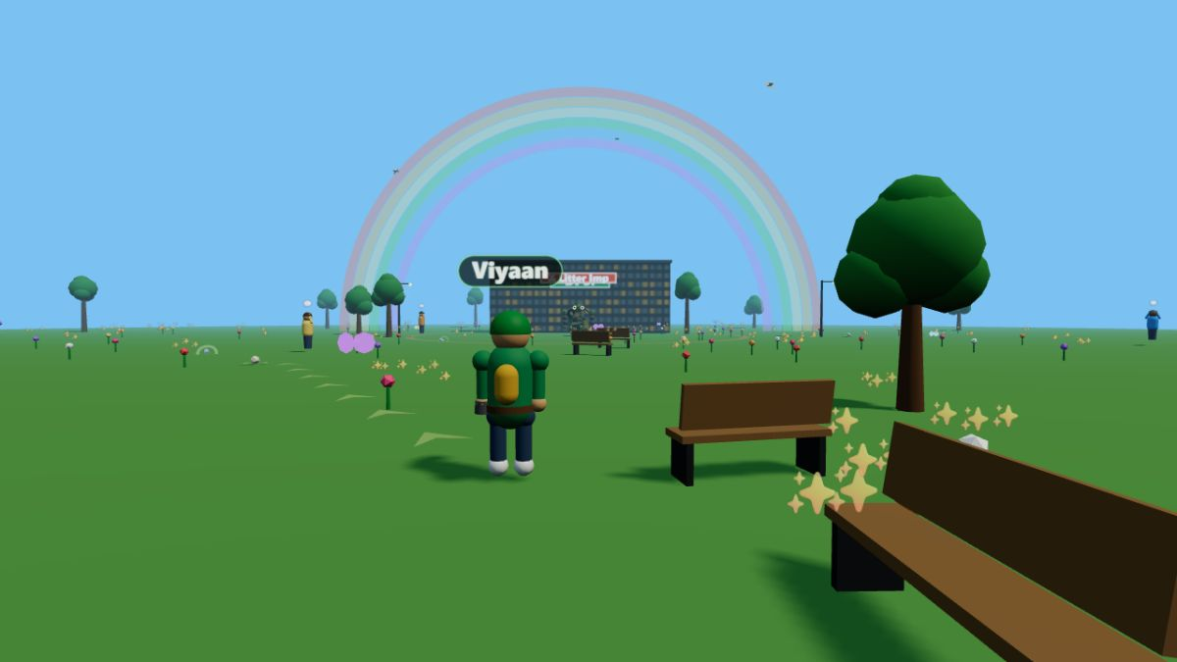
A 3D GAME FOR A CLEANER PLANET
GARBAGE
GRAPPLE
Swing. Clean. Rescue. Watch the world come back to life.
Sustainability Competition Entry
By Viaan and Mihir · DPSI
The fully restored world — the reward for cleaning up.
“Small Actions. Big Impact. Save Our Planet.”

Slide 2
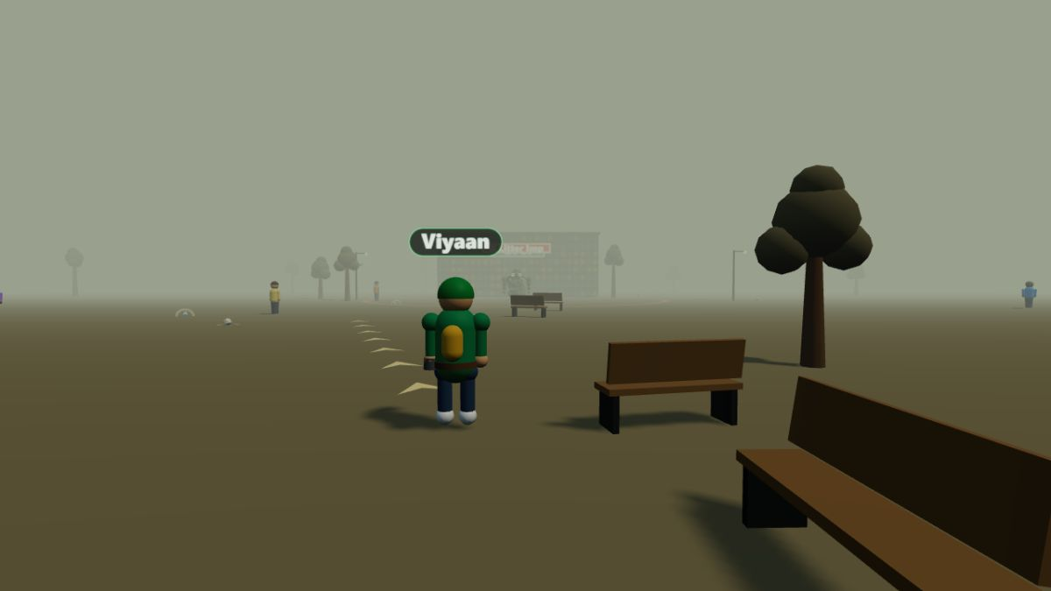
The Problem: Our World Is Drowning in Waste
450 years
for a single plastic bottle to decompose in nature
8 million tonnes
of plastic enter our oceans every single year
1 million+ animals
die every year from eating or getting trapped in litter
Where every level begins: smog, grey trees and litter everywhere.
Children hear these numbers all the time — but numbers don't change habits. Experiences do.

Slide 3
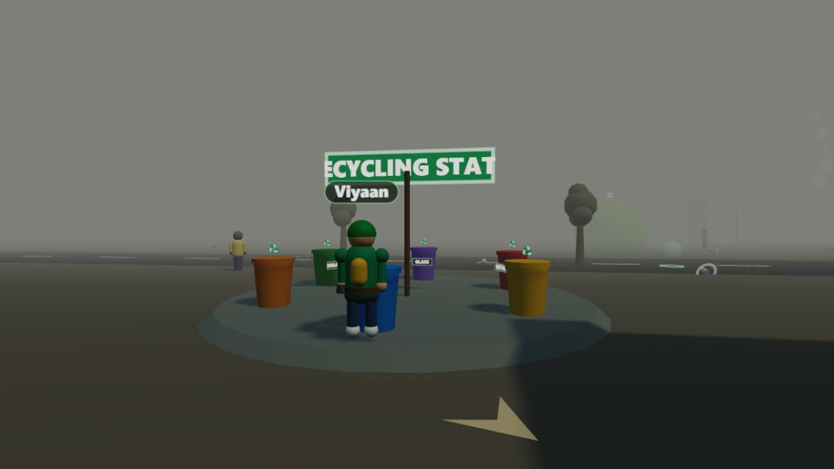
The Game: Garbage Grapple
A full 3D action game that runs in any web browser.
You are an Eco Ranger with a multi-purpose grappling hook
Grapple litter from trees, rooftops and water — or dash across the map
Sort everything into the correct segregation bins
Rescue trapped animals and defeat giant pollution monsters
5 worlds: School Campus → Park → City → Beach → River
Cleaning the smog-choked City Streets level.
COLLECT → SEGREGATE → RECYCLE → THE WORLD HEALS

Slide 4
Every Piece You Recycle Visibly Heals the World
BEFORE — polluted
AFTER — 100% recycled
The same spot in the game. As litter is recycled, the smog fades, trees regrow, flowers bloom,
butterflies and birds return — and a rainbow crowns the fully restored world.
The healing world IS the reward system. Players don't clean up for points — they clean up because they can see the planet getting better with every single piece.

Slide 5
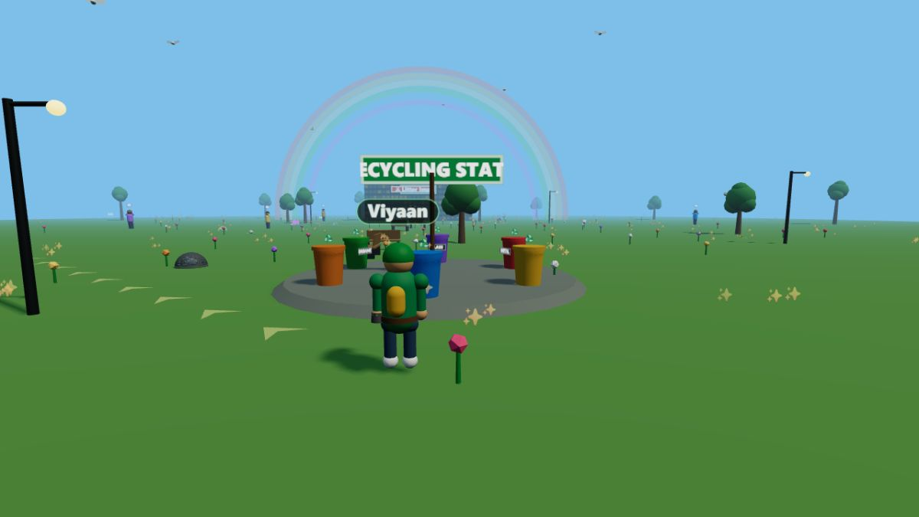
Learning Real Waste Segregation — by Playing
Six colour-coded bins, exactly like real segregation systems. Litter must go to the right bin — the game teaches the habit.
Plastic — bottles, wrappers
Paper — newspaper, cartons
Metal — cans, foil
Glass — bottles, jars
Organic — food waste, peels
The in-game Recycling Station — every deposit is auto-sorted with points for correct recycling.
E-Waste — batteries, circuit boards
Repetition builds habit: players sort hundreds of items across a full game.

Slide 6
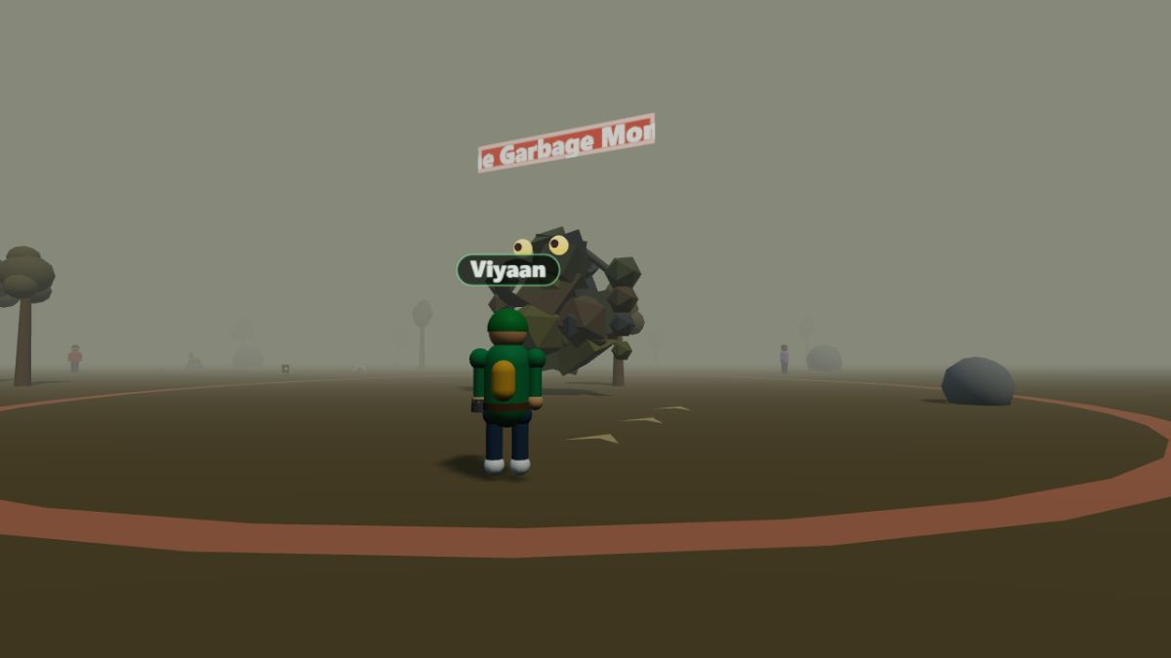
Rescue Wildlife. Defeat Pollution Itself.
Wildlife rescue
Birds, rabbits, turtles and deer are trapped in nets and litter — players free them and watch them return to the healed world.
Pollution becomes the villain
Every level ends with a boss made of pollution: the Litter Imp, Oil Sludge Beast, Smog Golem, Plastic Kraken and the Garbage Monster.
The only weapon that works against them? RECYCLING. Recycle litter to stun the monster, then grapple the pollution right out of its core.
Facing the Garbage Monster on the River Bank — recycling is the only way to win.

Slide 7
Real Eco-Knowledge and UN Goals — Built In
Every completed level teaches a real, verified eco fact:
Aligned with the UN Sustainable Development Goals:
“Recycling one aluminium can saves enough energy to run a TV for 3 hours.”
SDG 11
Sustainable Cities & Communities
SDG 12
Responsible Consumption & Production
“One litre of dumped oil can pollute one MILLION litres of fresh water.”
SDG 13
Climate Action
SDG 14
Life Below Water
“By 2050 there could be more plastic than fish in the sea — unless we act.”
SDG 15
Life on Land
Players earn an SDG badge for every restored world.

Slide 8
Sustainable by Design — Even the Technology
Zero installation
Runs instantly in any web browser on a free link — nothing to download, install or throw away.
Ultra-lightweight
About 4,000 lines of hand-written code and no heavy game engine — a tiny energy and data footprint.
100% procedural 3D
Every character, tree and monster is generated by code — no gigabytes of downloaded assets.
Runs on what schools have
Smooth on ordinary school computers — no new hardware, no e-waste created to play it.
A game about sustainability should not itself be wasteful.

Slide 9
Small Actions.
Big Impact.
Save Our Planet.
Garbage Grapple turns cleaning up into a superpower —
and every player leaves knowing the world is worth saving.
Thank you! — Viaan and Mihir· DPSI

Slide 10
