Slide 1
Neoantigen分析
——熊登坤

Slide 2
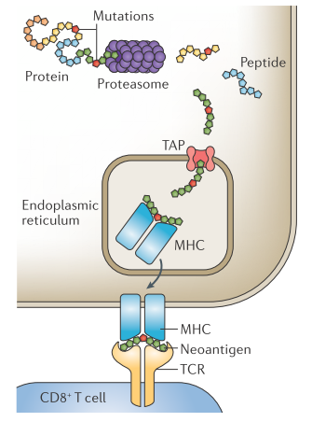
Neoantigen的产生过程
proteasomal cleavage:
netChop 2005
Pcleavage 2005
TAP transport:
PredTAP 2006
SVMTAP 2005
T cell propensity:
POPI 2007
POPISK 2011
Immunogenicity 2013
pMHC binding:
netMHCpan 2016
NetMHCcon 2012
CONSENSUS 2006
binding stability:
NetMHCstab 2014

Slide 3
HLA抗原的分类
HLA I类分子：
广泛分布于几乎所有的有核细胞表面。
其生理功能主要是向CD8T细胞提呈内源性抗原，CD8T细胞只能识别与HLA I类分子结合的抗原肽。
HLA II类分子：
仅分布于B淋巴细胞、巨噬细胞、树突细胞等少数细胞表面。
其生理功能主要是在免疫应答的始动阶段将经过处理的抗原多肽提呈给未致敏CD4T细胞
HLA III类分子：
主要包括补体分子C2,C4及Bf等；
与炎症应答和免疫调节有关。
Notes:
无论是I类还是II类，HLA分子与抗原肽的结合是HLA分子在细胞表面稳定表达的前提，不结合抗原肽的HLA分子虽然也可以被转运至细胞表面，但是很快就从细胞表面脱落或是被内吞进入细胞，导致免疫应答缺陷。正常生理情况下，细胞表面的HLA分子结合的是自身抗原，从而保证了HLA分子在细胞表面的有效表达。

Slide 4
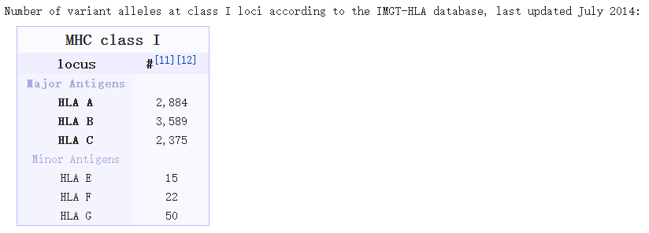
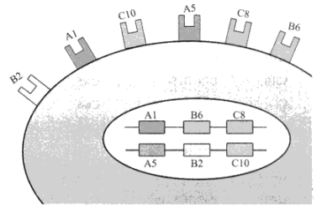
HLA的特点
HLA等位基因具有多态性
HLA的表达呈现共显性的特点
HLA以单倍型的方式向下遗传
HLA等位基因在单体型中呈非随机分布
多态性
共显性

Slide 5
HLA的命名
血清学
外显子同义突变
HLA-A*02：01：01：05
基因座位
外显子非同义突变
非编码区变异

Slide 6
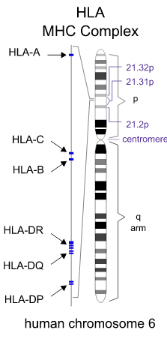
HLA-I基因结构
HLA I类分子是由α链和β2微球蛋白组成的异质二聚体：
α链由HLA-A,B,C等位基因编码；各等位基因包含有8个外显子，其中2,3号外显子与抗原多肽的结合有关；
β2微球蛋白由位于15号染色体上的相关基因编码； β2微球蛋白不直接参与I类分子的抗原递呈，但能促进内质网中新合成的HLA I类分子向细胞表面运输，并对分子的结构稳定和在细胞表面的表达具有辅助作用。
HLA I类分子能结合的氨基酸残基数相对固定，一般为9肽。

Slide 7
HLA-I分型
HLA分型技术：
血清学分型,PCR-SSP,PCR-SBT,直接测序
分析软件:
Optitype 2014
Polysolver 2015
使用OptiType对HLA进行分型时仅需对基因座A,B,C上2号、3号外显子及其两侧内含子序列（约4Kb）进行比对即可。Reference libraries for genomic and CDS are generated by extracting exons 2 and 3 from each known HLA-I allele.
因此，在设计捕获探针的时候，仅需针对该特定区域进行设计即可！
Notes:
（/mnt/NL200/xiongdk/software/OptiType-master/data/test/blast.txt）

Slide 8
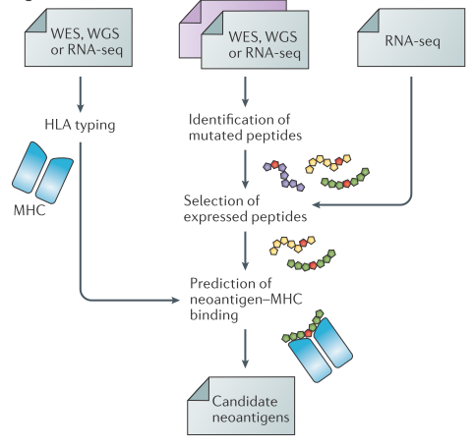
Neoantigen的识别
三大步骤：
Somatic mutation的识别；
HLA-1分型；
Neoantigen与MHC-1亲和力预测。

Slide 9
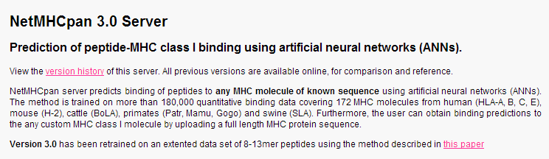
pMHC-I binding affinity
预测算法分类：
基于pMHC分子的3D结构（结构信息不足，预测可信度低）
基于序列信息：
Position-specific scoring matrices
Nonlinear methods (machine-learning)
Allele-specific mathods (NetMHC)
Pan-specific mathods (NetMHCpan)

Slide 10
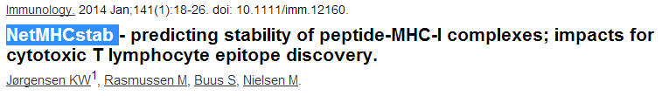
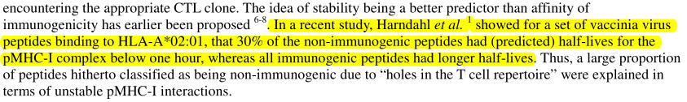
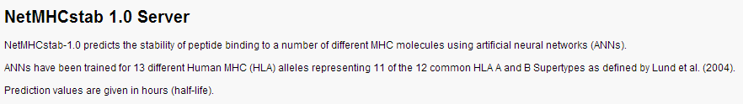
pMHC-I binding stability

Slide 11
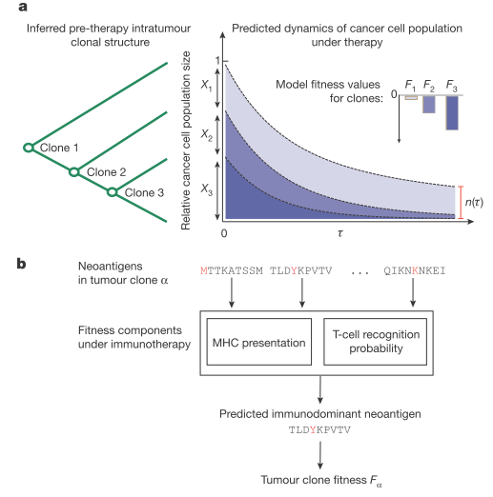





新抗原质量会影响免疫治疗疗效
10.1038/nature24473

Slide 12
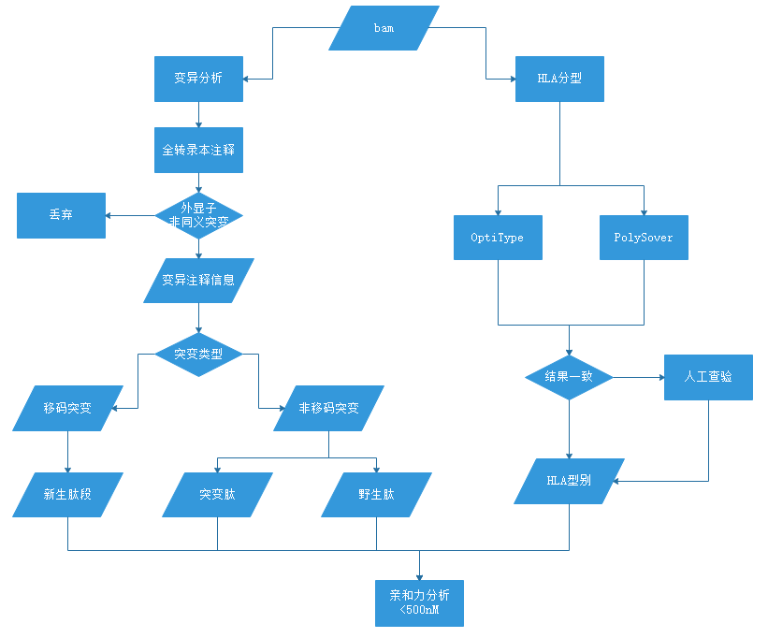
新抗原分析流程
Notes:
Todo:
锚定残基；
疗效预测算法的引入；
稳定性预测的引入

Slide 13
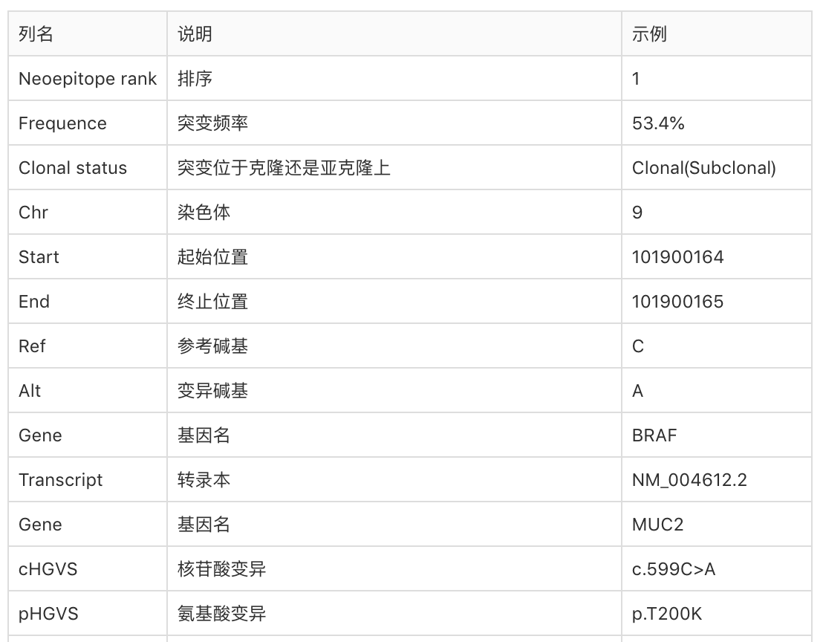
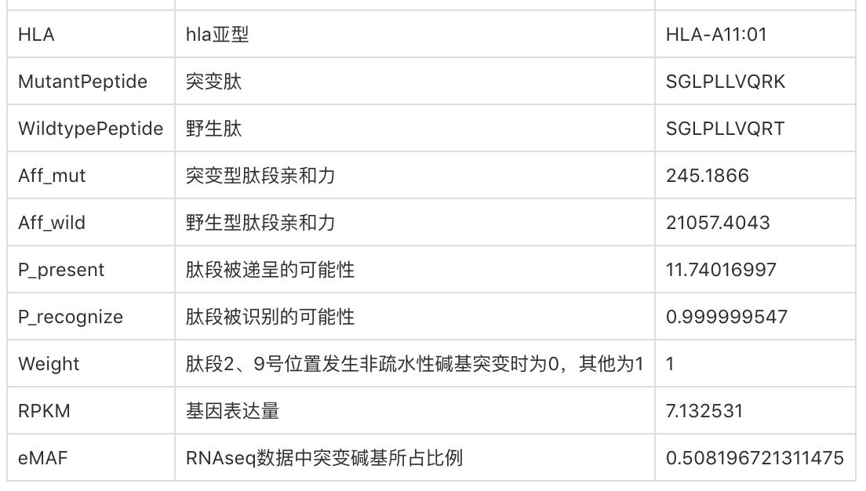
结果解读

Slide 14
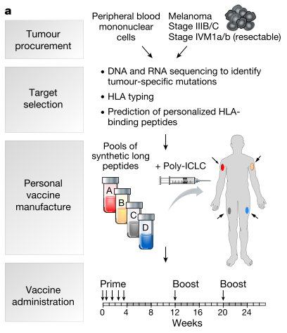
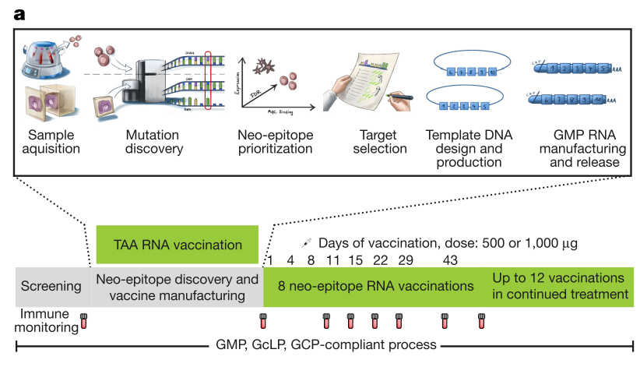
肿瘤疫苗
doi:10.1038/nature22991
10.1038@nature23003
Notes:
NetMHCpan version 2.4 was used to identify patient-specific mutation-containing epitopes that were predicted to bind to the MHC class I molecules. high predicted affinity (< 150 nM) somatic single nucleotide variations due to anchor residue changes. Only somatic single nucleotide variations that demonstrated expression of the mutated allele were used.
HLA binding affinity was predicted via the IEDB-recommended mode of the IEDB T cell prediction tools(version 2.5) using all variant-containing 8-11mers for HLA-A/B or 15-mers for HLA-DRB/DQB binding estimations. The final selection of up to ten mutated target peptides per patient required the decision of a target selection board that evaluated the target peptides based on MHC I and MHC II binding predictions, gene expression and variant allele frequency.

Slide 15
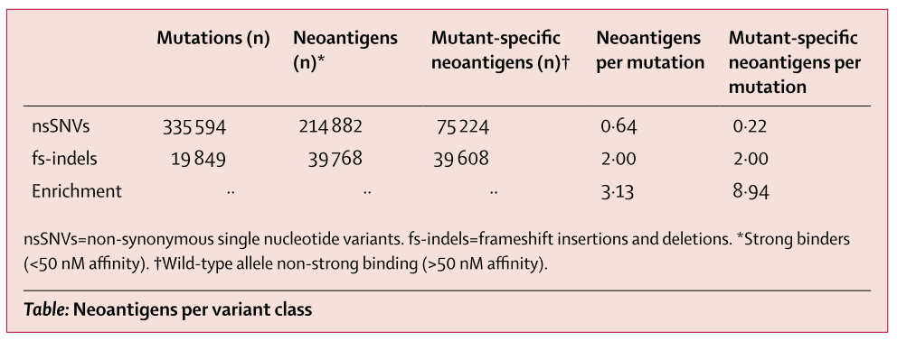
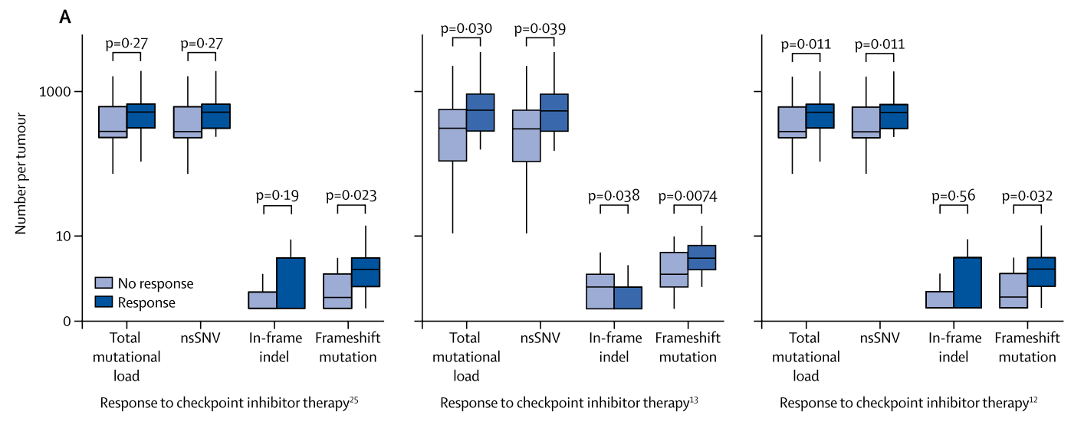
移码突变会提高neoantigen的发生率
http://dx.doi.org/10.1016/S1470-2045(17)30516-8
Notes:
When both wild-type and mutant peptides are predicted to bind, central immune
tolerance mechanisms might delete cells with the reactive T-cell receptor. Therefore, we repeated a pan-cancer analysis restricting the neoantigens to mutant-specific binders (ie, where the wild-type peptide is not predicted to be a strong binder), and showed that frameshift indels were nine times enriched for mutant-allele-only binders.
Binding affinitie were predicted using NetMHCpan(verion 2.4). High-affinity binder were defined a IC50 less than 50 nM. Wild-type allele non-strong binding was defined as IC 50 greater than 50 nM.

Slide 16
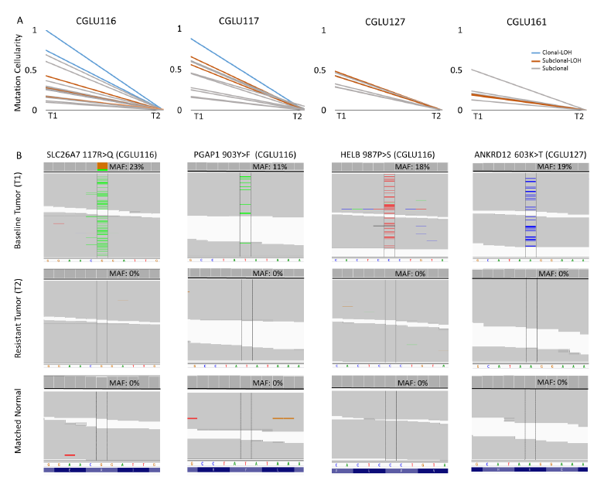
neoantigen在肿瘤进化过程中被选择性丢失
耐药后组织（T2）与治疗前组织（T1）相比，完全丢失的neoantigen数目分别为18, 10, 7和 6（图A）。
与MHC结合亲和力≤50nM的肿瘤新抗原中，丢失的neoantigen相比新增或保留的neoantigen ，其结合亲和力更强.
此外，约1/4丢失的neoantigen含有锚着位或次要锚着位残基相关突变，影响MHC与肿瘤新抗原的结合能力。
*亲和力数值越低，亲和力越强。
SLC26A7, PGAP1, HELB 和ANKRD12等明确与肿瘤新抗原相关的突变在治疗前组织中（T1）存在，而在耐药后组织（T2）及对照组织中未检测到（图B）。
Notes:
For single base substitutions, paired somatic and wild type peptides 8-11 amino acids in length at every position surrounding a somatic mutation was assessed.
In the case of frameshifts, all peptides 8-11 amino acids encompassing the new protein sequence resulting from the frameshift alteration were considered.
Anchor and auxiliary anchor residues for mutant peptides-HLA class I allele pairs were evaluated by the SYFPEITHI online tool (46). 2007
Peptides were further evaluated for antigen processing by netCTLpan (44) and were classified as cytotoxic T lymphocyte epitopes (E) or non-epitopes (NA). 2010
Tumor-associated expression levels derived from TCGA were used to generate a final ranking of candidate immunogenic peptides.

Slide 17
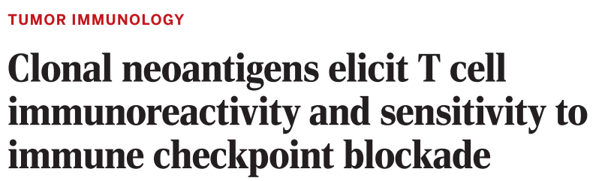
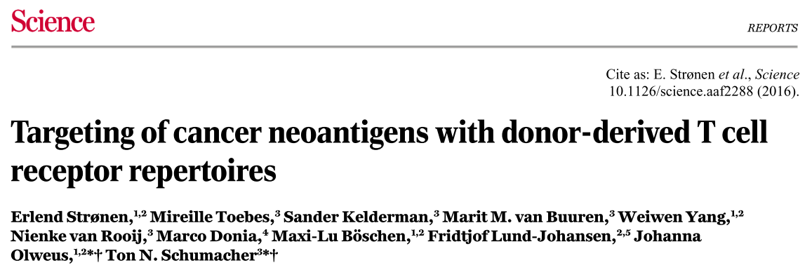
Neoantigen与免疫抑制剂

