Slide 1
Stock Prediction using Deep Learning
Chenyang Lu – 1002105063
Xinqi Shen – 1003567918
Xinming Ye - 1007027227

Slide 2
Introduction and Motivation
Nowadays, stock market prediction is a popular but challenging topic in the finicial research area.
Traditional method in this area includes technical analysis which uses technical indicators and human judgement. It needs strong expert knowledge of finance and years of practical experience.
Using Convolutional Neural Network based approach, we will make predictions by candlestick chart along with some other indicators.
Notes:
There are approximately 120 different classes of pet dogs are considered in the scope of our project. Here are some example classes of dogs we have as training data.

Slide 3
Prior Work
Starting from the seed program that was provided for us, we find several issues.
The original dataset uses 64*64 grayscale candlestick images and only includes 2 technical indicators which loses many useful information
The data loader method is mainly hard-coded, it lacks extensibility
A serious bug existed during training time causes only one class to be predicted
etc.
We will solve all the problems and also provide better performing models
Notes:
There are approximately 120 different classes of pet dogs are considered in the scope of our project. Here are some example classes of dogs we have as training data.

Slide 4
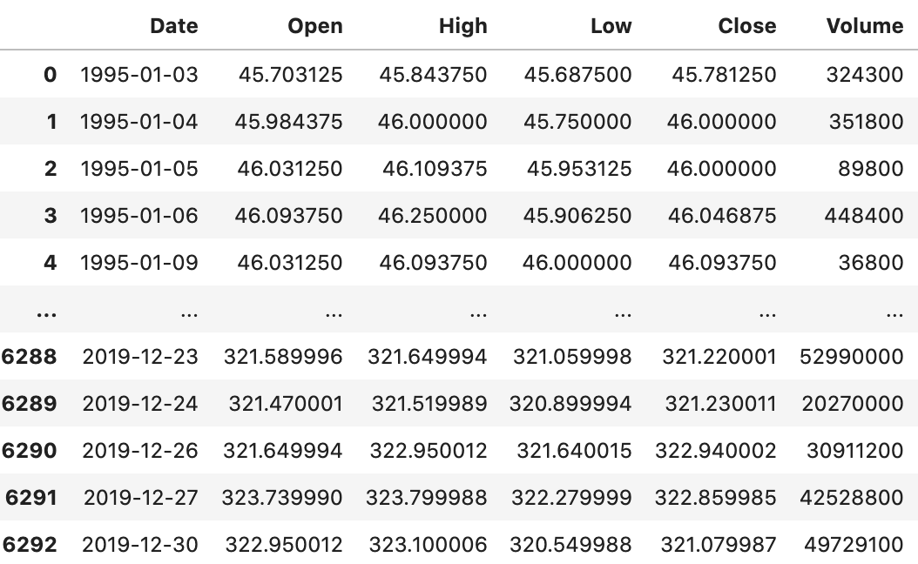
Dataset and Task
We use SPY between 1995 and 2019
The stock price prediction model proposed in this study learns the moving pattern of the independent variables for 1 month and forecasts the increase or decrease in the stock price of the next day. We generate candle stick images as our inputs.
target variables are either 1 or 0. When the closing price at time t-1 is higher than time t-2, is 1, otherwise 0.
Notes:
There are approximately 120 different classes of pet dogs are considered in the scope of our project. For semi-supervised purpose

Slide 5
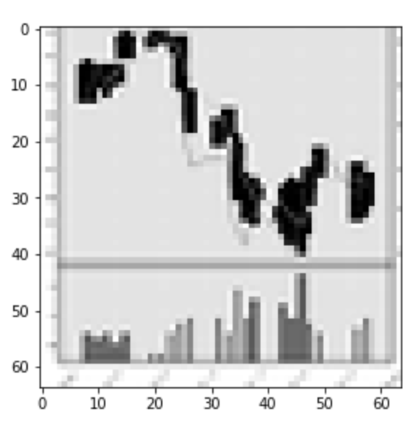
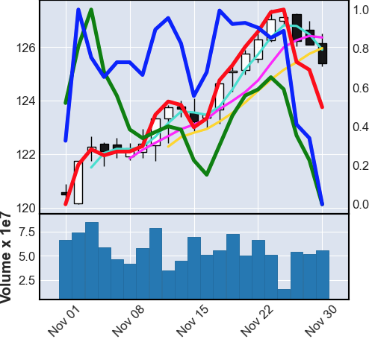
Candle Stick Image
previous input image - 64*64 grayscale
new input image -
224*224 RGB
Notes:
There are approximately 120 different classes of pet dogs are considered in the scope of our project. Here are some example classes of dogs we have as training data.

Slide 6
Candle Stick Image
We add 6 indicators in the candlestick image
3 days moving average(MA-3)
6 days moving average(MA-6)
9 days moving average(MA-9)
Relative Strength Index(RSI)
Commodity Channel Index(CCI)
Williams %R(WILLR)
Notes:
There are approximately 120 different classes of pet dogs are considered in the scope of our project. Here are some example classes of dogs we have as training data.

Slide 7
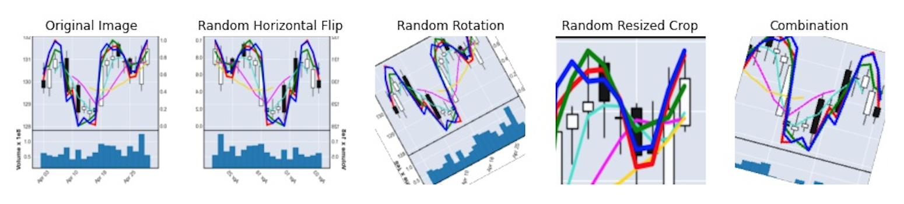
Dataset Extension -- data augmentation
Although we use 20 years data(1995-2019), since candlestick image is generated every month, the total number of images is only 300. Thus, we attempt to use the data augmentation skills to expand our dataset.
However, this approach is not performed as we expected. The candlestick images are very sensitive to these transformations, which leads to make worse predictions. So we don't end up including this step.
Notes:
There are approximately 120 different classes of pet dogs are considered in the scope of our project. Here are some example classes of dogs we have as training data.

Slide 8
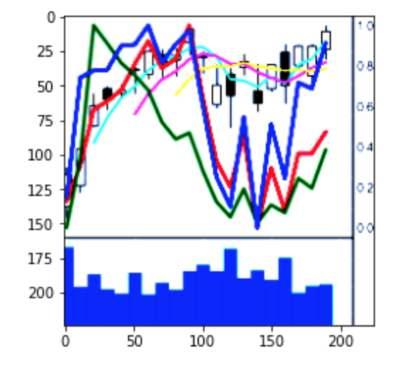
Data Pre-processing
Similar to numeric features, we also need normalize the input images before feeding into our model. The main purpose is to scale each channel to the same range(RGB image) and make computation efficient.
Visualize the normalized candlestick image
Notes:
There are approximately 120 different classes of pet dogs are considered in the scope of our project. Here are some example classes of dogs we have as training data.

Slide 9
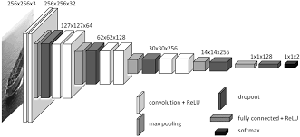
Baseline
We implemented a basic CNN as our baseline to predict label. The CNN has 3 convolution layers to extract features, 3 max pooling layers and two fully connected linear layers to classify those features into their respective categories. It also uses dropout and batch normalization to avoid overfitting.

Slide 10
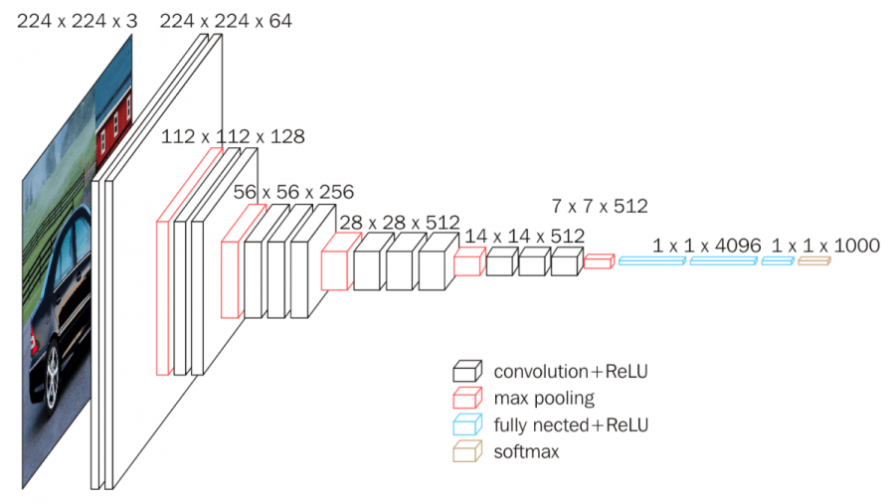
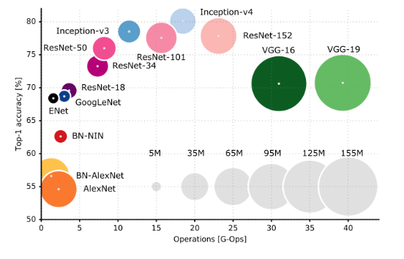
VGG16BN Net
5 convolution layer, 3 fully connected layer and one softmax output layer [1]
pros:
similar to AlexNet but only has a small convolution kernel size
large number of channels to get more information
large depth to increase prediction accuracy

Slide 11
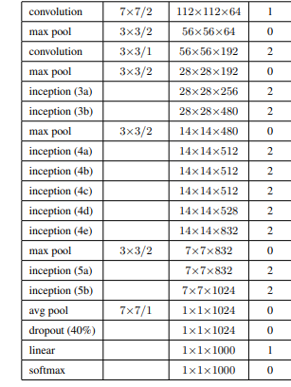
GoogLeNet
22 layers neural network
Most important feature is inception block
dimension reduction with 1*1 convolution
it allows for increasing the number of units at each stage significantly without an uncontrolled blow-up in computational complexity at later stages.
It has only 1/36 parameters when compared with VGGNet [2]

Slide 12
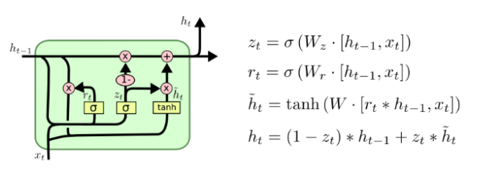
LSTM
Used Recurrent Neural Network with LSTM layer to analyze past data of the targeted stock market
2 layers
LSTM layer keeps the memory for a long time.
The advantage of this approach is solving the vanishing/exploding gradient problem.

Slide 13
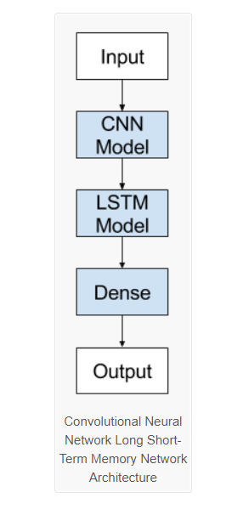
LSTM with CNN
It uses a two convolution layer CNN and transform the output into a two layer LSTM model with a fully connected layer to get the final output.

Slide 14
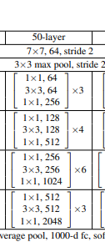
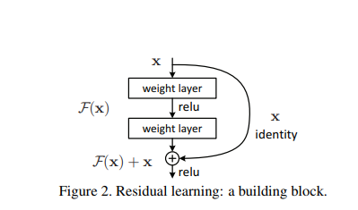
ResNet50
The most import feature of Resnet50[3] is the residual block: shortcut to combine the input of the block with the output of the block.
It helps to solve the issue of degradation caused by depth increasing.
Increases depth of network with less extra parameters.

Slide 15
Transfer Learning
All VGGnet, GoogleNet and ResNET were first pretrained with the imagenet which include 10 million images and then we fine-tuning with our own dataset
imagenet
Step1: pretrained
Model
our dataset
Step2:fine-tuning

Slide 16
The loss function used is crossentropyloss().
CrossEntropy loss is widely used for classification use-cases as it minimizes the loss between two probability distributions.
Adam’s optimizer with lr=0.001 is used to train the model as Adam combines the best properties of the adagrad and rmsprop algorithms to provide an optimization algorithm that can handle sparse gradients on noisy problems.

Slide 17
Classification Result
model | train accuracy | validation accuracy
CNN | 1.000000 | 0.687500
VGG-without-pretrain | 1.000000 | 0.744792
VGG_with_pretrain | 1.000000 | 0.968750
resnet_pretrain | 1.000000 | 0.796875
GoogLeNet_pretrain | 1.000000 | 0.713542
CNNwithLSTM | 0.681375 | 0.483725
LSTM | 0.721375 | 0.573725
batch_size =32, learning-rate = 1e-4,
epoch = 10, metric = Cross Entropy Loss

Slide 18
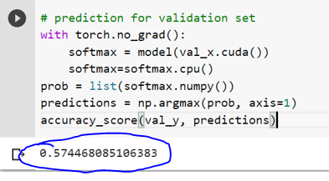
Comparison with Previous Work
Our Project Result
Previous Work Result
model | validation accuracy
CNN | 0.687500
VGG-without-pretrain | 0.744792
VGG_with_pretrain | 0.968750
resnet_pretrain | 0.796875
GoogLeNet_pretrain | 0.713542
CNNwithLSTM | 0.483725
LSTM | 0.573725

Slide 19
Conclusion
This project proposes a CNN-based model to predict the increase/decrease trend of the stock market using the last 30 days’ candlestick image and technical indicators.
Results of different models are compared, the model with the best performance is pretrained VGG-16 with a validation accuracy of 96%. This validation accuracy is significantly higher than the previous work.
Further improvement includes increasing the diversity of technical indicators, increasing dataset size and changing the learning rate of optimizer.

Slide 20
Reference
Karen Simonyan and Andrew Zisserman. Very deep convolutional networks for large-scale image recognition. In International Conference on Learning Representations, 2015.
Christian Szegedy, Wei Liu, Yangqing Jia, Pierre Sermanet, Scott E. Reed, Dragomir Anguelov, Dumitru Erhan, Vincent Vanhoucke, and Andrew Rabinovich. Going deeper with convolutions. CoRR, abs/1409.4842, 2014
Kaiming He, Xiangyu Zhang, Shaoqing Ren, and Jian Sun. Deep residual learning for image recognition. CoRR, abs/1512.03385, 2015.

