Slide 1
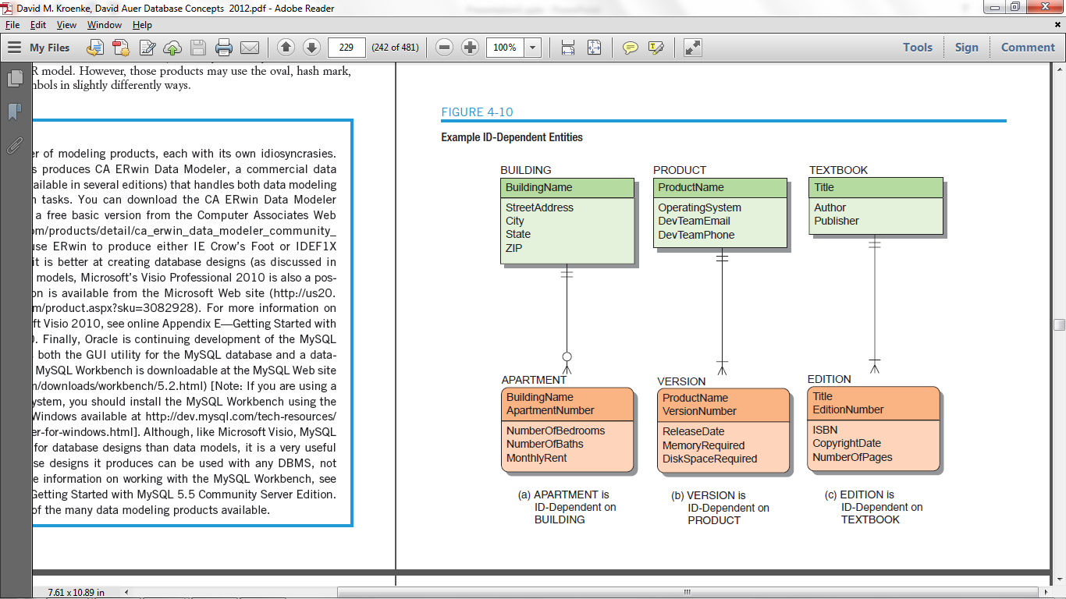
STUDENTCLASS
StudentID
ClassID
Grade
STUDENTS
StudentID
LastName
FirstName
EmailAddress
CLASS
ClassID
ClassNo
ClassName
Credits
Professor
Building
Room
Semester
Year
GRADE
Grade
Description

