Slide 1
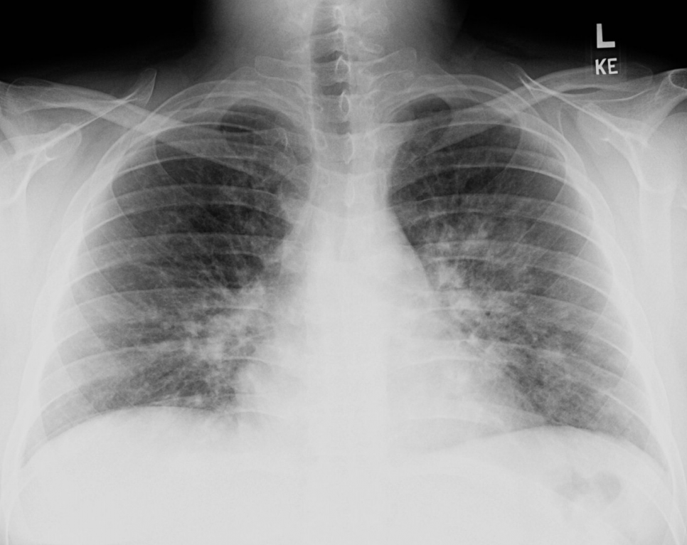
图像格式：PNG
标签格式：CSV
任务：分类
下载：直接下载
大小：1 GB
covid-chestxray-dataset
COVID-19 Image Data Collection
地址：https://github.com/ieee8023/covid-chestxray-dataset
@Article{ijerph17186933,
TITLE = {Unveiling COVID-19 from CHEST X-Ray with Deep Learning: A Hurdles Race with Small Data},
AUTHOR = {Tartaglione, Enzo and Barbano, Carlo Alberto and Berzovini, Claudio and Calandri, Marco and Grangetto, Marco},
JOURNAL = {International Journal of Environmental Research and Public Health},
VOLUME = {17}, YEAR = {2020}, NUMBER = {18},
ARTICLE-NUMBER = {6933},
PubMedID = {32971995},
ISSN = {1660-4601},
DOI = {10.3390/ijerph17186933}
}
@article{MAGUOLO20211,
title = {A critic evaluation of methods for COVID-19 automatic detection from X-ray images},
journal = {Information Fusion},
volume = {76}, pages = {1-7}, year = {2021},
issn = {1566-2535},
doi = {https://doi.org/10.1016/j.inffus.2021.04.008},
author = {Gianluca Maguolo and Loris Nanni}
}

Slide 2
图像格式：PNG
标签格式：CSV
任务：分类
下载：直接下载
大小：1 GB
COVIDGR datasets
地址：https://github.com/ari-dasci/OD-covidgr
@misc{tabik2020covidgr,
title={COVIDGR dataset and COVID-SDNet methodology for predicting COVID-19 based on Chest X-Ray images},
author={S. Tabik and A. Gómez-Ríos and J. L. Martín-Rodríguez and I. Sevillano-García and M. Rey-Area and D. Charte and E. Guirado and J. L. Suárez and J. Luengo and M. A. Valero-González and P. García-Villanova and E. Olmedo-Sánchez and F. Herrera},
year={2020},
eprint={2006.01409},
archivePrefix={arXiv},
primaryClass={eess.IV}
}

Slide 3
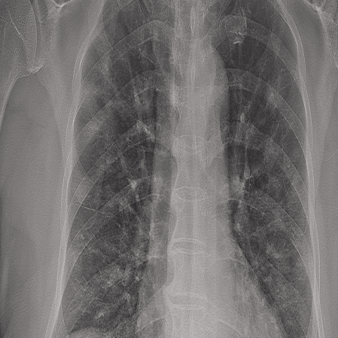
图像格式：PNG
标签格式：CSV
任务：分类
下载：直接下载
大小：1.41 GB
Novel COVID-19 Chestxray Repository
融合公开的胸部 X 光图像存储库{
COVID-19 Radiography Database,
COVID-Chestxray set,
Actualmed COVID chestxray dataset,
}
地址：https://www.kaggle.com/datasets/subhankarsen/novel-covid19-chestxray-repository
@article{bhowal2021choquet,
title={Choquet Integral and Coalition Game-based Ensemble of Deep Learning Models for COVID-19 Screening from Chest X-ray Images},
author={Bhowal, Pratik and Sen, Subhankar and Yoon, Jin Hee and Geem, Zong Woo and Sarkar, Ram},
journal={IEEE Journal of Biomedical and Health Informatics},
year={2021},
publisher={IEEE}
}

Slide 4
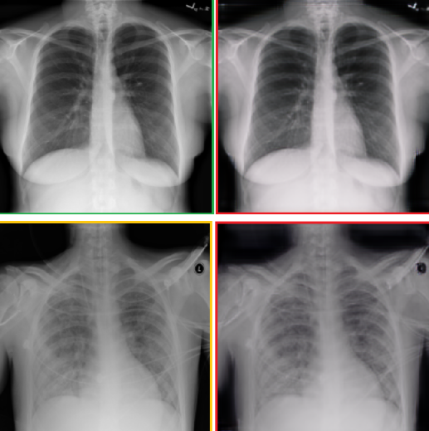
图像格式：JPEG
标签格式：CSV
任务：分类
下载：直接下载
大小：0.5 GB
Synthetic COVID-19 CXR Dataset
用于计算机辅助诊断的合成 COVID-19 胸部 X 射线数据集
地址：https://github.com/hasibzunair/synthetic-covid-cxr-dataset
@article{zunair2021synthesis,
title={Synthesis of {COVID}-19 chest {X}-rays using unpaired image-to-image translation},
author={Zunair, Hasib and Hamza, A Ben},
journal={Social Network Analysis and Mining},
volume={11},
number={1},
pages={1--12},
year={2021},
publisher={Springer}
}

Slide 5
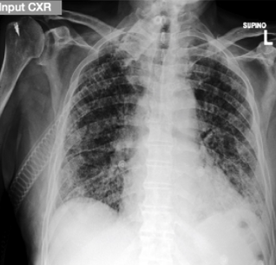
图像格式：DICOM
标签格式：CSV
任务：分类（打分）
下载：需要申请
大小：1 GB
BrixIA (BrixIA Covid-19)
COVID19 严重性评分评估项目和数据库
（需要申请下载）
地址：https://brixia.github.io/
@article{BS-Net2021,
title = {BS-Net: learning COVID-19 pneumonia severity on a large Chest X-Ray dataset},
journal = {Medical Image Analysis},
pages = {102046},
year = {2021},
issn = {1361-8415},
doi = {https://doi.org/10.1016/j.media.2021.102046},
author = {Alberto Signoroni and Mattia Savardi and Sergio Benini and Nicola Adami and Riccardo Leonardi and Paolo Gibellini and Filippo Vaccher and Marco Ravanelli and Andrea Borghesi and Roberto Maroldi and Davide Farina},
}
@article{borghesi2020covid,
title={COVID-19 outbreak in Italy: experimental chest X-ray scoring system for quantifying and monitoring disease progression},
author={Borghesi, Andrea and Maroldi, Roberto},
journal={La radiologia medica},
volume={125},
pages={509-513},
year={2020},
publisher={Springer}
}

Slide 6
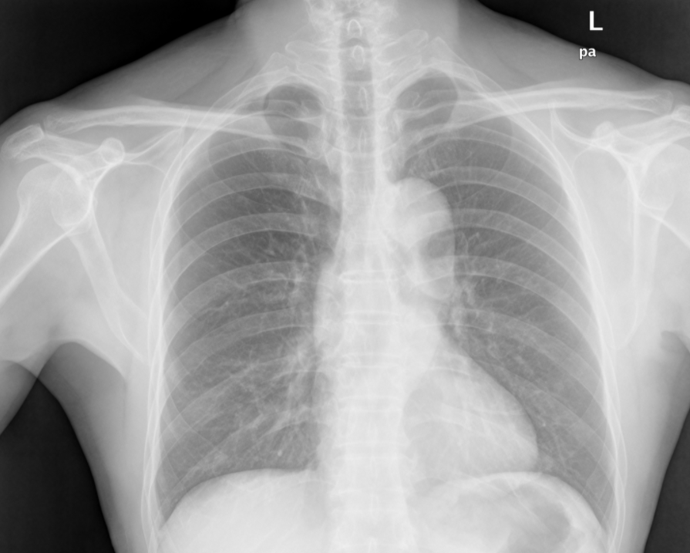
图像格式：PNG
标签格式：CSV
任务：分类
下载：直接下载
大小：3.77 GB
Tuberculosis Chest X-rays (Shenzhen)
深圳COVID-19 胸部 X 射线数据集
地址：https://www.kaggle.com/datasets/raddar/tuberculosis-chest-xrays-shenzhen
@article{shenzhenTuberculosis,
title={Two public chest X-ray datasets for computer-aided screening of pulmonary diseases},
author={Jaeger, Stefan and Candemir, Sema and Antani, Sameer and Wáng, Yì-Xiáng J and Lu, Pu-Xuan and Thoma, George},
journal={Quantitative imaging in medicine and surgery},
volume={4},
pages={6},
year={2014},
issn = {2223-4292.2014.11.20},
doi = {https://doi.org/10.3978/j},
}

Slide 7
图像格式：PNG
标签格式：CSV
任务：分类、检测
下载：直接下载
大小：45.7 GB
NIH Chest X-rays
美国国立卫生研究院胸部 X 光片
用自然语言处理和深度卷积神经网络处理临床胸片，从中判别和定位8中胸部疾病：
地址：https://nihcc.app.box.com/v/ChestXray-NIHCC/folder/36938765345
@INPROCEEDINGS{8099852,
author={Wang, Xiaosong and Peng, Yifan and Lu, Le and Lu, Zhiyong and Bagheri, Mohammadhadi and Summers, Ronald M.},
booktitle={2017 IEEE Conference on Computer Vision and Pattern Recognition (CVPR)},
title={ChestX-Ray8: Hospital-Scale Chest X-Ray Database and Benchmarks on Weakly-Supervised Classification and Localization of Common Thorax Diseases},
year={2017},
volume={},
number={},
pages={3462-3471},
doi={10.1109/CVPR.2017.369}}

Slide 8
图像格式：DICOM
标签格式：CSV
任务：分类、检测
下载：需要申请
大小：205.96GB
VinBigData Chest X-ray Abnormalities Detection
VinBigData 胸部 X 线异常检测
根据胸片自动定位和分类胸部异常
地址：https://www.kaggle.com/c/vinbigdata-chest-xray-abnormalities-detection
地址： https://vindr.ai/datasets/cxr
@misc{nguyen2020vindrcxr,
title={VinDr-CXR: An open dataset of chest X-rays with radiologist's annotations},
author={Ha Q. Nguyen and Khanh Lam and Linh T. Le and Hieu H. Pham and Dat Q. Tran and Dung B. Nguyen and Dung D. Le and Chi M. Pham and Hang T. T. Tong and Diep H. Dinh and Cuong D. Do and Luu T. Doan and Cuong N. Nguyen and Binh T. Nguyen and Que V. Nguyen and Au D. Hoang and Hien N. Phan and Anh T. Nguyen and Phuong H. Ho and Dat T. Ngo and Nghia T. Nguyen and Nhan T. Nguyen and Minh Dao and Van Vu},
year={2020},
eprint={2012.15029},
archivePrefix={arXiv},
primaryClass={eess.IV}
}

