Slide 2
版本控制软件-SVN
江泽东
2015-10-21

Slide 3
Step 2
$ cd lesson
SYSSSC@SYSSSC-PC MINGW64 /c/Program Files/Git/lesson
$ git clone git@github.com:39627020/lesson.git
Cloning into 'lesson'...
warning: You appear to have cloned an empty repository.
Checking connectivity... done.
$ cd lesson1/
SYSSSC@SYSSSC-PC MINGW64 /c/Program Files/Git/lesson1
$ git clone git@github.com:39627020/lesson.git
Cloning into 'lesson'...
warning: You appear to have cloned an empty repository.
Checking connectivity... done.

Slide 4
Step 3
$ git add readme.txt
SYSSSC@SYSSSC-PC MINGW64 /c/Program Files/Git/lesson/lesson (master)
$ git commit -m "课后作业 lesson"
[master (root-commit) aacce70] 课后作业 lesson
1 file changed, 1 insertion(+)
create mode 100644 readme.txt
SYSSSC@SYSSSC-PC MINGW64 /c/Program Files/Git/lesson/lesson (master)
$ git push origin master
Counting objects: 3, done.
Writing objects: 100% (3/3), 253 bytes | 0 bytes/s, done.
Total 3 (delta 0), reused 0 (delta 0)
To git@github.com:39627020/lesson.git
* [new branch] master -> master
SYSSSC@SYSSSC-PC MINGW64 /c/Program Files/Git/lesson/lesson (master)

Slide 5
Step 4
$ git pull
remote: Counting objects: 3, done.
remote: Total 3 (delta 0), reused 3 (delta 0), pack-reused 0
Unpacking objects: 100% (3/3), done.
From github.com:39627020/lesson
[new branch] master -> origin/master
SYSSSC@SYSSSC-PC MINGW64 /c/Program Files/Git/lesson1/lesson (master)
$ git add readme.txt
SYSSSC@SYSSSC-PC MINGW64 /c/Program Files/Git/lesson1/lesson (master)
$ git commit -m "课后作业 lesson1"
[master 1fd7977] 课后作业 lesson1
1 file changed, 2 insertions(+), 1 deletion(-)
SYSSSC@SYSSSC-PC MINGW64 /c/Program Files/Git/lesson1/lesson (master)
$ git push origin master
Counting objects: 3, done.
Writing objects: 100% (3/3), 301 bytes | 0 bytes/s, done.
Total 3 (delta 0), reused 0 (delta 0)
To git@github.com:39627020/lesson.git
aacce70..1fd7977 master -> master

Slide 6
Step 5
$ cd ../../lesson/lesson/
SYSSSC@SYSSSC-PC MINGW64 /c/Program Files/Git/lesson/lesson (master)
$ git add readme.txt
SYSSSC@SYSSSC-PC MINGW64 /c/Program Files/Git/lesson/lesson (master)
$ git commit -m "解决冲突 lesson"
[master 87328ea] 解决冲突 lesson
1 file changed, 2 insertions(+), 1 deletion(-)
SYSSSC@SYSSSC-PC MINGW64 /c/Program Files/Git/lesson/lesson (master)
$ git push origin master
To git@github.com:39627020/lesson.git
! [rejected] master -> master (fetch first)
error: failed to push some refs to 'git@github.com:39627020/lesson.git'
hint: Updates were rejected because the remote contains work that you do
hint: not have locally. This is usually caused by another repository pushing
hint: to the same ref. You may want to first integrate the remote changes
hint: (e.g., 'git pull ...') before pushing again.
hint: See the 'Note about fast-forwards' in 'git push --help' for details.
SYSSSC@SYSSSC-PC MINGW64 /c/Program Files/Git/lesson/lesson (master)

Slide 7
Step 6
$ git pull
remote: Counting objects: 3, done.
remote: Total 3 (delta 0), reused 3 (delta 0), pack-reused 0
Unpacking objects: 100% (3/3), done.
From github.com:39627020/lesson
aacce70..1fd7977 master -> origin/master
Auto-merging readme.txt
CONFLICT (content): Merge conflict in readme.txt
Automatic merge failed; fix conflicts and then commit the result.
SYSSSC@SYSSSC-PC MINGW64 /c/Program Files/Git/lesson/lesson (master|MERGING)
$ git add readme.txt
SYSSSC@SYSSSC-PC MINGW64 /c/Program Files/Git/lesson/lesson (master|MERGING)
$ git commit -m "解决冲突"
[master 348f233] 解决冲突
SYSSSC@SYSSSC-PC MINGW64 /c/Program Files/Git/lesson/lesson (master)
$ git push origin master
Counting objects: 9, done.
Delta compression using up to 4 threads.
Compressing objects: 100% (5/5), done.
Writing objects: 100% (9/9), 848 bytes | 0 bytes/s, done.
Total 9 (delta 1), reused 0 (delta 0)
To git@github.com:39627020/lesson.git
1fd7977..348f233 master -> master
SYSSSC@SYSSSC-PC MINGW64 /c/Program Files/Git/lesson/lesson (master)

Slide 8
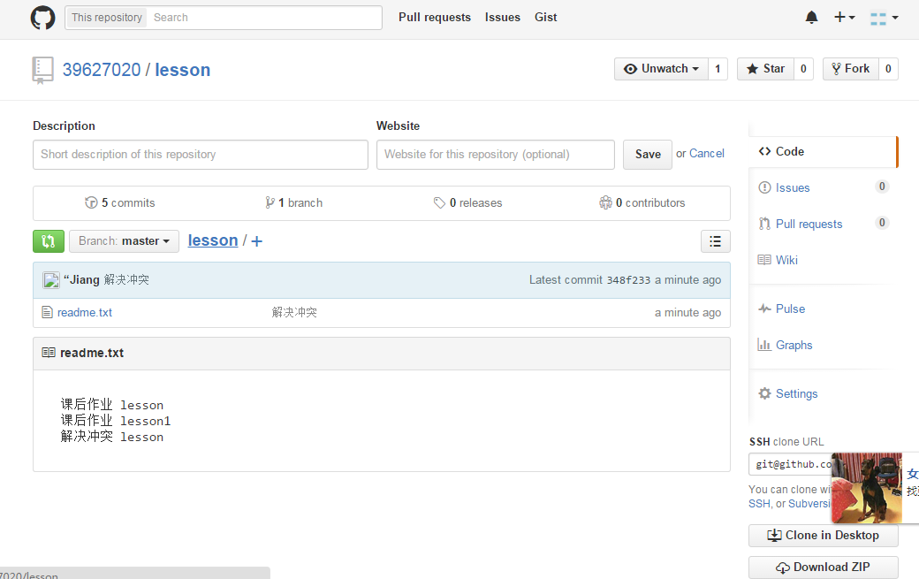
执行后github结果截图

